Slide 1



A community of learners, believers and friends
WB 26th April Collective Worship
But if we walk in the light, as he is in the light, we have fellowship with one another
1 John 1:7

Slide 2




April
27
In the name of the Father, Son and Holy Spirit
What is Vocation?

Slide 3



But if we walk in the light as He is in the light, we have fellowship with one another
LORD, make me a better person, more considerate to others, more honest with myself, more faithful to you.
Make me generous enough to want sincerely to do your will whatever it may be.
Help me to find my true vocation in life, and grant that through it I may find happiness myself and bring happiness to others. Amen
What are we called to do and be?

Slide 4



April
OCTOBER
28
In the name of the Father, Son and Holy Spirit
And whatever you ask in prayer, you will receive, if you have faith. Matthew 21:22

Slide 5



How do we know Jesus’ voice? We won’t hear Jesus calling to us with our ears, but we can hear him with our hearts. It can take practice to be still enough to be aware of God’s presence deep within us, but regularly taking the time to be quiet makes it more possible.
Stillness Script – Click here
In the name of the Father, Son and Holy Spirit

Slide 6



April
In the name of the Father, Son and Holy Spirit
29
Jesus is calling each one of us. What is your vocation? How will you serve others? It may be that there is a particular way of life that Jesus is calling you to live.
What mountains need moving in your life?
https://youtu.be/Z4ATBaI7ycY?si=kU3ofHlVhuS70h8M

Slide 7
April
30
In the name of the Father, Son and Holy Spirit
Jesus speaks to us all in scripture. Take the time to listen again to the Gospel. What is Jesus saying to you, today, through these words? Listen with your heart to Jesus speaking to you. This way of praying is sometimes called Lectio Divina, or divine reading - Lectio for short.
Still quietly, close your eyes if you like, and listen to the Gospel being read very slowly. Then listen as it’s read again.
Which words or phrases stand out to you? What is Jesus saying to you, today?
What do these words or phrases mean in your life? How will God’s word change the way you live?
You may like to use the thinking sheet on the next slide to help you reflect on how Jesus is speaking to you today.

Slide 8
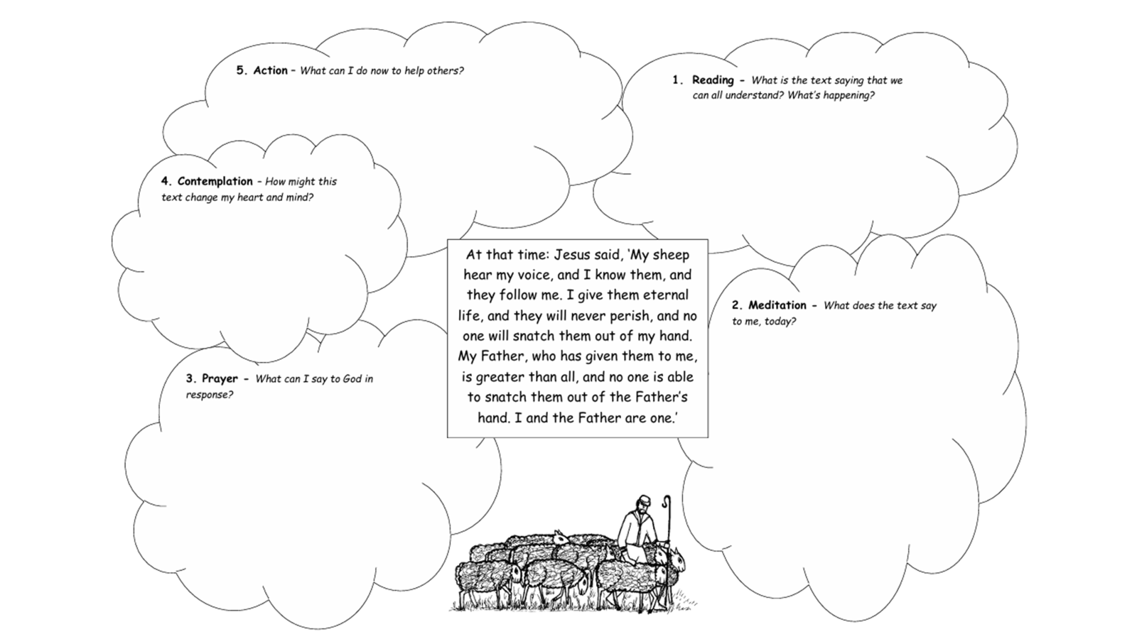

Slide 9

May
1
In the name of the Father, Son and Holy Spirit
What do you think your Vocation is?

Slide 10
"Then I heard the voice of the Lord saying, 'Whom shall I send?' And I said, 'Here I am! Send me!'"
As we listen for and follow our vocation, we pray together the words Jesus taught:
Our Father, who art in heaven, hallowed be
thy name. Thy kingdom come, thy will be done,
on earth, as it is in heaven. Give us this day our
daily bread and forgive us our trespasses as we
forgive those who trespass against us; and lead us
not into temptation, but deliver us from evil.
How can we follow our vocation?

