Slide 1



A community of learners, believers and friends
WB 20th April Collective Worship
But if we walk in the light, as he is in the light, we have fellowship with one another
1 John 1:7

Slide 2



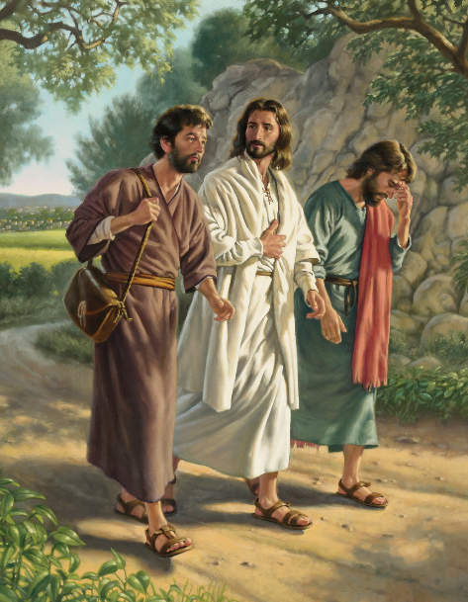

April
20
In the Name of the Father, the Son and the Holy Spirit
This week we focus on the theme of accompaniment
If we say that we have fellowship with him while we are walking in darkness, we lie and do not do what is true; but if we walk in the light as he himself is in the light, we have fellowship with one another.
1 John 1:7

Slide 3


Our School Prayer
LORD, make me a better person, more considerate to others, more honest with myself, more faithful to you. Make me generous enough to want sincerely to do your will whatever it may be. Help me to find my true vocation in life, and grant that through it I may find happiness myself and bring happiness to others.
St Joseph – Pray for us
St Teresa – Pray for us
How can we accompany each other this half term as a community of learners, believers and friends?

Slide 4



March
April
OCTOBER
21
In the name of the Father, Son and Holy Spirit
Two are better than one, because they have a good return for their labor: If either of them falls down, one can help the other up. But pity anyone who falls and has no one to help them up.
Ecclesiastes 4:9-10

Slide 5
Respond: Decide one small action or attitude you can take away from this reflection. How might this image shape your day or week?
Pray: Speak to God in your heart about what you have noticed. Ask what He might be saying to you through the image.
Visio Divina
Reflect: Think about why this part of the image draws you in. What thoughts or feelings does it stir?
Look: Gently look at the image and notice what stands out to you. What colours, symbols, or details catch your attention?

Slide 6


April
22
In the name of the Father, Son and Holy Spirit
And surely I am with you always, to the very end of the age.
Matthew 28:20

Slide 7

Quiet Mind Script
Use the Quiet Mind Script (on next slide and in resources) to help pupils enter a prayerful time of silence.
BE STILL
When do we feel alone?
How can we be there for others?
Do we trust that God is with us to the “very end of the age”
GATHER

Slide 8

April
OCTOBER
23
In the name of the Father, Son and Holy Spirit
As we continue to reflect on accompaniment, we reflect today on being together
Reflect on the words of the song – how could you apply the message to your life?
Lord, help us to be together, supporting each other and looking out for those in need. Send people to support us in our lives and always be with us.
Amen

Slide 9
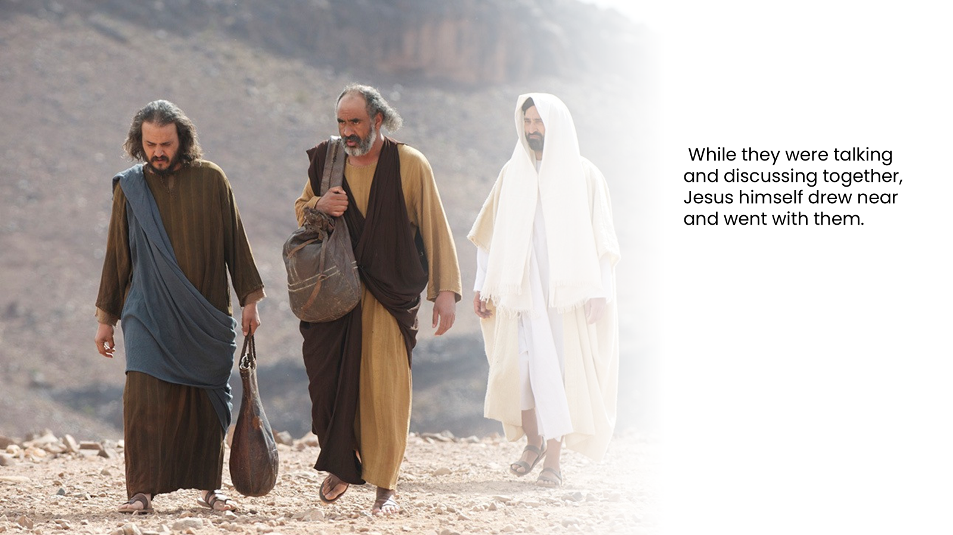
April
11
In the name of the Father, the Son and the Holy Spirit
24

Slide 10
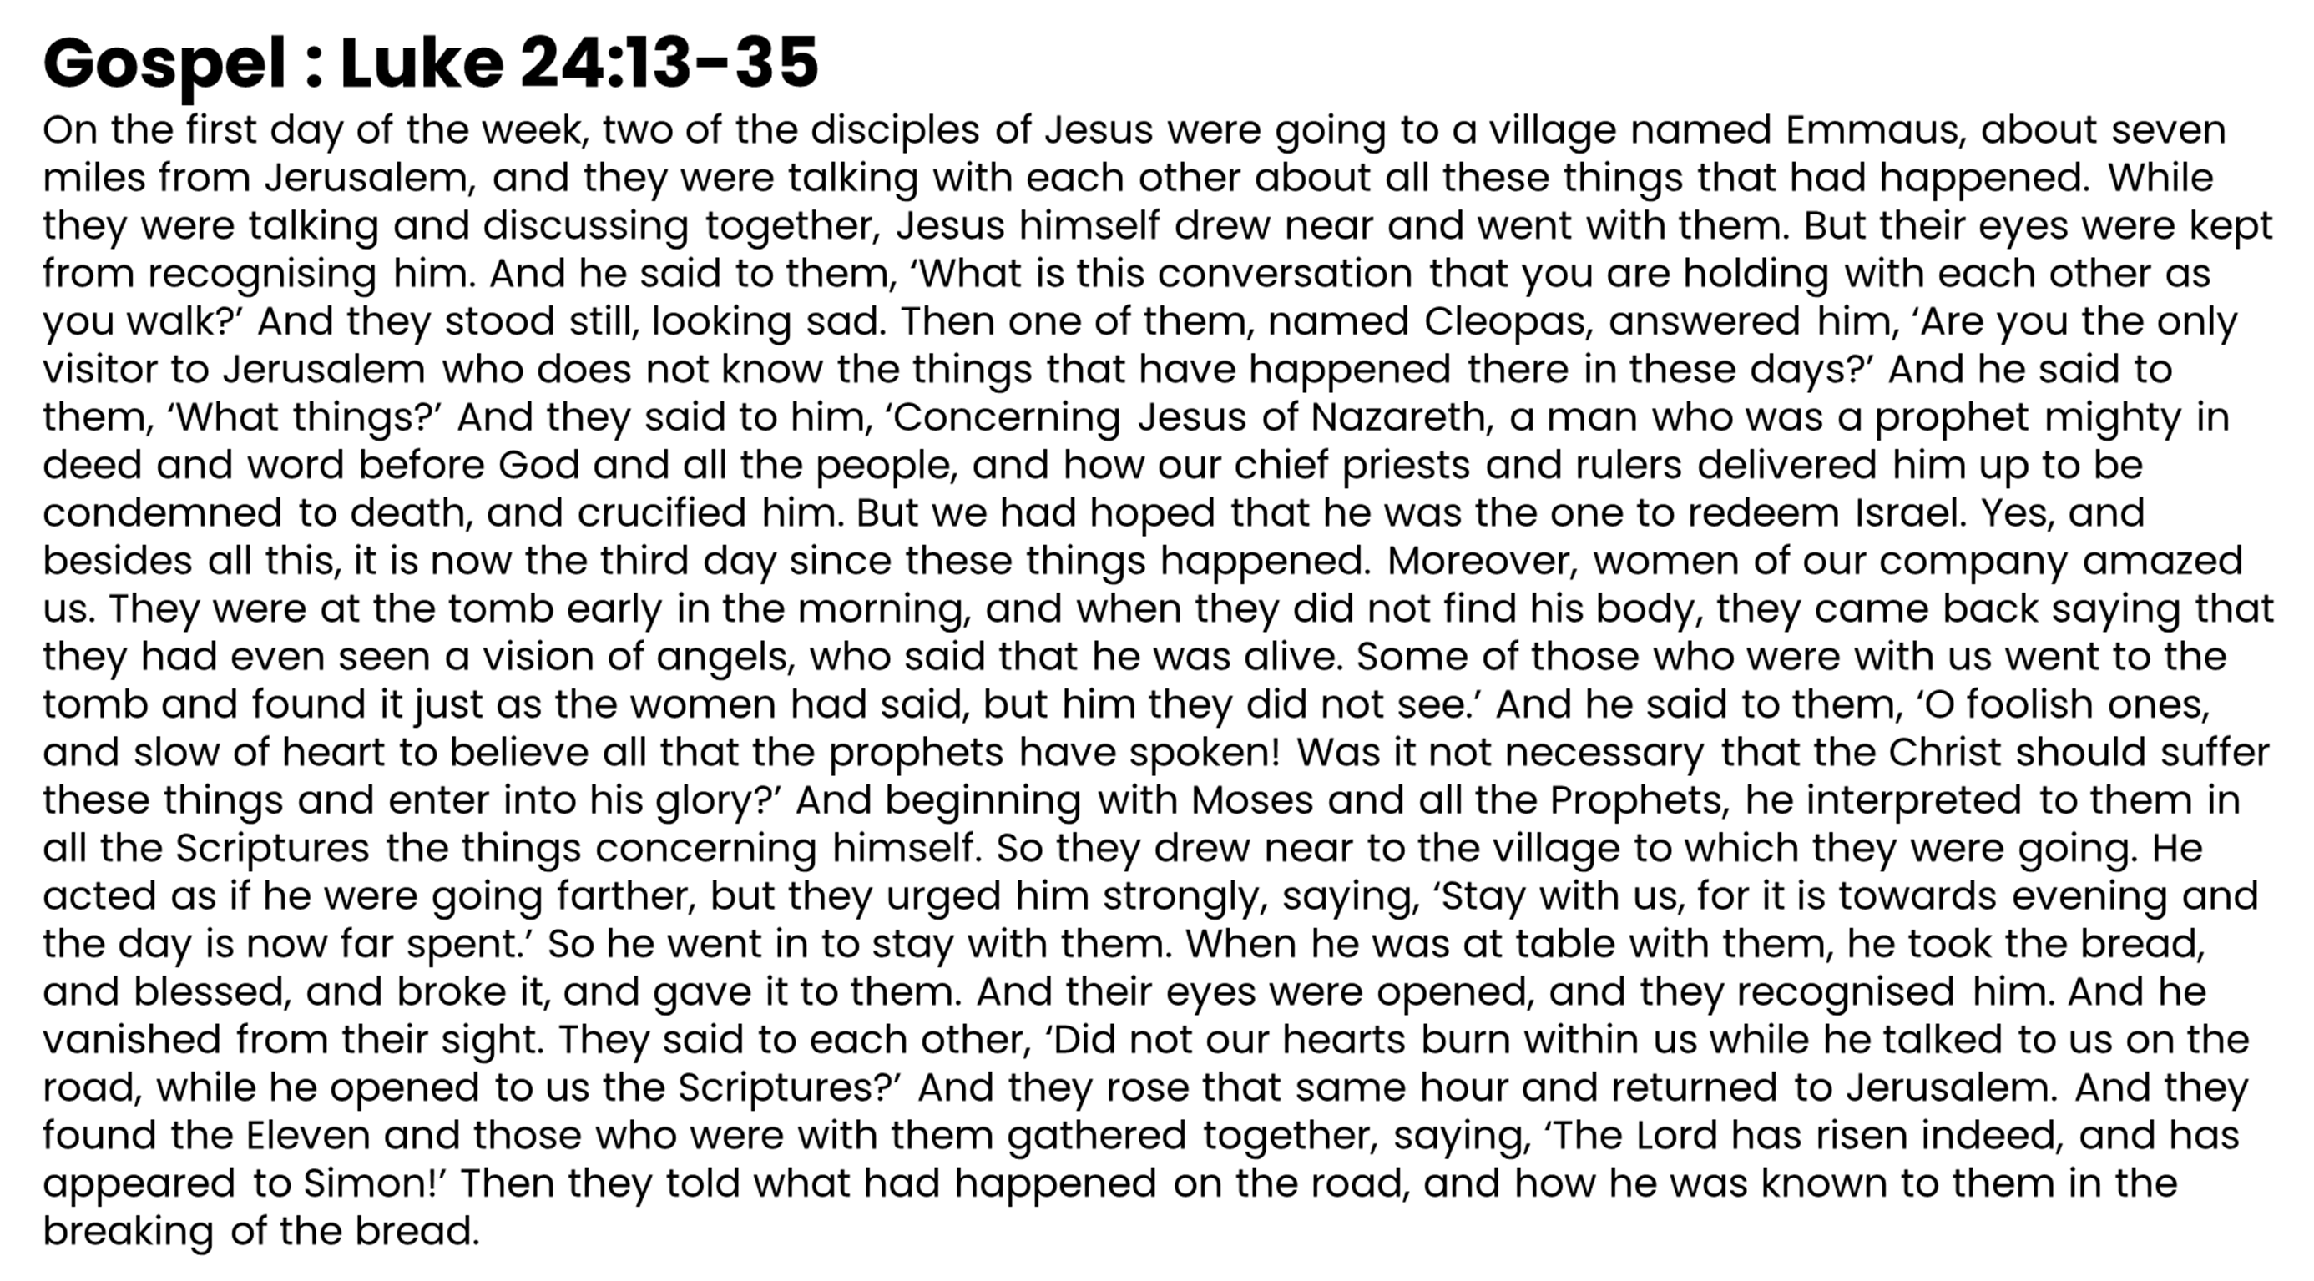

Slide 11
The disciples are disillusioned and disappointed. Their hopes and dreams have come to nothing. We don’t know why they didn’t recognise Jesus. As they walk, Jesus asks them to talk to him, to explain their thinking. He is interested in their take on what has happened and listens before helping to give them a better understanding of his mission.
As soon as he blesses and breaks the bread, they know who Jesus is. Am I welcoming to others? Am I open to recognising Jesus in unexpected places and unexpected people? Do I recognise Jesus is present in the bread and wine of Holy Communion?
. Do we feel happy and excited, knowing that we never need to be alone, that God is with us? How do we share our joy with others? God accompanies us on our journey, how will we accompany others?

Slide 12
God of all journeys,
you meet us on the road when our hearts are heavy and our hopes are uncertain.
In Jesus, you show us compassion, understanding, and the gift of presence.
Open our hearts to wisdom and truth,
stir within us a deep longing for justice, peace, and hope,
and help us recognize the sacred moments that transform our lives.
Strengthen us to walk forward with renewed purpose, serving one another with love and courage.
Amen.

