Slide 1



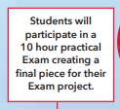

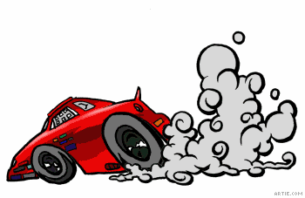


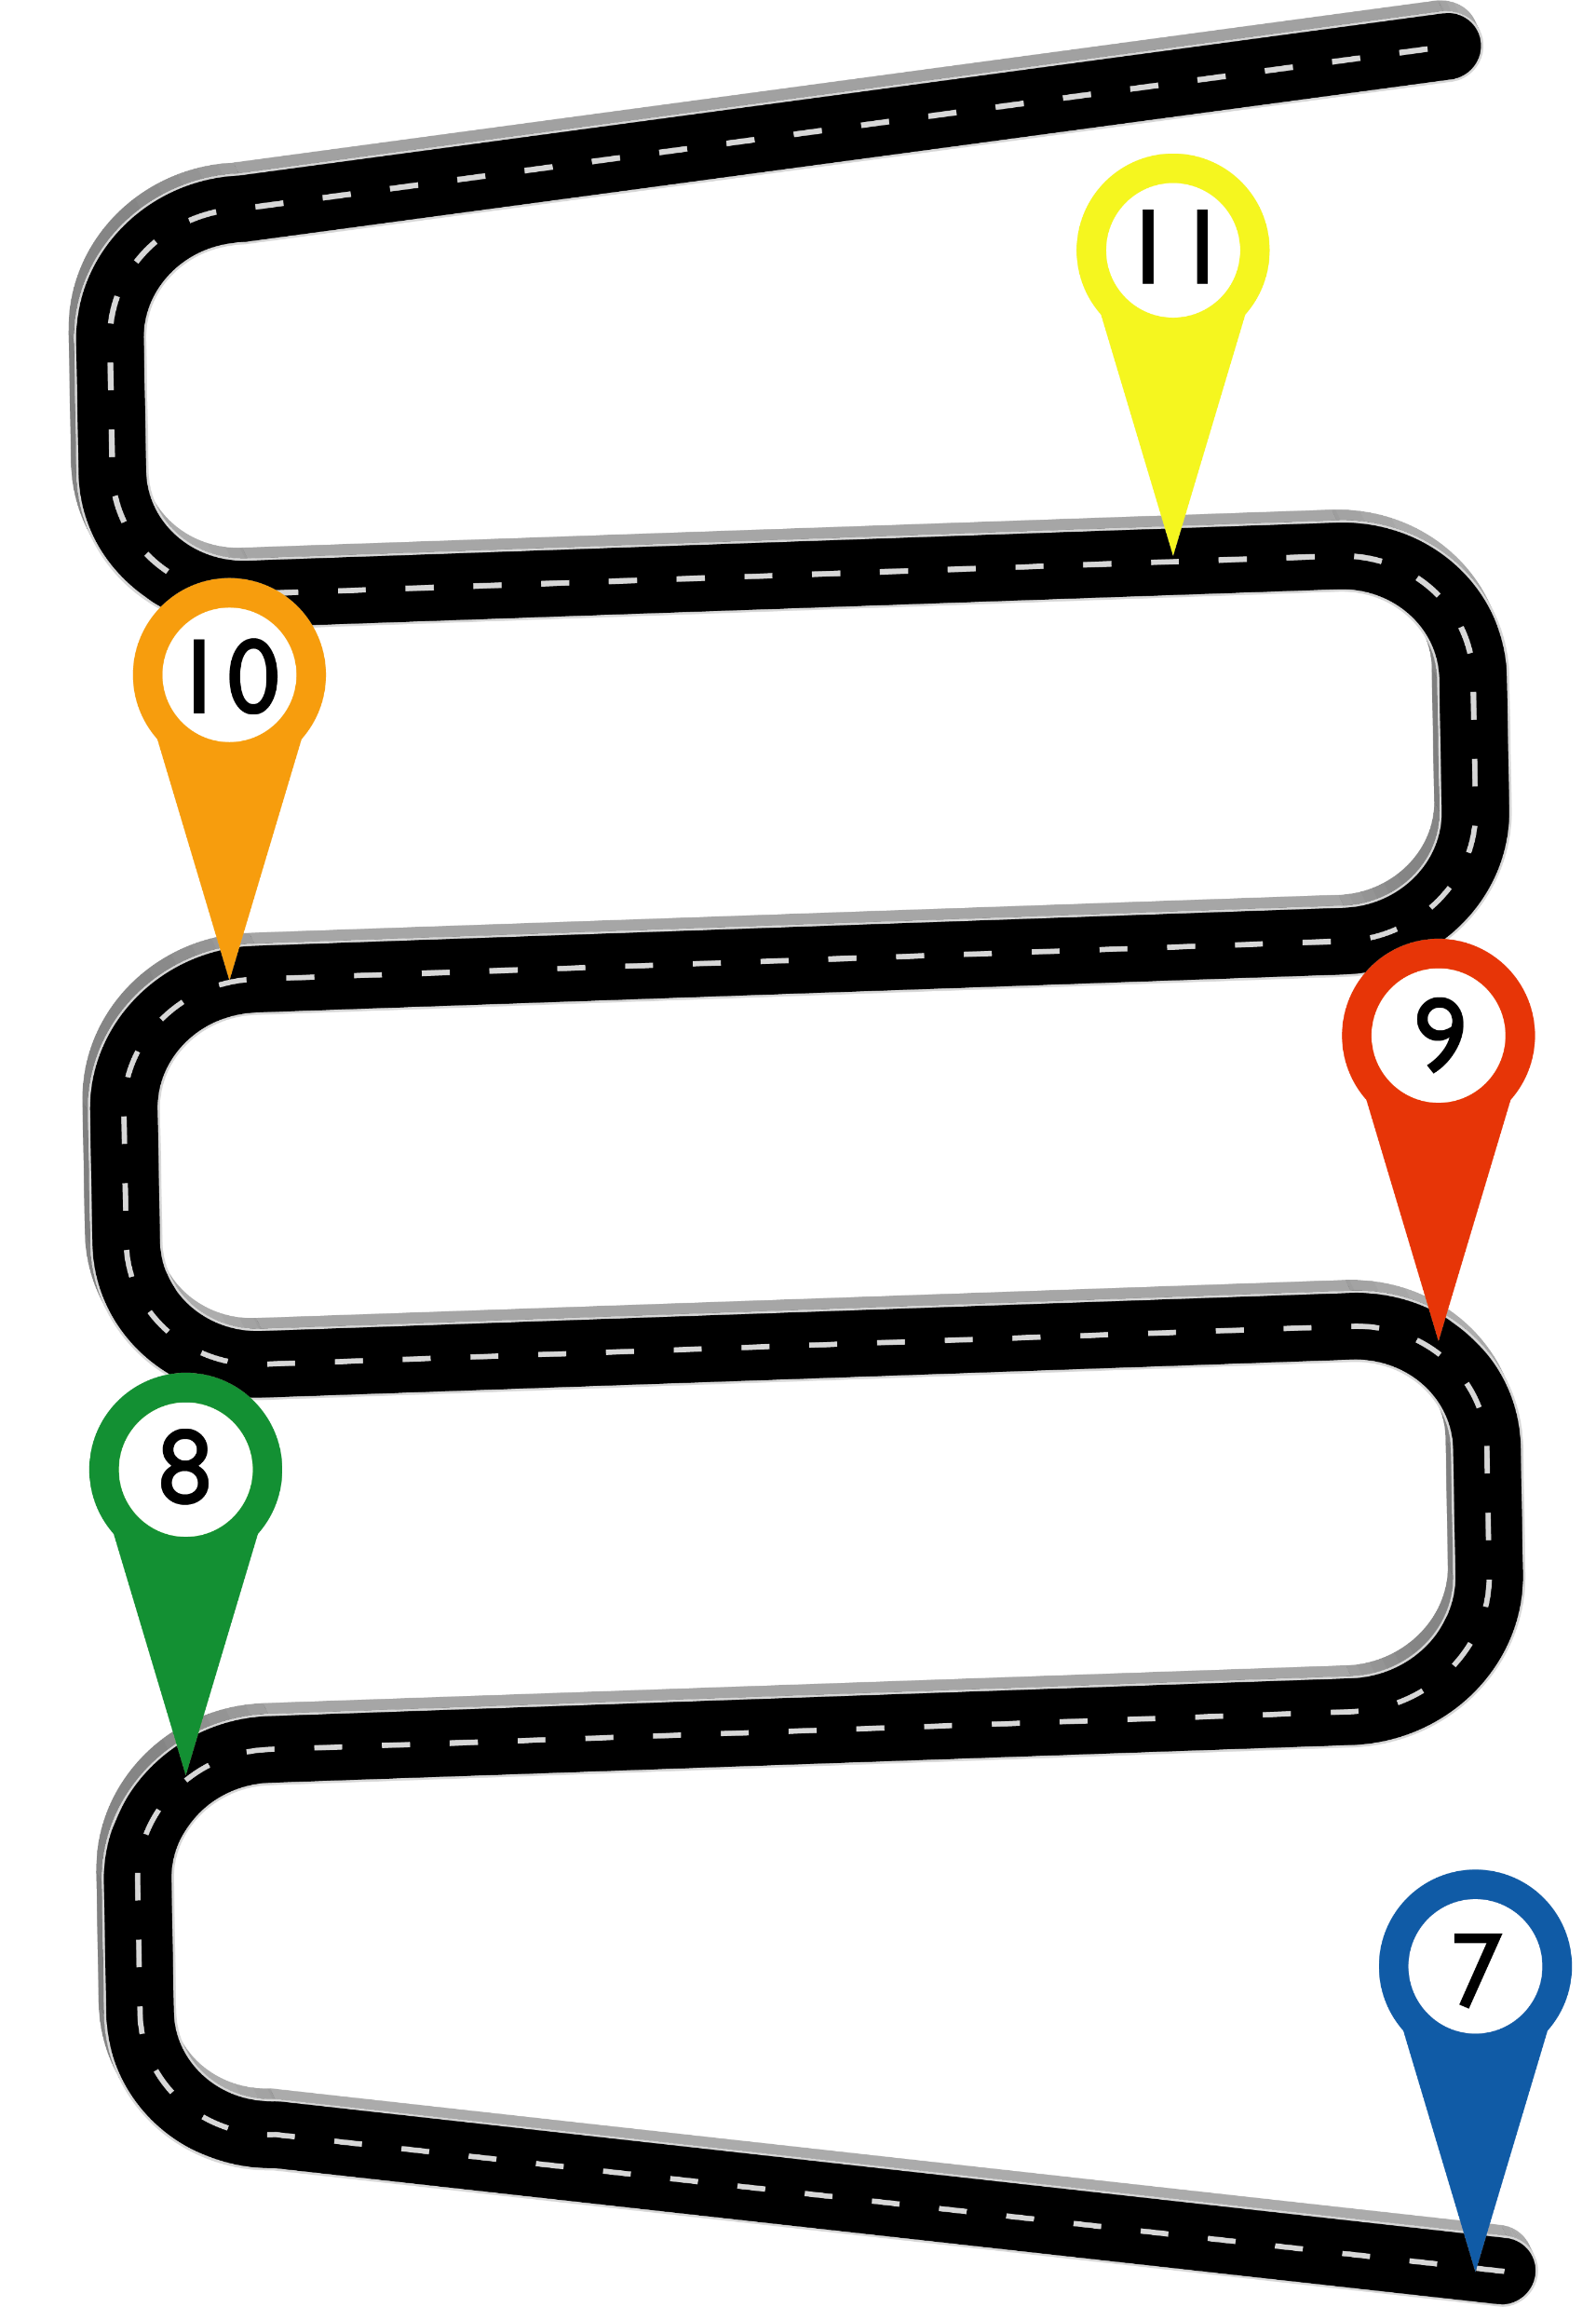
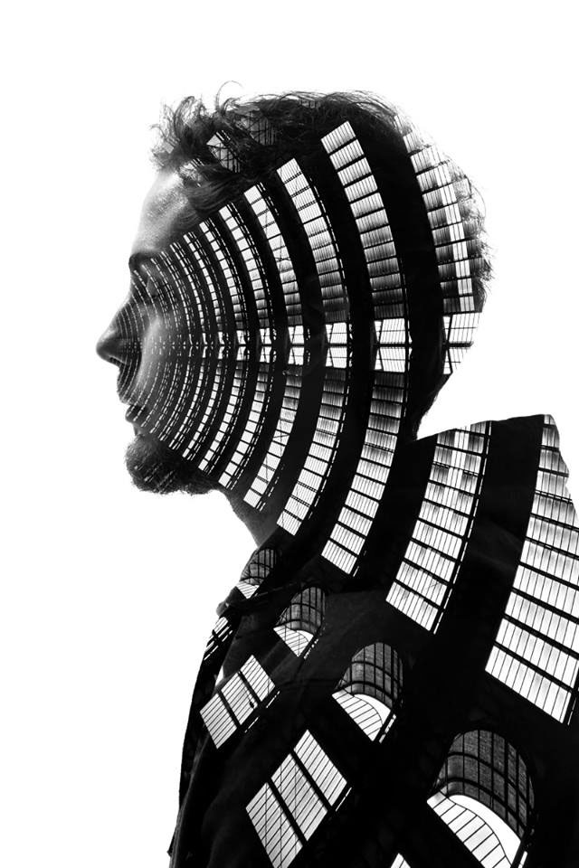




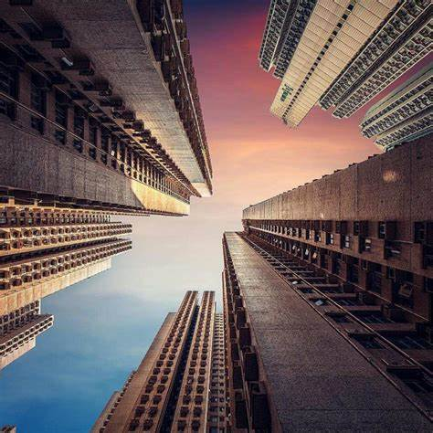


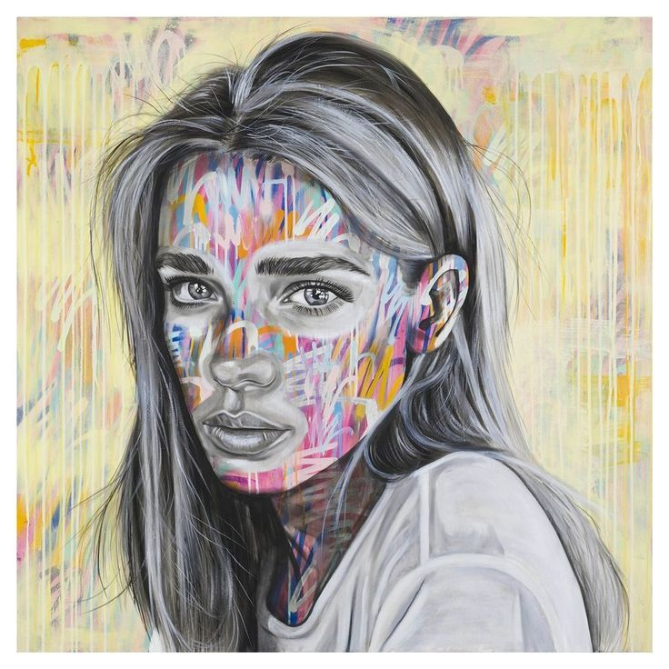

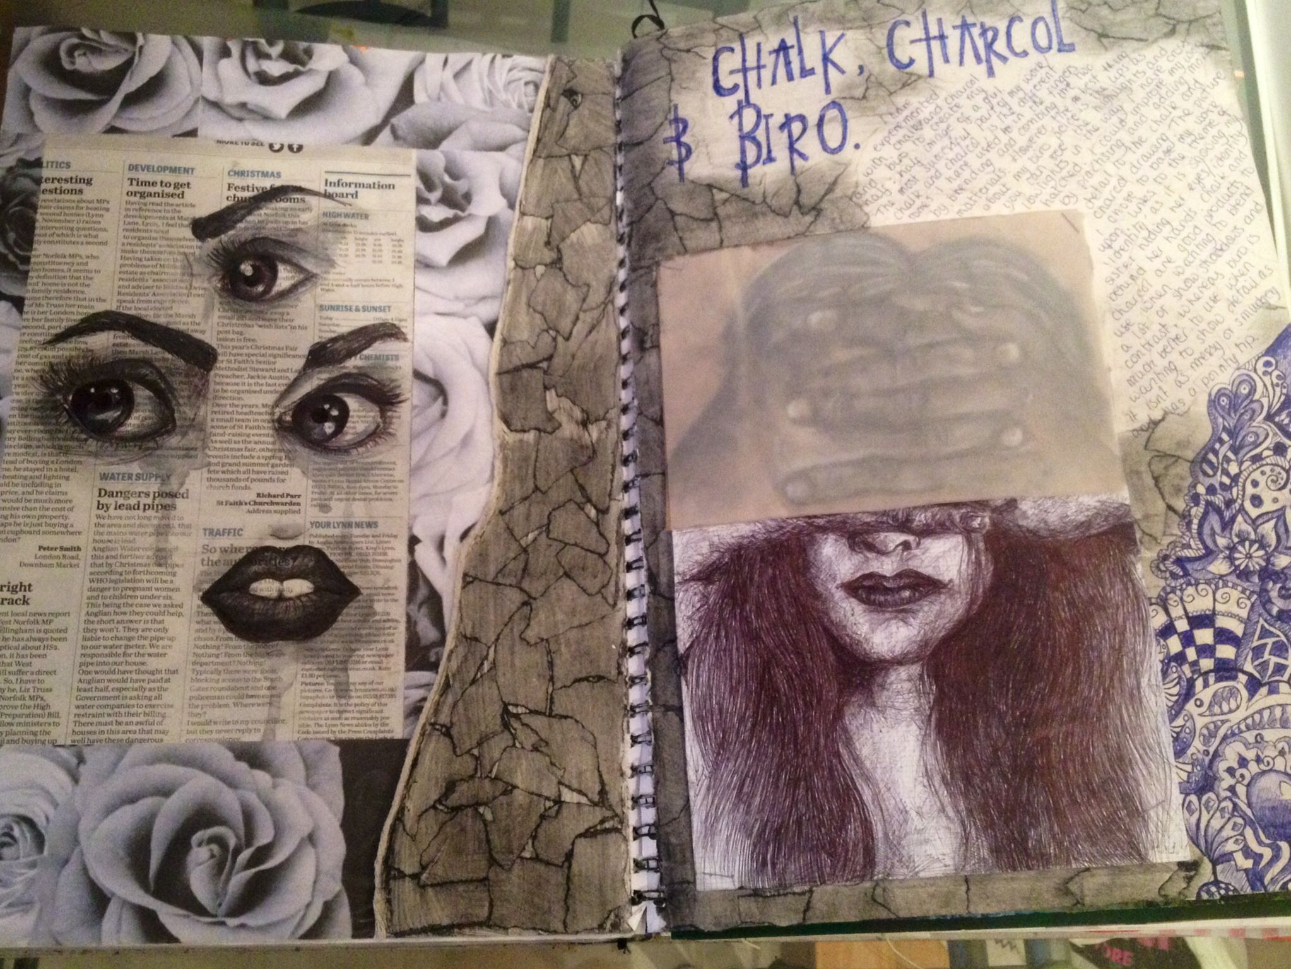
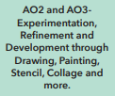

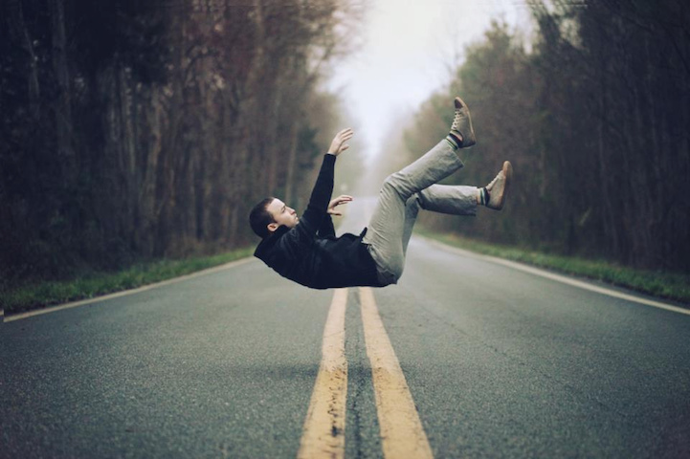
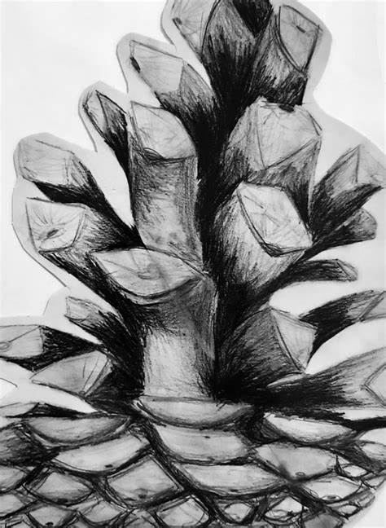

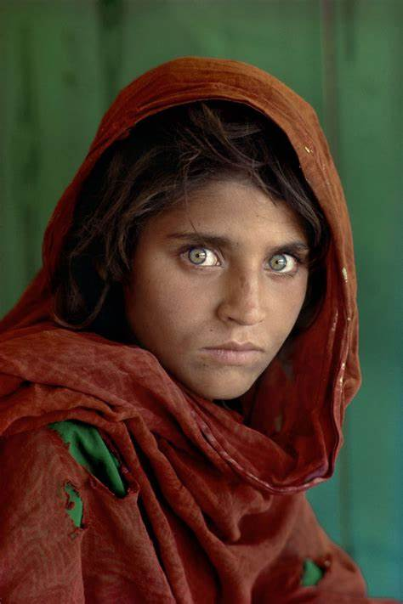
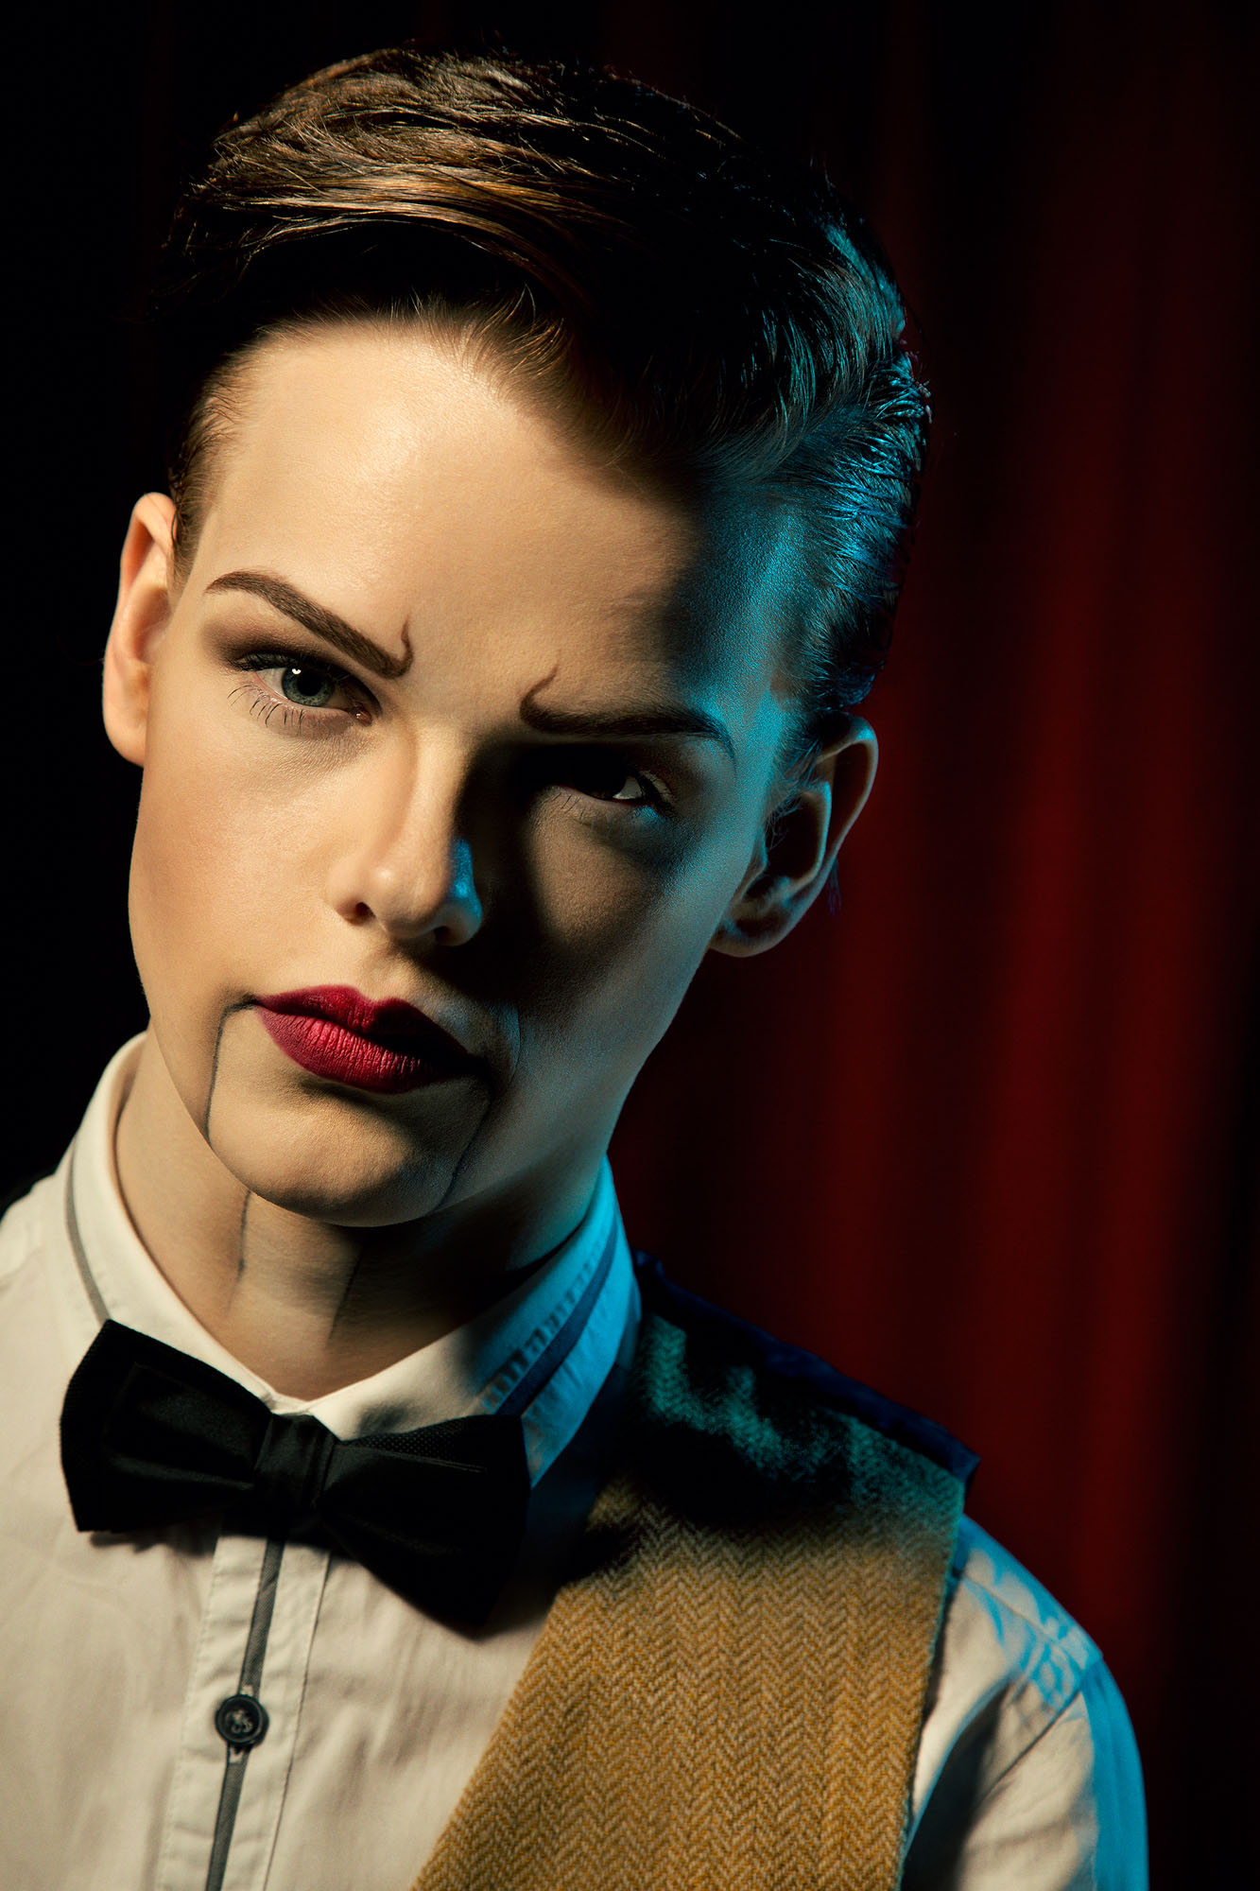

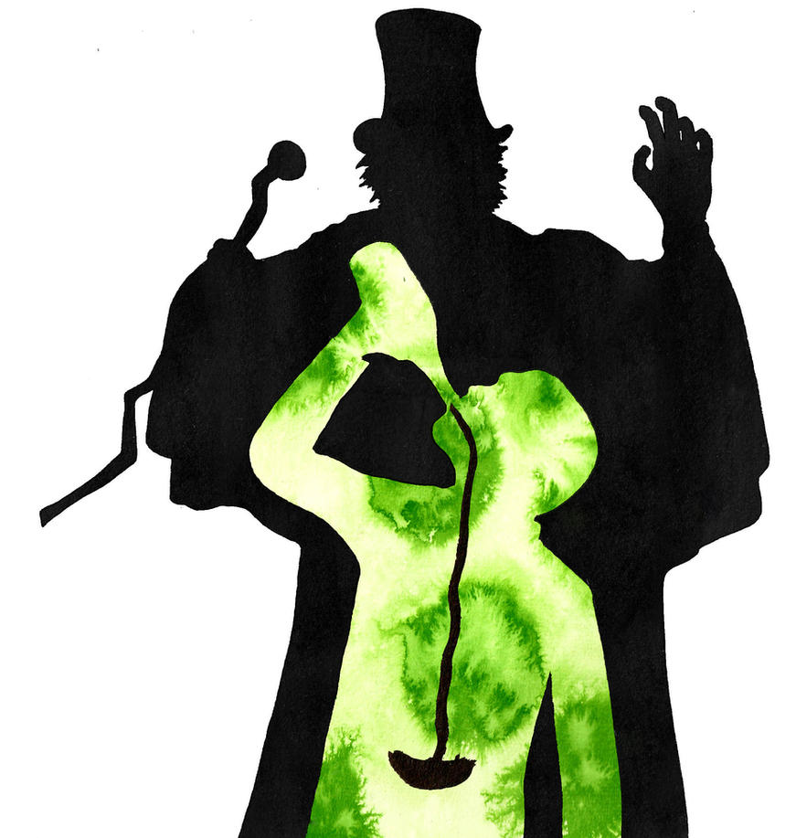
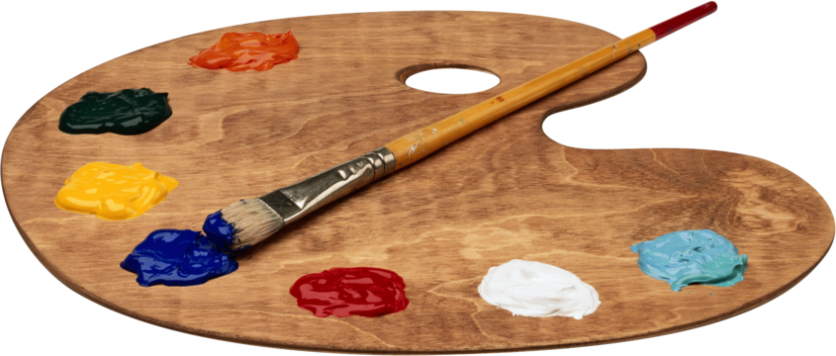

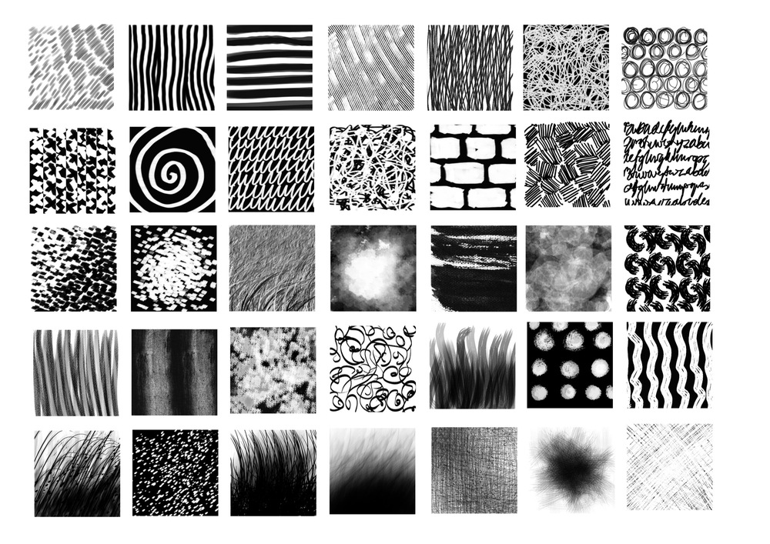

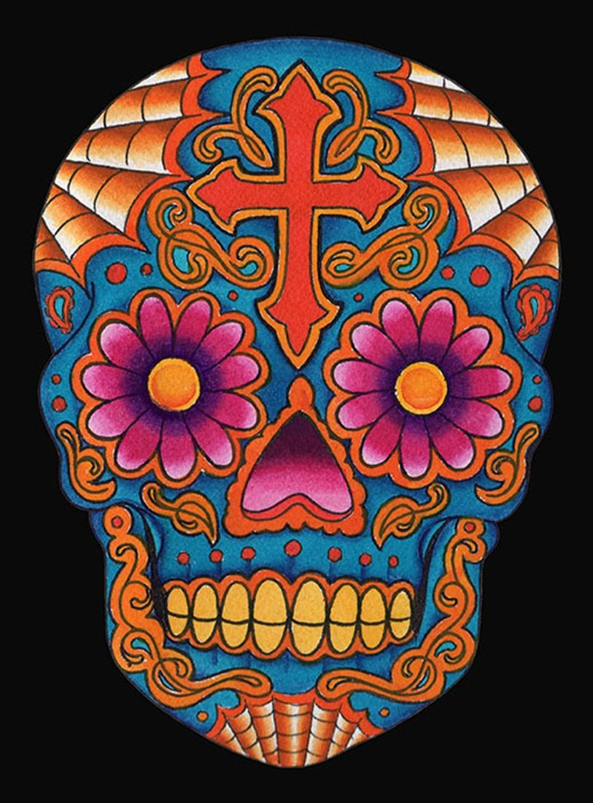
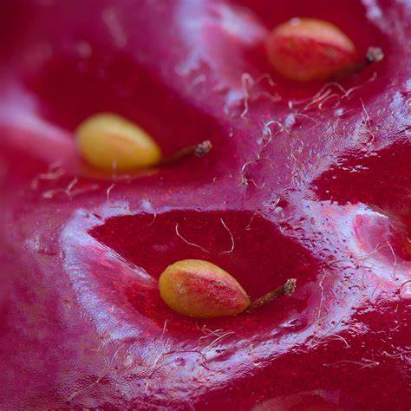
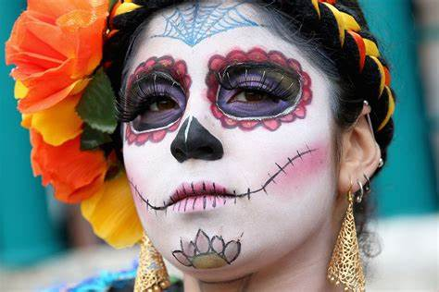

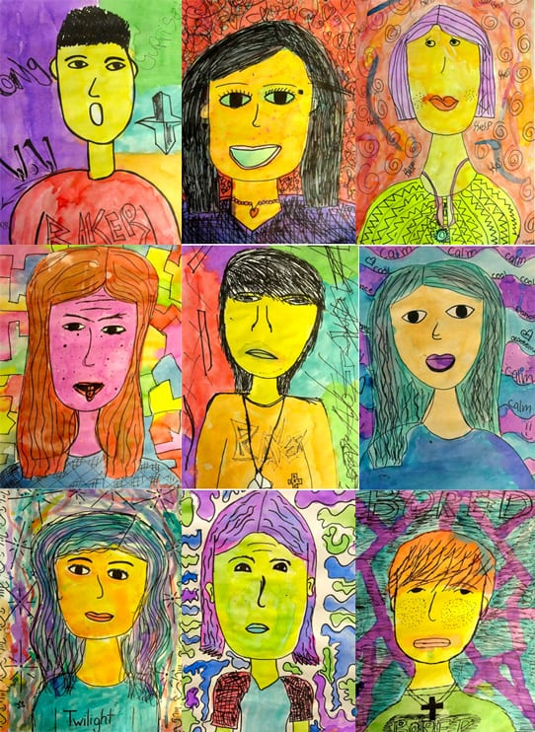

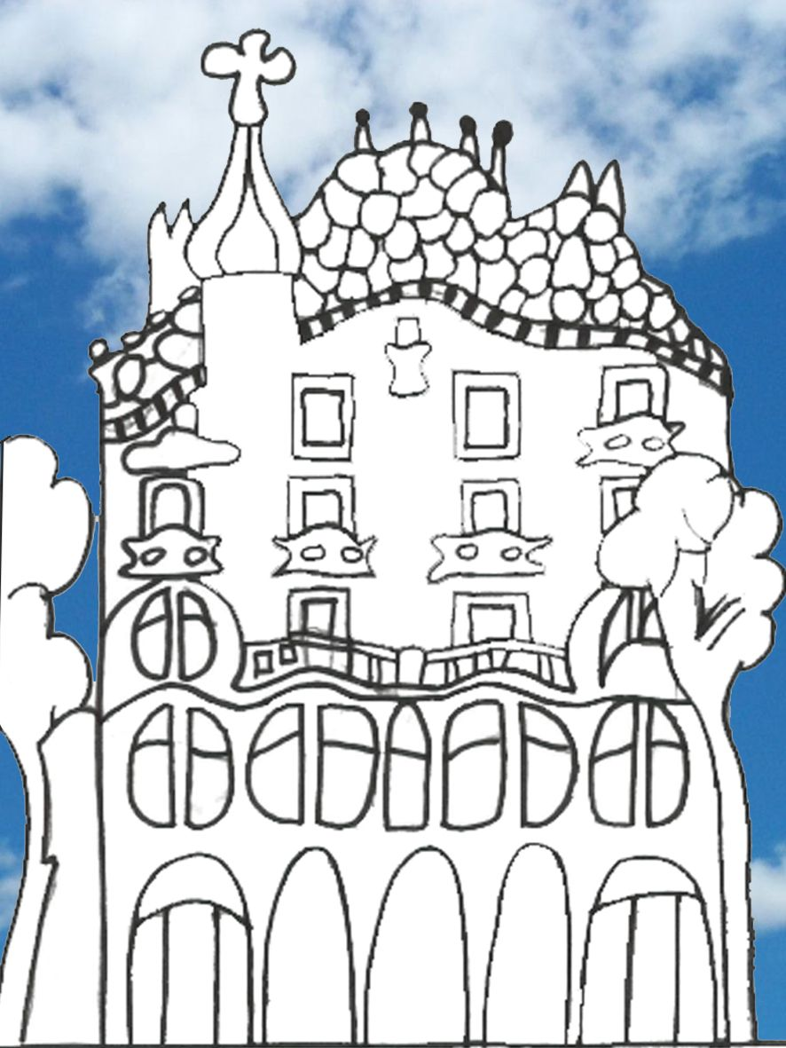


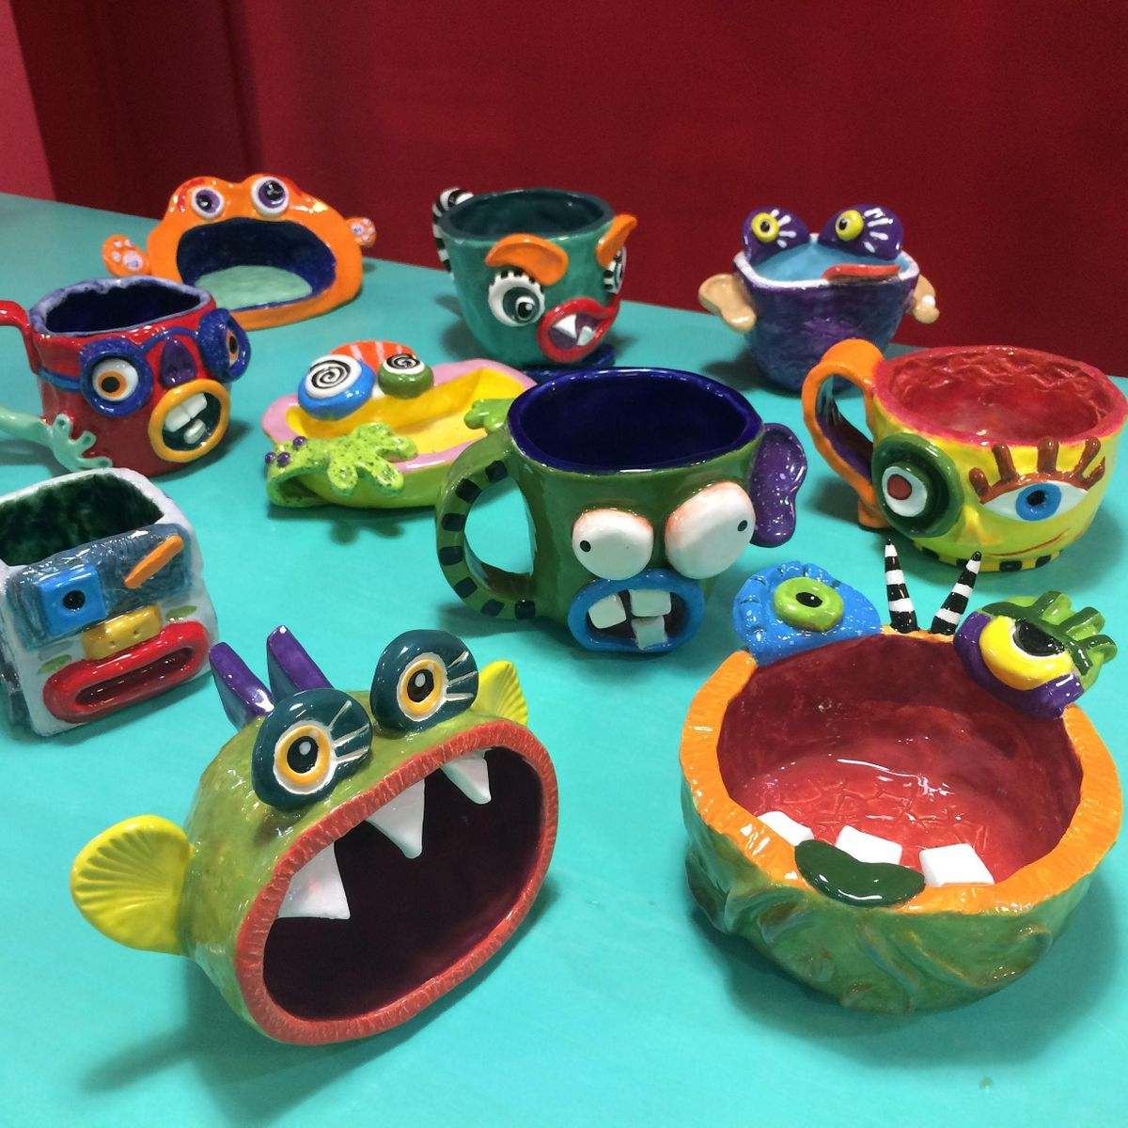
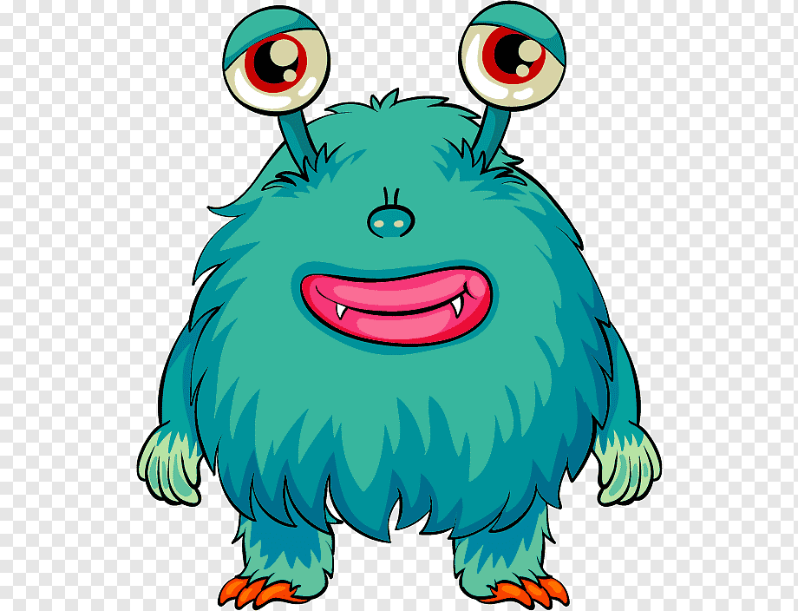

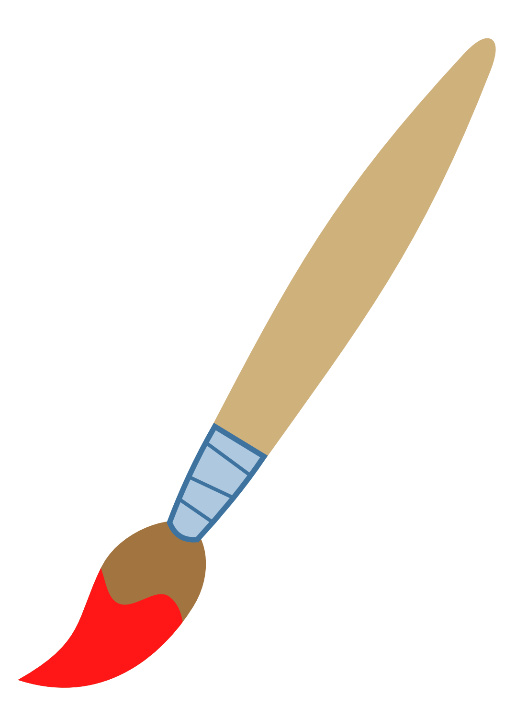
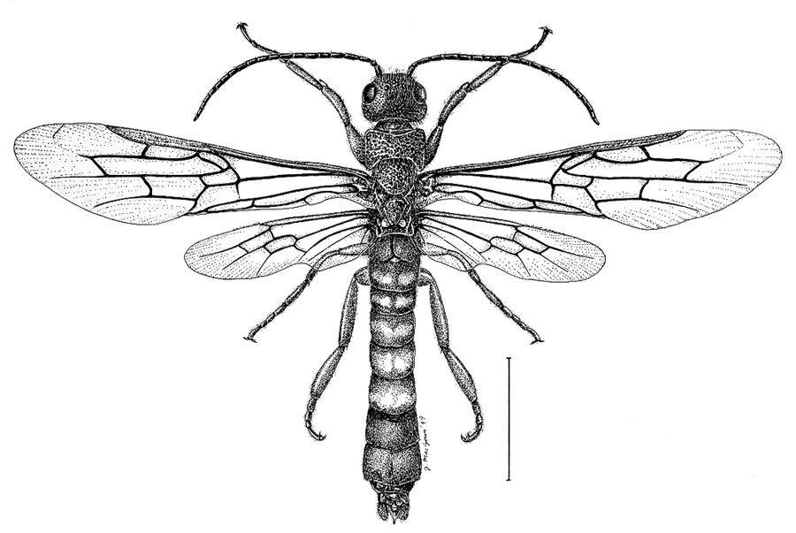
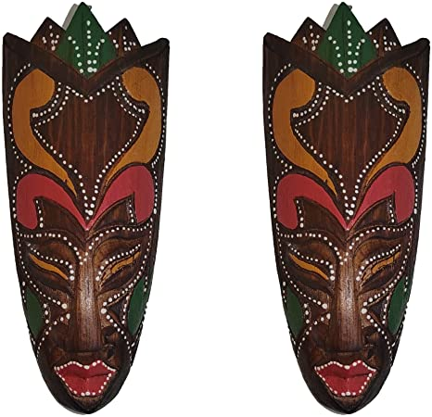




Your Learning Journey in Art
College/Sixth Form
Exhibition
University
Externally set task 40% of overall grade
Photography Unit:4
Architecture
Photoshop techniques
Collage techniques
Apprenticeships
Art Unit 2: Identity
- Portraiture
- Artist Dain
Photoshop techniques
- Printing
Painting
AO1
AO2
AO3
AO4
Photography unit: 2
Identity
Mixed media
Cultural influences
Mock exam
Photography Unit: 3
Weird and wonderful
- Levitation
Forced perspective
Legography
Ink droplets
AO1
AO2
AO3
AO4
AO5
AO6
Back to basics
- Revisit formal elements
- Revisit the colour wheel
H&S in art room
Art Unit 1: natural forms
- Ceramic unit
Look at the work of Kate Malone
Yellena James
Photography Unit 1:
- Close up
Camera basics
Composition
Michael Chase
Students will be taught on a rotation system
Day of the dead
Exploring the themes and culture of the Mexican festival. Building on formal elements to create a personal response experimenting with Papier Mache techniques and 3D sculptural techniques
AO1
AO2
AO3
AO4
Architecture
Exploring the timeline of architecture styles gaining a critical understanding Gaudi and Hundertwasser.
Pattern and colour theory
Shape and form
3D Sculptural response linked to Hundertwasser
AO1
AO2
AO3
AO4
Portraiture
Following the history of portraiture from fine art to abstract expressionism. Analysing the works of Basquiat, Van Gogh experimenting with a range of media to develop a final response.
Make me a designer
Links to industry-fashion, design and advertising
Researching pop art artists and responding to this through design
Formal elements
Promoting products
Mini beasts
Mark making techniques
Formal elements
Printing techniques looking at traditional print artists such as Katsushika Hokusai and more contemporary printers such as Eric Carle
Create a response to the theme using artists techniques
Mini monsters
- To develop drawing techniques to record observations and ideas
-Exploration of printing techniques
-Exploration of clay techniques
-To make a personal response linking to the work of Jon Burgerman
Draw the line
-Introduction to the formal elements
-Understanding of The colour wheel
-Texture
-Mark-Making
-Tone
-pattern
-Blending techniques
-Critical understanding of Van Gogh
AO1
AO2
AO3
AO4
Culture vulture
-Contextual understanding of African culture and tribes
-Critical understanding of the work of Angu Walters/Lanre Buraimoh/Picasso
-To develop on the formal elements to create a 3D sculpture in response to the artists

