Slide 1

Being celebrated week beginning 14th March
Competitions this week:
π memory test
π sculpture/cake
π song
π Photo Challenge
π related prizes for all!

Slide 2
π memory test
How many decimal places of Pi can you memorise?
Here are the first 20, search the internet for more.
3.14159265358979323846
We are looking for a champion, learn them and then recite them to your maths teacher before the end of this week!

Slide 3
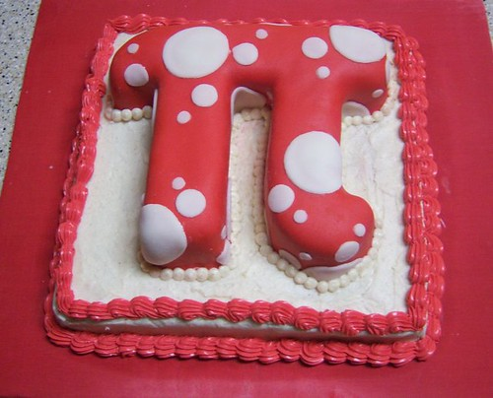
π sculpture
We are looking for the best pi sculpture, baked item or picture for the crafty students out there. It can be as big or small as you like, but π needs to be used in the design, either the symbol itself or its use in a circular piece.
Marks will be allocated for accuracy, as well as creativity.
Winning sculpture to be displayed.
Handing in deadline is Monday 21st March for judging.

Slide 4
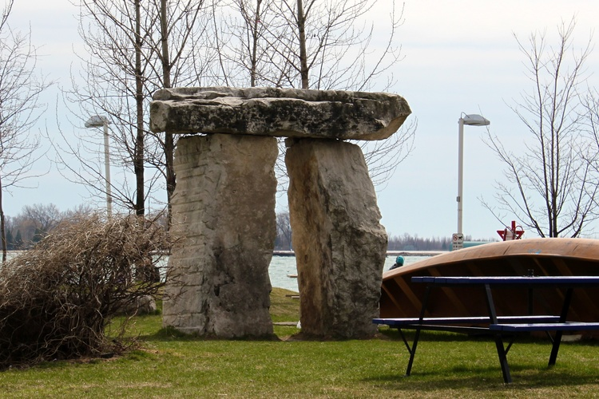
π photo challenge
We are looking for the best pi related photograph.
Marks will be allocated for creativity.
Winning photo to be displayed.
Handing in deadline is Monday 21st March for judging.

Slide 5
π song
For the performing artists, we are looking for the best pi related song, rap, or rhyme. It could be to an existing tune or song, but must include pi facts.
Here are two examples of maths songs
Example 1
Example 2
This does not need to be an individual entry, but maximum of 3 people involved in a song (limited for prize purposes)
Handing in deadline is Monday 21st March for judging. Entries to be recorded and emailed to Miss Williamson

