Slide 1
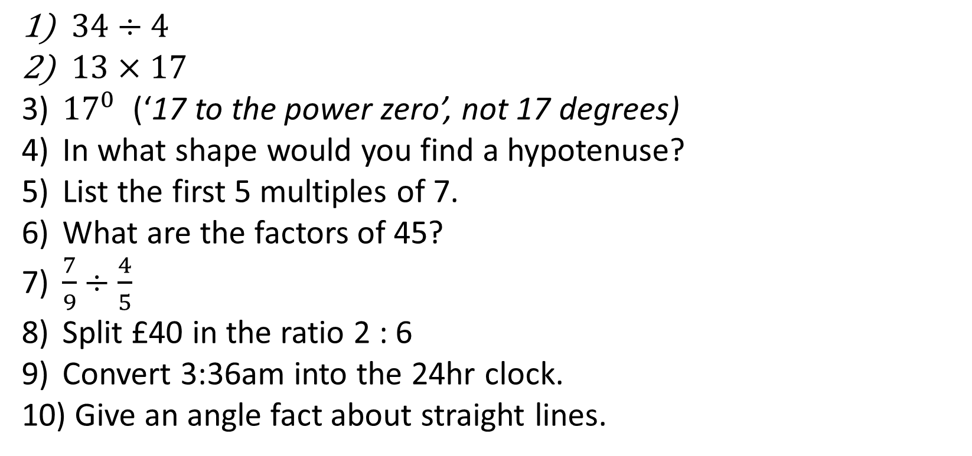
1-10 Quiz.
$34÷4$
$13×17$
${17}^{0}$ (‘17 to the power zero’, not 17 degrees)
In what shape would you find a hypotenuse?
List the first 5 multiples of 7.
What are the factors of 45?
$\frac{7}{9}÷\frac{4}{5}$
Split £40 in the ratio 2 : 6
Convert 3:36am into the 24hr clock.
Give an angle fact about straight lines.
Notes:
This could also be a YouTube clip, matching exercise, Anything that will engage the learners from the start of the lesson.
TUTOR TO TAKE THE REGISTER DURING THIS TIME. THERE IS NO NEED TO CALL OUT NAMES.

Slide 2
1-10 Quiz.
$34÷4$
$13×17$
${17}^{0}$ (‘17 to the power zero’, not 17 degrees)
In what shape would you find a hypotenuse?
List the first 5 multiples of 7.
What are the factors of 45?
$\frac{7}{9}÷\frac{4}{5}$
Split £40 in the ratio 2 : 6
Convert 3:36am into the 24hr clock.
Give an angle fact about straight lines.
8.5
221
1
Right angled triangle
7, 14, 21, 28, 35
1, 4, 9, 45
35/36
£10:£30
03:36
Add to 180
Notes:
This could also be a YouTube clip, matching exercise, Anything that will engage the learners from the start of the lesson.
TUTOR TO TAKE THE REGISTER DURING THIS TIME. THERE IS NO NEED TO CALL OUT NAMES.

Slide 3
Title: Venn Diagrams, Lesson 2
Objectives
To be able to fill in a Venn Diagram.
To be able to use Venn Diagram notation.
To be able to find probabilities from a Venn Diagram.

Slide 4
Starter
Sort the numbers 1 – 10 into this Venn diagram.
Even
Square

Slide 5
Starter
Sort the numbers 1 – 10 into this Venn diagram.
7
Even
Square
2
1
8
4
6
9
10
3
5

Slide 6
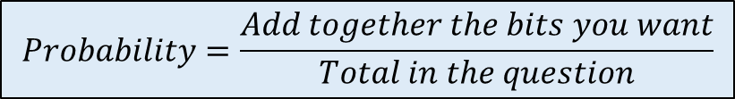
60 people were asked which newspaper they’d read in the past week. The Venn diagram on the right shows their responses.
A person is selected at random. Find the probability they:
Had read the Mirror but not the Sun
Had read at least one of the newspapers
Had read the Sun and the Telegraph but not the Mirror
Mirror
Sun
5
18
8
3
1
6
2
Telegraph
17
$$Probability=\frac{Add together the bits you want}{Total in the question}$$

Slide 7
When filling out a Venn Diagram always start from the centre and work out.
e.g. 100 people were asked if they liked tea or coffee. 20 people said they like neither, 55 said they liked both, 67 said they liked Tea and 68 said they liked coffee. Draw a Venn diagram to represent this situation.
T
C
67 - 55 = 12
12
55
68 – 55 = 13
13
20

Slide 8
The same principle needs to happen when there are three circles:
e.g. 114 people were asked if they liked apples, oranges or pears.
- 42 said all 3
30 liked just A and O
6 liked just O
71 liked P
57 liked A and P
52 liked O and P
92 liked A
A
O
5
30
6
42
15
10
4
2
P

Slide 9
40 students were split according to two characteristics.
20 students had blonde hair
18 students had blue eyes
12 students had blue eyes and blonde hair
Copy and complete the Venn diagram
b) A student is selected at random. What is the probability this student has exactly one of the characteristics?
120 people were asked what pet they had.
20 people had a rabbit
39 people had a cat
58 people had a dog
9 people had a cat and a rabbit
10 people had a dog and a rabbit
5 people had a dog and a cat
3 people had a dog, a cat and a rabbit
Complete the Venn diagram below
A person is selected at random. What is the probability they have at least 2 pets?
Blue Eyes
Blonde Hair
Dog
Cat
Rabbit

Slide 10
A
B
This means A and B.
AND rule
A
B
This means A or B.
OR rule
A
B
This means not A.

Slide 11
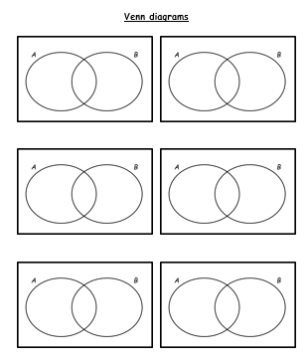
Sketch out these 6 Venn diagrams. They do not need to be particularly neat!

Slide 12
Shade the area that represents: P (B)
A
B
Notes:
Get students to come to the whiteboard and shade what they think

Slide 13
Shade the area that represents: P (B ’)
A
B

Slide 14
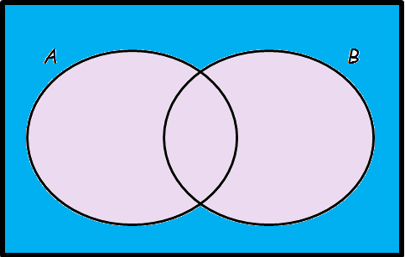
Shade the area that represents: P (A ’ ∩ B ’)
A
B

Slide 15
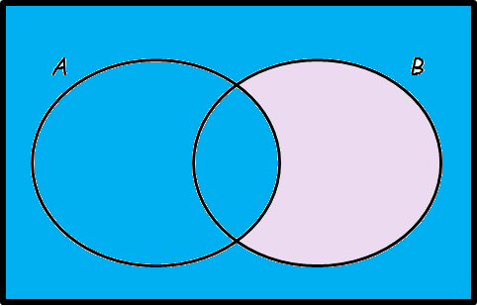
Shade the area that represents: P (A ∪ B ’)
A
B

Slide 16
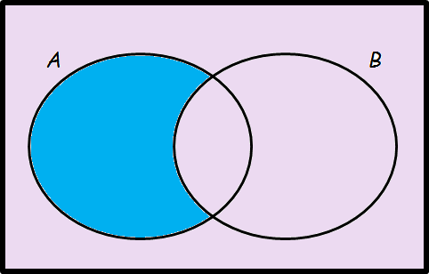
Shade the area that represents: P (A ∩ B ’)
A
B

Slide 17
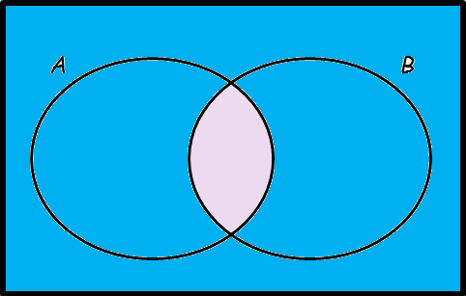
Shade the area that represents: P (A ’ ∪ B ’)
A
B

Slide 18
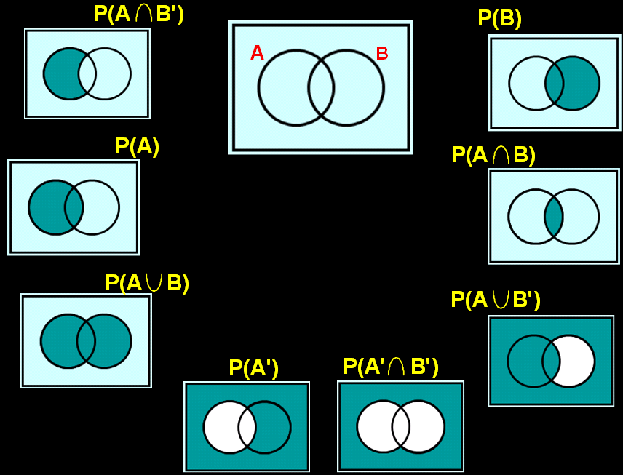

Slide 19
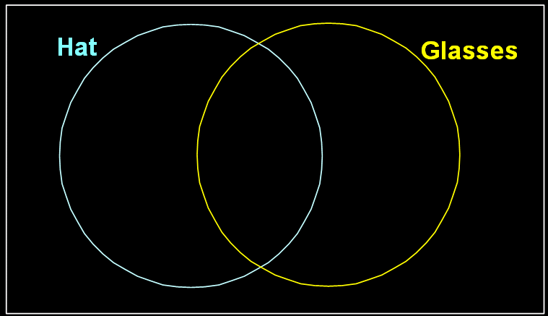
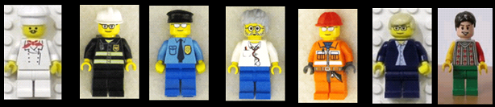

Slide 20








Slide 21
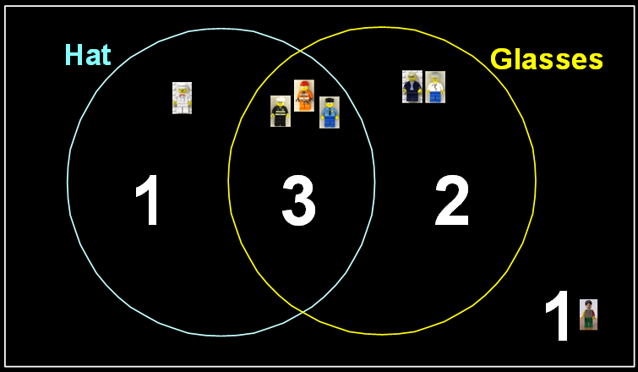

Slide 22









Slide 23
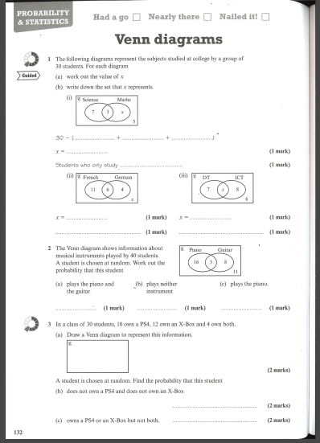

Slide 24

Todays Objectives – Have you met them?
Objectives
To be able to fill in a Venn Diagram.
To be able to use Venn Diagram notation.
To be able to find probabilities from a Venn Diagram.

Slide 25
Suggested Videos
For this lesson
Ordering Numbers: https://www.youtube.com/watch?v=gOmj58JdxL8
Ordering fractions decimals percentages – Corbettmaths
Percentages:
For next lesson
Adding & Subtracting Fractions:
https://www.youtube.com/watch?v=5juto2ze8Lg
Math Antics - Adding and Subtracting Fractions
Working with decimals:
https://www.youtube.com/watch?v=kwh4SD1ToFc
Math Antics - Decimal Arithmetic
BIDMAS:
https://www.youtube.com/watch?v=6K77Igo39vk
GCSE Maths - BIDMAS - Aslam Tutoring

