Slide 1
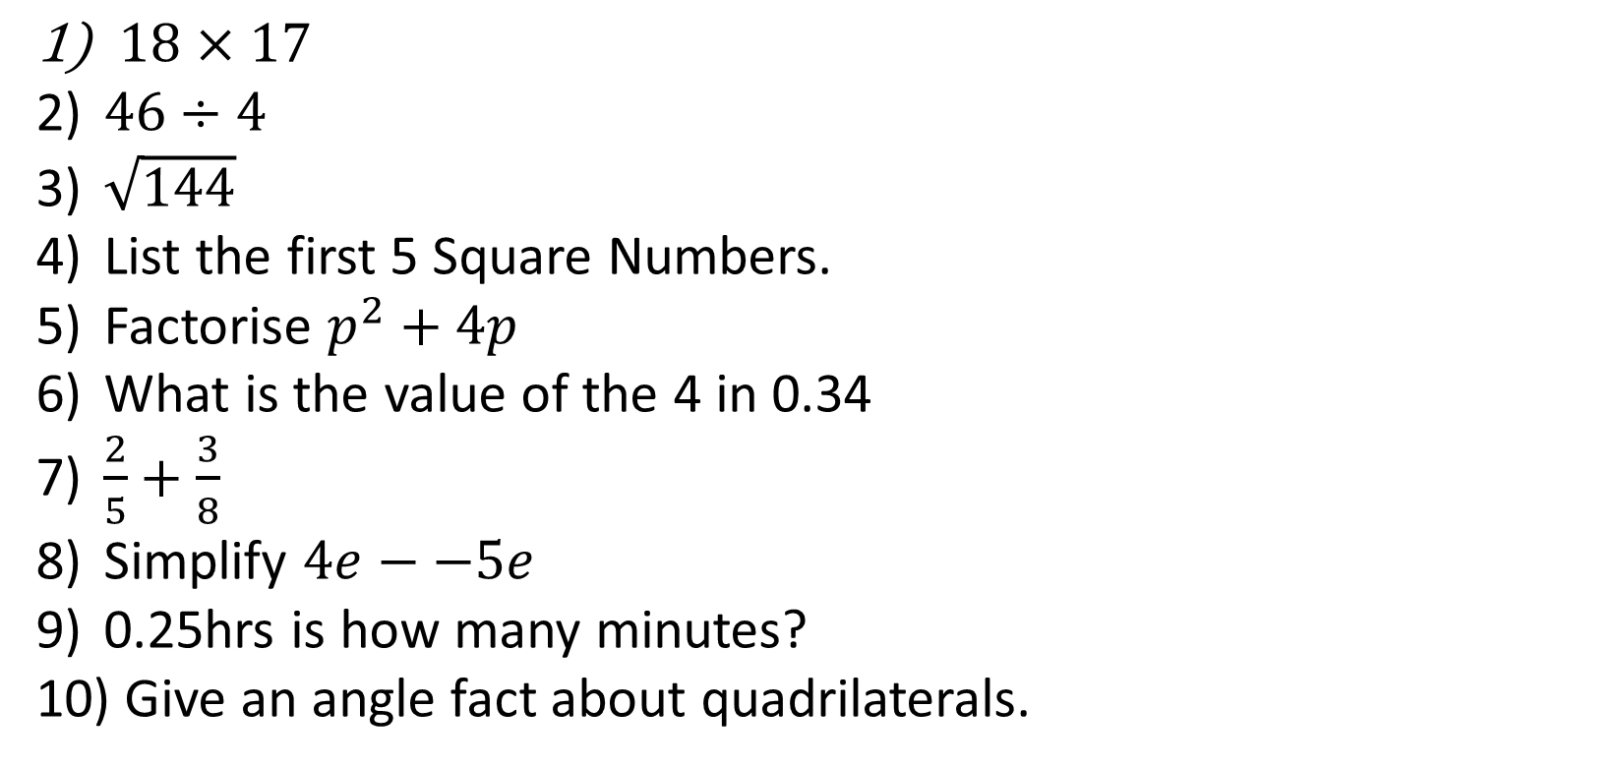
1-10 Quiz.
$18×17$
$46÷4$
$\sqrt{144}$
List the first 5 Square Numbers.
Factorise $p^{2}+4p$
What is the value of the 4 in 0.34
$\frac{2}{5}+\frac{3}{8}$
Simplify $4e−−5e$
0.25hrs is how many minutes?
Give an angle fact about quadrilaterals.
Notes:
This could also be a YouTube clip, matching exercise, Anything that will engage the learners from the start of the lesson.
TUTOR TO TAKE THE REGISTER DURING THIS TIME. THERE IS NO NEED TO CALL OUT NAMES.

Slide 2
1-10 Quiz.
$18×17$
$46÷4$
$\sqrt{144}$
List the first 5 Square Numbers.
Factorise $p^{2}+4p$
What is the value of the 4 in 0.34
$\frac{2}{5}+\frac{3}{8}$
Simplify $4e−−5e$
0.25hrs is how many minutes?
Give an angle fact about quadrilaterals.
306
11.5
12
1, 4, 9, 16, 25
p (p + 4)
4/100
31/40
9e
15 minutes
Angles add up to 360
Notes:
This could also be a YouTube clip, matching exercise, Anything that will engage the learners from the start of the lesson.
TUTOR TO TAKE THE REGISTER DURING THIS TIME. THERE IS NO NEED TO CALL OUT NAMES.

Slide 3
Title: HCF and LCM
Objectives
To be able to perform a Prime Factor Decomposition.
To be able to find the HCF and LCM using Venn Diagrams.

Slide 4
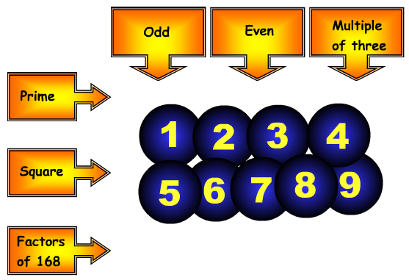
5
2
3
1
4
9
7
8
6
Sort the digits 1, 2, 3, 4, 5, 6, 7, 8, 9 into the grid so that they obey the row and column headings.

Slide 5
Prime Factor Trees
Write 36 as a product of its
prime factors.
36
Split the number into two factors.
Circle the factors if they are Prime.
If not split it down again.
List as a multiplication all the numbers circled.
3
12
4
3
2
2
36 = 2 × 2 × 3 × 3
= 2² × 3²

Slide 6
Prime Factor Trees
2100
Write 2100 as a product of its prime factors.
Split the number into two factors.
Circle the factors if they are Prime.
If not split it down again.
List as a multiplication all the numbers circled.
30
70
5
10
7
6
2
5
2
3
2100 = 2 × 2 × 3 × 5 × 5 × 7
= 2² × 3 × 5² × 7

Slide 7
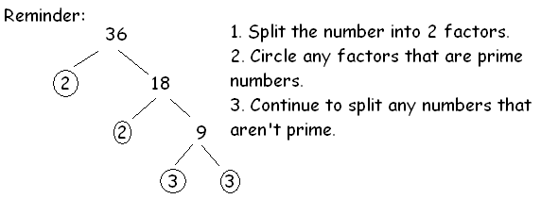
Your
Turn
Write each of these numbers as the product of its prime factors. Pick a difficulty and try to complete all 4 numbers.
10 14 15 30
28 48 60 72
112 240 144 192

Slide 8
Answers
10 = 2x 5 15 = 3 x 5
14 = 2 x 7 30 = 2 x 3 x 5
28 = 2²x 7 60 = 2²x 3 x 5
48 = 2⁴ x 3 72 = 2³ x 3²
112 = 2⁴ x 7 144 = 2⁴ x 3²
240 = 2⁴ x 3 x 5 192 = 2⁶ x 3

Slide 9
The highest common factor (HCF) of two numbers is the highest whole number which divides into both.
The lowest common multiple (LCM) of two numbers is the smallest number that is a multiple of both.

Slide 10
The easier questions
The highest common factor (HCF) of two numbers is the highest whole number which divides into both.
Q) Find the Highest Common Factor (HCF) of 32 and 48
Factors of 32:
1, 32, 2, 16, 4, 8
Factors of 48:
1, 48, 2, 24, 3, 16, 4, 12, 6, 8
The Highest Common Factor is 16

Slide 11
The easier questions
The lowest common multiple (LCM) of two numbers is the smallest number that is a multiple of both.
Q) Find the Lowest Common Multiple (LCM) of 6 and 10
Multiples of 6:
6, 12, 18, 24, 30, 36
Multiples of 10:
10, 20, 30, 40
The Lowest Common Multiple is 30

Slide 12
Bronze
Silver
Gold
Find the HCF of 4 and 10.
Find the HCF of 9 and 15.
Find the LCM of 3 and 5.
Find the LCM of 4 and 8.
Find the HCF of 18 and 42.
Find the HCF of 14 and 32.
Find the LCM of 10 and 15.
Find the LCM of 36 and 48.
Find the HCF of 24 and 64.
Find the HCF of 81 and 150.
Find the LCM of 25 and 85.
Find the LCM of 120 and 160.
Questions

Slide 13
Bronze
Silver
Gold
2
3
15
8
6
2
30
144
8
3
425
480
Answers

Slide 14
We can use the prime factors of a number to find the HCF and LCM of larger numbers.
Example: Find the HCF and the LCM of 60 and 294
60
294
60 =
2 × 2 × 3 × 5
294 =
2 × 3 × 7 × 7

Slide 15
60 = 2 × 2 × 3 × 5
294 = 2 × 3 × 7 × 7
60
294
2
2
7
3
7
5
HCF of 60 and 294 =
2 x 3 =
6

Slide 16
60 = 2 × 2 × 3 × 5
294 = 2 × 3 × 7 × 7
60
294
2
2
7
3
7
5
HCF of 60 and 294 =
2 x 3 =
6
LCM of 60 and 294 =
2 x 5 x 2 x 3 x 7 x 7 =
2940

Slide 17
Your Turn
Pick any 4 of the following questions to try and complete:
Find the HCF and LCM of
a) 12 and 20 b) 15 and 40
c) 18 and 24 d) 7 and 12
e) 30 and 42 f) 9 and 60
For each question I expect to see:
Prime Factor Decomposition for each number (2 trees)
The Venn Diagram
Answers for the HCF and LCM.
As you will see on the next slides, I have done this myself for every question.

Slide 18
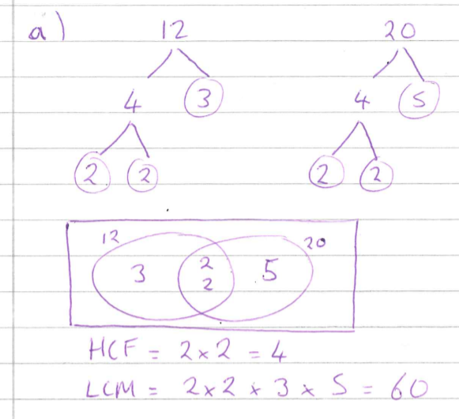
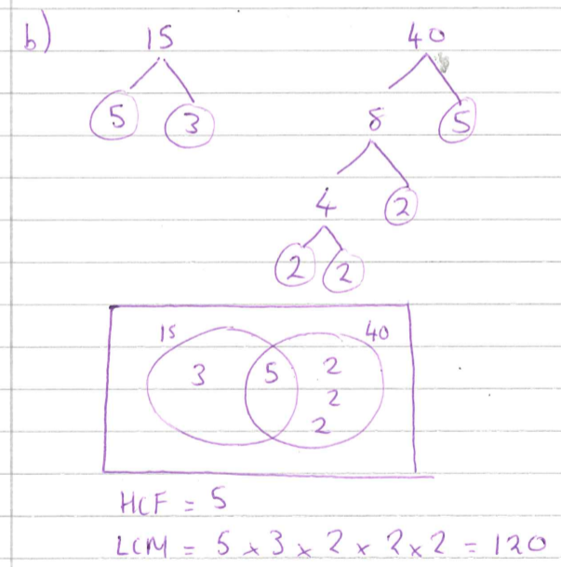

Slide 19
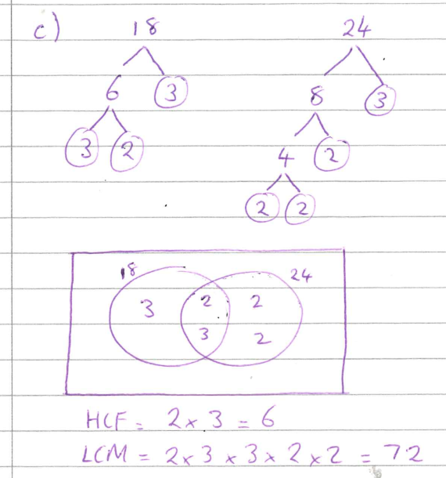
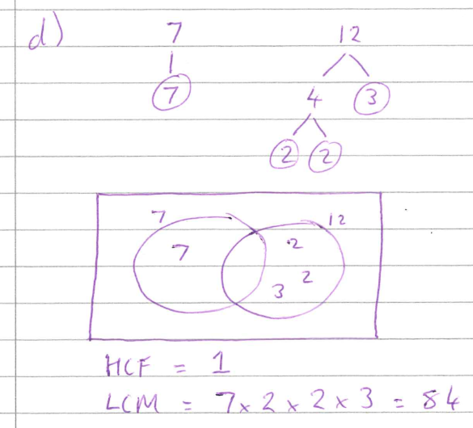

Slide 20
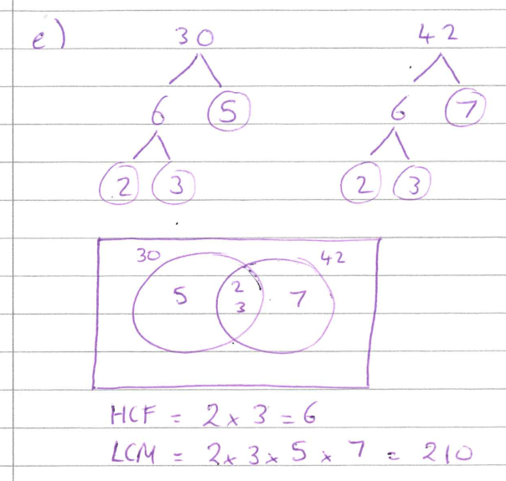
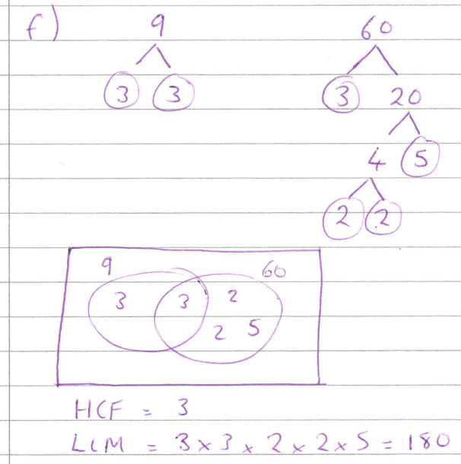

Slide 21
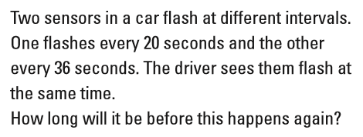
Common Worded Exam Questions

Slide 22
Common Worded Exam Questions
40 60 80 100 120 140 160 180 200 220 ……
72 108 144 180 …..
180 seconds

Slide 23
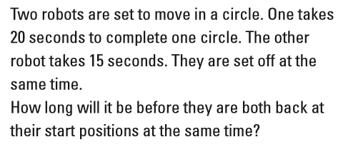
Common Worded Exam Questions

Slide 24
Common Worded Exam Questions
40 60 80 100 120 140 160 180 200 220 ……
15 30 45 60 …..
60 seconds

Slide 25

Todays Objectives – Have you met them?
Objectives
To be able to perform a Prime Factor Decomposition.
To be able to find the HCF and LCM using Venn Diagrams.

Slide 26
Suggested Videos
For this lesson
Ordering Numbers: https://www.youtube.com/watch?v=gOmj58JdxL8
Ordering fractions decimals percentages – Corbettmaths
Percentages:
For next lesson
Adding & Subtracting Fractions:
https://www.youtube.com/watch?v=5juto2ze8Lg
Math Antics - Adding and Subtracting Fractions
Working with decimals:
https://www.youtube.com/watch?v=kwh4SD1ToFc
Math Antics - Decimal Arithmetic
BIDMAS:
https://www.youtube.com/watch?v=6K77Igo39vk
GCSE Maths - BIDMAS - Aslam Tutoring

