Slide 1
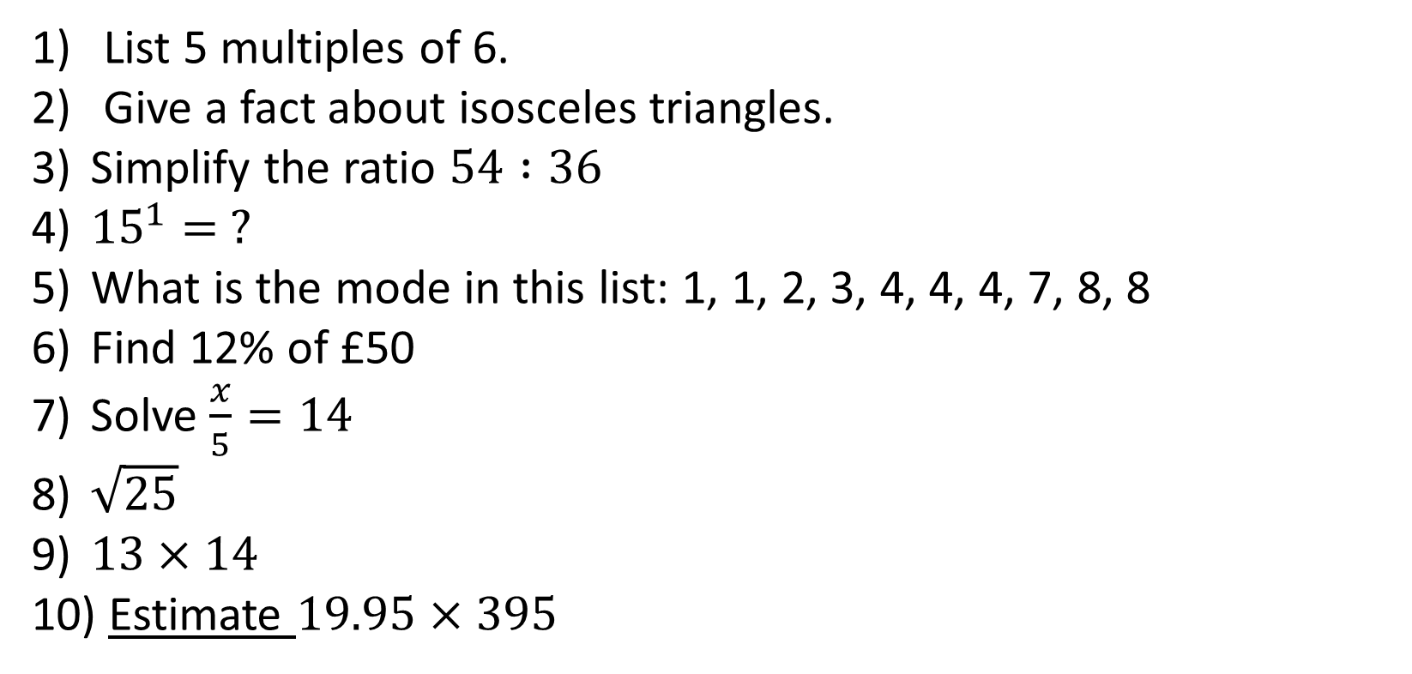
1-10 Quiz.
List 5 multiples of 6.
Give a fact about isosceles triangles.
Simplify the ratio $54 :36$
${15}^{1}= ?$
What is the mode in this list: 1, 1, 2, 3, 4, 4, 4, 7, 8, 8
Find 12% of £50
Solve $\frac{x}{5}=14$
$\sqrt{25}$
$13×14$
Estimate $19.95×395$
Notes:
This could also be a YouTube clip, matching exercise, Anything that will engage the learners from the start of the lesson.
TUTOR TO TAKE THE REGISTER DURING THIS TIME. THERE IS NO NEED TO CALL OUT NAMES.

Slide 2
1-10 Quiz.
List 5 multiples of 6.
Give a fact about isosceles triangles.
Simplify the ratio $54 :36$
${15}^{1}= ?$
What is the mode in this list: 1, 1, 2, 3, 4, 4, 4, 7, 8, 8
Find 12% of £50
Solve $\frac{x}{5}=14$
$\sqrt{25}$
$13×14$
Estimate $19.95×395$
6, 12. 18. 24, 30 …
It has 2 equal sides
3:2
15
4
6
70
5
182
8000
Notes:
This could also be a YouTube clip, matching exercise, Anything that will engage the learners from the start of the lesson.
TUTOR TO TAKE THE REGISTER DURING THIS TIME. THERE IS NO NEED TO CALL OUT NAMES.

Slide 3
Title: Algebra Basics and Brackets
Objectives
To be able to apply the basics of algebra.
To be able to expand simple brackets.
To be able to expand multiple brackets.
To be able to factorise.

Slide 4
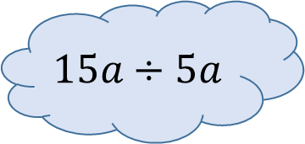
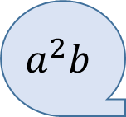
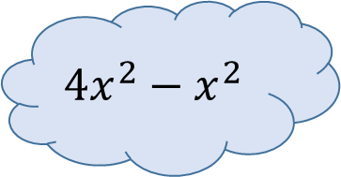
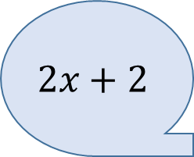
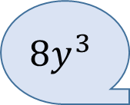
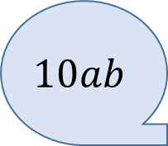
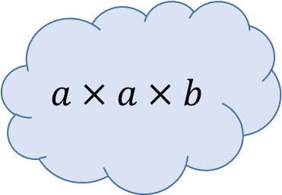
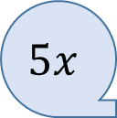
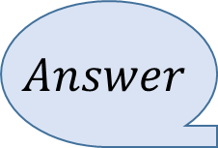
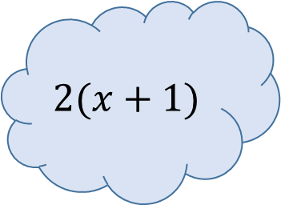
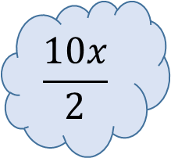
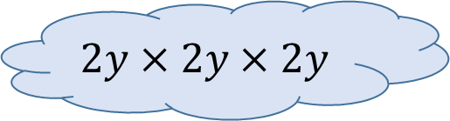
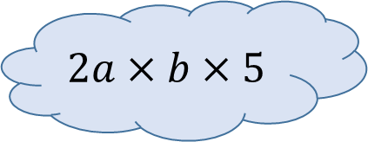
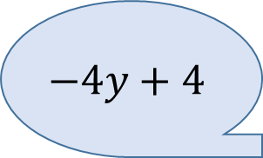

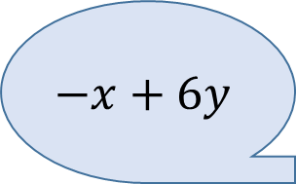
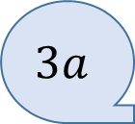
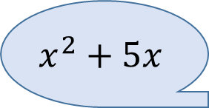
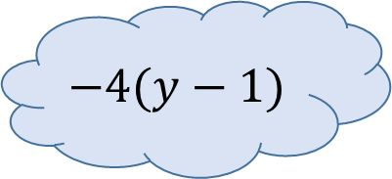
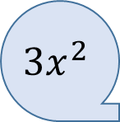

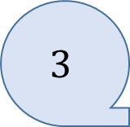
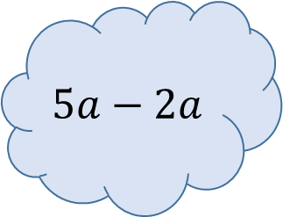
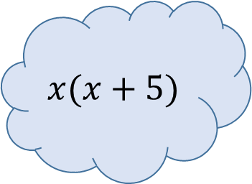
$$2(x+1)$$
$$2x+2$$
$$−x+6y$$
$$3x^{2}$$
$$4x^{2}−x^{2}$$
$$a×a×b$$
$$3a$$
$$x^{2}+5x$$
$$\frac{10x}{2}$$
$$5x$$
$$8y^{3}$$
$$15a÷5a$$
$$x(x+5)$$
$$5a−2a$$
$$−4(y−1)$$
$$a^{2}b$$
$$−4y+4$$
$$2y×2y×2y$$
$$2a×b×5$$
Match up the bubbles! They are all in pairs.
$$3$$
$$10ab$$
$$3x+5y−4x+y$$
$$Question$$
$$Answer$$

Slide 5
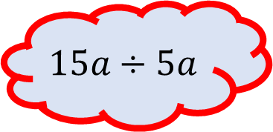
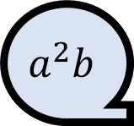
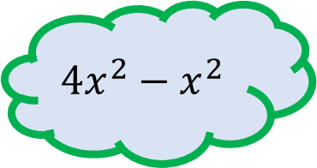
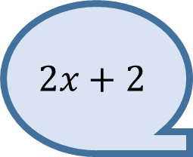
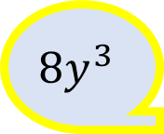
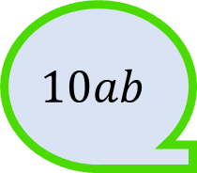
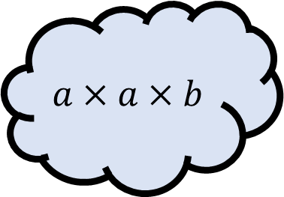
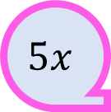
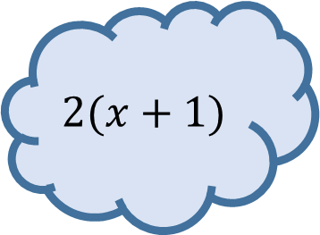
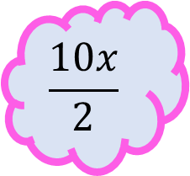
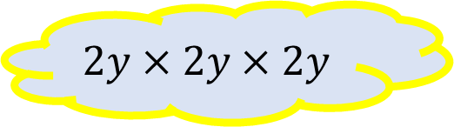
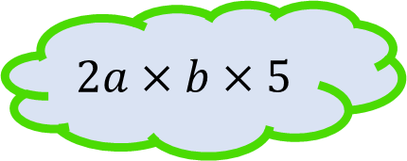
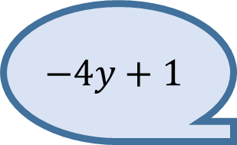
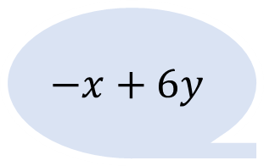
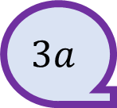
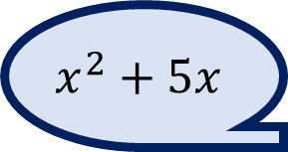
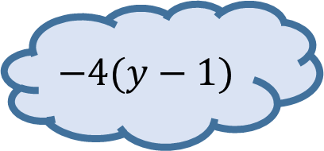
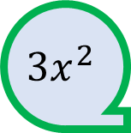
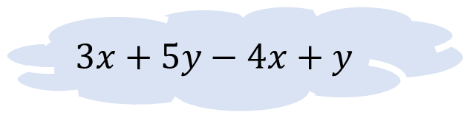
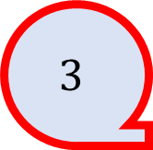
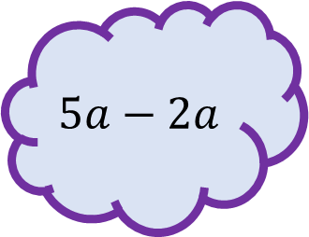
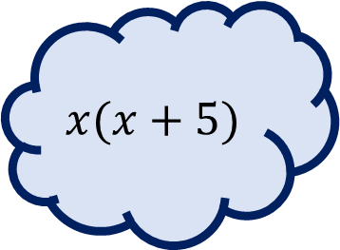
$$2(x+1)$$
$$2x+2$$
$$−x+6y$$
$$3x^{2}$$
$$4x^{2}−x^{2}$$
$$a×a×b$$
$$3a$$
$$x^{2}+5x$$
$$\frac{10x}{2}$$
$$5x$$
$$8y^{3}$$
$$15a÷5a$$
$$x(x+5)$$
$$5a−2a$$
$$−4(y−1)$$
$$a^{2}b$$
$$−4y+1$$
$$2a×b×5$$
Match up the bubbles! They are all in pairs.
$$2y×2y×2y$$
$$3$$
$$10ab$$
$$3x+5y−4x+y$$

Slide 6
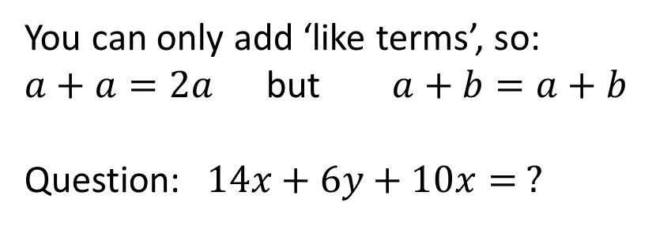
Addition
You can only add ‘like terms’, so:
$a+a=2a$ but $a+b=a+b$
Question: $14x+6y+10x= ?$
The Four Operations in Algebra

Slide 7
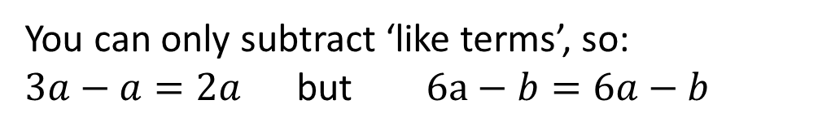
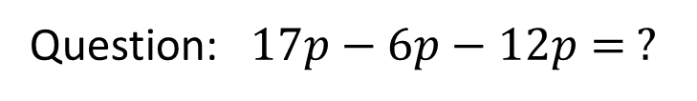
Addition
Subtraction
You can only add ‘like terms’, so:
$a+a=2a$ but $a+b=a+b$
Question: $14x+6y+10x= ?$
You can only subtract ‘like terms’, so:
$3a−a=2a$ but $6a−b=6a−b$
The Four Operations in Algebra
Question: $17p−6p−12p= ?$

Slide 8

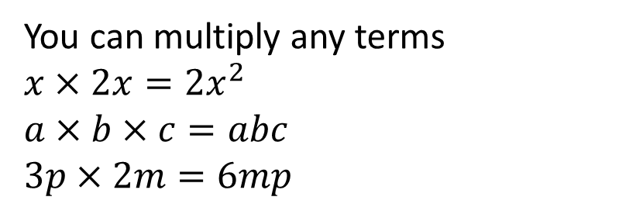
Addition
Subtraction
You can only add ‘like terms’, so:
$a+a=2a$ but $a+b=a+b$
Question: $14x+6y+10x= ?$
You can only subtract ‘like terms’, so:
$3a−a=2a$ but $6a−b=6a−b$
The Four Operations in Algebra
Question: $17p−6p−12p= ?$
Multiplication
You can multiply any terms
$$x×2x=2x^{2}$$
$$a×b×c=abc$$
$$3p×2m=6mp$$
Question: $3t×2n×6n= ?$

Slide 9
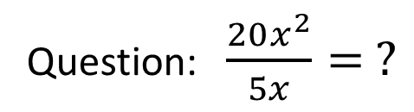

Addition
Subtraction
You can only add ‘like terms’, so:
$a+a=2a$ but $a+b=a+b$
Question: $14x+6y+10x= ?$
You can only subtract ‘like terms’, so:
$3a−a=2a$ but $6a−b=6a−b$
The Four Operations in Algebra
Question: $17p−6p−12p= ?$
Multiplication
Division
You can multiply any terms
$$x×2x=2x^{2}$$
$$a×b×c=abc$$
$$3p×2m=6mp$$
You can divide any terms, fractions are usually used for division in algebra
$x^{3}÷x=x^{2}$ or $\frac{x^{3}}{x}=x^{2}$
$$4x÷2y=\frac{2x}{y}$$
Question: $\frac{20x^{2}}{5x}= ?$
Question: $3t×2n×6n= ?$

Slide 10
Simplifying Expressions – Algebra Pyramids
8x + 6y
6x + 3y
3y + 2x
6x
3y
2x

Slide 11

Simplifying Expressions – Algebra Pyramids
7d + 6e
2d + 3e
3e + 5d
2x + 8y
2d
3e
5d
3x + 4y
4y - x
-2d + 6e
3x
4y
- x
2d + 3e
3e – 4d
2d
3e
-4d

Slide 12
Expanding Brackets
To expand brackets, multiply everything inside the brackets by what is outside them
x
4(a + 6) =
4a
+ 24
x

Slide 13
Expanding Brackets
To expand brackets, multiply everything inside the brackets by what is outside them
x
2(2t + 4)
4t
+ 8
x

Slide 14
Expanding Brackets
To expand brackets, multiply everything inside the brackets by what is outside them
x
5(a – 7)
5a
- 35
x

Slide 15
Find the mistakes:
SPOT THE MISTAKE
1) 3(q + 6) = 3q + 6
2) 9(p + 4) = p + 36
3) 6(y - 5) = 6y – 11
4) 8(w - 3) = w + 24
5) c(c + 4) = c² + 4 + c
Notes:
15

Slide 16



Bronze
Silver
Gold
$2(a+3)$
$3(b+4)$
$4(a−5)$
$2(2a+3)$
$−3(a+2)$
$2(b−3)$
$−4(a+4)$
$−2(b−2)$
$2\left(a+3\right)+3(a+4)$
$3\left(a+4\right)+2(a+2)$
$4\left(b−2\right)+3(b+4)$
$−2\left(a+1\right)−3(a−4)$

Slide 17



Bronze
Silver
Gold
$2a+6$
$3b+12$
$4a−20$
$4a+6$
$−3a−6$
$2b−6$
$−4a−16$
$−2b+4$
$5a+17$
$5a+16$
$7b+4$
$−5a+10$

Slide 18
3(n + 1) = 3n + ?
3

Slide 19
5(n + 2) = ?n + 10
5

Slide 20
10(n + 7) = 10n + ?
70

Slide 21
3(n + 6) = 3n + ?
18

Slide 22
6(-7 + n) = ? + 6n
-42

Slide 23
5(2n + 11) = ?n + 55
10

Slide 24
?(n + 2) = 6n + 12
6

Slide 25
?(4n + 1) = 8n + 2
2

Slide 26
-2(12 + n) = ? – 2n
-24

Slide 27
2(2n + ½) = ?n + 1
4

Slide 28
5n(n + 3) = 5n² + ?n
15

Slide 29
10(n + ½) = 10n + ?
5

Slide 30
7(n - 3) = ?n - 21
7

Slide 31
?(2n + 4) = 18n + 36
9

Slide 32
8(n + 3) = 8n + ?
24

Slide 33









Factorising – Opposite to expanding brackets, you need to put brackets in.
$Factorise the following: 1) 4x+8$ $2) 8x+18$ $3) x^{2}+2x$
$$4(x+2)$$
$$2(4x+9)$$
$$x(x+2)$$
$4) 6x+18$ $5) 25p+5$ $6) m^{2}+4m$
$$6(x+3)$$
$$5(5p+1)$$
m$(m+4)$
$7) 27x+54$ $8) 3n^{2}+15n$ $9) {6m}^{2}+21m$
$$9(3x+6)$$
$$3n(n+5)$$
$$3m(2m+7)$$

Slide 34
Factorise Challenge
$$3p^{2}qr^{3}+9pq^{2}r^{4}−15p^{3}qr$$
$$3pqr(pr^{2}+3qr^{2}−5p^{2})$$

Slide 35
Factorise Challenge
$$8x^{2}y^{3}z^{3}+16x^{5}y^{2}z^{4}−20x^{99}y^{50}z^{2}$$
$$4x^{2}y^{2}z^{2}(2yz+4x^{3}z^{2}−5x^{97}y^{48})$$

Slide 36

Todays Objectives – Have you met them?
Objectives
To be able to apply the basics of algebra.
To be able to expand simple brackets.
To be able to expand multiple brackets.
To be able to factorise.

Slide 37
CODE BREAKING
Y – X =
A + T – B =
N x A =
27 – Z =
C x C =
D x C =
I am found in the sea and on land but I do not walk or swim. I travel by foot but I am toeless. I'm never far from home. What am I?
A
S
N
A
I
L

Slide 38
Suggested Videos
For this lesson
Ordering Numbers: https://www.youtube.com/watch?v=gOmj58JdxL8
Ordering fractions decimals percentages – Corbettmaths
Percentages:
For next lesson
Adding & Subtracting Fractions:
https://www.youtube.com/watch?v=5juto2ze8Lg
Math Antics - Adding and Subtracting Fractions
Working with decimals:
https://www.youtube.com/watch?v=kwh4SD1ToFc
Math Antics - Decimal Arithmetic
BIDMAS:
https://www.youtube.com/watch?v=6K77Igo39vk
GCSE Maths - BIDMAS - Aslam Tutoring

