Slide 1

1-10 Quiz.
$2×2×2×2$
$3×3×3$
$5^{3}$
$6^{2}×5^{2}$
$6^{2}+5^{2}$
$5×5×5=5^{?}$
$6^{3}×2^{3}$
$225=?^{2}$
$243=3^{?}$
$4^{−2}=?$
Notes:
This could also be a YouTube clip, matching exercise, Anything that will engage the learners from the start of the lesson.
TUTOR TO TAKE THE REGISTER DURING THIS TIME. THERE IS NO NEED TO CALL OUT NAMES.

Slide 2
1-10 Quiz.
16
27
125
900
61
3
1728
15
5
1/16
$2×2×2×2$
$3×3×3$
$5^{3}$
$6^{2}×5^{2}$
$6^{2}+5^{2}$
$5×5×5=5^{?}$
$6^{3}×2^{3}$
$225=?^{2}$
$243=3^{?}$
$4^{−2}=?$
Notes:
This could also be a YouTube clip, matching exercise, Anything that will engage the learners from the start of the lesson.
TUTOR TO TAKE THE REGISTER DURING THIS TIME. THERE IS NO NEED TO CALL OUT NAMES.

Slide 3
Title: Laws of Indices
Objectives
To know the Three main Laws of Indices.
To be able to understand Negative Indices.

Slide 4
INDICES
Indices is the mathematical term for ‘power’
Indices is the plural term for ‘index’
5⁴
Indices apply only to the base to the left of it!
The index (power)
The base number

Slide 5
INDICES
What does 4² actually mean?
4 x 4
16

Slide 6
INDICES
What does 4⁵ actually mean?
4 x 4 x 4 x 4 x 4
1024

Slide 7
INDICES
How can we write 5 x 5 x 5 x 5?
This is now written in INDEX FORM
5⁴

Slide 8
INDICES
Write the following in index form
CAUTIOUS
3 x 3 x 3
8 x 8 x 8 x 8
4 x 4
2 x 2 x 2 x 2 x 2
4 x 4 x 4
CONFIDENT
5 x 5
7 x 7 x 7
4 x 4 x 4 x 4
9 x 9 x 9
18 x 18 x 18
SUPER CONFIDENT
3
7 x 7 x 7 ÷ 7
8 ÷ 8
0
Challenge!
Do you think it matters whether the base number is always the same? Can you put a number into index form by multiplying different numbers together? Try it out!

Slide 9
INDICES
Write the following in index form
CAUTIOUS
3³
8⁴
4²
2⁵
4³
CONFIDENT
5²
7³
4⁴
9³
18³
SUPER CONFIDENT
3¹
7²
8⁰
0
Challenge!
Do you think it matters whether the base number is always the same? Can you put a number in index form by multiplying different numbers together? Try it out!

Slide 10
Multiplying Indices
Example 1…
Simplify 8³ x 8⁴
= 8x8x8 x 8x8x8x8
= 8⁷
Example 2…
Simplify 5² x 5⁴
= 5x5 x 5x5x5x5
= 5⁶
This only works for numbers with the same base number!

Slide 11
Multiplying Indices
8³ x 8⁴ = 8⁷
5² x 5⁴ = 5⁶
Is there a quick way?
ADD THE POWERS!

Slide 12
Am I Correct?
NO
5⁶ x 6⁵ = 30¹¹
5⁶ x 5⁵ = 5³⁰
5⁶ x 5⁵ = 5¹¹
NO
YES

Slide 13
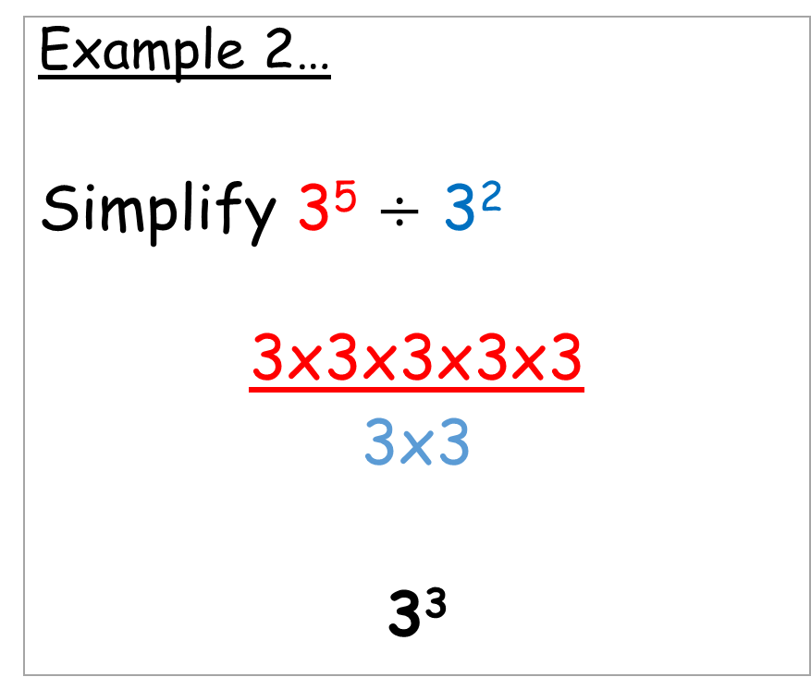
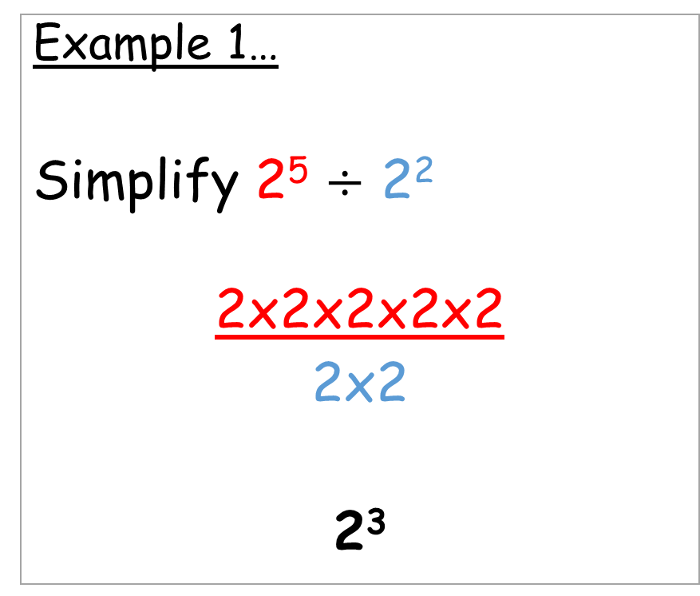
Dividing Indices
Example 1…
Simplify 2⁵ $÷$ 2²
2x2x2x2x2
2x2
2³
Example 2…
Simplify 3⁵ $÷$ 3²
3x3x3x3x3
3x3
3³
This only works for numbers with the same base number!

Slide 14
Dividing Indices
2⁵ ÷ 2² = 2³
3⁵ ÷ 3² = 3³
Is there a quick way?
SUBTRACT THE POWERS!

Slide 15
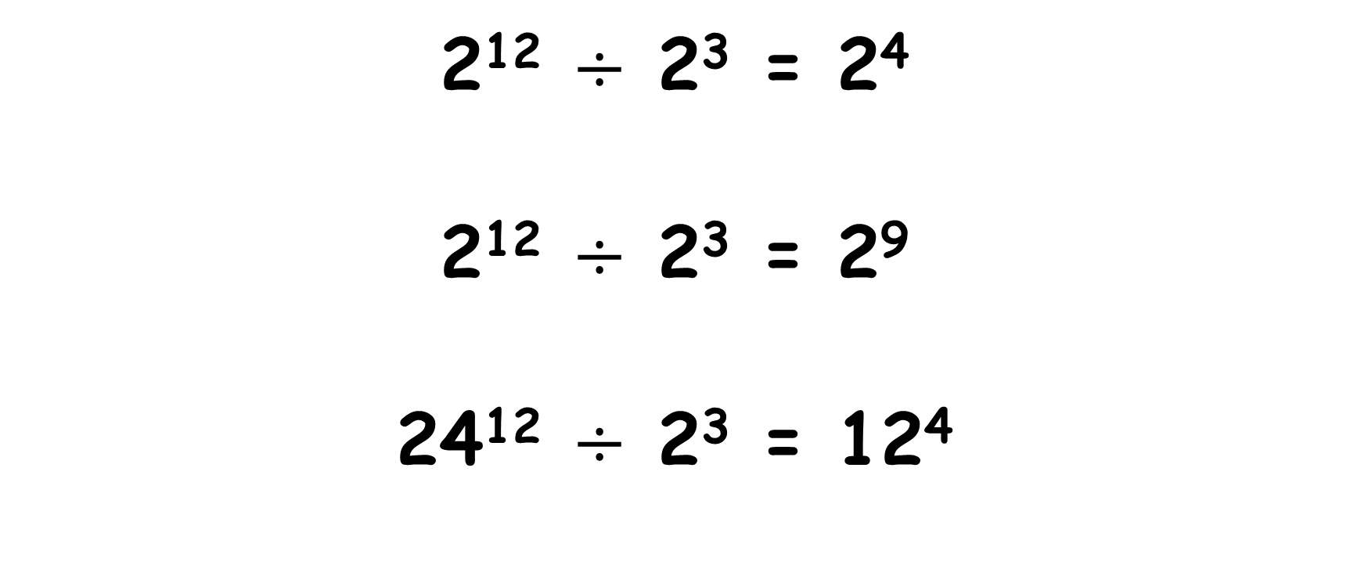
Am I Correct?
NO
2¹² $÷$ 2³ = 2⁴
2¹² $÷$ 2³ = 2⁹
24¹² $÷$ 2³ = 12⁴
YES
NO

Slide 16
Indices in Brackets
Example 1…
Simplify (3⁵)³
3⁵ x 3⁵ x 3⁵
3¹⁵
Example 2…
Simplify (a³)³
a³ x a³ x a³
a⁹
This only works for numbers with the same base number!

Slide 17
Indices in Brackets
(3⁵)³
(a³)³
Is there a quick way?
MULTIPLY THE POWERS!

Slide 18
Am I Correct?
(4²)³ = 4⁵
(4²)³ = 4⁶
(4²)³ = 64⁶
NO
YES
NO

Slide 19

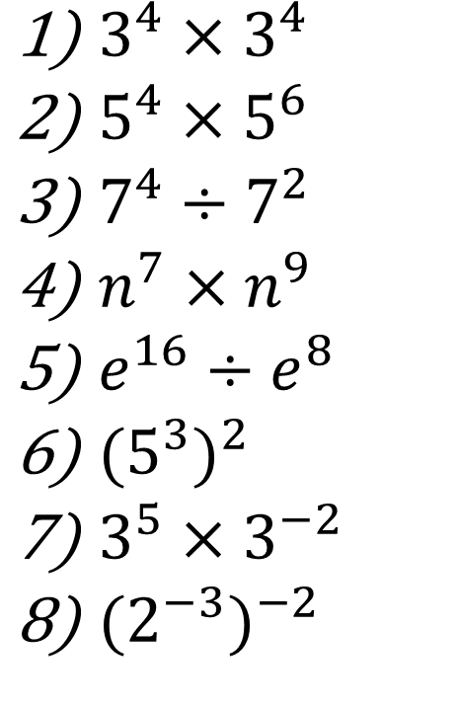
Quick Questions!
$3^{4}×3^{4}$
$5^{4}×5^{6}$
$7^{4}÷7^{2}$
$n^{7}×n^{9}$
$e^{16}÷e^{8}$
${{(5}^{3})}^{2}$
$3^{5}×3^{−2}$
${{(2}^{−3})}^{−2}$
$3^{8}$
$5^{10}$
$7^{2}$
$n^{16}$
$e^{8}$
$5^{6}$
$3^{3}$
$2^{6}$

Slide 20
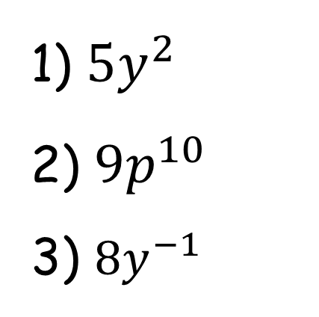
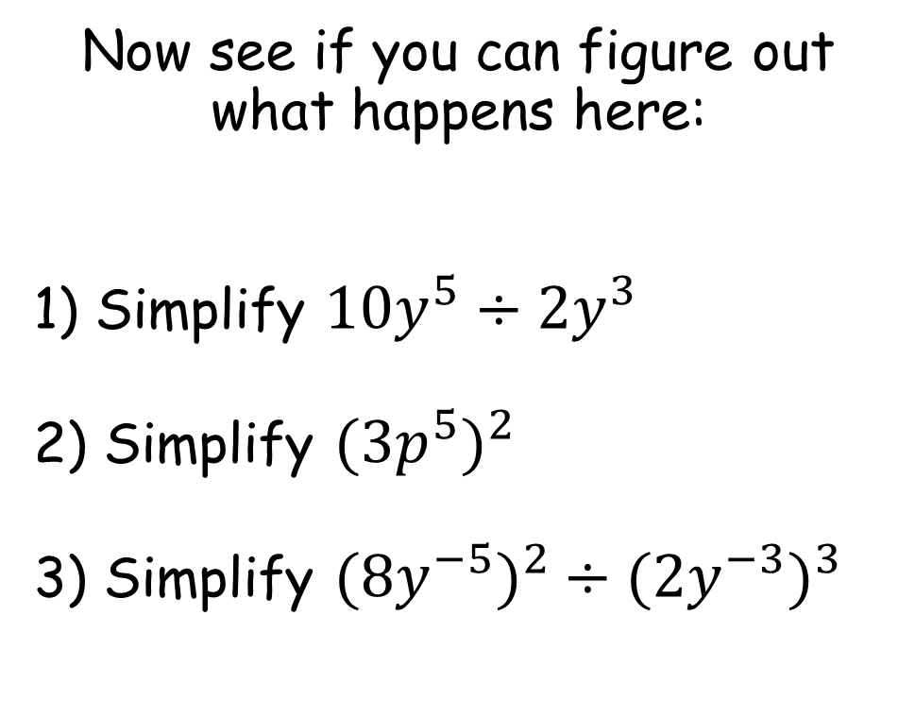
Now see if you can figure out what happens here:
1) Simplify ${10y}^{5}÷{2y}^{3}$
2) Simplify ${{(3p}^{5})}^{2}$
3) Simplify ${{(8y}^{−5})}^{2}÷{{(2y}^{−3})}^{3}$
1) ${5y}^{2}$
2) ${9p}^{10}$
3) ${8y}^{−1}$

Slide 21
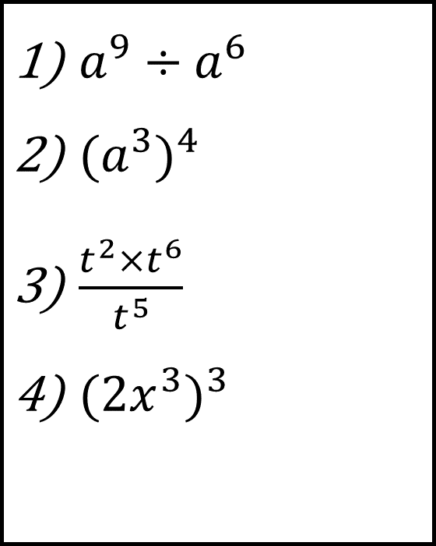
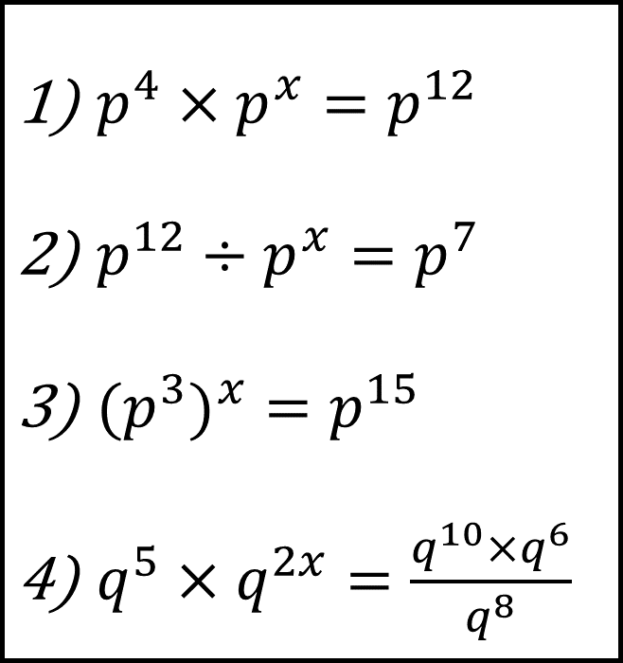
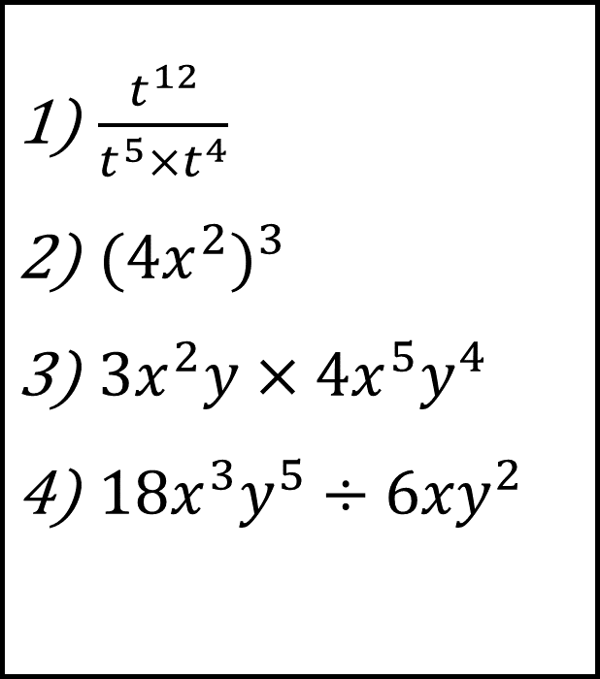
Bronze
Silver
Gold
$a^{9}÷a^{6}$
${{(a}^{3})}^{4}$
$\frac{t^{2}×t^{6}}{t^{5}}$
${{(2x}^{3})}^{3}$
$\frac{t^{12}}{t^{5}×t^{4}}$
${{(4x}^{2})}^{3}$
${3x}^{2}y×{4x}^{5}y^{4}$
${18x}^{3}y^{5}÷{6xy}^{2}$
$p^{4}×p^{x}=p^{12}$
$p^{12}÷p^{x}=p^{7}$
${{(p}^{3})}^{x}=p^{15}$
$q^{5}×q^{2x}=\frac{q^{10}×q^{6}}{q^{8}}$

Slide 22
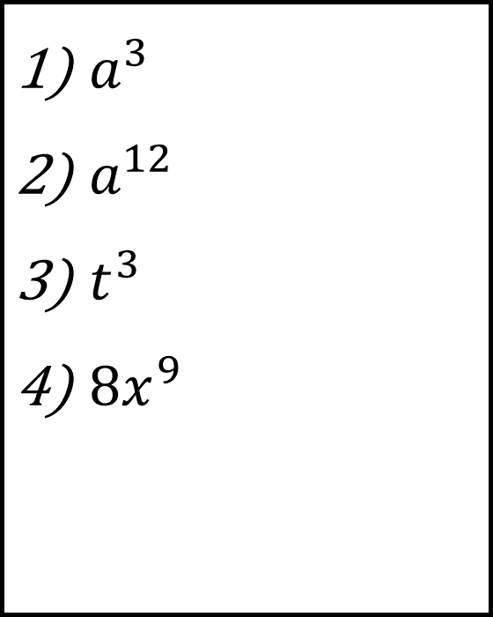
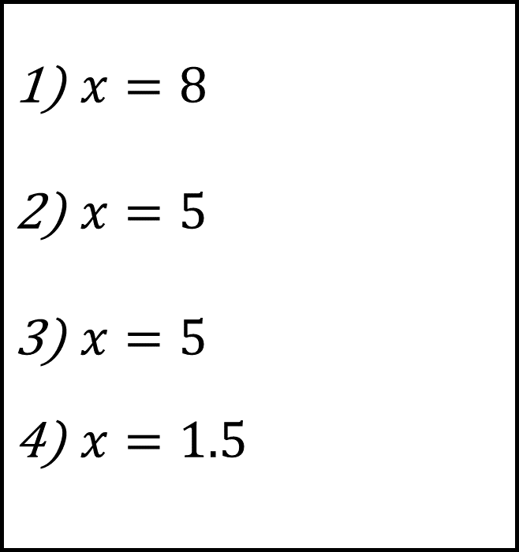
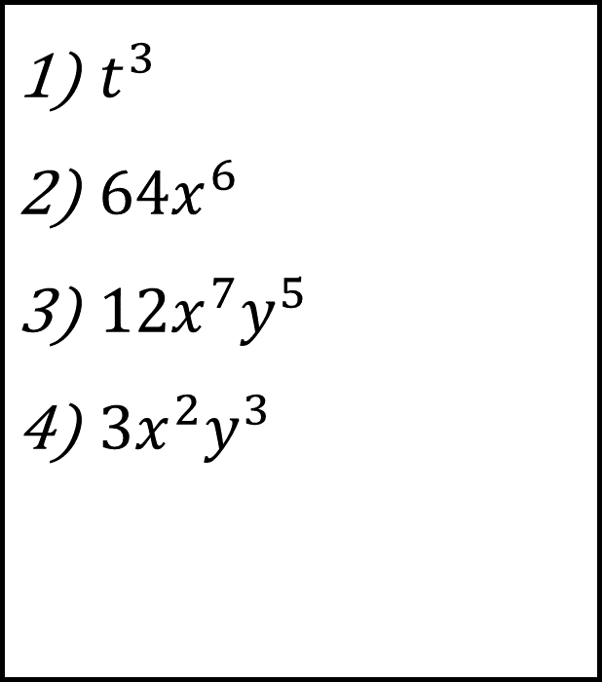
Bronze
Silver
Gold
$a^{3}$
$a^{12}$
$t^{3}$
${8x}^{9}$
$t^{3}$
${64x}^{6}$
${12x}^{7}y^{5}$
${3x}^{2}y^{3}$
$x=8$
$x=5$
$x=5$
$x=1.5$

Slide 23

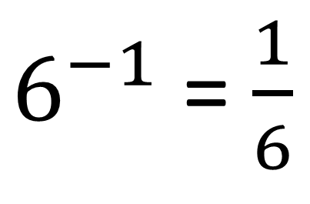


What happens when we have negative indices?
Discussion
Point
$6^{−1}$ = $\frac{1}{6}$
$3^{−3}$ = $\frac{1}{27}$
Can you
write your
own rule?
$4^{−2}$ = $\frac{1}{16}$
$2^{−4}$ = $\frac{1}{16}$

Slide 24
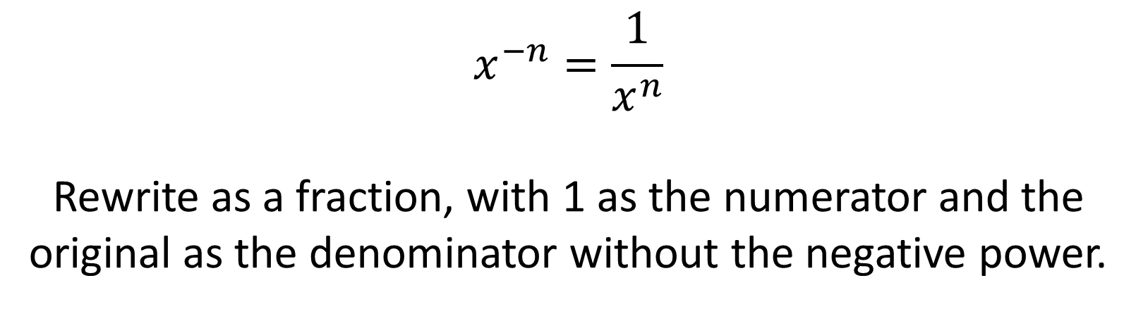
$$x^{−n}=\frac{1}{x^{n}}$$
Rewrite as a fraction, with 1 as the numerator and the original as the denominator without the negative power.

Slide 25
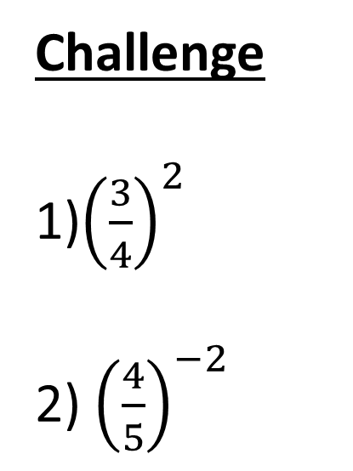
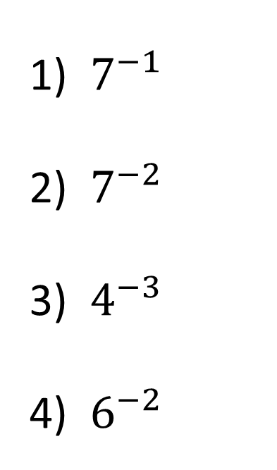



Your Turn
$\frac{1}{7}$
$\frac{1}{49}$
$\frac{1}{64}$
$\frac{1}{36}$
$7^{−1}$
${ 7}^{−2}$
${ 4}^{−3}$
${ 6}^{−2}$
Challenge
1)${\left(\frac{3}{4}\right)}^{2}$
2) ${\left(\frac{4}{5}\right)}^{−2}$
$$\frac{9}{16}$$
$$\frac{25}{16}$$

Slide 26

Todays Objectives – Have you met them?
Objectives
To know the Three main Laws of Indices.
To be able to understand Negative Indices.

Slide 27
Suggested Videos
For this lesson
Ordering Numbers: https://www.youtube.com/watch?v=gOmj58JdxL8
Ordering fractions decimals percentages – Corbettmaths
Percentages:
For next lesson
Adding & Subtracting Fractions:
https://www.youtube.com/watch?v=5juto2ze8Lg
Math Antics - Adding and Subtracting Fractions
Working with decimals:
https://www.youtube.com/watch?v=kwh4SD1ToFc
Math Antics - Decimal Arithmetic
BIDMAS:
https://www.youtube.com/watch?v=6K77Igo39vk
GCSE Maths - BIDMAS - Aslam Tutoring

