Slide 1
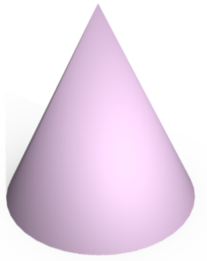
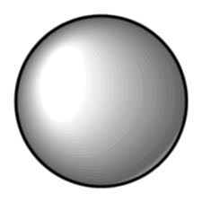
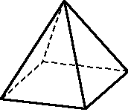
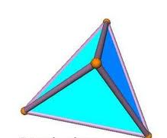
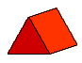
To start
Name the following 3D shapes
How many vertices, edges and faces does each shape have?
D
A
B
C
E
F
G
H

Slide 2
Activity One
Key words:
Face, Edge, Vertex
For each of the shapes from the starter, write down how many 1) faces, 2) edges and 3) vertices each 3D shape has.
D
A
B
C
CUBE
SPHERE
CYLINDER
CONE
E
F
G
H
TRIANGULAR PRISM
SQUARE-BASED PYRAMID
TETRAHEDRON
CUBOID

Slide 3
Title: Surface Area, Nets, Plans & Elevations
Objectives
To be able to find the Surface Area of simple 3D shapes.
To be able to interpret Nets.
To be able to interpret Plans & Elevations.

Slide 4
Surface area of a cuboid
To find the surface area of a shape, we calculate the total area of all of the faces.
A cuboid has 6 faces.
The top and the bottom of the cuboid have the same area.
Notes:
Discuss the meaning of surface area. The important thing to remember is that although surface area is found for three-dimensional shapes, it only has two dimensions. It is therefore measured in square units.

Slide 5
Surface area of a cuboid
To find the surface area of a shape, we calculate the total area of all of the faces.
A cuboid has 6 faces.
The front and the back of the cuboid have the same area.

Slide 6
Surface area of a cuboid
To find the surface area of a shape, we calculate the total area of all of the faces.
A cuboid has 6 faces.
The left hand side and the right hand side of the cuboid have the same area.

Slide 7
Surface area of a cuboid
To find the surface area of a shape, we calculate the total area of all of the faces.
Can you work out the surface area of this cuboid?
5 cm
8 cm
The area of the top = 8 × 5
= 40 cm²
7 cm
The area of the front = 7 × 5
= 35 cm²
The area of the side = 7 × 8
= 56 cm²

Slide 8
Surface area of a cuboid
To find the surface area of a shape, we calculate the total area of all of the faces.
5 cm
So the total surface area =
8 cm
2 × 40 cm²
Top and bottom
7 cm
+ 2 × 35 cm²
Front and back
+ 2 × 56 cm²
Left and right side
= 80 + 70 + 112 = 262 cm²
Notes:
Stress the importance of working systematically when finding the surface area to ensure that no faces have been left out.
We can also work out the surface area of a cuboid by drawing its net (see slide 51). This may be easier for some pupils because they would be able to see every face rather than visualizing it.

Slide 9
Surface Area
Each face is the same – a square.
Area A = 5 x 5
= 25cm²
Total Surface Area = 6 x 25
= 150cm²
5cm
A
5cm
5cm

Slide 10
Surface Area
Surface area is the total area of the outside of a 3D object
Area A = 5 x 9
= 45cm²
Area B = 9 x 3
= 27cm²
Area C = 3 x 5
= 15cm²
Total Surface Area = (45 + 27 + 15) x 2
= 174cm²
B
C
A
5cm
3cm
9cm

Slide 11
Surface Area
Area A = 8 x 11
= 88cm²
Area B = 5 x 11
= 55cm²
Area C = 5 x 8
= 40cm²
TOTAL SURFACE AREA
= (88 + 55 + 40) x 2
= 183 x 2
= 366cm²
C
B
11cm
A
5cm
8cm

Slide 12
1.
B
B
2.
2cm
C
C
5cm
A
A
2cm
4cm
150cm²
40cm²
5cm
5cm
3.
B
4.
B
A
C
7m
C
6cm
A
2m
3m
5cm
82cm²
10cm
280cm²

Slide 13
Find the total surface area.
Area of Triangles = ½ x 3 x 6
= 9m²
= 9 x 2
= 18m²
Area of Rectangle 1 = 10 x 6
= 60m²
Area of Rectangle 2 = 7 x 10
= 70m²
Area of Rectangle 3 = 3 x 10
= 30m²
Total Surface Area = 18+ 60 + 70 + 30
= 178m²
7cm
10cm
3cm
6cm

Slide 14
Quick Check
This is the volume.
1) 60cm²
1
You have not multiplied by 2.
2) 52cm²
2cm
6cm
Wrong units.
3) 104cm³
5cm
You have missed some faces.
4) 80cm²
104cm²
Other

Slide 15
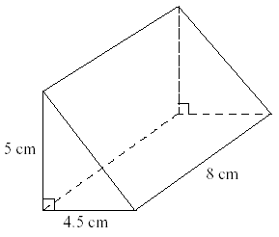
Calculate the Surface Area
1
2
7cm
3
9cm
3cm
7cm
2cm
6cm
5cm
5cm
4cm
12cm
4
5
10cm
6
13cm
5cm
8cm
4cm
12cm
12cm
8cm
8cm
7
3cm
6cm
5cm
Toblerone are making a new family sized bar.
Each piece is an equilateral triangle, and will have the following dimensions:
The bar will consist of 12 equal pieces.
What will the total surface area of the wrapper need to be?
4cm
1cm
4cm

Slide 16
Calculate the Surface Area
1
2
7cm
3
104cm²
142cm²
510cm²
9cm
3cm
7cm
2cm
6cm
5cm
5cm
4cm
12cm
4
5
10cm
6
336cm²
13cm
108cm²
300cm²
5cm
8cm
4cm
12cm
12cm
8cm
8cm
7
3cm
6cm
5cm
Toblerone are making a new family sized bar.
Each piece is an equilateral triangle, and will have the following dimensions:
The bar will consist of 12 equal pieces.
What will the total surface area of the wrapper need to be?
4cm
160cm²
1cm
4cm

Slide 17
A length of copper piping is in the shape of a triangular prism. The triangle on it’s end is a right angle, 9mm by 4mm by 10mm. The piece of pipe is 18cm long. What is the surface area of the pipe?
Area of Triangles = (9 x 4) ÷ 2
= 18mm²
= 18 x 2
= 36mm²
10mm
9mm
Front Rectangle = 180 x 10
= 1800mm²
180mm
4mm
Back Rectangle = 180 x 9
= 1620mm²
Total Surface Area = 36 + 1800 + 1620 + 720
= 4176mm²
Base Rectangle = 180 x 4
= 720mm²

Slide 18
No. | Name | Faces | Edges | Vertices
1 | Cube | 6 | 12 | 8
2 | Cuboid | 6 | 12 | 8
3 | Sphere | 1 | 0 | 0
4 | Cylinder | 3 | 2 | 0
5 | Cone | 2 | 1 | 1
6 | Square-Based Pyramid | 5 | 8 | 5
7 | Triangular-Based Pyramid | 4 | 6 | 4
8 | Triangular Prism | 5 | 9 | 6
9 | Trapezoidal Prism | 6 | 12 | 8
10 | Hexagonal Prism | 8 | 18 | 12
11 | Irregular Quadrilateral Prism | 6 | 12 | 8
12 | Irregular Quadrilateral Prism | 6 | 12 | 8

Slide 19
Nets
A net shows what a 3D solid could look like if ‘unfolded’ and laid out flat
Can you name the 3D solids with these nets?
Square-based pyramid
Cylinder
Triangular prism
Cube

Slide 20
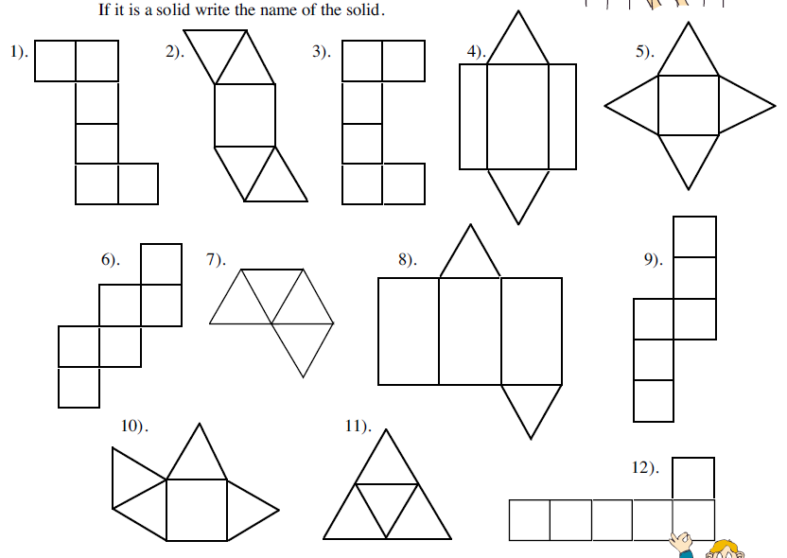
Starter
Which of these nets would form a 3D shape?

Slide 21

Starter
Which of these nets would form a 3D shape?

Slide 22
Drawing nets
3cm
2cm
6cm
You then need to draw the two ends of the cuboid. These are 2cm by 3cm
DON’T FORGET THE TOP! The top is the same as the bottom – 2cm by 6cm
First draw the base. This is 2 cm by 6cm.
Next draw the side of the shape. The sides are 3cm by 6cm.

Slide 23
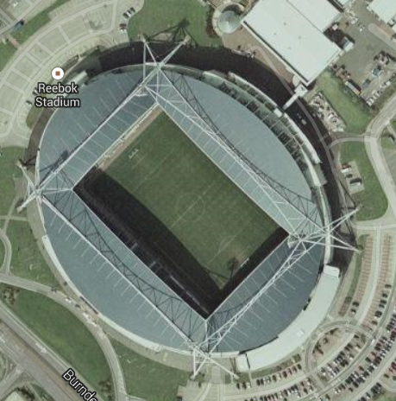
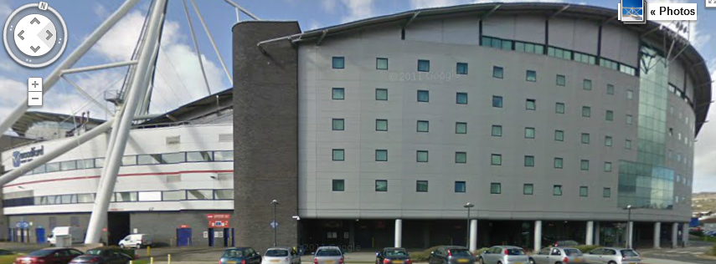
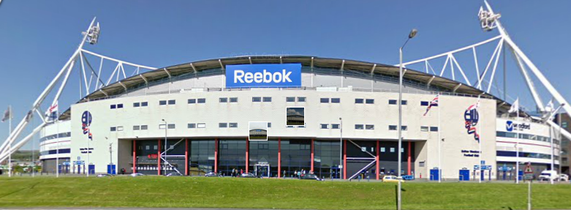
Reebok Stadium
Plan view
(The view from above)
Side elevation
(The view from the side)
How would you describe these views of the Reebok Stadium?
Front elevation
(The view from the front)

Slide 24
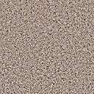



Plans and Elevations
Discuss the following views of the model church
(possible) Side Elevation (Left)
3
Plan
4
2
Front Elevation
Side Elevation (Right)
1

Slide 25
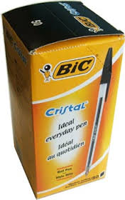
8cm
8cm
Try to accurately draw the following:
The plan view
The side elevation
The front elevation
of the pen box.
Side
15cm
Front

Slide 26
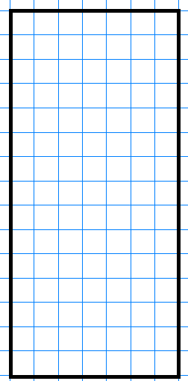
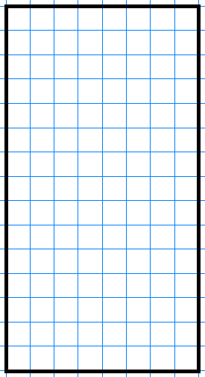
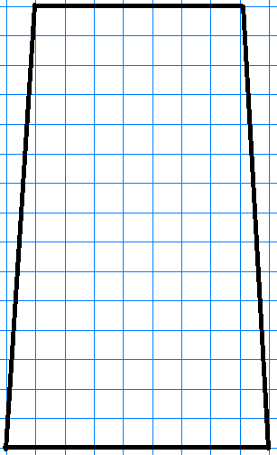
Quick check
What's wrong with the other ones?
Which one is the side view for the pen box:
1
2
3

Slide 27
Cubes
Plan View
Plans and Elevations
1
Decide which of the views below is either a plan, front elevation or side elevation of the object shown.
Side Elevation
Front Elevation
A
B
C
Plan
Front Elevation
Side Elevation

Slide 28
Plan View
Plans and Elevations
2
Decide which of the views below is either a plan, front elevation or side elevation of the object shown.
Side Elevation
Front Elevation
A
B
C
Front Elevation
Plan
Side Elevation

Slide 29
Plan View
Plans and Elevations
3
Decide which of the views below is either a plan, front elevation or side elevation of the object shown.
Side Elevation
Front Elevation
A
B
C
Side Elevation
Front Elevation
Plan

Slide 30
Plan View
Plans and Elevations
4
Decide which of the views below is either a plan, front elevation or side elevation of the object shown.
Side Elevation
Front Elevation
A
B
C
Front Elevation
Side Elevation
Plan

Slide 31
Plan View
Plans and Elevations
5
Decide which of the views below is either a plan, front elevation or side elevation of the object shown.
Front Elevation
Side Elevation
A
B
C
Side Elevation
Front Elevation
Plan

Slide 32
Prisms
Plan View
Plans and Elevations
Decide which of the views below is either a plan, front elevation or side elevation of the object shown.
Side Elevation
Front Elevation
C
A
B
Front Elevation
Side Elevation
Plan

Slide 33
Plan View
Plans and Elevations
Decide which of the views below is either a plan, front elevation or side elevation of the object shown.
Side Elevation
Front Elevation
B
A
C
Side Elevation
Plan
Front Elevation

Slide 34
Plan View
Plans and Elevations
Decide which of the views below is either a plan, front elevation or side elevation of the object shown.
Side Elevation
C
Front Elevation
A
B
Side Elevation
Front Elevation
Plan

Slide 35
Plan View
Plans and Elevations
Decide which of the views below is either a plan, front elevation or side elevation of the object shown.
Side Elevation
Front Elevation
B
C
A
Plan
Side Elevation
Front Elevation

Slide 36
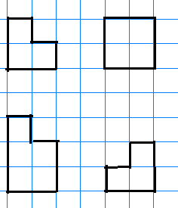
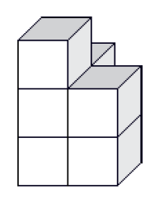
Quick check
Match the correct plan view to my shape
1)
3)
2)
4)

Slide 37
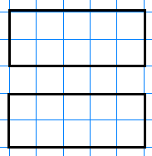
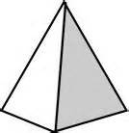
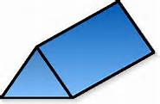
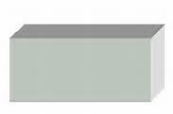

Quick check
Which shape matches my plan and elevations?
Plan View
1)
2)
Side elevation
3)
Front elevation

Slide 38
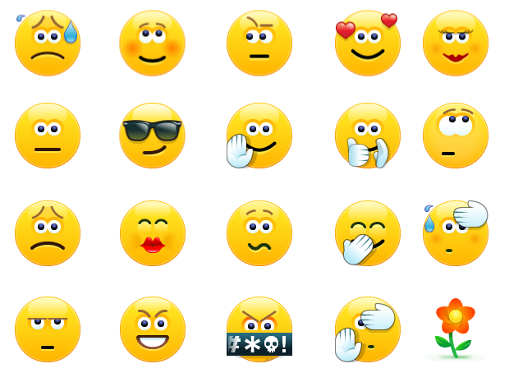
Todays Objectives – Have you met them?
Objectives
To be able to find the Surface Area of simple 3D shapes.
To be able to interpret Nets.
To be able to interpret Plans & Elevations.

Slide 39
Suggested Videos
For this lesson
https://www.youtube.com/watch?v=ZJ-VMcbLTaU
Surface Area and Volume
https://www.youtube.com/watch?v=JJ0VGIzwXUU
Nets
https://www.youtube.com/watch?v=BnwoipoGWJ8
Plans and Elevations
For next lesson
https://www.youtube.com/watch?v=WDRhdtR96E0
Currency conversions
https://www.youtube.com/watch?v=rMZI-ZrGoJE
Multiplying and dividing decimals

