Slide 1
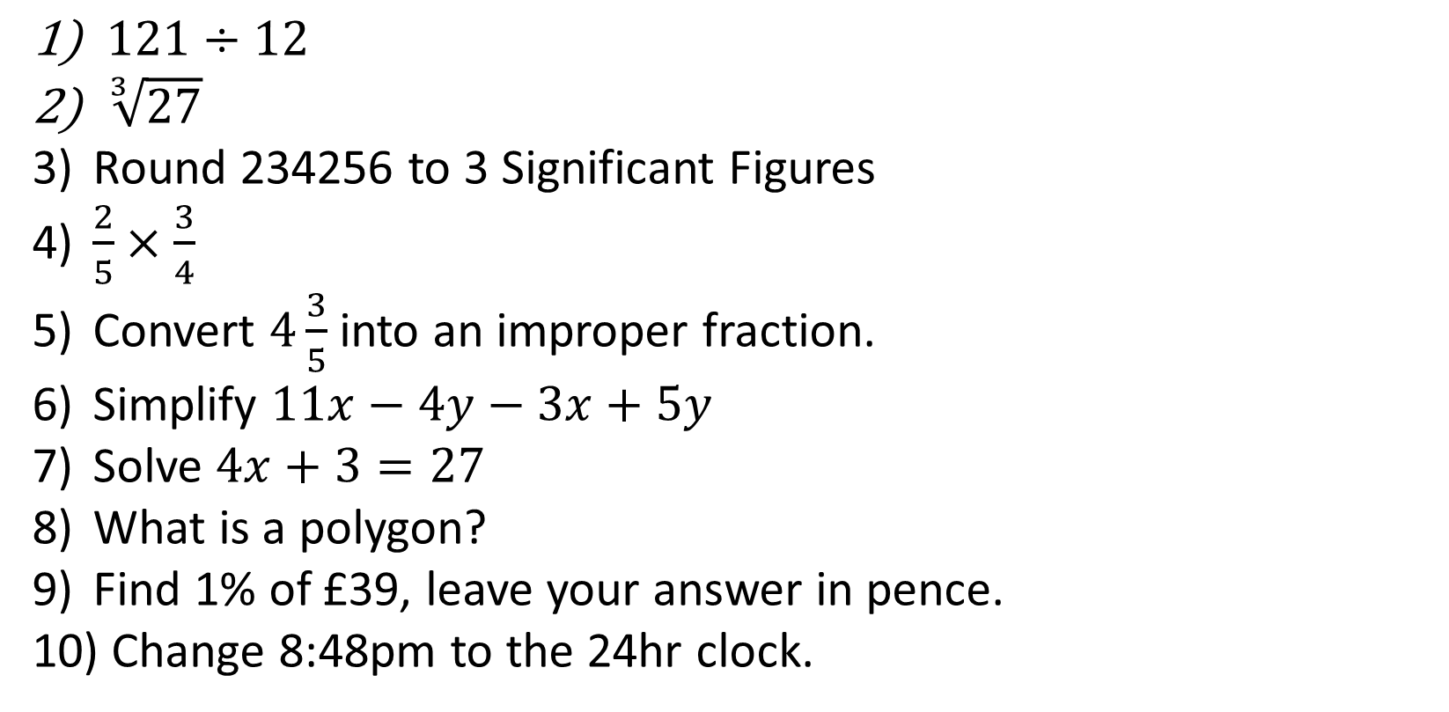
1-10 Quiz.
$121÷12$
$\sqrt[3]{27}$
Round 234256 to 3 Significant Figures
$\frac{2}{5}×\frac{3}{4}$
Convert $4\frac{3}{5}$ into an improper fraction.
Simplify $11x−4y−3x+5y$
Solve $4x+3=27$
What is a polygon?
Find 1% of £39, leave your answer in pence.
Change 8:48pm to the 24hr clock.
Notes:
This could also be a YouTube clip, matching exercise, Anything that will engage the learners from the start of the lesson.
TUTOR TO TAKE THE REGISTER DURING THIS TIME. THERE IS NO NEED TO CALL OUT NAMES.

Slide 2
1-10 Quiz.
$121÷12$
$\sqrt[3]{27}$
Round 234256 to 3 Significant Figures
$\frac{2}{5}×\frac{3}{4}$
Convert $4\frac{3}{5}$ into an improper fraction.
Simplify $11x−4y−3x+5y$
Solve $4x+3=27$
What is a polygon?
Find 1% of £39, leave your answer in pence.
Change 8:48pm to the 24hr clock.
11
3
234000
3/10
23/5
8x+y
X = 6
Multi straight sided shape
39p
20:48
Notes:
This could also be a YouTube clip, matching exercise, Anything that will engage the learners from the start of the lesson.
TUTOR TO TAKE THE REGISTER DURING THIS TIME. THERE IS NO NEED TO CALL OUT NAMES.

Slide 3
Title: FDPs Summary
Objectives
To be able to order numbers, decimals and fractions.
To be able to convert between Mixed Numbers & Improper Fractions.
To be able to express a fraction as a percentage.
To be able to increase & decrease by a percentage.

Slide 4
Fractions | Decimals | Percentages
31/100
 | 0.38
 |  | 35%
 | 0.2
17/25
 |  | 90%
13/40
 | 0.125
49/60
2/3
Why are these not out of 100?

Slide 5
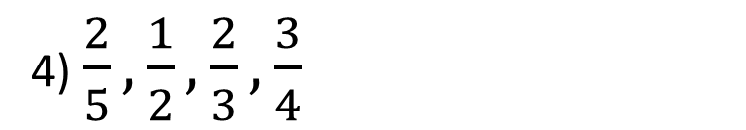
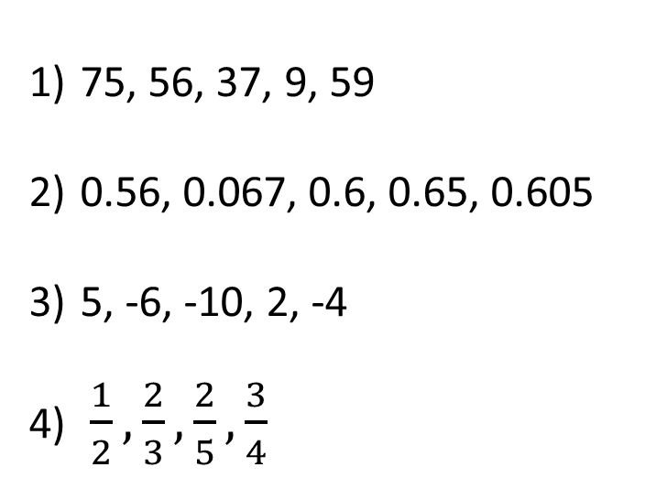
Ordering Numbers, Decimals & Fractions
Have a try at ordering these, smallest to largest, let’s see what you already know!
75, 56, 37, 9, 59
0.56, 0.067, 0.6, 0.65, 0.605
5, -6, -10, 2, -4
$\frac{1}{2},\frac{2}{3},\frac{2}{5},\frac{3}{4}$
9, 37, 56, 59, 75
2) 0.56, 0.067, 0.6, 0.65, 0.605
3) -10, -6, -4, 2, 5
4) $\frac{2}{5}, \frac{1}{2},\frac{2}{3},\frac{3}{4}$

Slide 6
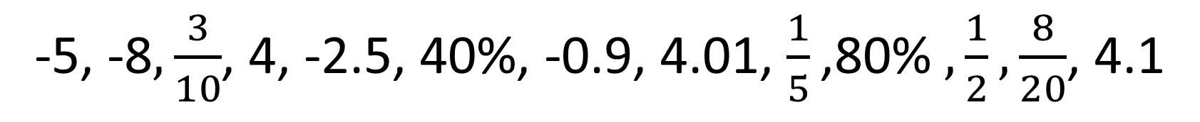
Order these numbers in ascending order:
Hints
-5, -8$, \frac{3}{10}$, 4, -2.5, 40%, -0.9, 4.01, $\frac{1}{5}\text{,8}\text{0\% }, \frac{1}{2}, \frac{8}{20}$, 4.1
Negatives are always small
Try lining up the decimals.
Convert the fractions.
Notes:
Easiest to use your own whiteboard at this stage I think.

Slide 7
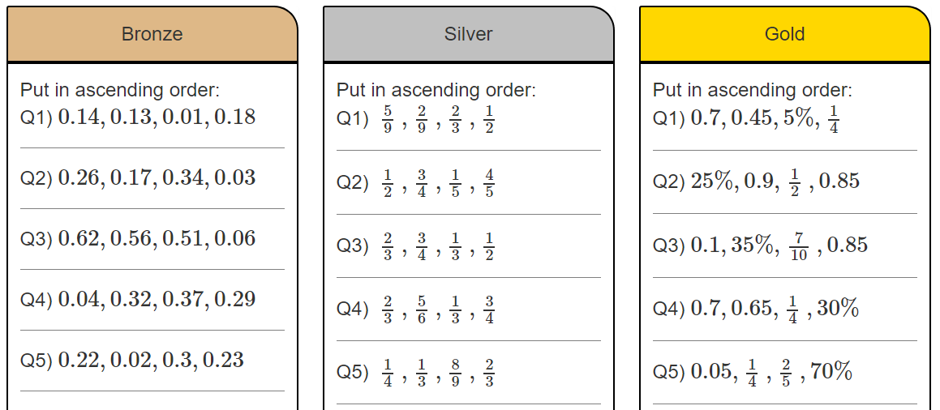

Slide 8
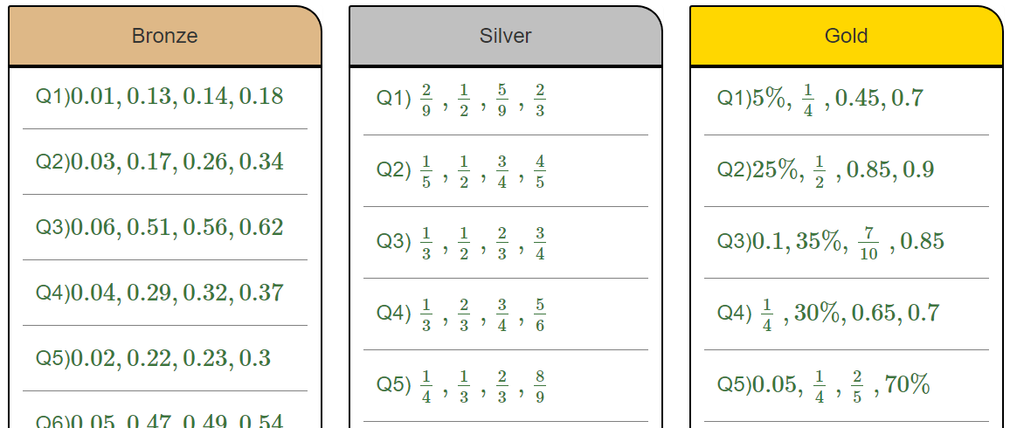

Slide 9
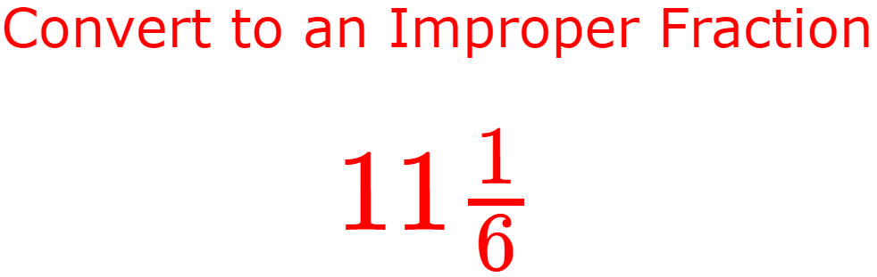
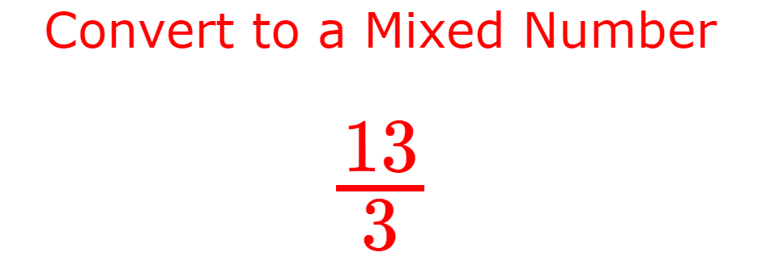
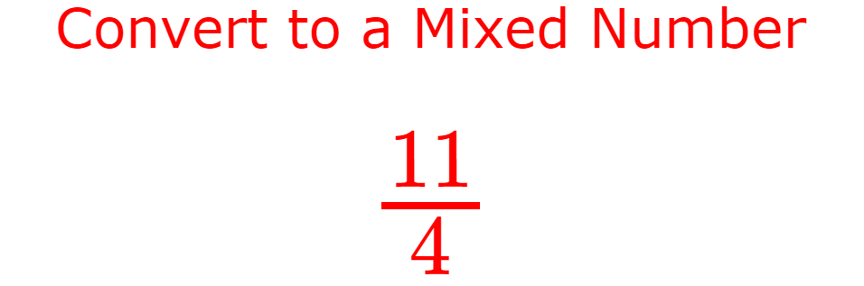
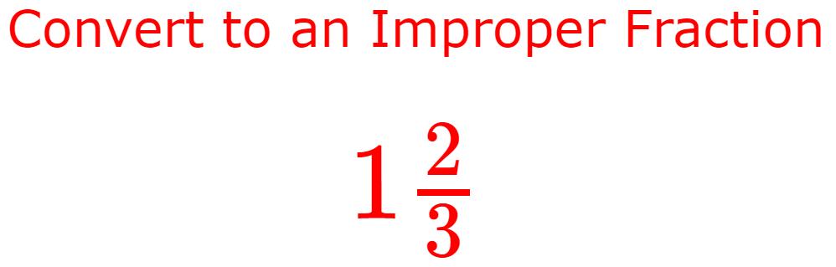
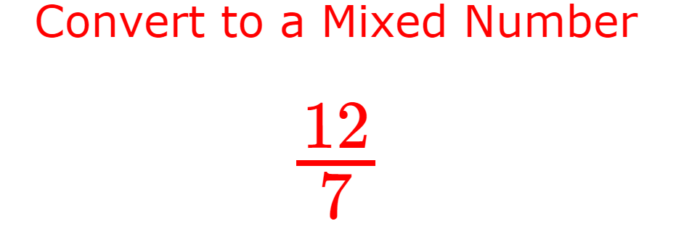
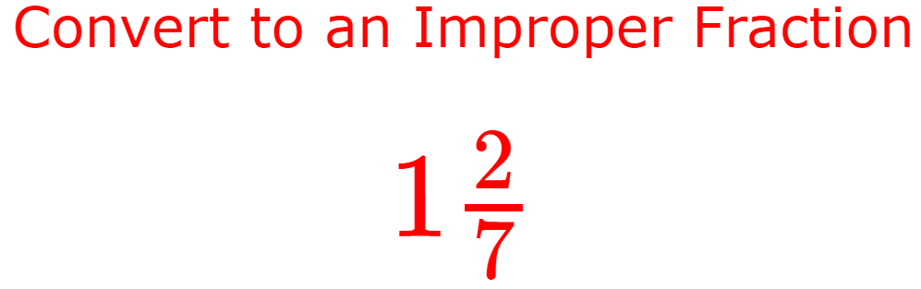
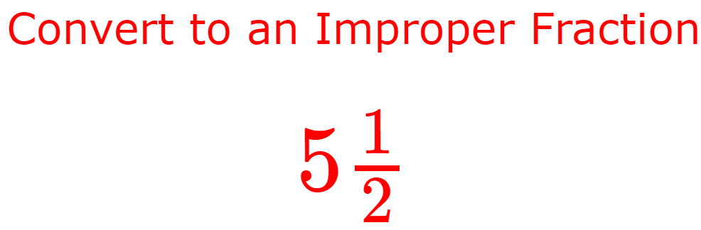
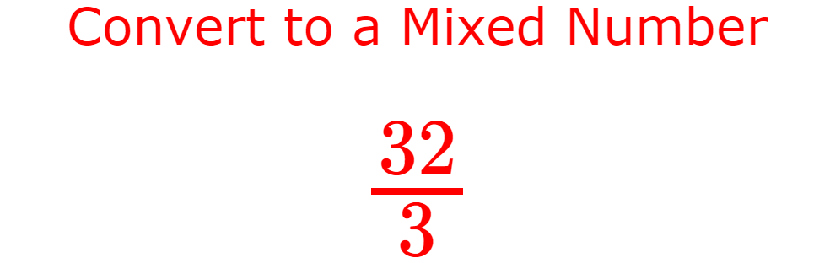
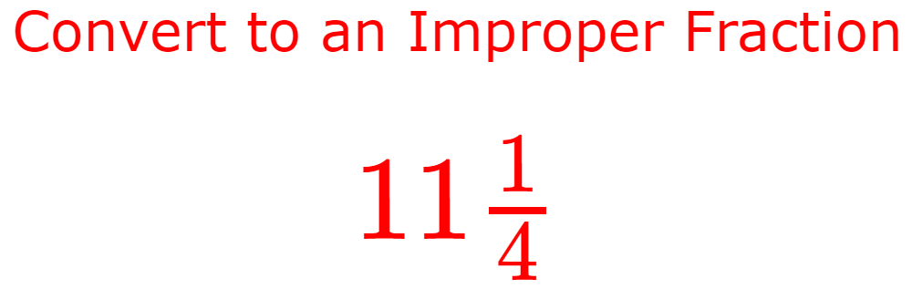
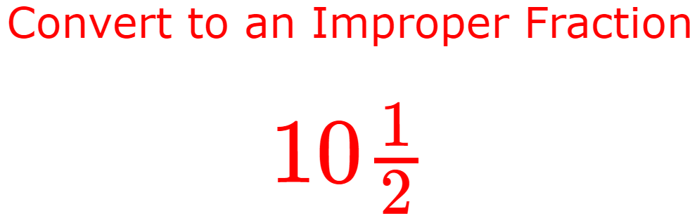
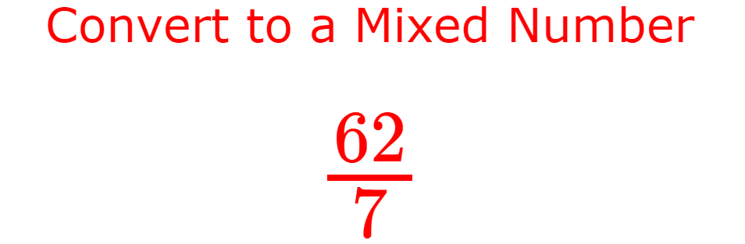
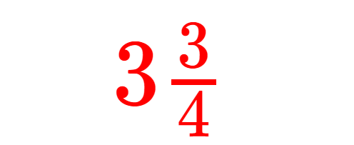
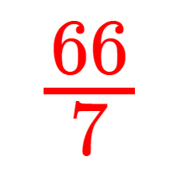
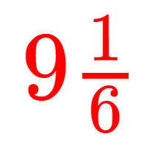
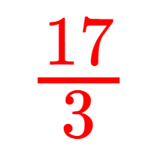
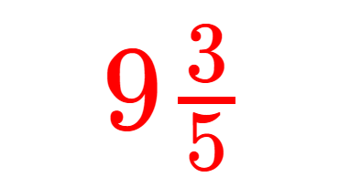

Slide 10
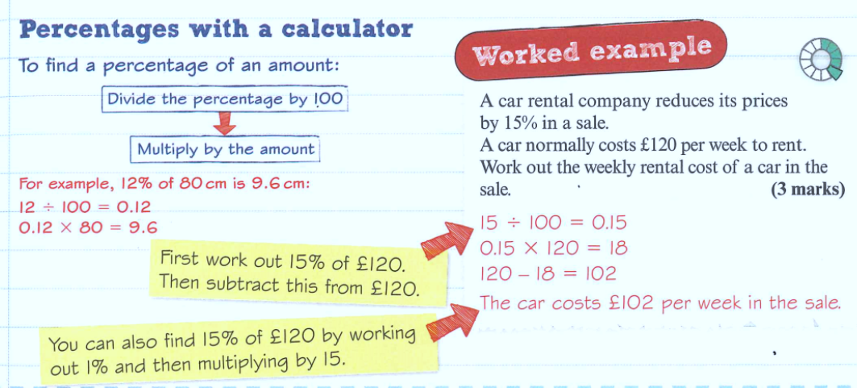

Slide 11
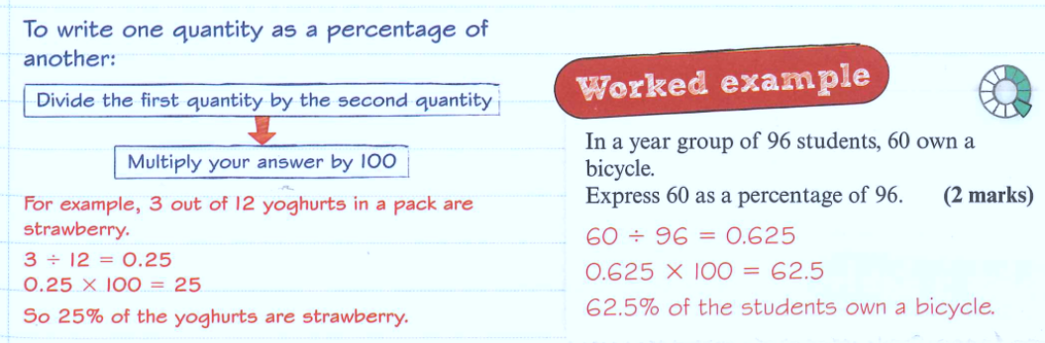

Slide 12
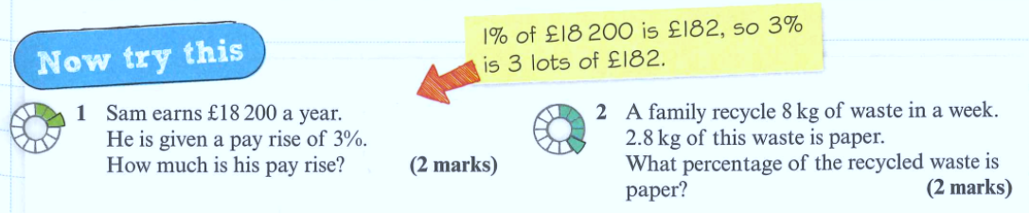

Slide 13
Percentage increase
The value of Frank’s house has gone up by 20% in the last year. If the house was worth £150 000 one year ago, how much is it worth now?
Find the result in a single calculation.
The original amount is 100%:
100%
20%
Now we add 20%
We now have 120%
120 x 150 000
100
= £180 000
Or written slightly quicker: $1.2×150000=£180000$

Slide 14
Percentage decrease
Bluetooth speakers originally costing £75 are reduced by 30% in a sale. What is the sale price?
The original amount is 100% like this:
70%
100%
30%
Now we subtract 30%
We now have 70% of the original amount.
70 x 75
100
= £52.50
Or written slightly quicker: $0.7×75=£52.50$

Slide 15
Show your working in your book:
Increase 50 by 40%
Decrease 75 by 20%
Increase 45 by 63%
Decrease 67 by 37%
Decrease 82 by 14%
Increase 136 by 24%
Decrease 49 by 19%
Increase 88 by 56%
= 70
= 60
= 73.35
= 42.21
= 70.52
= 168.64
= 39.69
= 137.28
= 140%
100%
20%
40%
= 80%
100%

Slide 16
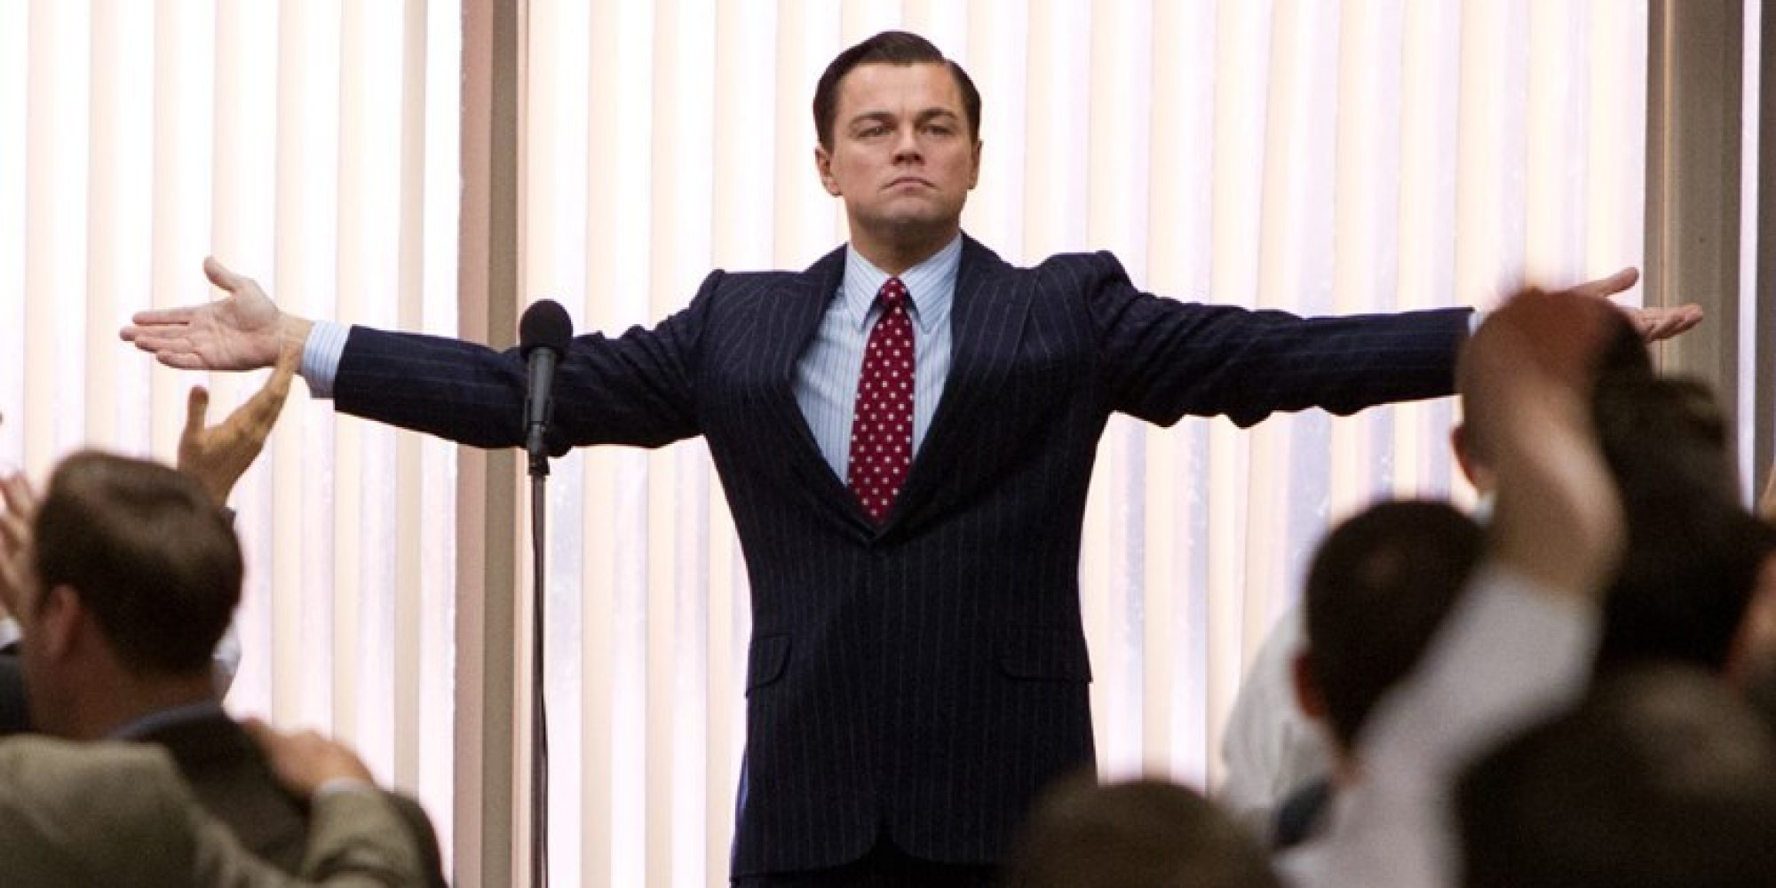
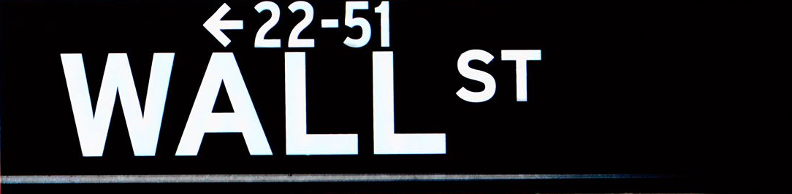
Welcome to
The Mount Maths
Stock Exchange
Make millions £££ or go bust!

Slide 17
Choose your stocks, you have £100,000 to invest, pick wisely!
Mrs Moosajee’s stationery shop
McDonalds
MC Wise and DJ Luck’s album
Vle.MathsWatch.com
Webuyanycar.com
You can choose up to 3 stocks, as well as saving some in the bank to gain a guaranteed 5% increase per year.

Slide 18
Event | Effect
The Hub starts selling cheap pencil cases. | Share price drops by 25%
Burger King goes bust. | Share price rises by 35%
Fraction Knight gets to number 1 in the maths charts! | Share price rises by 100%
MathWatch crashes so students can’t do their homework | Share price drops by 10%
webuyanycar.com starts buying vans too. | Share price increases by 12%

Slide 19
Event | Effect
Mrs Moosajee designs amazing last-forever pencils! | Share price rises by 65%
McDonalds start selling Pizza. | Share price rises by 33%
MC Wise gets a cold so recording can’t take place. | Share price drops by 17%
MathsWatch creates videos for primary school age children. | Share price rises by 45%
People begin to get annoyed by the webuyanycar.com song | Share price drops by 18%

Slide 20
Event | Effect
Mrs Moosajee starts selling her products at WHSmiths | Share price rises by 38%
McDonalds merges with Coca Cola | Share price rises by 110%
Miss Letts joins the song-writing team | Share price rises by 45%
MathsWatch is updated so it works on ipads too! | Share price rises by 77%
British Parliament ban the webuyanycar.com song | Share price crashes to 0.

Slide 21
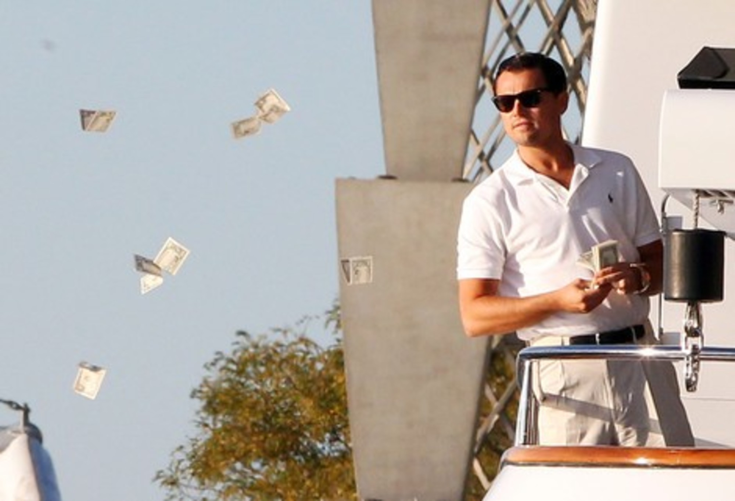
How did you do?
Are you a millionaire?

Slide 22

Todays Objectives – Have you met them?
Objectives
To be able to order numbers, decimals and fractions.
To be able to convert between Mixed Numbers & Improper Fractions.
To be able to express a fraction as a percentage.
To be able to increase & decrease by a percentage.

Slide 23
Suggested Videos
For this lesson
Ordering Numbers: https://www.youtube.com/watch?v=gOmj58JdxL8
Ordering fractions decimals percentages – Corbettmaths
Converting Mixed Numbers to Improper Fractions
https://www.youtube.com/watch?v=TrutPJf9GmQ
Change a Mixed Number to an Improper Fraction
Converting Improper Fractions to Mixed Numbers
https://www.youtube.com/watch?v=GpumUOiGS6Q
Change an Improper Fraction into a Mixed Number
Fraction as a percentage
https://www.youtube.com/watch?v=TzQA2hWdb3o
How to: Fraction to Percent Using Division : Fractions & Percentages
Percentage Increase/Deacrease
https://www.youtube.com/watch?v=TQqgFtjZ42E
Percentage/decimal multipliers (with calculator)
For next lesson
TBC

