Slide 1
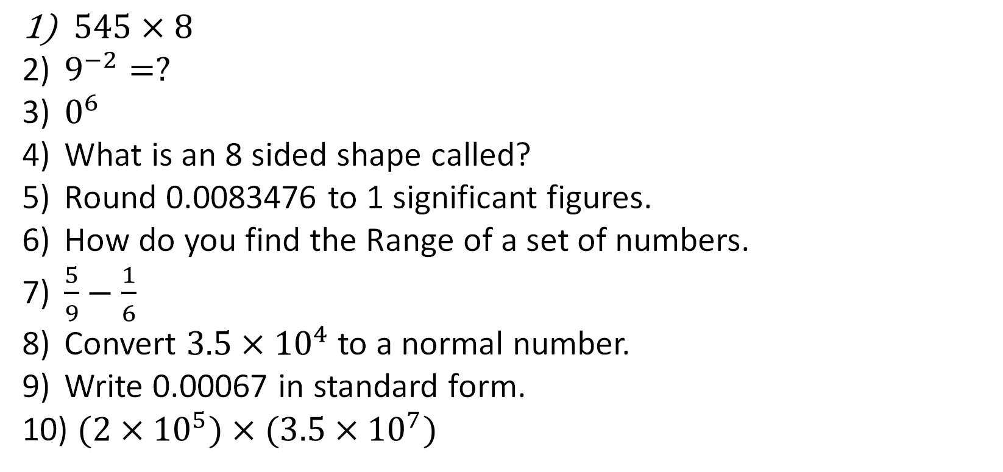
1-10 Quiz.
$545×8$
$9^{−2}=?$
$0^{6}$
What is an 8 sided shape called?
Round 0.0083476 to 1 significant figures.
How do you find the Range of a set of numbers.
$\frac{5}{9}−\frac{1}{6}$
Convert $3.5×{10}^{4}$ to a normal number.
Write 0.00067 in standard form.
$(2×{10}^{5})×(3.5×{10}^{7})$

Slide 2
1-10 Quiz.
4360
1/81
0
Octagon
0.008
Biggest – smallest
7/18
35000
6.7 x 10⁻⁴
7 x 10¹²
$545×8$
$9^{−2}=?$
$0^{6}$
What is an 8 sided shape called?
Round 0.0083476 to 1 significant figures.
How do you find the Range of a set of numbers.
$\frac{5}{9}−\frac{1}{6}$
Convert $3.5×{10}^{4}$ to a normal number.
Write 0.00067 in standard form.
$(2×{10}^{5})×(3.5×{10}^{7})$

Slide 3
Title: Volume of Prisms
Objectives
To be able to find the Volume of 3D Shapes.
- Cuboids
- Triangular Prisms
- Cylinders
- Trapezoidal Prisms

Slide 4
Starter: Find the Area of each Shape
6m
120mm
110mm
4m
9cm
100mm
50mm
4cm

Slide 5



Starter: Find the Area of each Shape
6m
120mm
110mm
4m
9cm
100mm
50mm
4cm
$$36{cm}^{2}$$
$$2500{mm}^{2}$$
$$12{cm}^{2}$$

Slide 6
A Prism
Cylinder
Cuboid
Cross section
Triangular Prism
Trapezoid Prism
Volume of Prism = length x Cross-sectional area

Slide 7
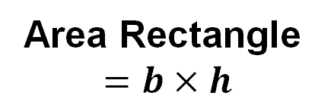
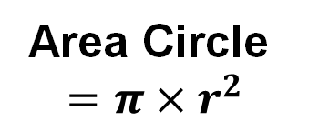
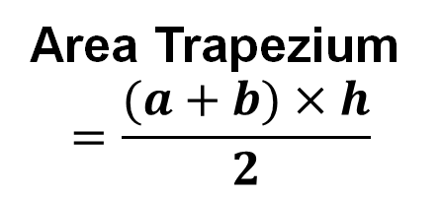
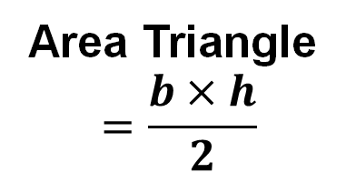
Area Formulae
a
h
r
h
h
b
b
b
Area Triangle
$$=\frac{b×h}{2}$$
Area Circle
$$=π×r^{2}$$
Area Trapezium
$$=\frac{(a+b)×h}{2}$$
Area Rectangle
$$=b×h$$

Slide 8
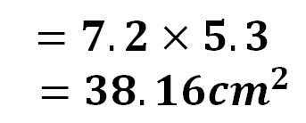

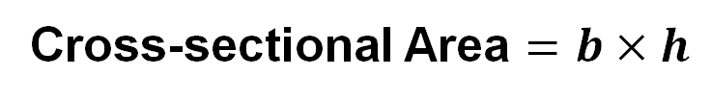


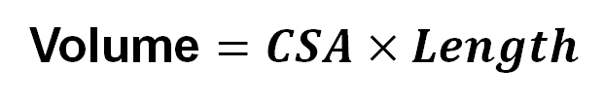
Volume of a Cuboid
Cross-sectional Area $=b×h$
5.3cm
$$=7.2×5.3$$
$=38.16{cm}^{2}$
10.6cm
DO NOT ROUND!
7.2cm
Volume $=CSA×Length$
USE ‘ANS’!
$$=38.16×10.6$$
$$=404.496{cm}^{3}$$
Sensible degree of accuracy if
not stated in question.
$$=404.5{cm}^{3}$$

Slide 9


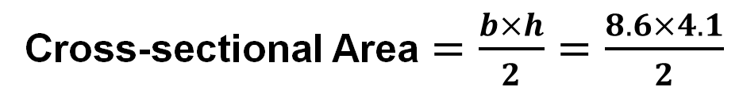


Volume of a Triangular Prism
4.1cm
4.9cm
Cross-sectional Area $=\frac{b×h}{2}=\frac{8.6×4.1}{2}$
6.2cm
$$=17.63{cm}^{2}$$
8.6cm
DO NOT ROUND!
Volume $=CSA×Length$
USE ‘ANS’!
$$=17.63×6.2$$
$$=109.306{cm}^{3}$$
Sensible degree of accuracy if
not stated in question.
$$=109.3{cm}^{3}$$

Slide 10
Find the Volume
of these 6 Prisms
1
2
3
5cm
7mm
5m
2cm
7mm
7m
8cm
7mm
4
6m
5
6
5mm
11m
3cm
6cm
6mm
6m
12cm
11mm
6m

Slide 11
Find the Volume
of these 6 Prisms
1
2
3
7mm
7mm
343mm³
105m³
5cm
80cm³
5m
2cm
7m
8cm
7mm
4
6m
5
6
5mm
165mm³
11m
108cm³
396m³
3cm
6cm
6mm
6m
12cm
11mm
6m

Slide 12
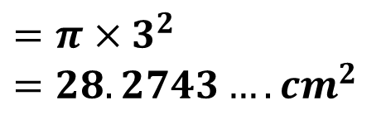

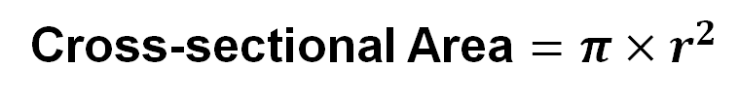


Volume of a Cylinder
Cross-sectional Area $=π×r^{2}$
3cm
$$=π×3^{2}$$
$$=28.2743….{cm}^{2}$$
DO NOT ROUND!
5cm
Volume $=CSA×Length$
USE ‘ANS’!
$$=28.2743…×5$$
$$=141.3716…{cm}^{3}$$
Sensible degree of accuracy if
not stated in question.
$$=141.4{cm}^{3}$$

Slide 13


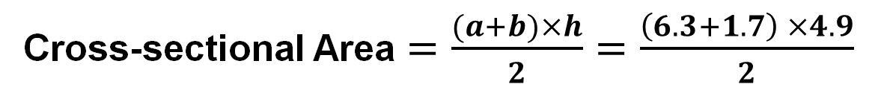


Volume of a Trapezoid Prism
6.3cm
Cross-sectional Area $=\frac{(a+b)×h}{2}=\frac{\left(6.3+1.7\right) ×4.9}{2}$
4.9cm
DO NOT ROUND!
$$=19.6{cm}^{2}$$
8.2cm
1.7cm
Volume $=CSA×Length$
USE ‘ANS’!
$$=19.6×8.2$$
$$=160.72{cm}^{3}$$
Sensible degree of accuracy if
not stated in question.
$$=160.7{cm}^{3}$$

Slide 14
Find the Volume of these 3 Prisms
1
2
3
7mm
4m
7mm
5cm
5m
12.5m
8cm
9m

Slide 15
Find the Volume of these 3 Prisms
Leave your answers to 1dp
1
2
3
7mm
406.25m³
4m
628.3cm³
7mm
5cm
1077.6mm³
5m
12.5m
8cm
9m

Slide 16
Volume of Prisms
Problem Solving
4cm
Area A = 11 x 4 = 44cm²
Area B = 8 x 13 = 104cm²
Area C = 11 x 3 = 33cm²
Total Area of Cross-Section = 44 + 104 + 33
= 181cm²
VOLUME = 181 x 25
= 4525cm³
A
3cm
20cm
B
C
3cm
25cm
11cm

Slide 17
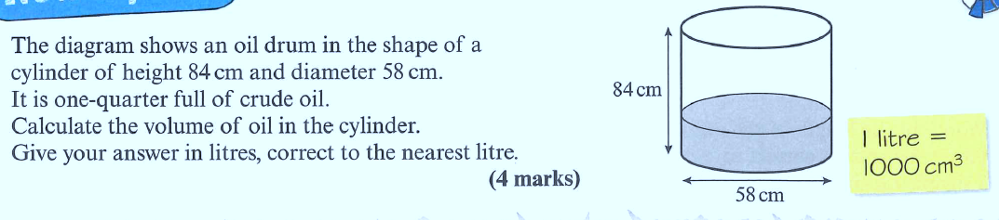
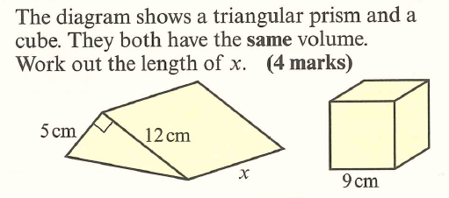
Try these two
Past Paper Style
Questions

Slide 18
Height of oil = 21cm
Volume = ∏ x 29² x 21
Volume = 55483.67 cm³
Volume = 55483.67 cm³
55483.67 ÷ 1000 = 55.48
Volume = 55 litres
Radius = 29cm
Volume of cube = 9 x 9 x 9
Volume of cube = 729 cm³
So volume of prism = 729 cm³
(5 x 12) ÷ 2 x x = 729
X = 24.3 cm

Slide 19

Todays Objectives – Have you met them?
Objectives
To be able to find the Volume of 3D Shapes.
- Cuboids
- Triangular Prisms
- Cylinders
- Trapezoidal Prisms

Slide 20
Suggested Videos
For this lesson
Ordering Numbers: https://www.youtube.com/watch?v=gOmj58JdxL8
Ordering fractions decimals percentages – Corbettmaths
Percentages:
For next lesson
Adding & Subtracting Fractions:
https://www.youtube.com/watch?v=5juto2ze8Lg
Math Antics - Adding and Subtracting Fractions
Working with decimals:
https://www.youtube.com/watch?v=kwh4SD1ToFc
Math Antics - Decimal Arithmetic
BIDMAS:
https://www.youtube.com/watch?v=6K77Igo39vk
GCSE Maths - BIDMAS - Aslam Tutoring

