Slide 1
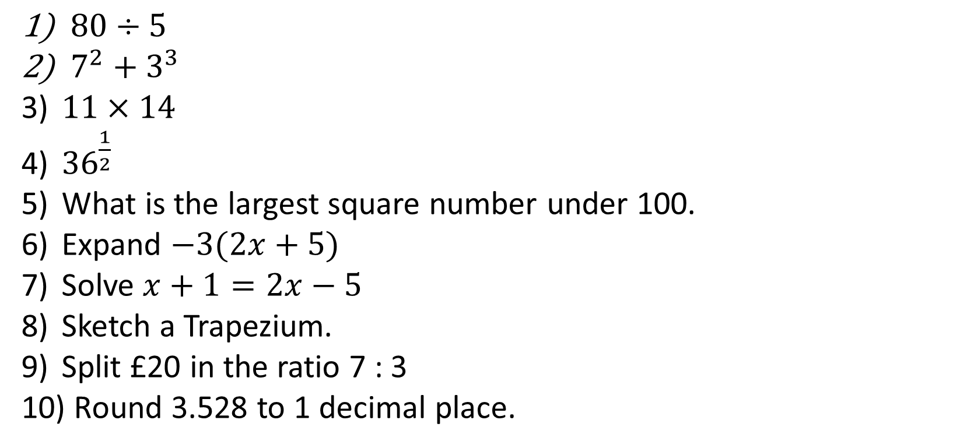
1-10 Quiz.
$80÷5$
$7^{2}+3^{3}$
$11×14$
${36}^{\frac{1}{2}}$
What is the largest square number under 100.
Expand $−3(2x+5)$
Solve $x+1=2x−5$
Sketch a Trapezium.
Split £20 in the ratio 7 : 3
Round 3.528 to 1 decimal place.
Notes:
This could also be a YouTube clip, matching exercise, Anything that will engage the learners from the start of the lesson.
TUTOR TO TAKE THE REGISTER DURING THIS TIME. THERE IS NO NEED TO CALL OUT NAMES.

Slide 2
1-10 Quiz.
$80÷5$
$7^{2}+3^{3}$
$11×14$
${36}^{\frac{1}{2}}$
What is the largest square number under 100.
Expand $−3(2x+5)$
Solve $x+1=2x−5$
Sketch a Trapezium.
Split £20 in the ratio 7 : 3
Round 3.528 to 1 decimal place.
16
76
154
6
81
-6x -15
X = 6
14 : 6
3.5
Notes:
This could also be a YouTube clip, matching exercise, Anything that will engage the learners from the start of the lesson.
TUTOR TO TAKE THE REGISTER DURING THIS TIME. THERE IS NO NEED TO CALL OUT NAMES.

Slide 3
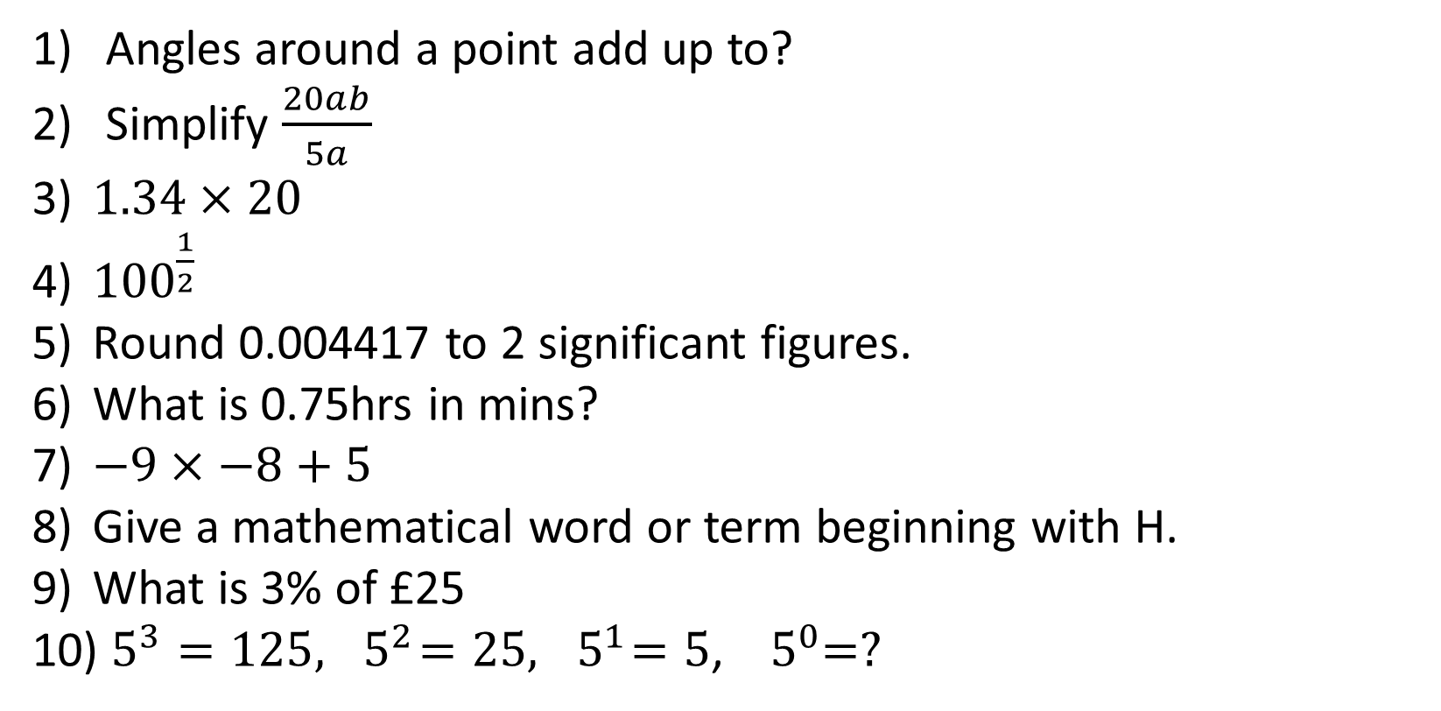
1-10 Quiz.
Angles around a point add up to?
Simplify $\frac{20ab}{5a}$
$1.34×20$
${100}^{\frac{1}{2}}$
Round 0.004417 to 2 significant figures.
What is 0.75hrs in mins?
$−9×−8+5$
Give a mathematical word or term beginning with H.
What is 3% of £25
$5^{3}=125,{ 5}^{2}=25,{ 5}^{1}=5$, ${ 5}^{0}=?$
Notes:
This could also be a YouTube clip, matching exercise, Anything that will engage the learners from the start of the lesson.
TUTOR TO TAKE THE REGISTER DURING THIS TIME. THERE IS NO NEED TO CALL OUT NAMES.

Slide 4
1-10 Quiz.
Angles around a point add up to?
Simplify $\frac{20ab}{5a}$
$1.34×20$
${100}^{\frac{1}{2}}$
Round 0.004417 to 2 significant figures.
What is 0.75hrs in mins?
$−9×−8+5$
Give a mathematical word or term beginning with H.
What is 3% of £25
$5^{3}=125,{ 5}^{2}=25,{ 5}^{1}=5$, ${ 5}^{0}=?$
360
4b
26.8
10
0.0044
45 mins
77
Hypotenuse
75p
1
Notes:
This could also be a YouTube clip, matching exercise, Anything that will engage the learners from the start of the lesson.
TUTOR TO TAKE THE REGISTER DURING THIS TIME. THERE IS NO NEED TO CALL OUT NAMES.

Slide 5

Title: Plotting Lines and Curves
Objectives
To be able to plot a line from a table.
To understand $y=mx+c$
To be able to plot simple curves using a table.

Slide 6
QUICK START
Name the following graphs:
4
5
-5
-2
y = 4
x = 5
y = -2
x = -5

Slide 7
In order to draw a straight line graph, we need a few things:
A set of axis to draw on.
An equation.
Some coordinates to plot (minimum 2)

Slide 8
Example 1
To generate some coordinates, we use a table. We can choose any values of x we like, but we have to calculate the y values.. We calculate our y values by
substituting x values into the equation:
This generates coordinates to plot on a graph
y = x + 2
x | -3 | -2 | -1 | 0 | 1 | 2 | 3
y
(-3,-1)
(0, 2)
⁻1
0
1
2
3
4
5
(-2,0)
(1, 3)
(-1, 1)
(2, 4)
(0, 2)
(3, 5)

Slide 9
Example 1
y
10
y = x + 2
9
8
7
x
x | -3 | -2 | -1 | 0 | 1 | 2 | 3
y
6
x
5
x
⁻1
0
1
2
3
4
5
4
x
3
x
This generates coordinates to plot on a graph
x
2
x
1
x
-10
-9
-8
-7
-6
-5
-4
-3
-2
-1
0
1
2
3
4
5
6
7
8
9
10
x
-1
(-3,-1)
(0, 2)
-2
(1, 3)
-3
(-2,0)
-4
(-1, 1)
(2, 4)
We find a straight
line.
-5
-6
(0, 2)
(3, 5)
-7
-8
-9
-10

Slide 10
Complete the table for the equations.
y = x
y = x + 3
x | -2 | -1 | 0 | 1 | 2
y
x | -2 | -1 | 0 | 1 | 2
y
⁻2
⁻1
0
1
2
1
2
3
4
5
y = x +1
y = x - 2
x | -2 | -1 | 0 | 1 | 2
y
x | -2 | -1 | 0 | 1 | 2
y
⁻1
0
1
2
3
⁻4
⁻3
⁻2
⁻1
0
Plot the coordinates
When each table is completed

Slide 11
y
y = x
10
x | -2 | -1 | 0 | 1 | 2
y
9
⁻2
⁻1
0
1
2
8
7
x
y = x +1
6
5
x
x
x | -2 | -1 | 0 | 1 | 2
y
4
x
x
⁻1
0
1
2
3
x
3
x
2
x
x
x
y = x + 3
x
1
x
x
x
-10
-9
-8
-7
-6
-5
-4
-3
-2
-1
0
1
2
3
4
5
6
7
8
9
10
x
x
-1
x | -2 | -1 | 0 | 1 | 2
y
x
x
-2
1
2
3
4
5
x
x
-3
y = x - 2
x
-4
-5
x | -2 | -1 | 0 | 1 | 2
y
-6
-7
⁻4
⁻3
⁻2
⁻1
0
-8
-9
-10

Slide 12
y
What do you notice about these straight lines?
10
9
8
y = x
7
x
y = x + 1
6
5
x
x
y = x + 3
4
x
x
x
3
x
y = x - 2
2
x
x
x
x
1
x
x
x
They are parallel to each
other i.e. they have the same
gradient
-10
-9
-8
-7
-6
-5
-4
-3
-2
-1
0
1
2
3
4
5
6
7
8
9
10
x
x
-1
x
x
-2
x
x
-3
The number added/subtracted
to x is where the line
crosses the y axis. We call this
the y-intercept.
x
-4
-5
-6
-7
-8
-9
-10

Slide 13
Complete the table for
the equation and plot the graph.
y = x
y = 3x
x | -2 | -1 | 0 | 1 | 2
y
x | -2 | -1 | 0 | 1 | 2
y
⁻2
⁻1
0
1
2
⁻6
⁻3
0
3
6
y = 2x
y = ⁻x
x | -2 | -1 | 0 | 1 | 2
y
⁻4
⁻2
0
4
x | -2 | -1 | 0 | 1 | 2
y
2
2
1
0
⁻1
⁻2

Slide 14
y = x
y
10
x
x | -2 | -1 | 0 | 1 | 2
y
9
y = 2x
8
⁻3
⁻1
0
1
3
7
x
6
5
x | -2 | -1 | 0 | 1 | 2
y
x
4
x
x
⁻4
⁻2
0
2
4
3
x
x
2
x
y = 3x
1
x
x
x
x
x
-10
-9
-8
-7
-6
-5
-4
-3
-2
-1
0
1
2
3
4
5
6
7
8
9
10
x
x
x | -2 | -1 | 0 | 1 | 2
y
x
-1
⁻6
⁻3
0
3
6
x
x
-2
x
-3
y = ⁻x
-4
x
-5
x | -2 | -1 | 0 | 1 | 2
y
-6
-7
2
1
0
⁻1
⁻2
x
-8
-9
-10

Slide 15
y
What do you notice about these straight lines?
10
x
9
8
y = x
7
x
y = 2x
6
5
y = 3x
x
4
x
x
y = -x
3
x
x
2
x
1
x
x
x
x
x
-10
-9
-8
-7
-6
-5
-4
-3
-2
-1
0
1
2
3
4
5
6
7
8
9
10
They are not parallel - they have different gradients
The gradient is the number in front of the x
x
x
x
-1
x
x
-2
x
-3
-4
x
-5
-6
-7
x
-8
-9
-10

Slide 16
Gradient
We look at the gradient more closely:
5
4
3
2
1
y = x
“every time we go
across 1 we go up 1”
So the gradient is 1.
x
x
0 1 2 3 4 5 6

Slide 17
Gradient
5
4
3
2
1
y = 2x
x
So we say :
“every time we go across 1
we go up 2”
So the gradient is 2
x
x
0 1 2 3 4 5 6

Slide 18
Gradient
x
5
4
3
2
1
y = 3x
So we say :
x
“every time we go across 1
we go up 3”
So the gradient is 3
x
0 1 2 3 4 5 6

Slide 19
Gradient
y = ⁻x
2
1
0
⁻1
⁻2
So we say :
“every time we go across 1
we go down 1”
So the Gradient is -1
x
0 1 2 3 4 5 6
x
x

Slide 20
Find the Equation
In order to find the equation of the line we need to read the graph and write the equation in this form:
y = mx + c
Find the gradient (m)
‘Move one place to the right and see how far up or down you go...’
Find the y-intercept (c)
‘See where the line crosses the y-axis’

Slide 21
Try writing down the equation of the following graphs. You will see each for about 15 secs, there are 3 to complete.

Slide 22
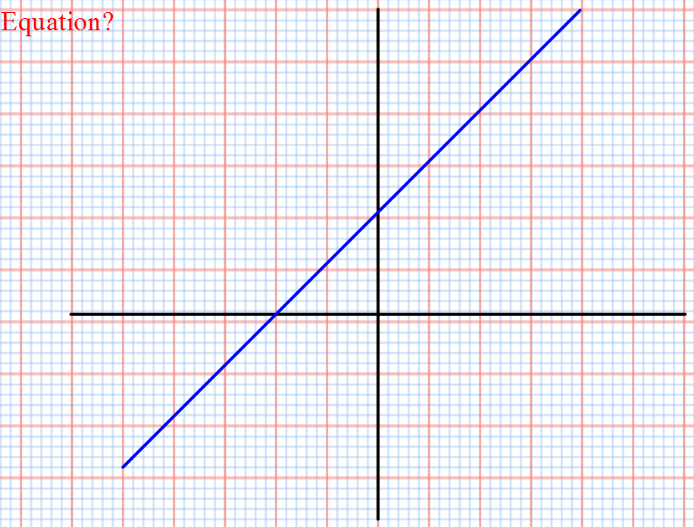

Slide 23
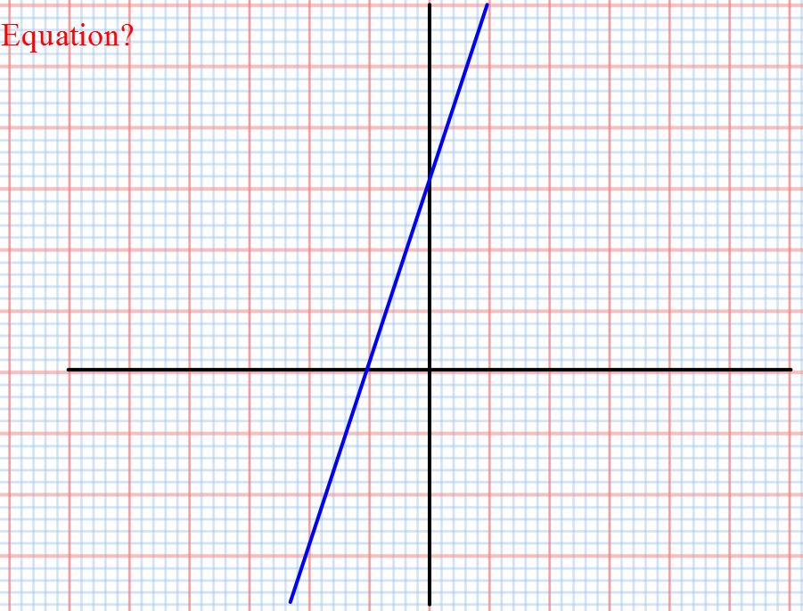

Slide 24
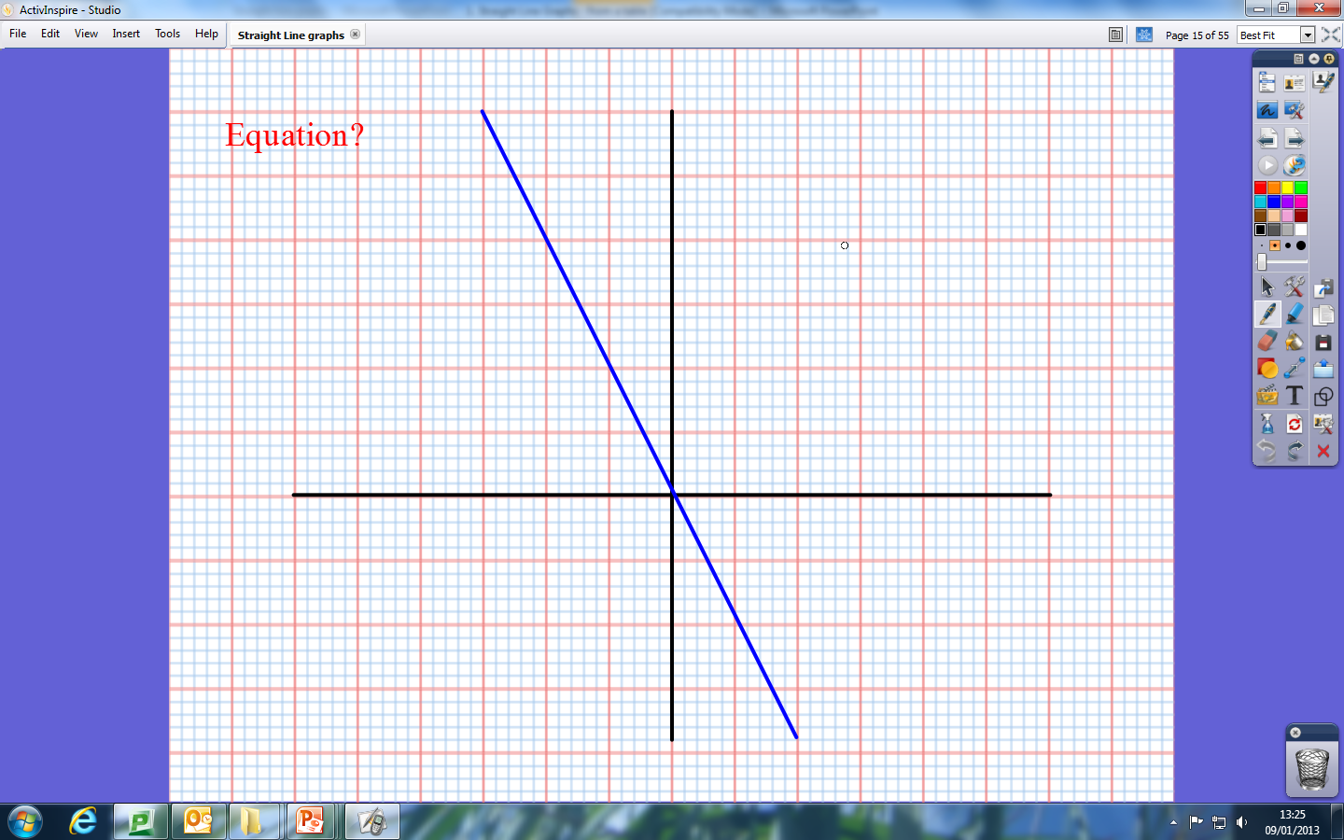

Slide 25
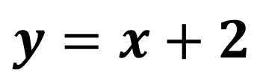
$$y=x+2$$

Slide 26
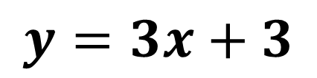
$$y=3x+3$$

Slide 27
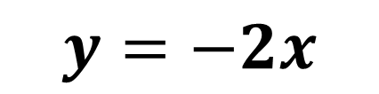
$$y=−2x$$

Slide 28
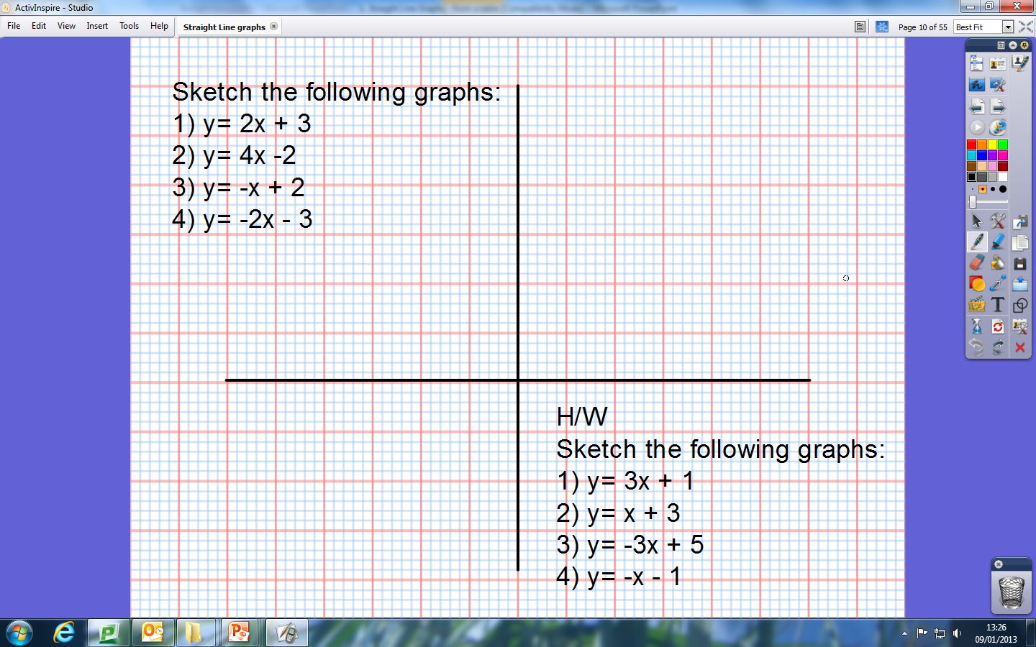
Hint, make a mark for the intercept first, then think about the gradient.

Slide 29

Copy and complete this table, then plot the graph.
$$y=2x^{2}−2$$
What do you think will be different about this graph?
What is causing this difference?
x | -2 | -1 | 0 | 1 | 2
y |  | 0

Slide 30
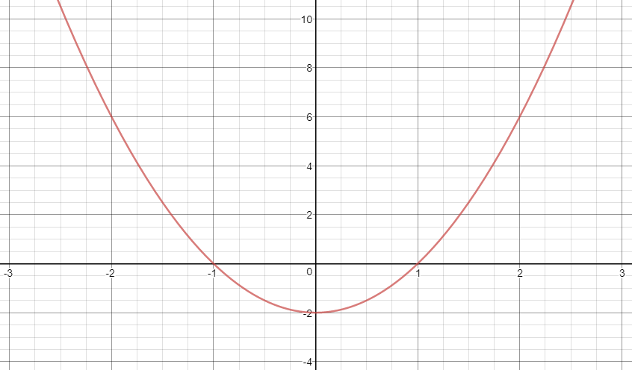
What else should be added to this diagram?

Slide 31


Now try and plot this graph.
$$y=x^{2}−4x+3$$
x | -2 | -1 | 0 | 1 | 2
y

Slide 32

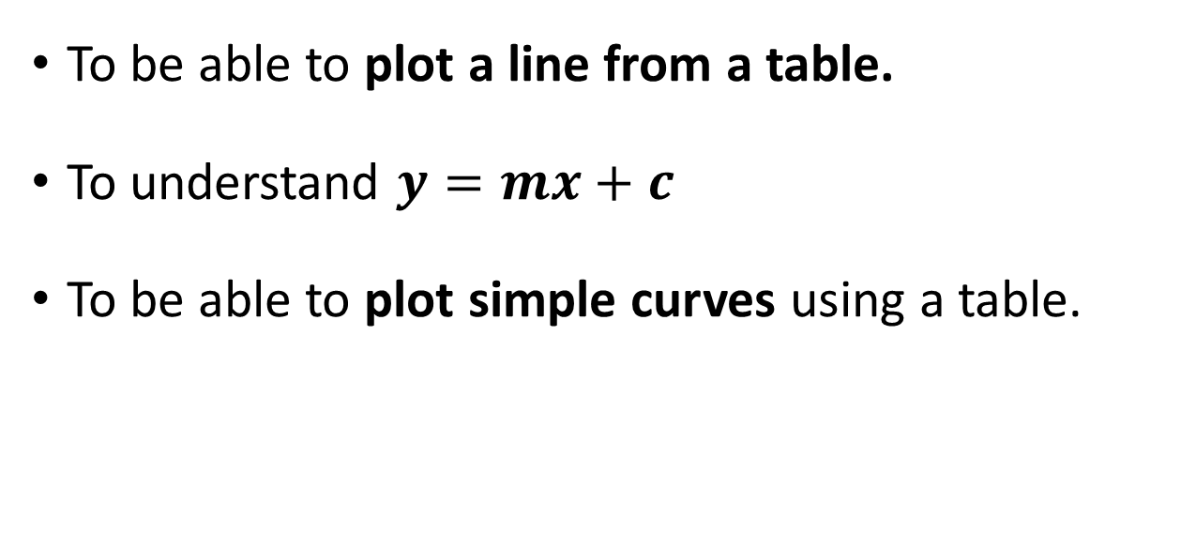
Todays Objectives – Have you met them?
Objectives
To be able to plot a line from a table.
To understand $y=mx+c$
To be able to plot simple curves using a table.

Slide 33
Suggested Videos
For this lesson
Ordering Numbers: https://www.youtube.com/watch?v=gOmj58JdxL8
Ordering fractions decimals percentages – Corbettmaths
Percentages:
For next lesson
Adding & Subtracting Fractions:
https://www.youtube.com/watch?v=5juto2ze8Lg
Math Antics - Adding and Subtracting Fractions
Working with decimals:
https://www.youtube.com/watch?v=kwh4SD1ToFc
Math Antics - Decimal Arithmetic
BIDMAS:
https://www.youtube.com/watch?v=6K77Igo39vk
GCSE Maths - BIDMAS - Aslam Tutoring

