Slide 1
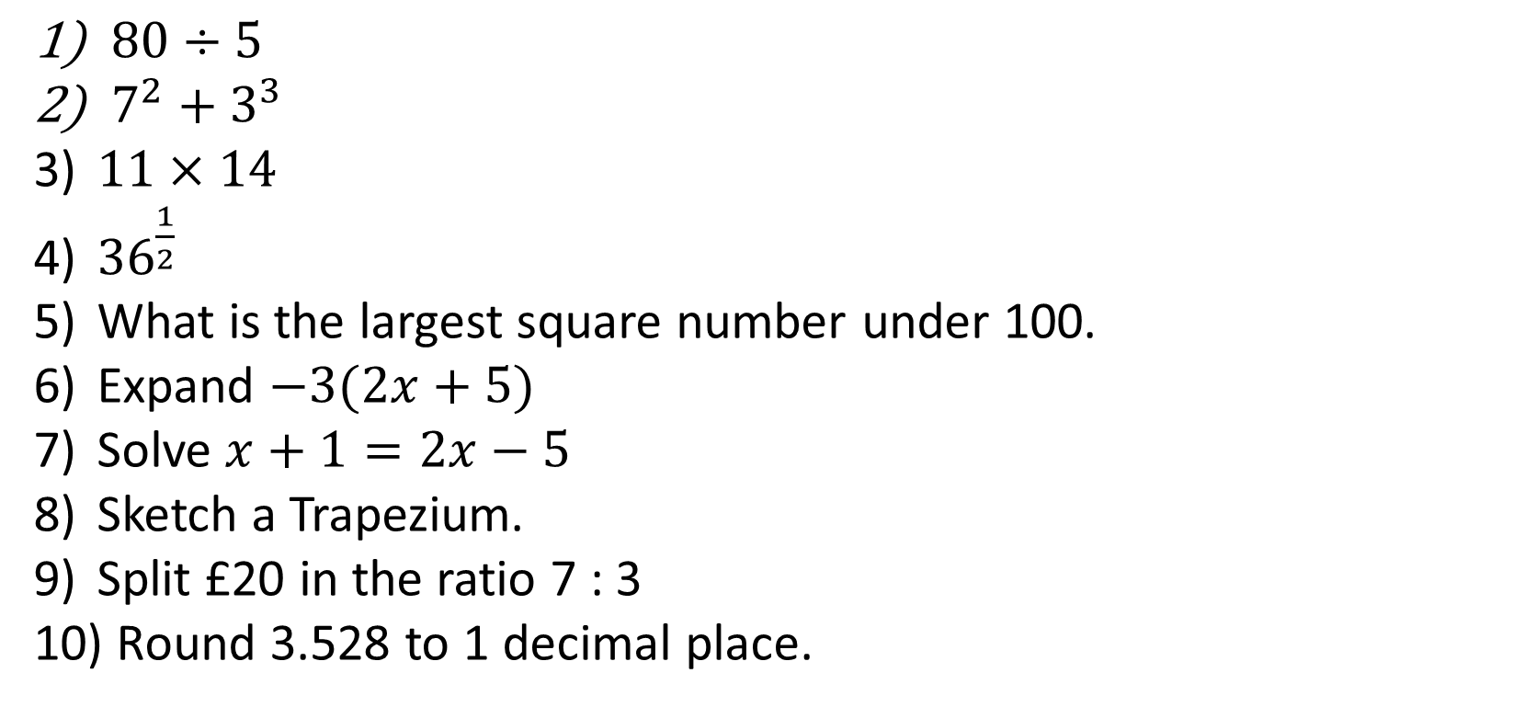
1-10 Quiz.
$80÷5$
$7^{2}+3^{3}$
$11×14$
${36}^{\frac{1}{2}}$
What is the largest square number under 100.
Expand $−3(2x+5)$
Solve $x+1=2x−5$
Sketch a Trapezium.
Split £20 in the ratio 7 : 3
Round 3.528 to 1 decimal place.
Notes:
This could also be a YouTube clip, matching exercise, Anything that will engage the learners from the start of the lesson.
TUTOR TO TAKE THE REGISTER DURING THIS TIME. THERE IS NO NEED TO CALL OUT NAMES.

Slide 2
1-10 Quiz.
$80÷5$
$7^{2}+3^{3}$
$11×14$
${36}^{\frac{1}{2}}$
What is the largest square number under 100.
Expand $−3(2x+5)$
Solve $x+1=2x−5$
Sketch a Trapezium.
Split £20 in the ratio 7 : 3
Round 3.528 to 1 decimal place.
16
76
154
6
81
-6x-15
X = 6
£14:£6
3.5
Notes:
This could also be a YouTube clip, matching exercise, Anything that will engage the learners from the start of the lesson.
TUTOR TO TAKE THE REGISTER DURING THIS TIME. THERE IS NO NEED TO CALL OUT NAMES.

Slide 3
Title: Averages, Lesson 1
Objectives
To be able to find the mean, mode and median from a list of numbers.
To be able to find averages from frequency tables.

Slide 4

Peter Piper picked a peck of pickled peppers.
A peck of pickled peppers Peter Piper picked.
Find the
Mean (b) Mode (c) Range
number of letters in the words
4.6
7,5
6

Slide 5
Definitions:
Mean – Add all the values up, divide this by how many values there are.
Mode – The most occurring value in the data.
Range – The highest value subtract the lowest value.
Median – Order the data, the median is the middle value.

Slide 6
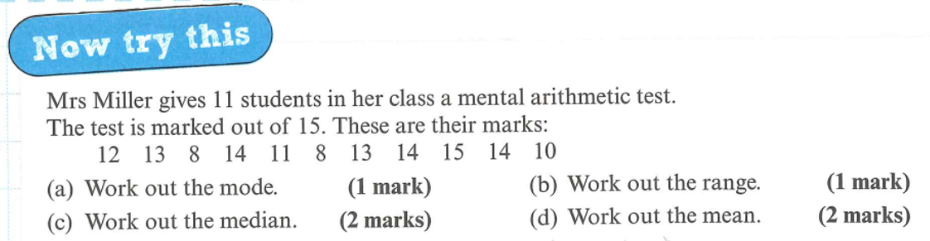
Definitions:
Mean – Add all the values up, divide this by how many values there are.
Mode – The most occurring value in the data.
Range – The highest value subtract the lowest value.
Median – Order the data, the median is the middle value.

Slide 7
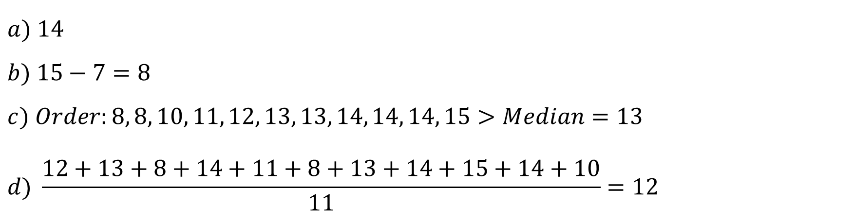
$$a) 14$$
$$b) 15−7=8$$
$$c) Order:8, 8, 10, 11, 12, 13, 13, 14, 14, 14, 15>Median=13$$
$$d) \frac{12+13+8+14+11+8+13+14+15+14+10}{11}=12$$

Slide 8
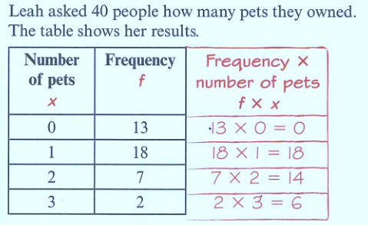
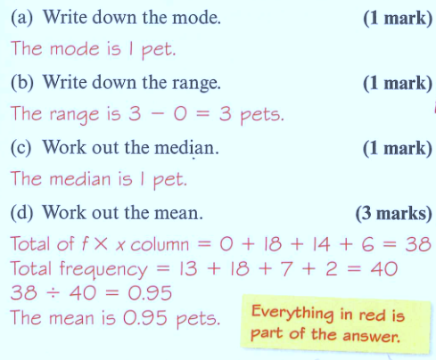

Slide 9
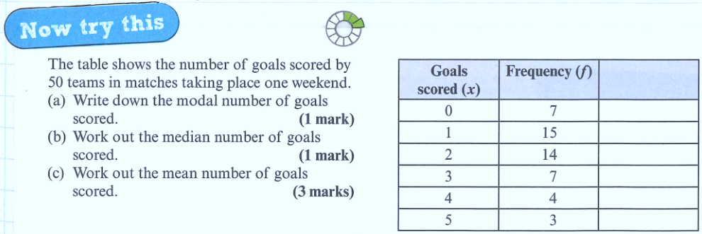

Slide 10
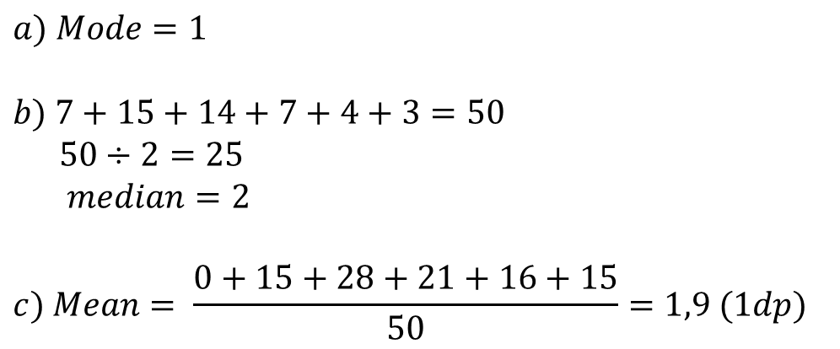
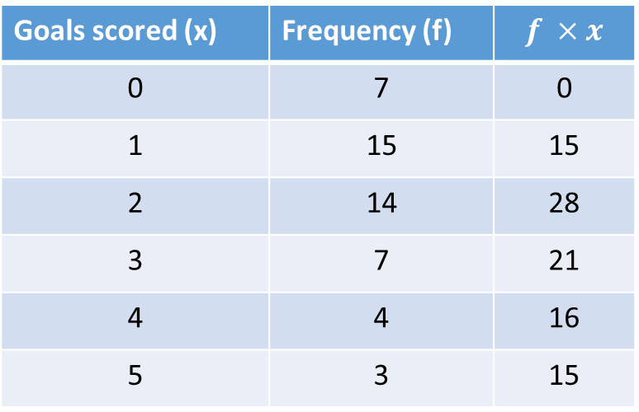
Goals scored (x) | Frequency (f) | $$f ×x$$
0 | 7 | 0
1 | 15 | 15
2 | 14 | 28
3 | 7 | 21
4 | 4 | 16
5 | 3 | 15
$$a) Mode=1$$
$$b) 7+15+14+7+4+3=50$$
$$50÷2=25$$
$$median=2$$
$$c) Mean= \frac{0+15+28+21+16+15}{50}=1,9 (1dp)$$

Slide 11
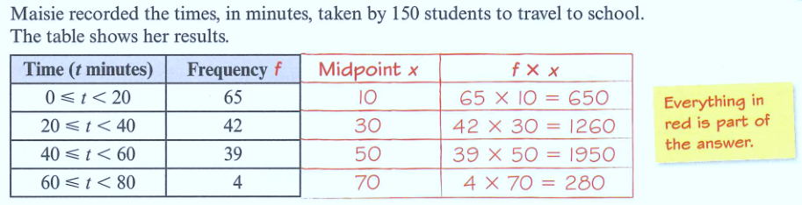
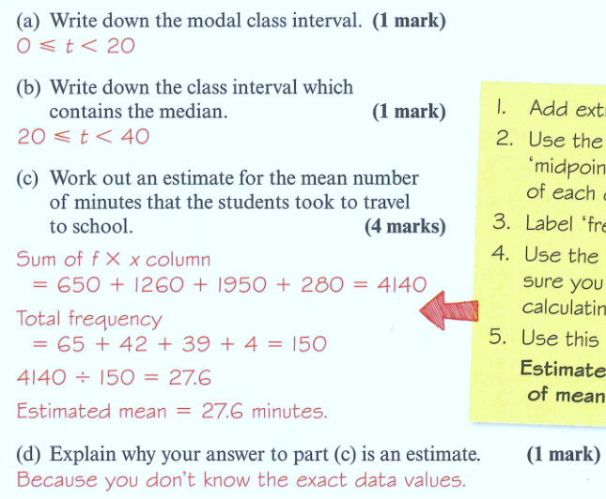

Slide 13
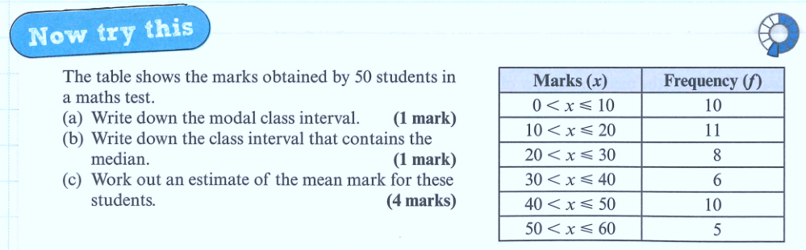

Slide 14
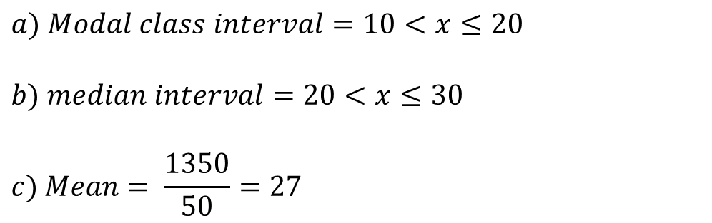
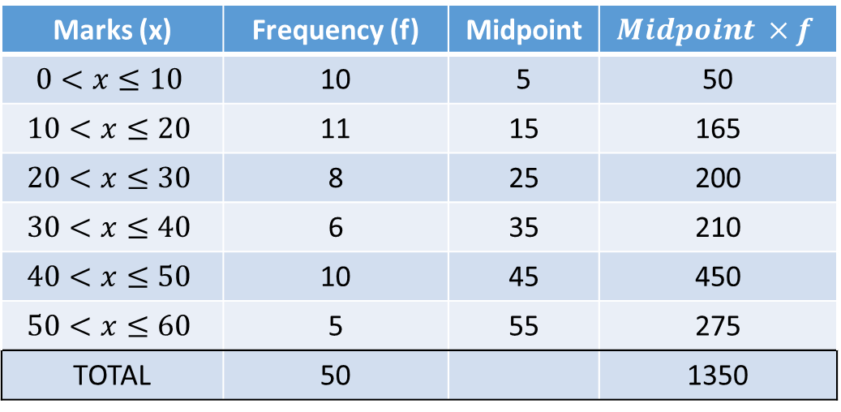
Marks (x) | Frequency (f) | Midpoint | $$Midpoint ×f$$
$$0<x≤10$$ | 10 | 5 | 50
$$10<x≤20$$ | 11 | 15 | 165
$$20<x≤30$$ | 8 | 25 | 200
$$30<x≤40$$ | 6 | 35 | 210
$$40<x≤50$$ | 10 | 45 | 450
$$50<x≤60$$ | 5 | 55 | 275
TOTAL | 50 |  | 1350
$$a) Modal class interval=10<x≤20$$
$$b) median interval=20<x≤30$$
$$c) Mean= \frac{1350}{50}=27$$

Slide 15
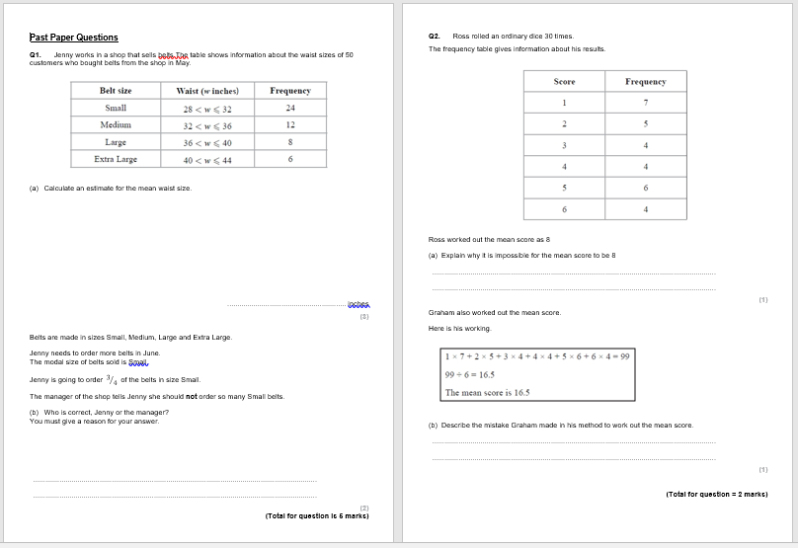
Past Paper Questions
Now try to put your knowledge into action with these Past Paper questions.

Slide 16

Todays Objectives – Have you met them?
Objectives
To be able to find the mean, mode and median from a list of numbers.
To be able to find averages from frequency tables.

Slide 17
Suggested Videos
For this lesson
Ordering Numbers: https://www.youtube.com/watch?v=gOmj58JdxL8
Ordering fractions decimals percentages – Corbettmaths
Percentages:
For next lesson
Adding & Subtracting Fractions:
https://www.youtube.com/watch?v=5juto2ze8Lg
Math Antics - Adding and Subtracting Fractions
Working with decimals:
https://www.youtube.com/watch?v=kwh4SD1ToFc
Math Antics - Decimal Arithmetic
BIDMAS:
https://www.youtube.com/watch?v=6K77Igo39vk
GCSE Maths - BIDMAS - Aslam Tutoring

