Slide 1
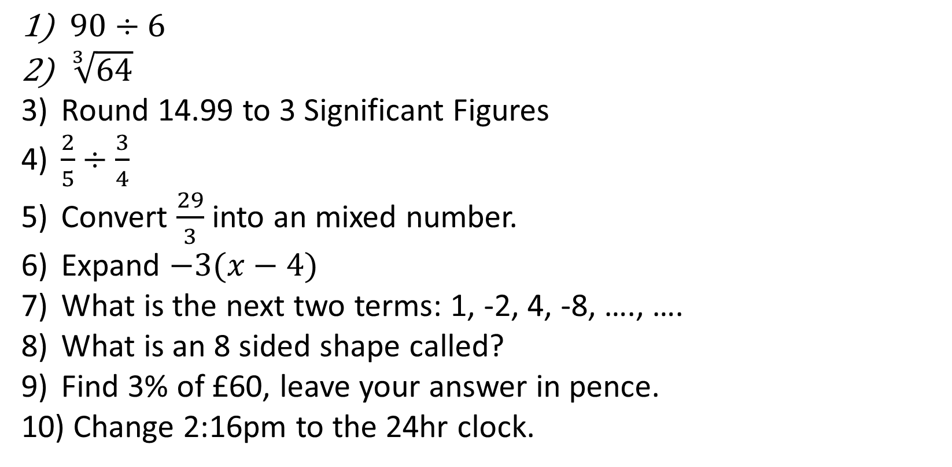
1-10 Quiz.
$90÷6$
$\sqrt[3]{64}$
Round 14.99 to 3 Significant Figures
$\frac{2}{5}÷\frac{3}{4}$
Convert $\frac{29}{3}$ into an mixed number.
Expand $−3(x−4)$
What is the next two terms: 1, -2, 4, -8, …., ….
What is an 8 sided shape called?
Find 3% of £60, leave your answer in pence.
Change 2:16pm to the 24hr clock.
Notes:
This could also be a YouTube clip, matching exercise, Anything that will engage the learners from the start of the lesson.
TUTOR TO TAKE THE REGISTER DURING THIS TIME. THERE IS NO NEED TO CALL OUT NAMES.

Slide 2
1-10 Quiz.
$90÷6$
$\sqrt[3]{64}$
Round 14.99 to 3 Significant Figures
$\frac{2}{5}÷\frac{3}{4}$
Convert $\frac{29}{3}$ into an mixed number.
Expand $−3(x−4)$
What is the next two terms: 1, -2, 4, -8, …., ….
What is an 8 sided shape called?
Find 3% of £60, leave your answer in pence.
Change 2:16pm to the 24hr clock.
15
4
15.0
8/15
9 2/3
-3x + 12
16, -32
Octagon
18p
14:16
Notes:
This could also be a YouTube clip, matching exercise, Anything that will engage the learners from the start of the lesson.
TUTOR TO TAKE THE REGISTER DURING THIS TIME. THERE IS NO NEED TO CALL OUT NAMES.

Slide 3
Title: Charts and Graphs, Lesson 1
Objectives
To be able to draw and analyse pie charts.
To be familiar with bar charts and pictograms.
To be able to draw and interpret scatter graphs and time series graphs.

Slide 4
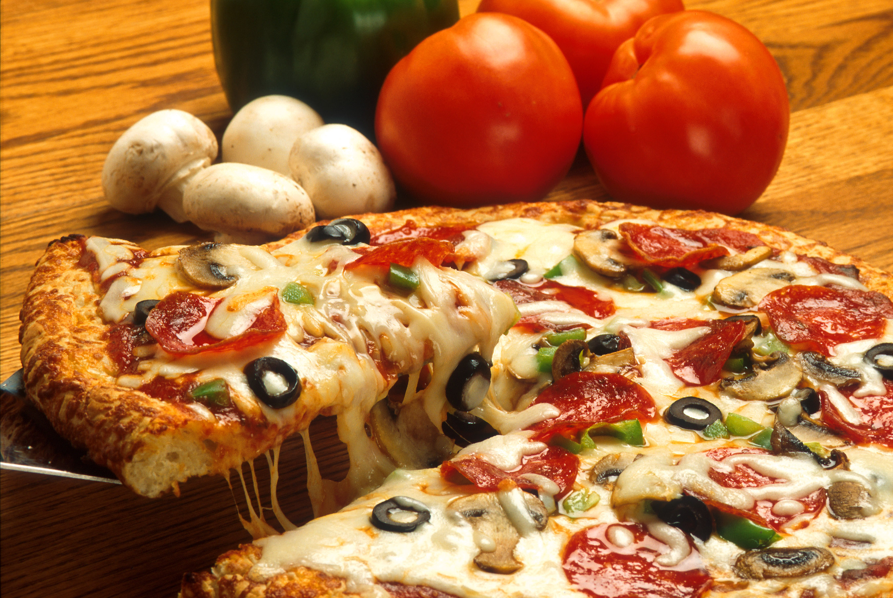
Ten people buy a pizza, if they all have one slice (the same size) what is the size of each slice?
Each person gets 36°
360°÷ 10 =36

Slide 5
12 people buy a pizza, if they all have one slice (the same size) what is the size of each slice?
Each person gets 30°
360°÷ 12=30°

Slide 6
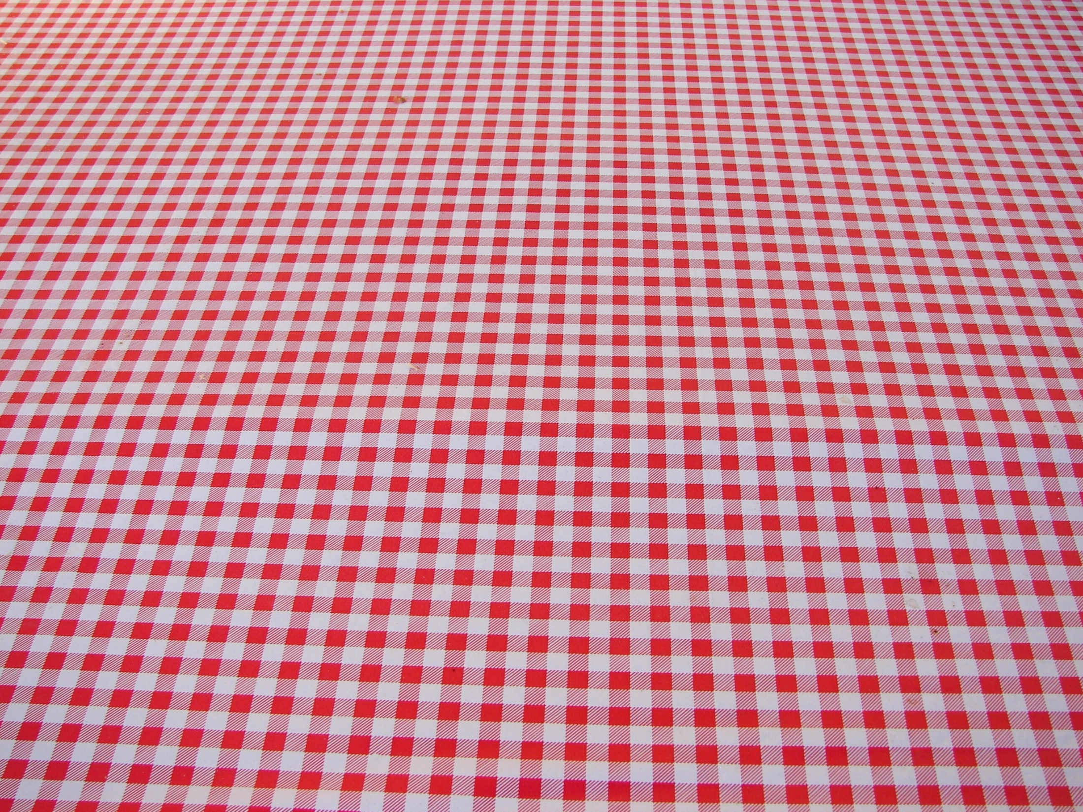
20 people have a pizza, 15 are men and 5 are women.
What size slice does each person get?
360°÷ 20=18°
What is the size of the men’s bit?
18° x 15= 270 °
What is the size of the women's bit?
18° x 5= 90 °

Slide 7

60 people are asked what their favourite book is.
25 say Twilight, 7 none, 15 the bible and 13 GCSE maths. Display this information in a pie chart
What size slice does each person get?
360°÷ 60=6°
Twilight
6° x 25= 150 °
None
6° x 7= 42 °
Bible
6° x 15= 90 °
GCSE Maths
6° x 13= 78 °

Slide 8

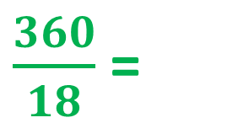
My Results
Pie Charts
“What is your favourite Quality Street?”
Sweet | Results
Strawberry Cream | 5
Orange Cream | 3
Purple Hazelnut | 6
Green Triangle | 2
Other | 2
TOTAL
Degrees
100°
60°
120°
40°
40°
Degrees
X 20
$\frac{360}{18}$ =
X 20
20°
18
360°

Slide 9
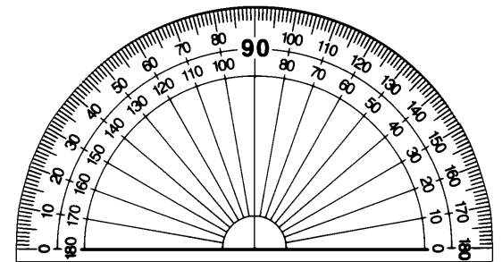
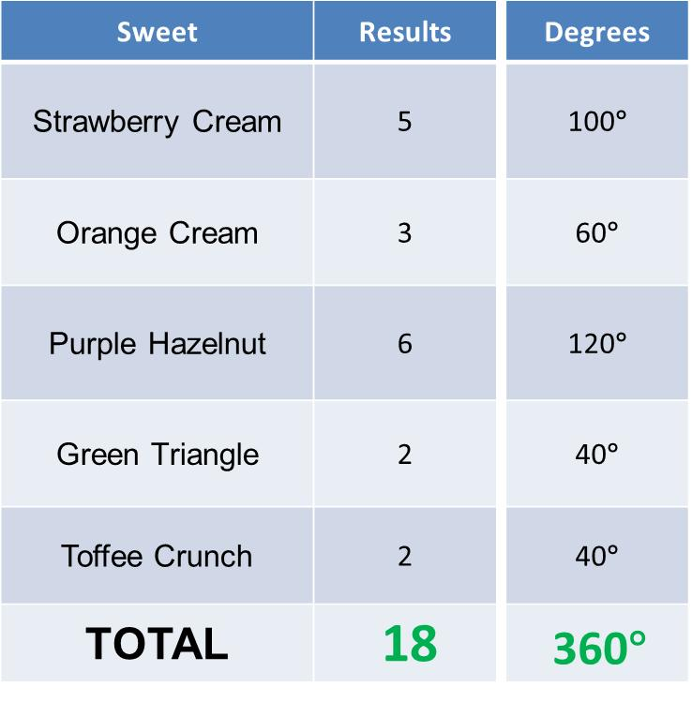
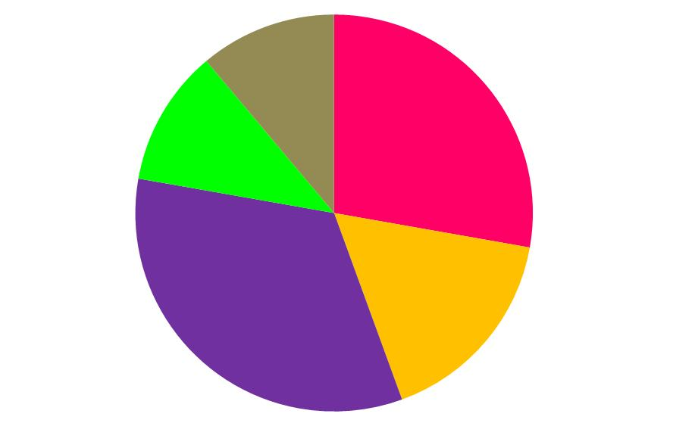

Pie Charts

Slide 10
Pie Charts
Sweet | Results
Malteasers | 7
Bounty | 5
Galaxy | 6
Snickers | 2
Mars | 4
TOTAL
Using these results for people’s favourite ‘Celebration’ chocolates, construct a Pie Chart yourself.

Slide 11
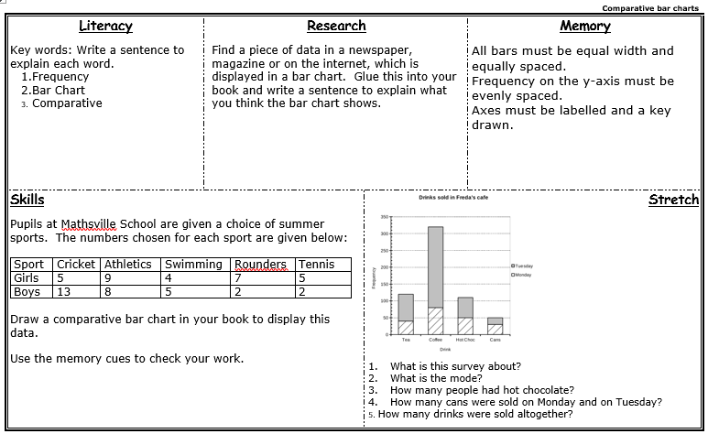
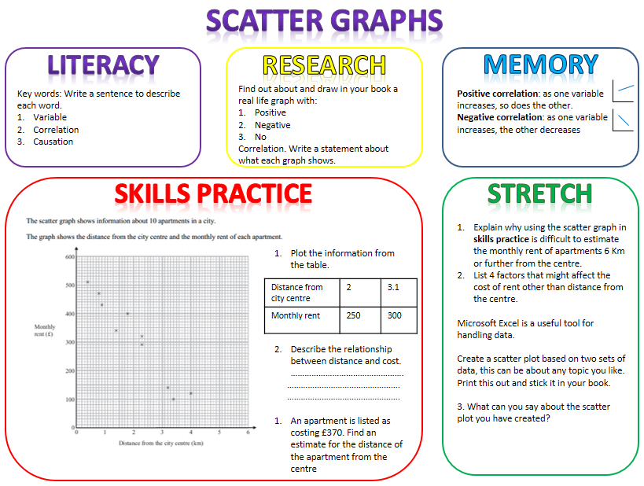

Slide 12
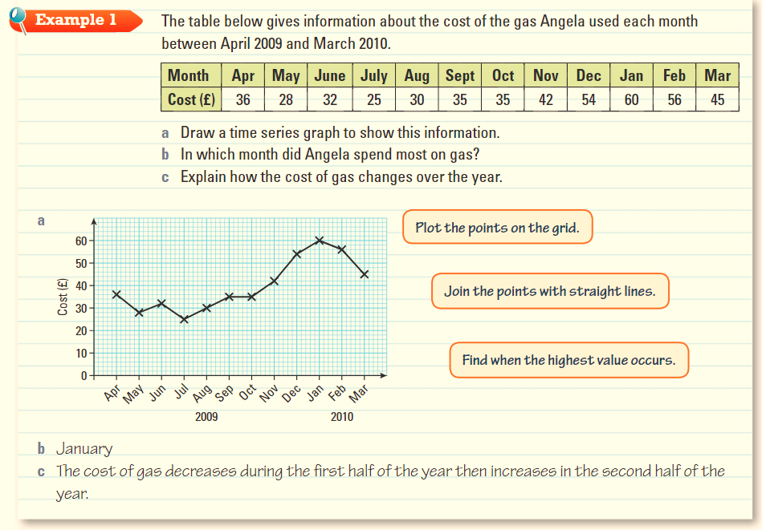
Time Series Graphs
This is the collective name for all graphs that have time as the x-axis. Try out this question:

Slide 14

Todays Objectives – Have you met them?
Objectives
To be able to draw and analyse pie charts.
To be familiar with bar charts and pictograms.
To be able to draw and interpret scatter graphs and time series graphs.

Slide 15
Suggested Videos
For this lesson
Pie Charts:
https://www.youtube.com/watch?v=p_nPxTRuLxo
Drawing Pie Charts
Bar Charts:
https://www.youtube.com/watch?v=LEXbMW-Amao
Drawing Bar Charts - CorbettMaths
Scatter Graphs:
https://www.youtube.com/watch?v=VUaOCgJTPjI
Scatter Graphs - CorbettMaths
For next lesson

