Slide 1
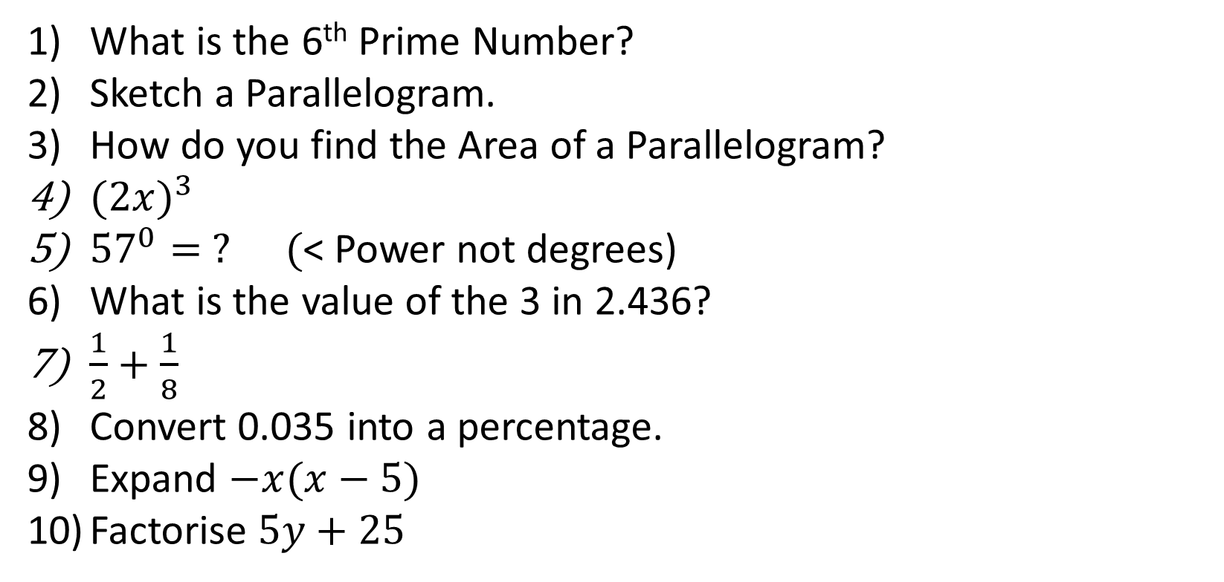
1-10 Quiz.
What is the 6th Prime Number?
Sketch a Parallelogram.
How do you find the Area of a Parallelogram?
${(2x)}^{3}$
${57}^{0}= ? ($< Power not degrees)
What is the value of the 3 in 2.436?
$\frac{1}{2}+\frac{1}{8}$
Convert 0.035 into a percentage.
Expand $−x(x−5)$
Factorise $5y+25$
Notes:
This could also be a YouTube clip, matching exercise, Anything that will engage the learners from the start of the lesson.
TUTOR TO TAKE THE REGISTER DURING THIS TIME. THERE IS NO NEED TO CALL OUT NAMES.

Slide 2
1-10 Quiz.
What is the 6th Prime Number?
Sketch a Parallelogram.
How do you find the Area of a Parallelogram?
${(2x)}^{3}$
${57}^{0}= ? ($< Power not degrees)
What is the value of the 3 in 2.436?
$\frac{1}{2}+\frac{1}{8}$
Convert 0.035 into a percentage.
Expand $−x(x−5)$
Factorise $5y+25$
11
Base x vertical height
8x³
1
3/100
5/8
3.5%
-x² + 5x
5(y + 5)
Notes:
This could also be a YouTube clip, matching exercise, Anything that will engage the learners from the start of the lesson.
TUTOR TO TAKE THE REGISTER DURING THIS TIME. THERE IS NO NEED TO CALL OUT NAMES.

Slide 3
Title: Ratio, Recipes and Best Buy
Objectives
To be able to simplify fractions with different units.
To be able to split an amount into a ratio.
To be able to find unknowns with ratios.

Slide 4

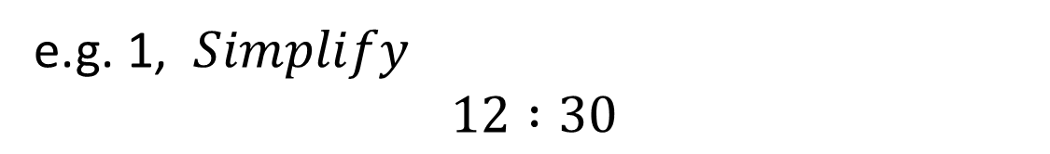


Ratio
Simplifying Ratios (very similar to simplifying fractions)
e.g. 1, $Simplify$
$$12 :30$$
$$÷6$$
$$÷6$$
$$2 :5$$

Slide 5

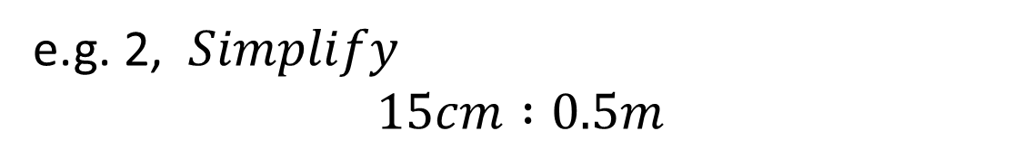



Ratio
Simplifying Ratios (very similar to simplifying fractions)
e.g. 2, $Simplify$
$$15cm :0.5m$$
Convert
Units
Convert
Units
$$15cm :50cm$$
$$÷5$$
$$÷5$$
$$3 :10$$

Slide 6
Bronze
Silver
Gold
12 : 8
21 : 14
56 : 72
10 : 20 : 8
96 : 120
45 : 60
14 : 35 : 70
1m : 40cm
125 : 30
0.5 : 3
3kg : 750g
15hours to 1 day
Questions

Slide 7
Bronze
Silver
Gold
3 : 2
3 : 2
7 : 9
5 : 10 : 4
4 : 5
3 : 4
2 : 5 : 10
5 : 2
25 : 6
1 : 6
4 : 1
5 : 8
Answers

Slide 8
Share £35 in the ratio 3 : 4
3 x £5 =£15
4 x £5 = £20
There are 7 coins – worth £35
How much is each coin worth?
£35 ÷ 7 = £5
So how much is each pile worth?

Slide 9
Share £20 in the ratio 2 : 3
2 x £4 =£8
3 x £4 = £12
There are 5 coins – worth £20
How much is each coin worth?
£20 ÷ 5 = £4
So how much is each pile worth?

Slide 10
Share £36 in the ratio 3 : 4 : 5
3 x £3 =£9
4 x £3 = £12
5 x £3 = £15
There are 12 coins – worth £36
How much is each coin worth?
£36 ÷ 12 = £3
So how much is each pile worth?

Slide 11
Bronze
Silver
Gold
Split 18 into the ratio 1 : 2
Share 80 in the ratio 3 : 7
Divide £240 in the ratio 7 : 2 : 15
Divide 280kg in the ratio 2 : 5
Split 1km in the ratio 19 : 1
Share £240 in the ratio 3 : 5 : 12
Bob and Sarah share a box of 36 chocolates in the ratio 4 : 5, how many does Bob get?
Divide 364 days in the ratio 5 : 2
Split 2km in the ratio 9 : 4 : 7
Questions

Slide 12
Bronze
Silver
Gold
6 : 12
24 : 56
£70 : £20 : £150
80kg : 200kg
950m : 50m
£36 : £60 : £144
16
260 : 104
900m : 400m : 700m
Answers

Slide 13



Worded Questions
Two types of crisps, plain and salt ‘n’ vinegar, were bought for a school party in the ratio 5 : 3
The school bought 60 packets of salt ‘n’ vinegar crisps.
How many packets of plain crisps did they buy?
How many packets of crisps altogether did they buy?
a)
Plain : Salt ‘n’ vinegar
$$5 :3$$
$$×?$$
$$? :60$$

Slide 14


Worded Questions
Two types of crisps, plain and salt ‘n’ vinegar, were bought for a school party in the ratio 5 : 3
The school bought 60 packets of salt ‘n’ vinegar crisps.
How many packets of plain crisps did they buy?
How many packets of crisps altogether did they buy?
a)
Plain : Salt ‘n’ vinegar
$$5 :3$$
$$×20$$
$$×20$$
$$? :60$$

Slide 15

Worded Questions
Two types of crisps, plain and salt ‘n’ vinegar, were bought for a school party in the ratio 5 : 3
The school bought 60 packets of salt ‘n’ vinegar crisps.
How many packets of plain crisps did they buy?
How many packets of crisps altogether did they buy?
a)
Plain : Salt ‘n’ vinegar
$$5 :3$$
$$×20$$
$$×20$$
$$100 :60$$

Slide 16

Worded Questions
Two types of crisps, plain and salt ‘n’ vinegar, were bought for a school party in the ratio 5 : 3
The school bought 60 packets of salt ‘n’ vinegar crisps.
How many packets of plain crisps did they buy?
How many packets of crisps altogether did they buy?
b)
Plain : Salt ‘n’ vinegar
$$100 :60$$

Slide 17
Worded Questions
Two types of crisps, plain and salt ‘n’ vinegar, were bought for a school party in the ratio 5 : 3
The school bought 60 packets of salt ‘n’ vinegar crisps.
How many packets of plain crisps did they buy?
How many packets of crisps altogether did they buy?
b)
Plain : Salt ‘n’ vinegar
$$100 :60$$
The school bought $100+60=160 packets of crisps$

Slide 18
Your Turn
The soft drinks Coke, Orange and Vimto were bought for the school disco in the ratio 10 : 5 : 3. The school bought 80 cans of Orange.
How much Coke did they buy?
How much Vimto did they buy?
2) When I harvested my apples I found some had been eaten by wasps, some were rotten and some were good. These were in the ratio 6 : 5 : 25. Eighteen of my apples had been eaten by wasps.
What percentage of my apples were rotten?
How many good apples did I get?

Slide 19
Your Turn
The soft drinks Coke, Orange and Vimto were bought for the school disco in the ratio 10 : 5 : 3. The school bought 80 cans of Orange.
How much Coke did they buy?
How much Vimto did they buy?
160 cans
48 cans
2) When I harvested my apples I found some had been eaten by wasps, some were rotten and some were good. These were in the ratio 6 : 5 : 25. Eighteen of my apples had been eaten by wasps.
What percentage of my apples were rotten?
How many good apples did I get?
13.9%
75 good apples

Slide 20
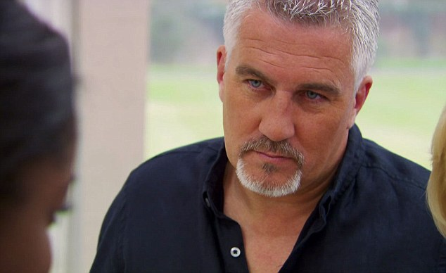
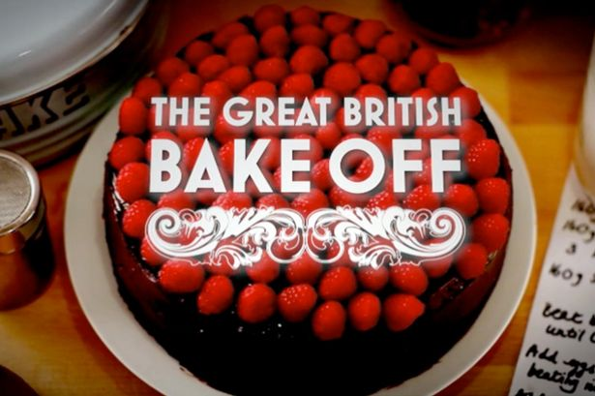
‘Mount St Joseph does the Great British Bake-Off’
Paul Hollywood wants you to make a superb Victoria Sponge. But as usual the recipe is not straight forward.

Slide 21
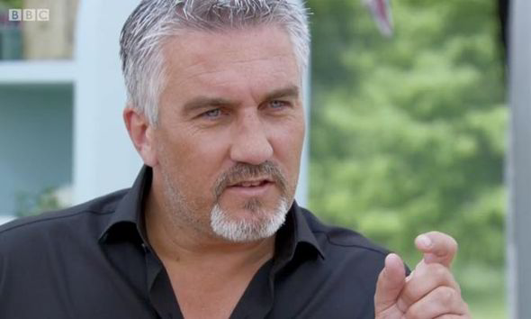
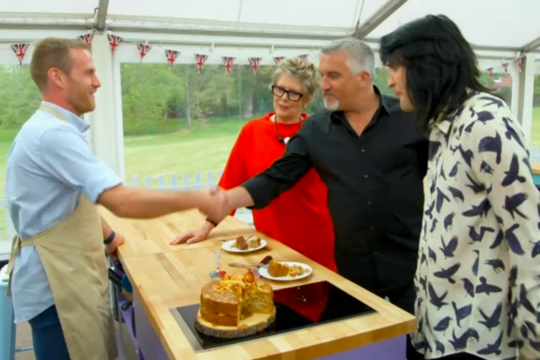
Ingredients
4 Eggs
120g Casting Sugar
110g Flour
2 tsp Baking Powder
145g Margarine
The ingredients shown above in Paul’s recipe will only bake a cake for 6 people. How much of each ingredient will be needed if we are making one cake for 9 people?

Slide 22
Ingredients
4 Eggs
120g Casting Sugar
110g Flour
2 tsp Baking Powder
145g Margarine
The ingredients shown above in Paul’s recipe will only bake a cake for 6 people. How much of each ingredient will be needed if we are making one cake for 9 people?
Ingredients
4 + 2 = 6 Eggs
120g + 60g = 180g Casting Sugar
110g + 55g = 165g Flour
2 tsp + 1 tsp = 3tsp Baking Powder
145g + 72.5g = 217.5g Margarine
9 people is 6 + 3, so half as much ingredients need to be added again.

Slide 23
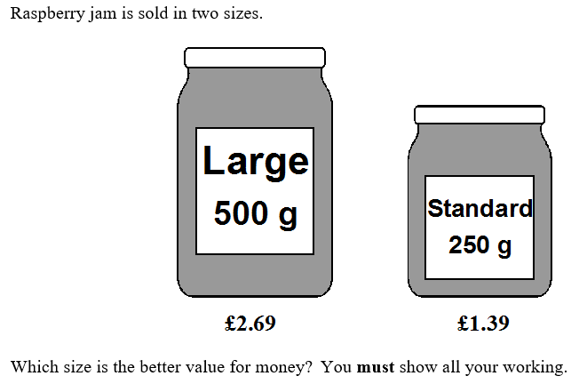
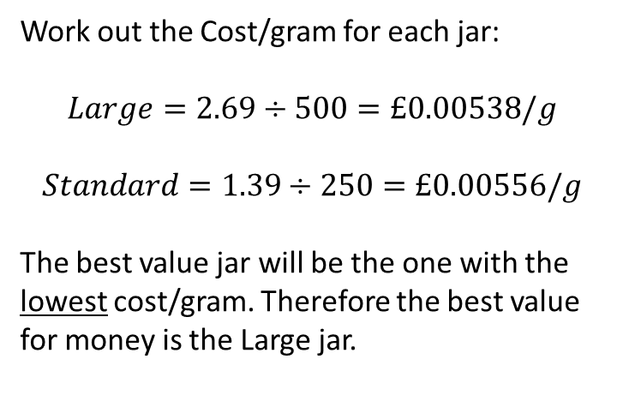
Work out the Cost/gram for each jar:
$$Large=2.69÷500=£0.00538/g$$
$$Standard=1.39÷250=£0.00556/g$$
The best value jar will be the one with the lowest cost/gram. Therefore the best value for money is the Large jar.

Slide 24
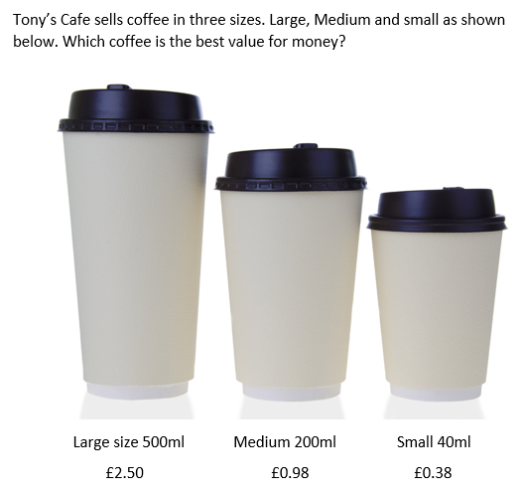
Two of your staff members have answered this question. They may have made some deliberate mistakes. Using the mark scheme below, work out what score they should get.
M1 – For a correct method to work out the cost per unit of two cups.
M1 – For correctly working out all three costs.
A1 – Either: £0.005, £0.0049, £0.0095
0.5p, 0.49p, 0.95p
200, 255, 105 (ml/£)
C1 - for correct conclusion based on their figures (consistent units) (dep on at least one M1 scored)
4 marks

Slide 25
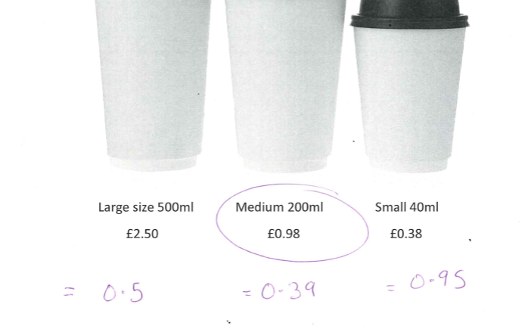
M1 – For a correct method to work out the cost per unit of two cups.
M1 – For correctly working out all three costs.
A1 – Either: £0.005, £0.0049, £0.0095
0.5p, 0.49p, 0.95p
200, 255, 105 (ml/£)
C1 - for correct conclusion based on their figures (consistent units) (dep on at least one M1 scored)

Slide 26
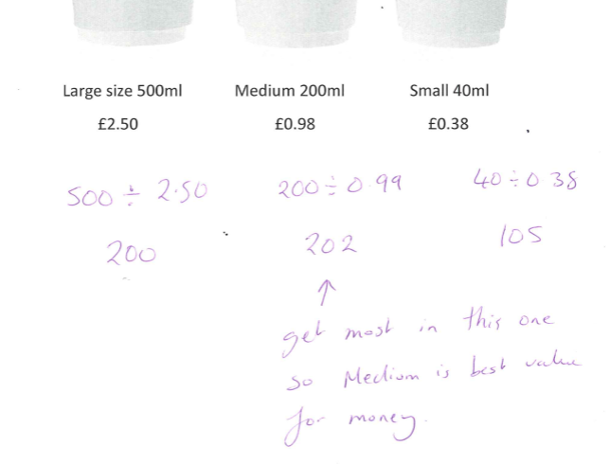
M1 – For a correct method to work out the cost per unit of two cups.
M1 – For correctly working out all three costs.
A1 – Either: £0.005, £0.0049, £0.0095
0.5p, 0.49p, 0.95p
200, 255, 105 (ml/£)
C1 - for correct conclusion based on their figures (consistent units) (dep on at least one M1 scored)

Slide 27
Can you now write out a perfect answer for the full 4 marks?

Slide 28
Can you now write out a perfect answer for the full 4 marks?
Large 250 ÷ 500 = 0.5p per ml
Medium 98 ÷ 200 = 0.49p per ml
Small 38 ÷ 40 = 0.95p per ml
Medium is best value for money

Slide 29
Quick Quiz!

Slide 30
2 : 6
? : 3
1

Slide 31
15 : 5
3 : ?
1

Slide 32
18 : 16
9 : ?
8

Slide 33
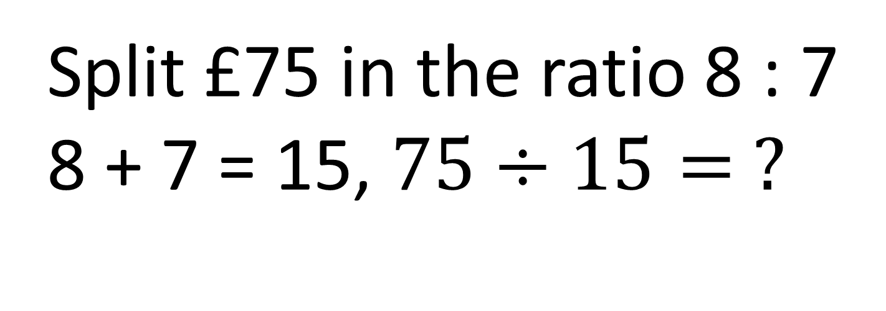
Split £75 in the ratio 8 : 7
8 + 7 = 15, $75÷15= ?$
5

Slide 34
8 : 7
? : ?
x 7
x 7
56
49

Slide 35
48 : ?
4 : 3
36

Slide 36
40cm : 1m
40 : ?
100

Slide 37
4m : 240cm
400 : 240
40 : 24
? : 3
5

Slide 38
2 : 3.5
4 : ?
7

Slide 39
4 : ?
16 : 1
0.25

Slide 40
8 : 20 : 12
? : 5 : ?
2
3

Slide 41
7 : 2 : ?
28 : ? : 12
3
8

Slide 42
11 : 7
132 : ?
x ?
12
84

Slide 43

Todays Objectives – Have you met them?
Objectives
Reminder: Compilation Homework Due 11th Dec
To be able to simplify fractions with different units.
To be able to split an amount into a ratio.
To be able to find unknowns with ratios.

Slide 44
Suggested Videos
For this lesson
Ordering Numbers: https://www.youtube.com/watch?v=gOmj58JdxL8
Ordering fractions decimals percentages – Corbettmaths
Percentages:
For next lesson
Adding & Subtracting Fractions:
https://www.youtube.com/watch?v=5juto2ze8Lg
Math Antics - Adding and Subtracting Fractions
Working with decimals:
https://www.youtube.com/watch?v=kwh4SD1ToFc
Math Antics - Decimal Arithmetic
BIDMAS:
https://www.youtube.com/watch?v=6K77Igo39vk
GCSE Maths - BIDMAS - Aslam Tutoring

