Slide 1
Y11
Top Tips for Revision
2019/20
A community of learners, believers and friends

Slide 2
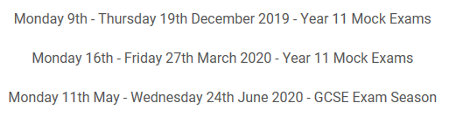

Slide 3
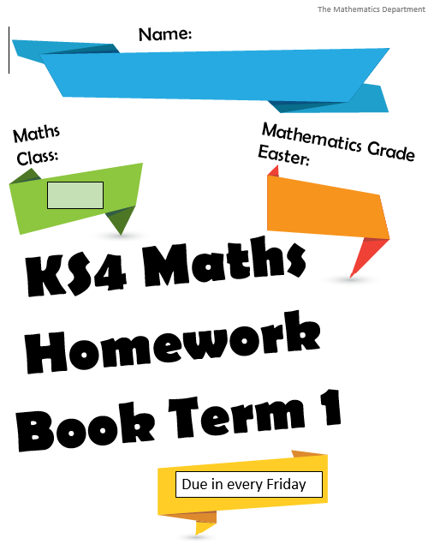
Mathematics
Homework
Check homework is being complete each week – there are Maths clinics each lunch time

Slide 4
Mathematics
Revision Tips
Start now!
10 – 20 mins, 5 times a week
Watch a video – do some questions

Slide 5
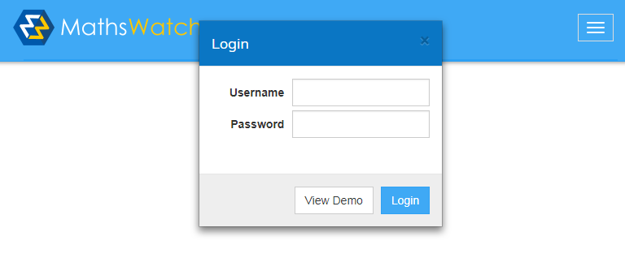
Mathematics
Revision resources
MathsWatch - https://vle.mathswatch.co.uk/vle/
jsmith@msj
jsmith@msj
See example for username of John Smith
This website includes video tutorials and tasks to complete on key topics.

Slide 6
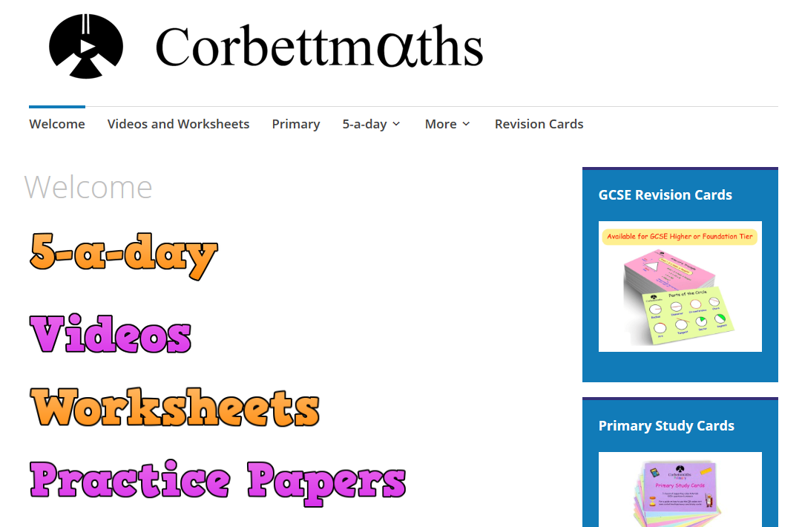
Mathematics
Corbett Maths

Slide 7
An excellent website
www.onmaths.com
www.mathsgenie.co.uk
www.senecalearning.com

Slide 8
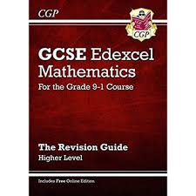
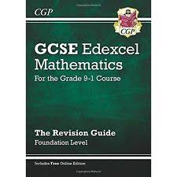
Mathematics
Revision guides
Edexcel revision guides and workbooks are £3 each and they can be bought on Parent Mail.

Slide 9
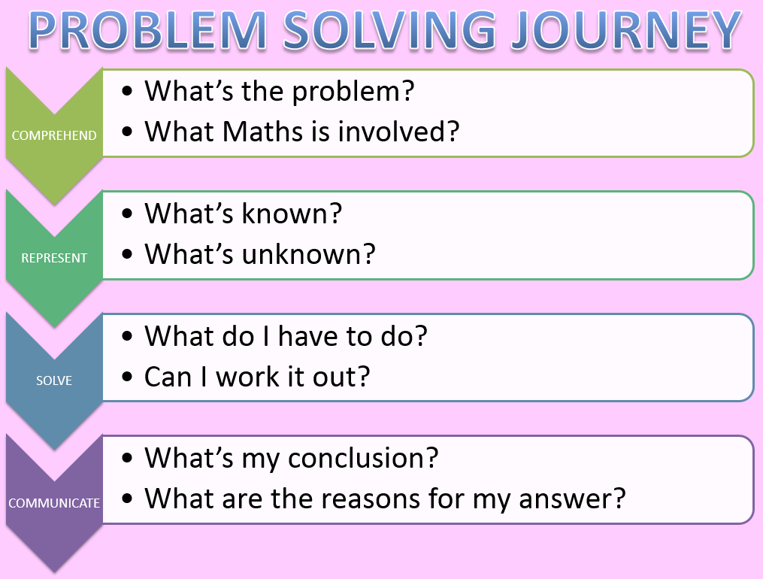
Mathematics
5 key tips:
Read and re-read the question (even if you think you know what it is asking)
Check the marks – 3 marks means 3 things to do
Show all working out (you never know where you can pick up marks)
Monitor your time – remember 1 mark = 1 minute
Part ‘a’ and part ‘b’ of a question will be linked
(see what you did in part ‘a’ to help you in part ‘b’)

