Slide 1
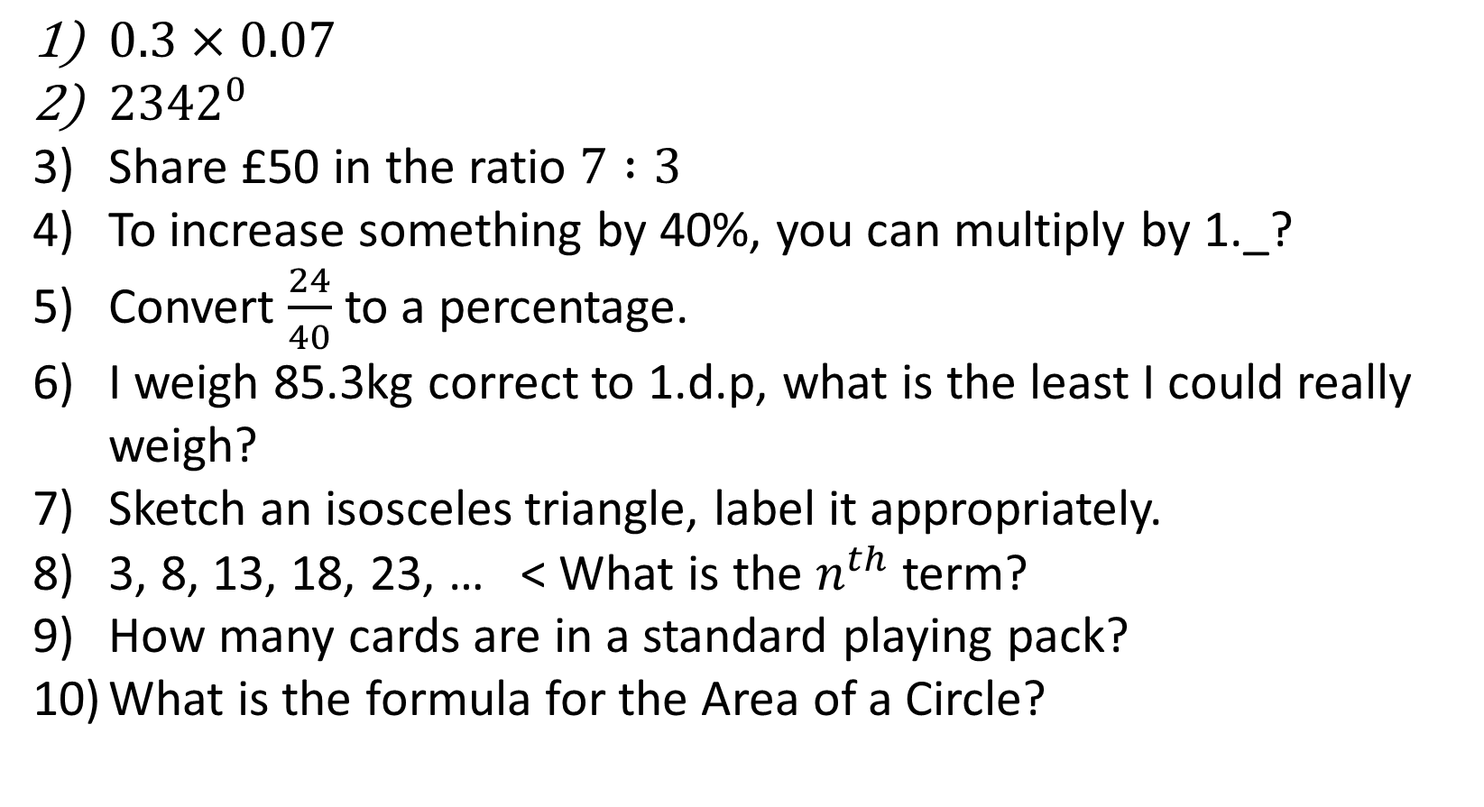
1-10 Quiz.
$0.3×0.07$
${2342}^{0}$
Share £50 in the ratio $7 :3$
To increase something by 40%, you can multiply by 1._?
Convert $\frac{24}{40}$ to a percentage.
I weigh 85.3kg correct to 1.d.p, what is the least I could really weigh?
Sketch an isosceles triangle, label it appropriately.
3, 8, 13, 18, 23, … < What is the $n^{th}$term?
How many cards are in a standard playing pack?
What is the formula for the Area of a Circle?
Notes:
This could also be a YouTube clip, matching exercise, Anything that will engage the learners from the start of the lesson.
TUTOR TO TAKE THE REGISTER DURING THIS TIME. THERE IS NO NEED TO CALL OUT NAMES.

Slide 2
1-10 Quiz.
$0.3×0.07$
${2342}^{0}$
Share £50 in the ratio $7 :3$
To increase something by 40%, you can multiply by 1._?
Convert $\frac{24}{40}$ to a percentage.
I weigh 85.3kg correct to 1.d.p, what is the least I could really weigh?
Sketch an isosceles triangle, label it appropriately.
3, 8, 13, 18, 23, … < What is the $n^{th}$term?
How many cards are in a standard playing pack?
What is the formula for the Area of a Circle?
0.021
1
£35:£15
1.4
60%
85.25kg
5n – 2
52
Area = ∏r²
Notes:
This could also be a YouTube clip, matching exercise, Anything that will engage the learners from the start of the lesson.
TUTOR TO TAKE THE REGISTER DURING THIS TIME. THERE IS NO NEED TO CALL OUT NAMES.

Slide 3
Title: Simultaneous Equations & Error Intervals
Objectives
To be able to solve simultaneous equations by elimination.
To be able to find Upper/Lower Bounds and Error Intervals.

Slide 4
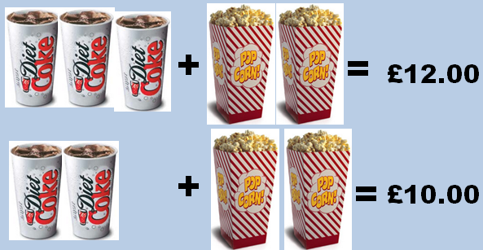


Pictures take ages! Is there an easier way to represent a coke and popcorn?
= C
= P
3c + 2p = 12
2c + 2p = 10
c = 2

Slide 5
So that’s why we use Simultaneous Equations…
When we have 2 different unknown letters, we can solve the equations at the same time (simultaneously).
Bronze: Solve: 6x + y = 15
4x + y = 11
What makes these questions easier/harder than each other?
Silver: Solve: 4x + 3y = 27
2x + y = 17
Gold: Solve: 2x + 3y = 30
5x + 7y = 71

Slide 6
We have 2 unknowns: x and y
Bronze:
Solve: 6x + 1y = 15 (1)
4x + 1y = 11 (2)
SAME SIGN SUBTRACT
Step 1: Eliminate the letter with the same co-efficient (by SUBTRACTING in this question)…
6x + 1y = 15
4x + 1y = 11 -
2x = 4
x = 2
Step 2: To find y, we substitute
x = 2 back into one of the original equations (equation 1)
(6 x 2) + y = 15
12 + y = 15
(-12)
y = 3

Slide 7
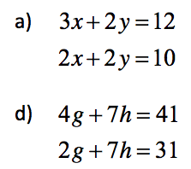
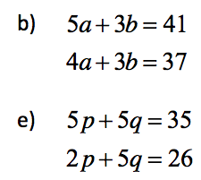
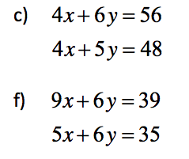
Activity 1
X = 2 y = 3 b) a = 4 b = 7 c) x = 2 y = 8
d) g = 5 h = 3 e) p = 3 h = 4 f) x = 1 y = 5

Slide 8
Bronze:
Solve: 4x + 3y = 32 (1)
5x – 3y = 13 (2)
We have 2 unknowns: x and y
DIFFERENT SIGN ADD
Step 1: Eliminate the letter with the same co-efficient (by ADDING in this question)
4x + 3y = 32
5x - 3y = 13 +
9x = 45
x = 5 (÷ 9)
Step 2: To find y, we substitute
x = 5 back into one of the original equations (equation 1)
(4 x 5) + 3y = 32
20 + 3y = 32
3y = 12 (- 20)
y = 4 (÷ 3)

Slide 9
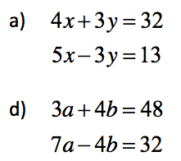
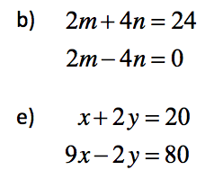
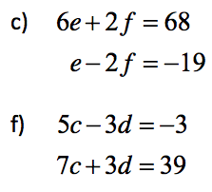
Activity

Slide 10
Activity
X = 5 y = 4 b) m = 6 n = 3 c) e = 7 f = 13
d) a = 8 b = 6 e) x = 10 y = 5 f) c = 3 d = 6

Slide 11
When Co-Efficient’s are not the same…
Silver: Solve: 3x + 3y = 18 (1)
5x + y = -2 (2)
SAME SIGN SUBTRACT
Step 1: When neither co-efficient’s are the same we multiply one or both equations to make them the same…
Multiply equation (2) by 3
15x + 3y = -6 (3)
We call this equation (3)
We use the original equation 1 and new equation 3.
Step 3: To find y, we substitute
x = -2 back into one of the original equations (equation 1)
(3 x -2) + 3y = 18
-6 + 3y = 18
3y = 24 (+ 6)
y = 8 (÷ 3)
Step 2: Eliminate the letter with the same co-efficient (by SUBTRACTING in this question)
(3) 15x + 3y = -6
(1) 3x + 3y = 18 –
12x = - 24
x = -2 (÷ 12)

Slide 12
Silver: Solve: x + 4y = 6 (1)
3x - 2y = 4 (2)
DIFFERENT SIGN ADD
Step 1: When neither co-efficient’s are the same we multiply one or both equations to make them the same…
Multiply equation (2) by x2
6x – 4y = 8 (3)
We call this equation (3)
We use the original equation 1 and new equation 3.
Step 2: Eliminate the letter with the same co-efficient (by ADDING in this question)
(1) x + 4y = 6
(3) 6x - 4y = 8 +
7x = 14
x = 2 (÷ 7)

Slide 13
Activity
Solve:
5x + 2y = 20
2x + 4y = 24
b) 3x + 2y = 26
4x – y = 20
Solve:
c) 2x + 9y = 69
x + 3y = 24
d) 4x + 3y = 19
3x – 4y = 8
X = 2 y = 5 c) x = 3 y = 7
x = 6 y = 4 d) x = 4 y = 1

Slide 14

Upper and Lower Bounds
The length of a piece of string has been rounded to 7cm.
What is the shortest and longest it could have been before rounding?
6cm
7cm
8cm
Lower Bound
Upper Bound
6.5cm
7.5cm
The error interval is: 6.5cm≤x<7.5cm

Slide 15
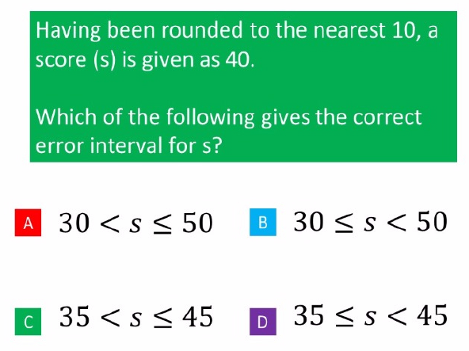
Error Intervals Quick Quiz

Slide 16
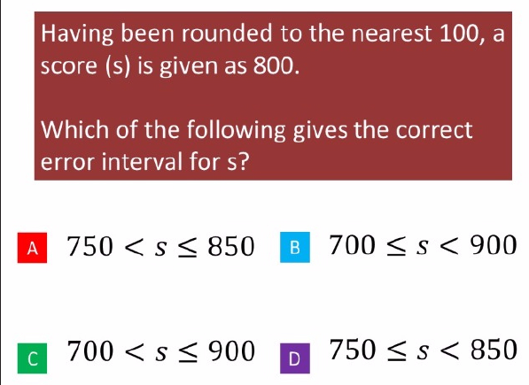

Slide 17
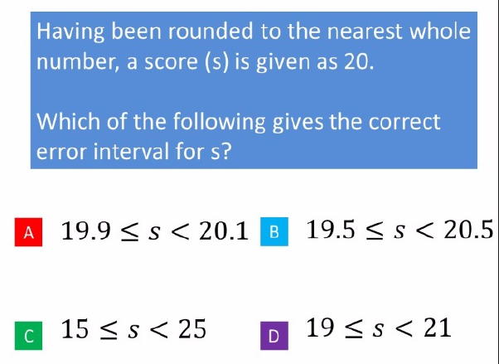

Slide 18
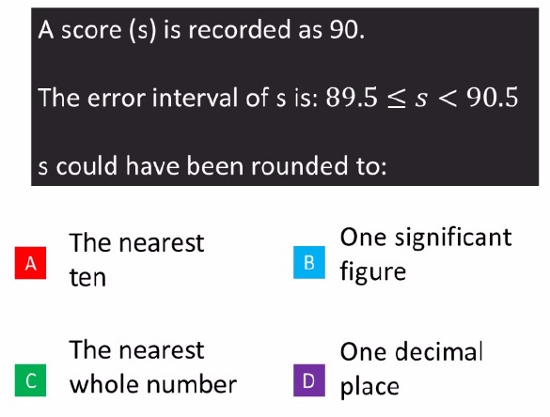

Slide 19
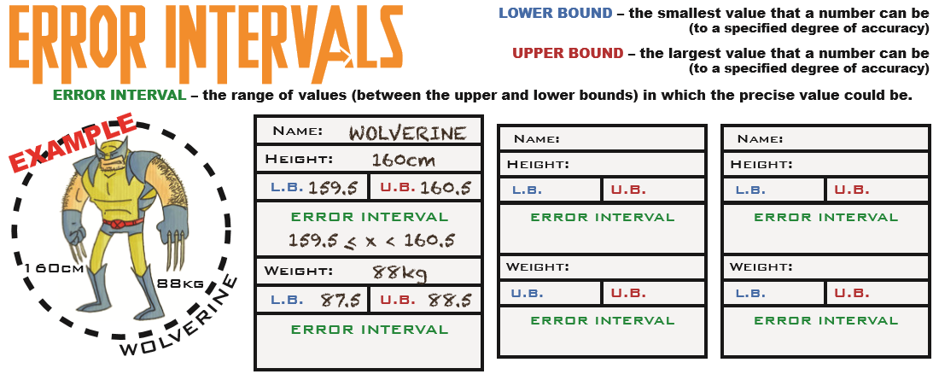

Slide 20
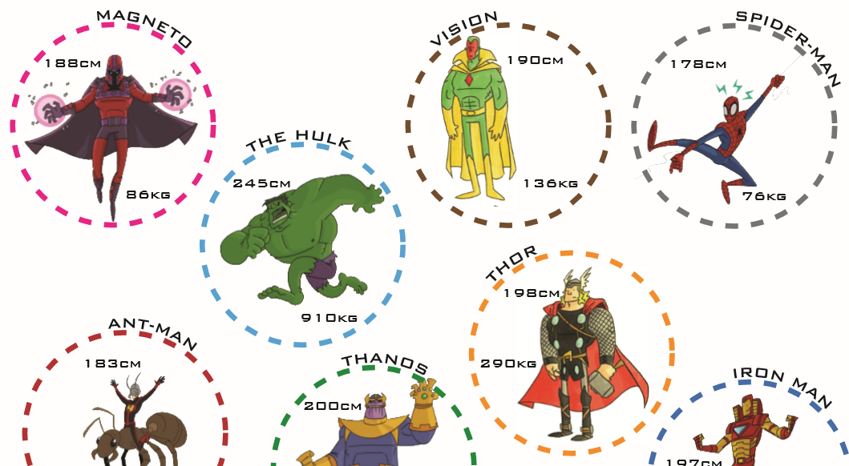
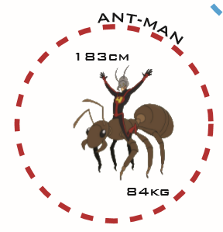
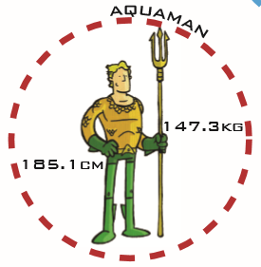

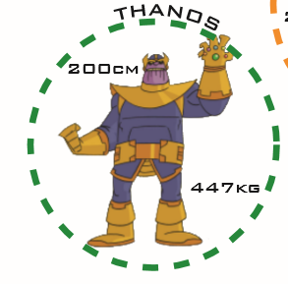
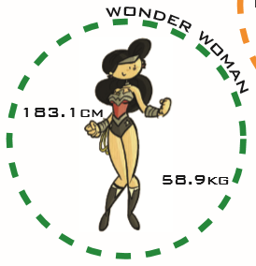

Slide 21
Plenary
The sum of 2 numbers is 19 and their difference is 5. Find the value of each of the numbers.

Slide 22
Plenary
The sum of 2 numbers is 19 and their difference is 5. Find the value of each of the numbers.
12 and 7

Slide 23

Todays Objectives – Have you met them?
Objectives
To be able to solve simultaneous equations by elimination.
To be able to find Upper/Lower Bounds and Error Intervals.

Slide 24
Suggested Videos
For this lesson
Ordering Numbers: https://www.youtube.com/watch?v=gOmj58JdxL8
Ordering fractions decimals percentages – Corbettmaths
Percentages:
For next lesson
Adding & Subtracting Fractions:
https://www.youtube.com/watch?v=5juto2ze8Lg
Math Antics - Adding and Subtracting Fractions
Working with decimals:
https://www.youtube.com/watch?v=kwh4SD1ToFc
Math Antics - Decimal Arithmetic
BIDMAS:
https://www.youtube.com/watch?v=6K77Igo39vk
GCSE Maths - BIDMAS - Aslam Tutoring

