Slide 1
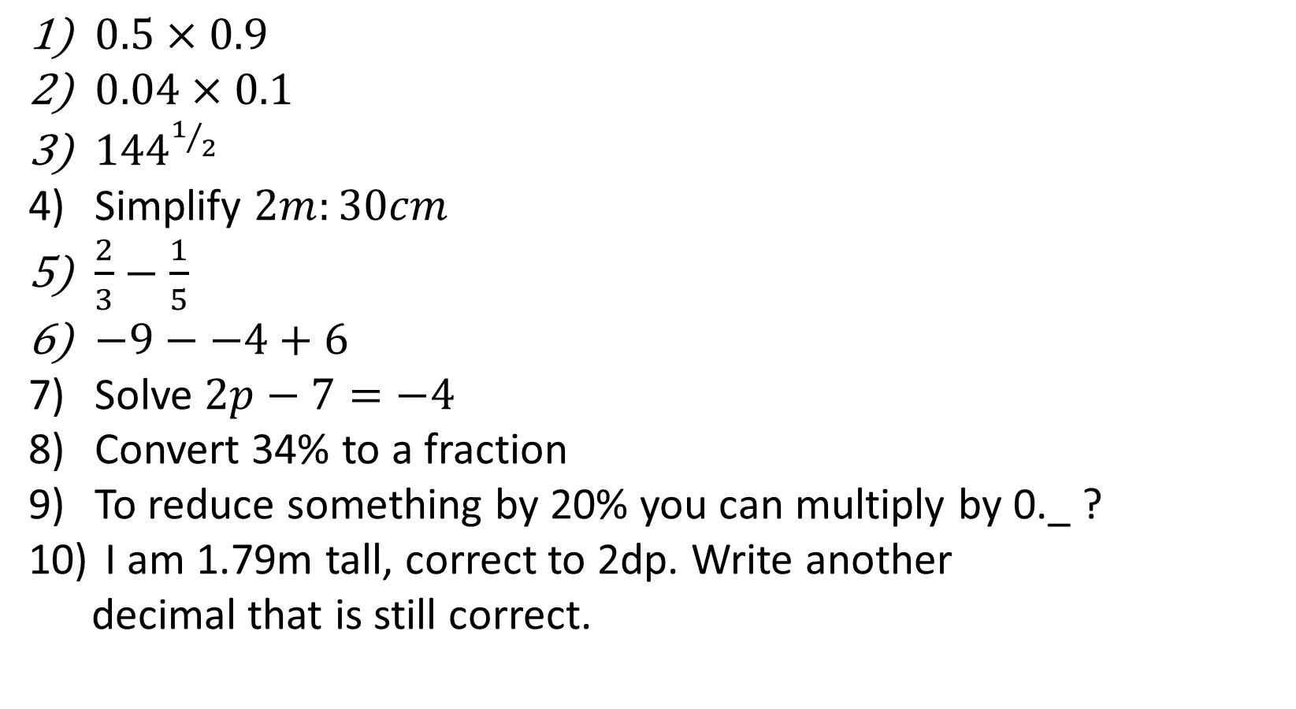
1-10 Quiz.
$0.5×0.9$
$0.04×0.1$
${144}^{1/2}$
Simplify $2m:30cm$
$\frac{2}{3}−\frac{1}{5}$
$−9−−4+6$
Solve $2p−7=−4$
Convert 34% to a fraction
To reduce something by 20% you can multiply by 0._ ?
I am 1.79m tall, correct to 2dp. Write another
decimal that is still correct.
Notes:
This could also be a YouTube clip, matching exercise, Anything that will engage the learners from the start of the lesson.
TUTOR TO TAKE THE REGISTER DURING THIS TIME. THERE IS NO NEED TO CALL OUT NAMES.

Slide 2
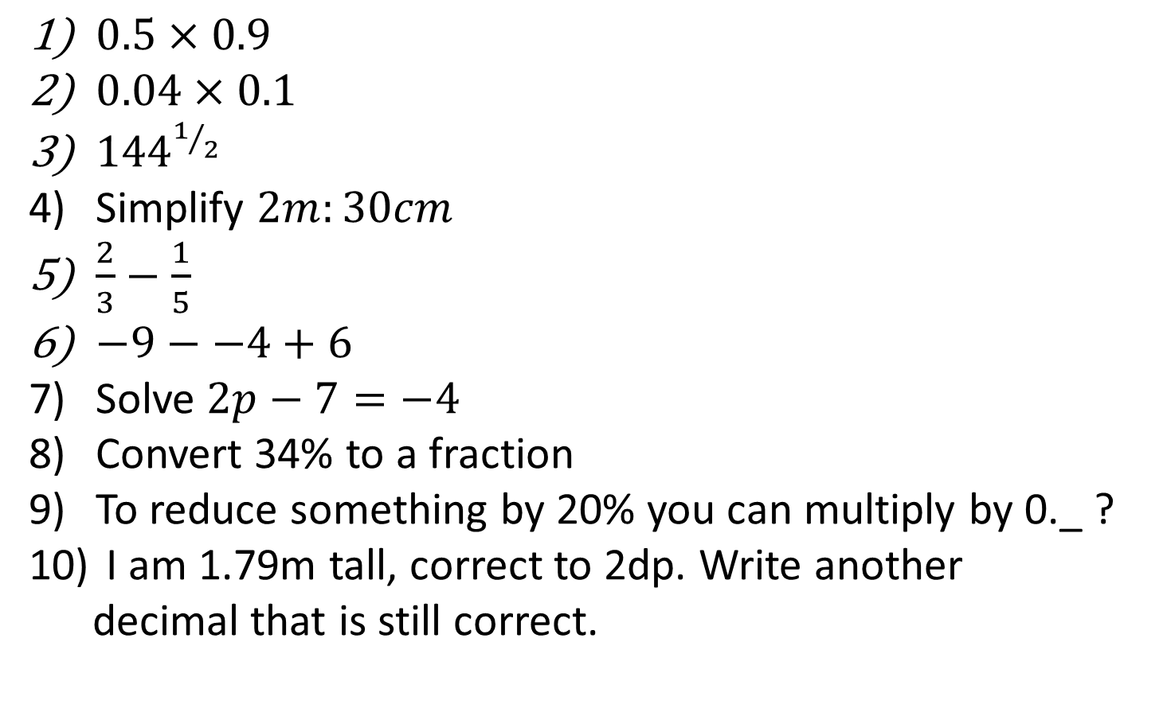
1-10 Quiz.
0.45
0.004
12
20 :3
7/15
1
P = 1.5
34/100 or 17/50
0.8
1.786 ….
$0.5×0.9$
$0.04×0.1$
${144}^{1/2}$
Simplify $2m:30cm$
$\frac{2}{3}−\frac{1}{5}$
$−9−−4+6$
Solve $2p−7=−4$
Convert 34% to a fraction
To reduce something by 20% you can multiply by 0._ ?
I am 1.79m tall, correct to 2dp. Write another
decimal that is still correct.
Notes:
This could also be a YouTube clip, matching exercise, Anything that will engage the learners from the start of the lesson.
TUTOR TO TAKE THE REGISTER DURING THIS TIME. THERE IS NO NEED TO CALL OUT NAMES.

Slide 3
Title: Inequalities and Rearranging Formulae
Objectives
To be able to solve inequalities and understand the difference between them and equations.
To be able to rearrange formulae.

Slide 4
Inequalities
What are the inequality signs?
There are 4 inequality signs.
They work a bit like “equals” signs.
>
<
≥
≤
Greater than
Less than
Greater than or equal to
Less than or equal to

Slide 5
Inequalities
What’s the point of inequality signs?
Some problems don’t have one specific answer.
Inequalities give a range of possible answers.
We can represent this range of answers on a number line.

Slide 6

Some examples:
Inequalities
○ represents < or >.
● represents ≤ or ≥.
Represent $x>−1$ on the number line.
Represent $x≤3$ on the number line.
●
○
-6
-5
-4
-3
-2
-1
0
1
2
3
4
5
6
7

Slide 7

Your Turn
Inequalities
$x<4$
$x≥2$
$x≤−3$
●
●
○
-6
-5
-4
-3
-2
-1
0
1
2
3
4
5
6
7

Slide 8
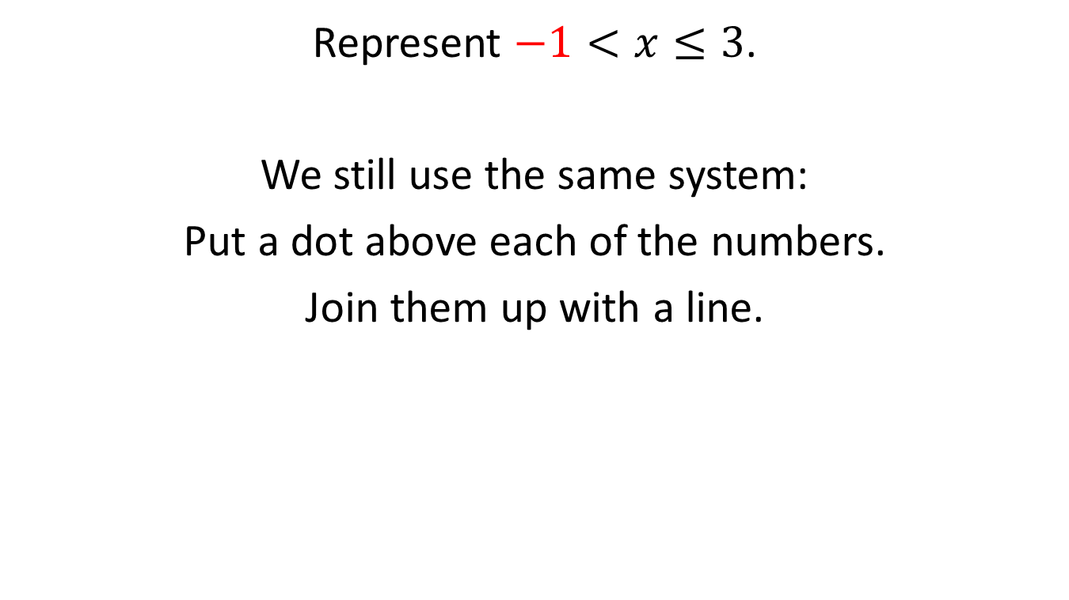
What about this?
Inequalities
Represent $−1<x≤3$.
We still use the same system:
Put a dot above each of the numbers.
Join them up with a line.
○
●
-6
-5
-4
-3
-2
-1
0
1
2
3
4
5
6
7

Slide 9

Your Turn
Inequalities
$1<x<4$
$−4≤x<2$
●
○
○
○
-6
-5
-4
-3
-2
-1
0
1
2
3
4
5
6
7

Slide 10
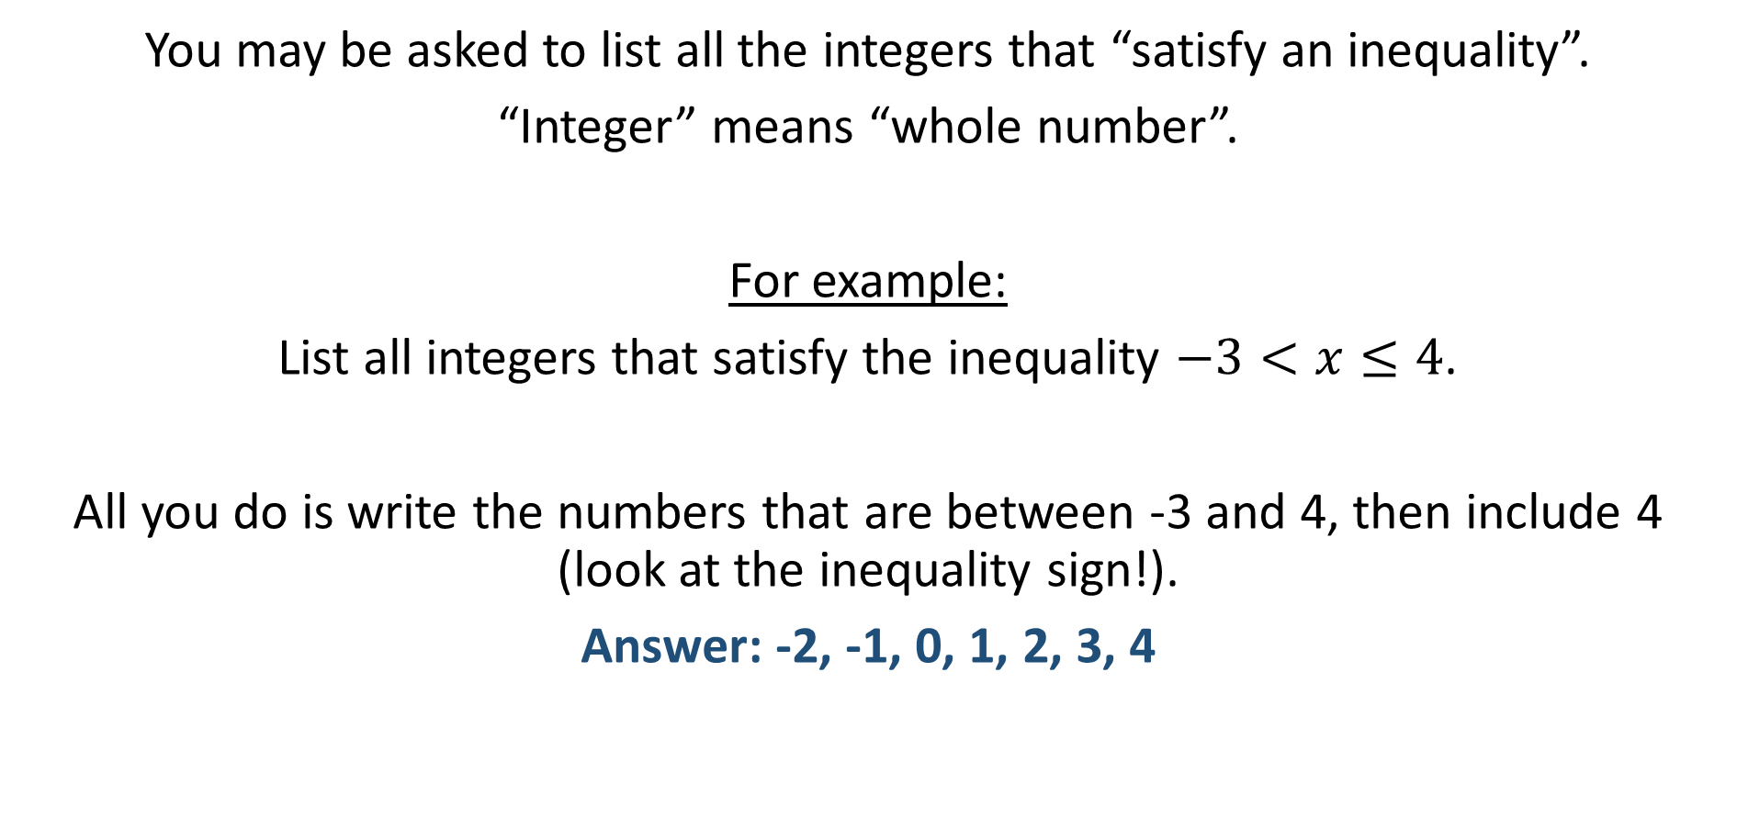
Inequalities
One last thing:
You may be asked to list all the integers that “satisfy an inequality”.
“Integer” means “whole number”.
For example:
List all integers that satisfy the inequality $−3<x≤4$.
All you do is write the numbers that are between -3 and 4, then include 4 (look at the inequality sign!).
Answer: -2, -1, 0, 1, 2, 3, 4

Slide 11

Inequalities
List the integer values that satisfy the inequalities below:
$−2≤x<3$
$1<x≤5$
-2, -1, 0, 1, 2
2, 3, 4, 5

Slide 12
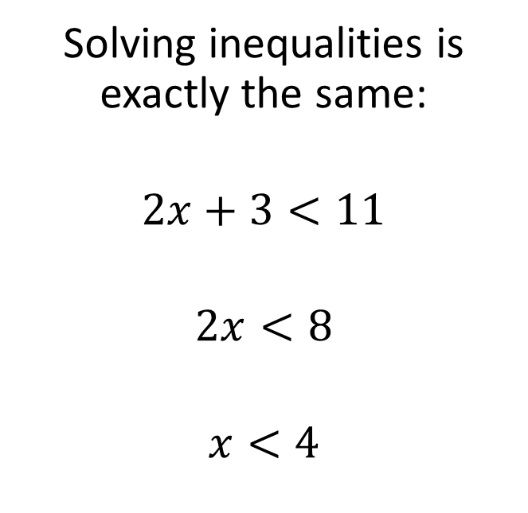

Inequalities
How do you solve inequalities?
Can you solve this?
$$2x+3=11$$
$$2x=8$$
$$x=4$$
Solving inequalities is exactly the same:
$$2x+3<11$$
$$2x<8$$
$$x<4$$

Slide 13





Try solving these inequalities:
Inequalities
$$x<1$$
$3x+2<5$
$5x−4≥26$
$4x+7>35$
$7<2x−5$
$$x≥6$$
$$x>7$$
$6<x$ or
$$x>6$$

Slide 14
Inequalities
Be careful with negatives!
When you multiply or divide an inequality by a negative number, the inequality sign swaps around.
The same thing happens with equals signs, only it makes no difference.

Slide 15
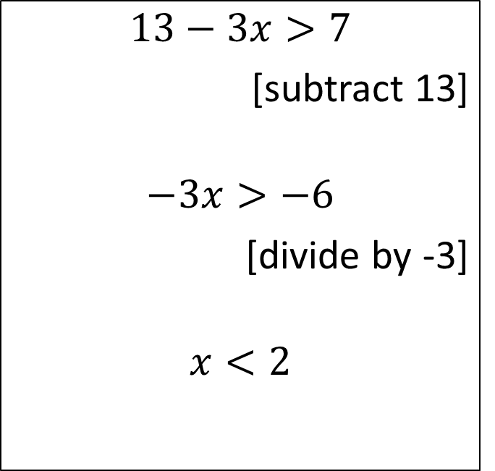
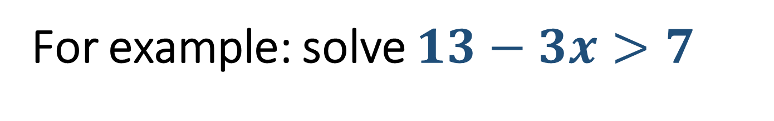
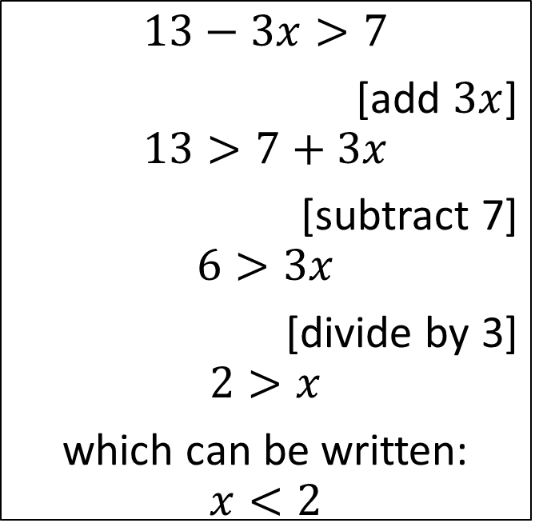
Inequalities
For example: solve $13−3x>7$
Method 1
Method 2
$$13−3x>7$$
[subtract 13]
$$−3x>−6$$
[divide by -3]
$$x<2$$
$$13−3x>7$$
[add $3x$]
$$13>7+3x$$
[subtract 7]
$$6>3x$$
[divide by 3]
$$2>x$$
which can be written:
$$x<2$$
Both methods give the same answer!

Slide 16



Your Turn
Inequalities
$21−8x≥13$
$5−4x<13$
$$x≤1$$
$$x>−2$$

Slide 17






Inequalities
Two inequality signs? How on earth…?
$$5<2x−1<13$$
Solve .
$$6<2x$$
$$2x<14$$
$$3<x$$
$$x<7$$
$$3<x<7$$

Slide 18
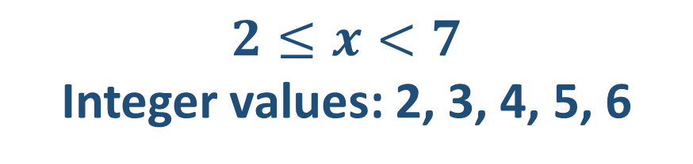

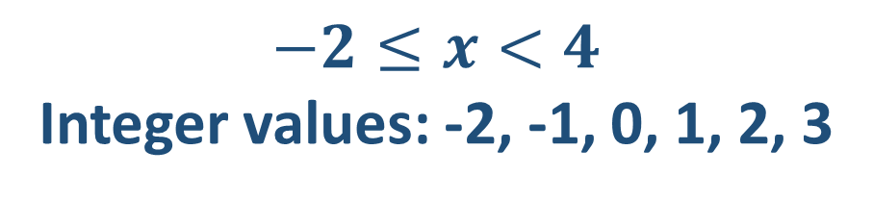
Solve these inequalities and write all the integer values that satisfy them:
$8≤3x+2<23$
$−5<4x+3≤19$
$$2≤x<7$$
Integer values: 2, 3, 4, 5, 6
$$−2≤x<4$$
Integer values: -2, -1, 0, 1, 2, 3

Slide 19
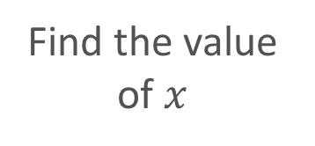

Inequalities
An example:
Solve $5x−3>3x+5$
[subtract $3x$]
$$2x−3>5$$
[Add 3]
$$2x>8$$
[Divide by 2]
Answer:
$$x>4$$
Move the smallest ‘x’
Move any spare numbers
Find the value of $x$

Slide 20



Inequalities
Solve these inequalities:
$7x+3≥3x+11$
$x−7<4x+2$
$$x≥2$$
$$x>−3$$

Slide 21
Rearranging Formulae
Uses the same skills as Solving Equations.
Have a look at the following example, do you remember how to do it? Is it completely new?

Slide 22

Changing the Subject of the Formula
Make $x$ the subject of the formula:
$$y = 7x – 2$$
$$y + 2 = 7x$$
$$\frac{y+2}{7}=x$$
(+ 2)
(+ 2)
(÷ 7)
(÷ 7)

Slide 23
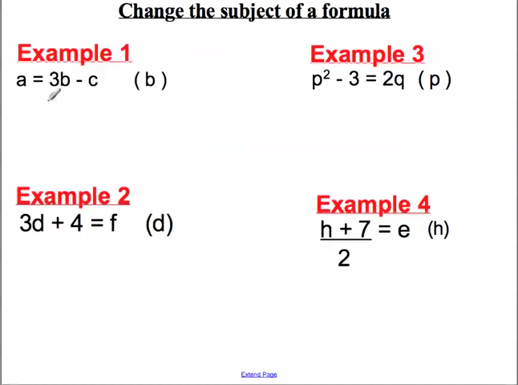

Slide 24
(a + c)/3 = b
p = √(2q + 3)
d = (f – 4) / 3
h = 2e - 7

Slide 25
VR
V = IR
I = ?
V
R
R
V
Notes:
Amber

Slide 26
Vπr²
V = πr²h
h = ?
V
πr²
Vr²
π
Notes:
Amber

Slide 27
a(v – u)
v = u + at
t = ?
v + u
a
v - u
a
Notes:
Amber

Slide 28
A
2h
A = ½bh
b = ?
2A
h
2Ah
Notes:
Amber

Slide 29
2A - b
h
A = ½(a + b)h
a = ?
2Ah
b
2A – b
h
Notes:
Amber

Slide 30
c - a
a² + b² = c²
b = ?
√(c² - a²)
√(a² - c²)
Notes:
Amber

Slide 31

Todays Objectives – Have you met them?
Objectives
To be able to solve inequalities and understand the difference between them and equations.
To be able to rearrange formulae.

Slide 32
Suggested Videos
For this lesson
Ordering Numbers: https://www.youtube.com/watch?v=gOmj58JdxL8
Ordering fractions decimals percentages – Corbettmaths
Percentages:
For next lesson
Adding & Subtracting Fractions:
https://www.youtube.com/watch?v=5juto2ze8Lg
Math Antics - Adding and Subtracting Fractions
Working with decimals:
https://www.youtube.com/watch?v=kwh4SD1ToFc
Math Antics - Decimal Arithmetic
BIDMAS:
https://www.youtube.com/watch?v=6K77Igo39vk
GCSE Maths - BIDMAS - Aslam Tutoring

