Slide 1
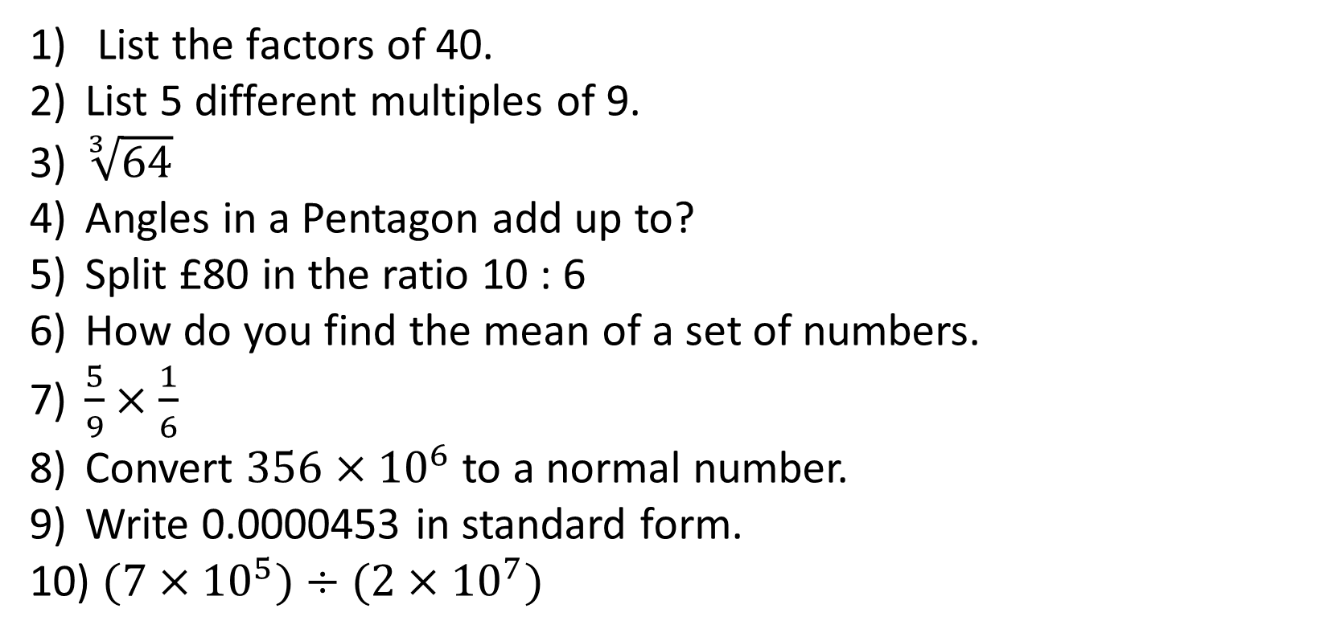
1-10 Quiz.
List the factors of 40.
List 5 different multiples of 9.
$\sqrt[3]{64}$
Angles in a Pentagon add up to?
Split £80 in the ratio 10 : 6
How do you find the mean of a set of numbers.
$\frac{5}{9}×\frac{1}{6}$
Convert $356×{10}^{6}$ to a normal number.
Write 0.0000453 in standard form.
$(7×{10}^{5})÷(2×{10}^{7})$
Notes:
This could also be a YouTube clip, matching exercise, Anything that will engage the learners from the start of the lesson.
TUTOR TO TAKE THE REGISTER DURING THIS TIME. THERE IS NO NEED TO CALL OUT NAMES.

Slide 2
1-10 Quiz.
List the factors of 40.
List 5 different multiples of 9.
$\sqrt[3]{64}$
Angles in a Pentagon add up to?
Split £80 in the ratio 10 : 6
How do you find the mean of a set of numbers.
$\frac{5}{9}×\frac{1}{6}$
Convert $356×{10}^{6}$ to a normal number.
Write 0.0000453 in standard form.
$(7×{10}^{5})÷(2×{10}^{7})$
1, 2, 4, 5, 8, 10, 20, 40
9, 18, 27, 36, 45, ……
4
540
50 : 30
Add up and divide by how many numbers
5/54
3560000
4.53 x 10⁻⁵
3.5 x 10⁻²
Notes:
This could also be a YouTube clip, matching exercise, Anything that will engage the learners from the start of the lesson.
TUTOR TO TAKE THE REGISTER DURING THIS TIME. THERE IS NO NEED TO CALL OUT NAMES.

Slide 3
Title: Conversions
Objectives
To be able to convert lengths into different units.
To be able to use conversion graphs.
To be able to convert currencies using exchange rates

Slide 4

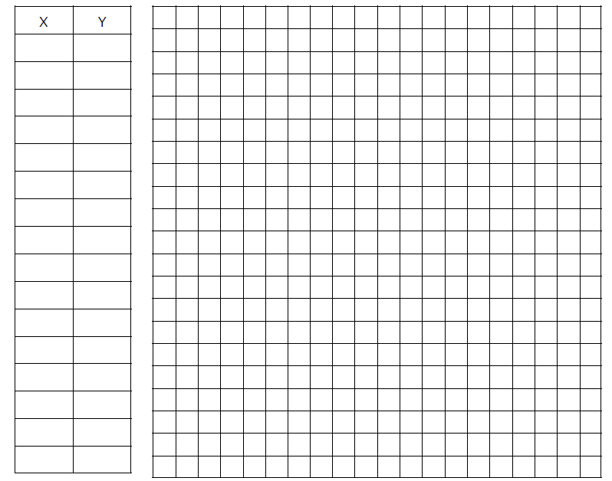
Dave’s getting the bus all holiday.
How much will it cost for a 6 day bus pass?
He’s decided he wants to spend £50 on the bus pass and wants to know what pass it will get him.
(probably why he needs to sort out his finances.)
70
60
£25
50
40
Price (£)
30
20
10
16 days
0
0
2
4
6
8
10
12
14
16
18
Days

Slide 5
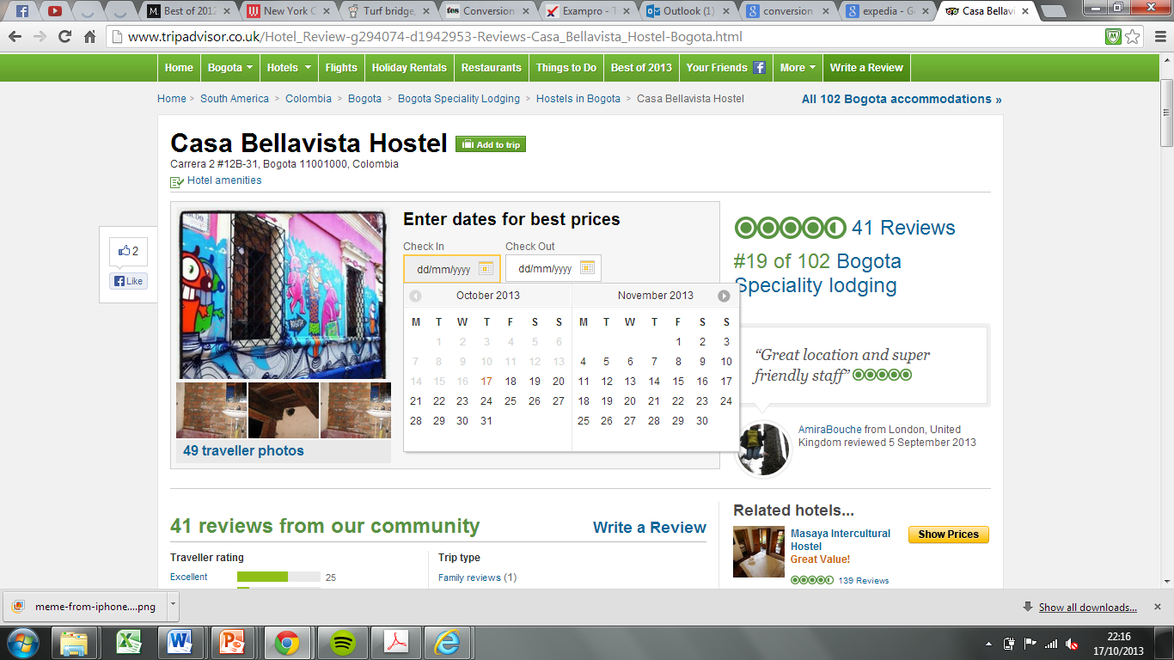
Dave’s found this amazing hotel with two price plans.
How much will it cost Dave to stay at ‘Casa BelleVista’ for 4 nights?
How much on price plan purple?
700
600
500
400
£300
Price (£)
300
200
£200
100
0
0
2
4
6
8
10
12
14
16
18
Days

Slide 6
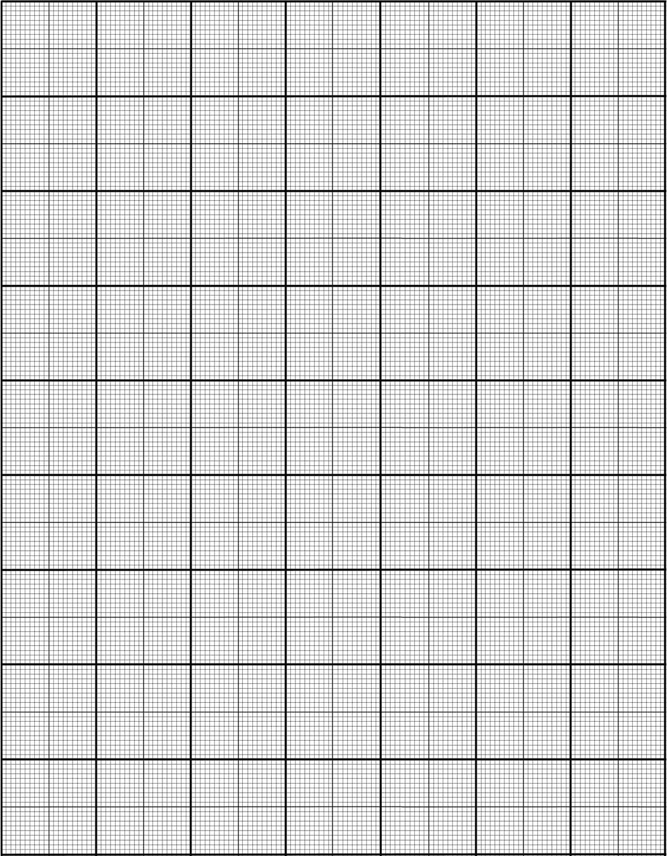
Hours worked | 20 | 40 | 60 | 80 | 100
Pay (£) | 73.60 | 147.20 | 220.80 | 294.40 | 368
400
350
How much do you get paid for:
50 hours?
35 hours?
How many hours do you have to work to earn:
c) £200
d) £275
300
£185
250
£127
Pay (£)
200
150
55
100
76
50
0
0
20
40
60
80
100
Hours Worked

Slide 7
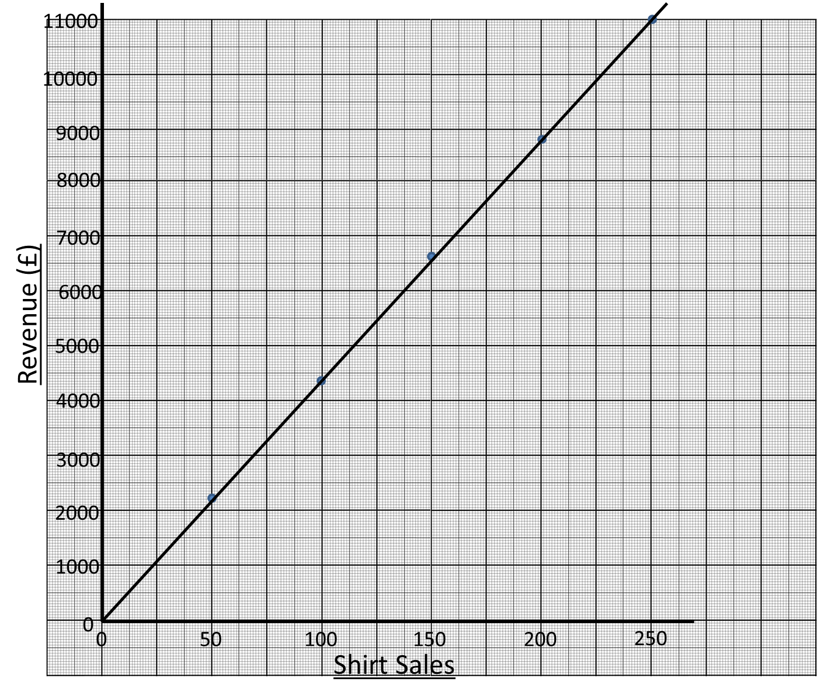
b) How much is made from selling:
i) 90 shirts
ii) 175 shirts
c) How many shirts need to be sold to make:
i) £5000
ii) £6400
£4000
£7600
114
147

Slide 8
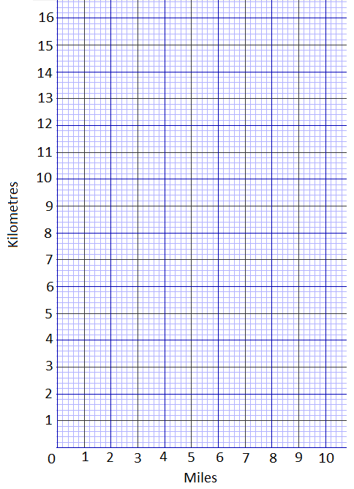
Conversion Graphs
5 miles = 8 kilometres
Draw a conversion graph to show this information
I ran 10km recently for charity. How many miles is that?
6.2 miles
Mr. Connell is currently training to run a marathon which is approx 26.2 miles. How many kilometres is this?
42km

Slide 9
Conversion Graphs
5 miles = 8 kilometres
Mr. Walmsley and
Mr. Gribbon are taking on the Iron Man challenge again this year.
It consists of:
A 2.4 mile swim
A 112 mile bike ride
And
A marathon (26.2 miles)
How far are they travelling in kilometres?
3.8km
179.4km
42km
Total = 225.2km

Slide 10
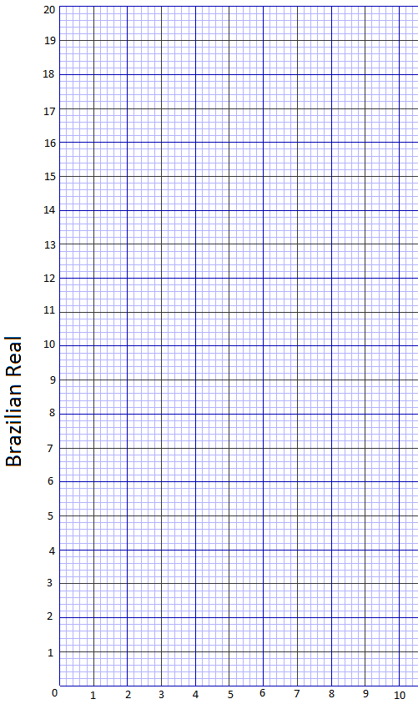
1 Brazilian Real is equal to £0.30
Convert:
a) £1 into Real
b) 15 Real into Pounds
c) 100 Real into Pounds
d) £50 into Real
e) 45 Real into Pounds
3.20 Real
£4.50
£30
166 Real
£13.50
The cheapest ticket for the world cup final is rumoured to cost around 350 Real. How much is that in pounds?

Slide 11
Why Metric Matters!

Slide 12
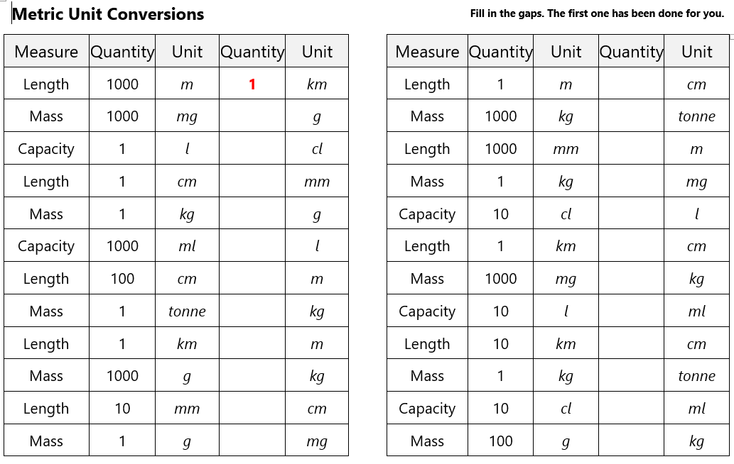

Slide 13
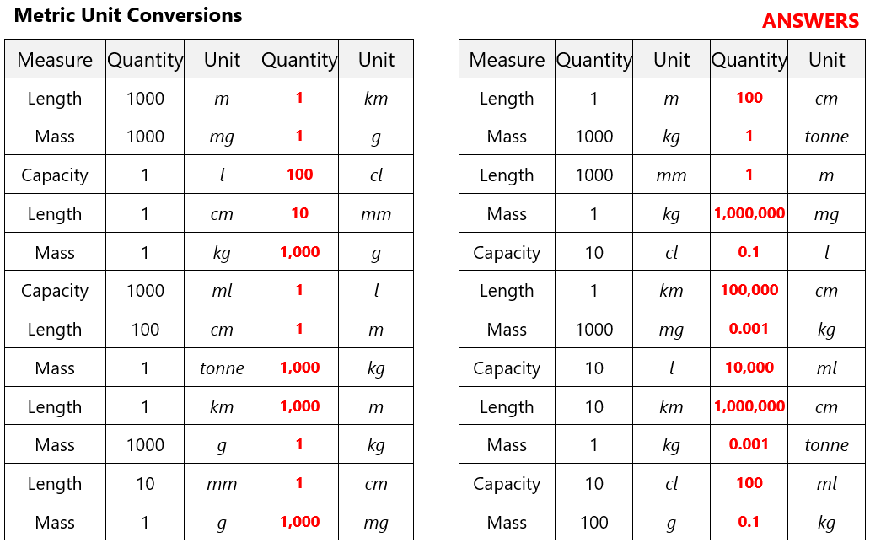

Slide 14
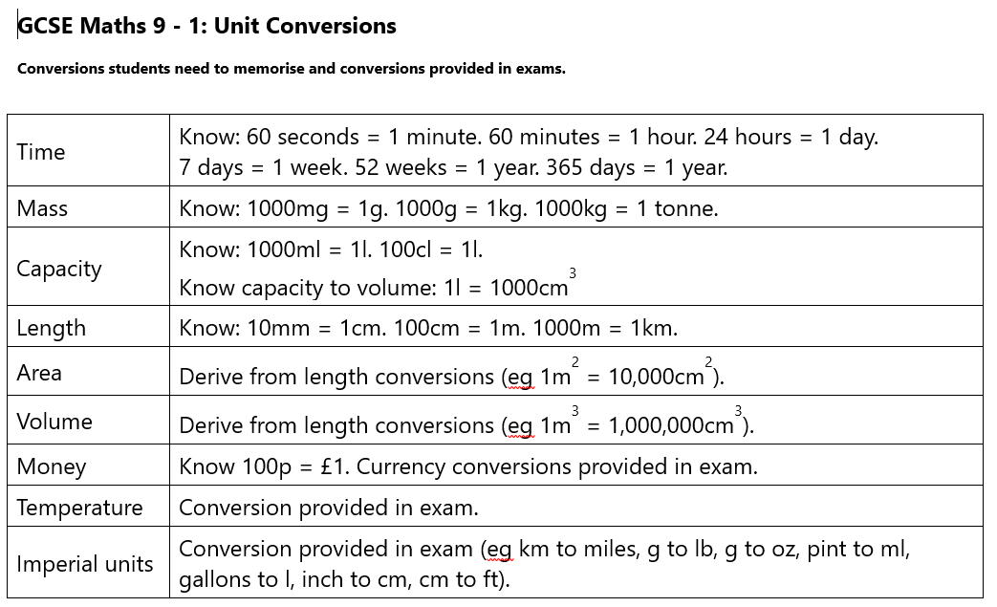

Slide 15
Metric Conversions: Length
Converting between these units you need to multiply or divide by powers of 10
Here is an example using length (metres)
mm cm m km
÷ 10
÷ 100
÷ 1000
x 10
x 100
x 1000
1km = 1000m
1m = 100cm
1cm = 10mm

Slide 16
Metric Conversions: Areas
What is the area of a square 1m by 1m in cm²
1m
100cm
1m
100cm
Area 1m x 1m = 1m²
1m = 100cm
Area 100cm x 100cm = 10,000cm²
1m² = 10,000cm²

Slide 17
Metric Conversions: Volumes
What is the volume of a cube 1m by 1m by 1m in cm³
1m
100cm
1m
100cm
1m
100cm
Volume 1m x 1m x 1m = 1m³
1m = 100cm
100cm x 100cm x 100cm = 1,000,000cm³
1m³ = 1,000,000cm³

Slide 18
Metric Conversions:
Area & Volume
Metric Area
mm² cm² m² km²
÷ 10²
÷ 100²
÷ 1000²
x 10²
x 100²
x 1000²
Metric Volume
mm³ cm³ m³ km³
÷ 10³
÷ 100³
÷ 1000³
x 10³
x 100³
x 1000³

Slide 19
Practice – Convert:
5m into cm
250mm into m
0.0025km into mm
4m² into cm²
1200cm² into m²
0.032cm³ into mm³
1500000mm³ into m³
x 100
5 x 100 = 500 cm
÷ 10
÷ 100
250 ÷ 1000 = 0.25 m
x 1000
x 100
x 10
0.0025 x 1000000 = 2500 mm
x 100²
4 x 100² = 40000 cm²
÷ 100²
1200 ÷ 100² = 0.12 m²
x 10³
0.032 x 10³ = 32 mm³
÷ 10³
÷ 100³
1500000 ÷ 10³ ÷ 100³ = 0.0015 m³

Slide 20
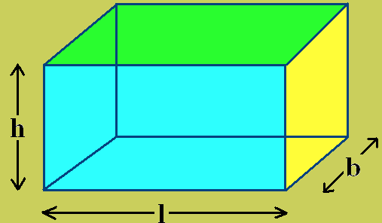
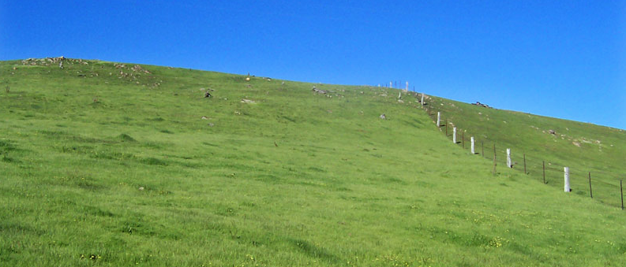
Contextualised
(a) A rectangle is 6m by 4m. What is it’s area in cm²?
(b) A cuboid is 2cm by 3cm by 5cm. What is it’s volume in mm³?
(c) A field has an area of 36000000m². What is it’s area in km²?
6m x 4m = 24m²
24m² x 100² = 240000cm²
2cm x 3cm x 5cm = 30cm³
30cm³ x 10³ = 30000mm³
36000000m² ÷ 1000² = 36km²

Slide 21
Practice – Contextualised:
A cube has a volume of 8cm³. What is it’s volume in m³?
A square has an area of 8100m². What is the length of each side of the square in km?
A football pitch is 80m by 120m. Calculate: (1) the perimeter in cm. (2) The area in km².
5miles ≈ 8 kilometres. The approximate distance between London and Cambridge is 60 miles. How far is it between London and Cambridge in metres?
8cm³ ÷ 100³ = 0.000008m³
√8100 = 90
So the length of each side is 90m
90 ÷ 1000 = 0.09km
Perimeter = 80 + 80 + 120 + 120 = 400m
400m x 100 = 40000cm
Area = 80 x 120 = 9600m²
9600m² ÷ 1000² = 0.0096km²
5miles ≈ 8 kilometres
60 ÷ 5 = 12
8 x 12 = 96
London to Cambridge is 96km
London to Cambridge is 96km x 1000 = 96000m

Slide 22
Exchange Rates
The current Exchange Rate from pounds to Euros is:
£1 : €1.60
x 1.6
÷ 1.6

Slide 23
Exchange Rates
x 1.6
Always draw a conversion diagram like this one!
£1 : €1.60
1) Convert £2.50 into Euros
→ 2.5 x 1.6 = €4
2) If I return from a holiday with €12 Euros, what will I receive in pounds?
→ 12 ÷ 1.6 = €7.50
÷ 1.6

Slide 24

Exchange Rates
Mark came back from the USA. He changed $24.50 into pounds. He received £12.50. What was the Exchange rate?
Pounds (£)
Dollars ($)
£12.50
$24.50
So the exchange rate is:
£1 = $1.96
x ?
12.50 x ? = 24.50
? = 24.50 ÷ 12.50
? = 1.96

Slide 25
Consolidate
A student bought a pair of sunglasses in the USA.
He paid $35.50
In England, an identical pair of sunglasses costs £26.99
The exchange rate is £1 = $1.28
In which country were the sunglasses cheaper, and by how much?
Show all your working.
(Total 3 marks)
Method 1
26.99 x 1.28 = $34.5472
= $34.55
35.50- 34.55 = $0.95
Cheaper in the UK by $0.95
Method 2
35.50 ÷ 1.28 = £27.734375
= £27.73
27.73 – 26.99 = £0.74
Cheaper in the UK by £0.74

Slide 26

Todays Objectives – Have you met them?
Objectives
To be able to convert lengths into different units.
To be able to use conversion graphs.

Slide 27
Suggested Videos
For this lesson
Ordering Numbers: https://www.youtube.com/watch?v=gOmj58JdxL8
Ordering fractions decimals percentages – Corbettmaths
Percentages:
For next lesson
Adding & Subtracting Fractions:
https://www.youtube.com/watch?v=5juto2ze8Lg
Math Antics - Adding and Subtracting Fractions
Working with decimals:
https://www.youtube.com/watch?v=kwh4SD1ToFc
Math Antics - Decimal Arithmetic
BIDMAS:
https://www.youtube.com/watch?v=6K77Igo39vk
GCSE Maths - BIDMAS - Aslam Tutoring

