Slide 1
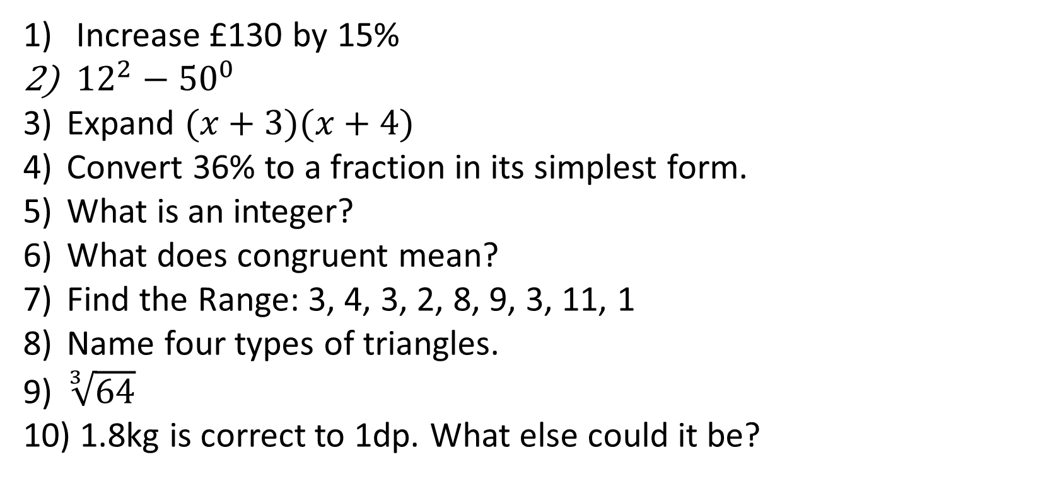
1-10 Quiz.
Increase £130 by 15%
${12}^{2}−{50}^{0}$
Expand $(x+3)(x+4)$
Convert 36% to a fraction in its simplest form.
What is an integer?
What does congruent mean?
Find the Range: 3, 4, 3, 2, 8, 9, 3, 11, 1
Name four types of triangles.
$\sqrt[3]{64}$
1.8kg is correct to 1dp. What else could it be?
Notes:
This could also be a YouTube clip, matching exercise, Anything that will engage the learners from the start of the lesson.
TUTOR TO TAKE THE REGISTER DURING THIS TIME. THERE IS NO NEED TO CALL OUT NAMES.

Slide 2
1-10 Quiz.
Increase £130 by 15%
${12}^{2}−{50}^{0}$
Expand $(x+3)(x+4)$
Convert 36% to a fraction in its simplest form.
What is an integer?
What does congruent mean?
Find the Range: 3, 4, 3, 2, 8, 9, 3, 11, 1
Name four types of triangles.
$\sqrt[3]{64}$
1.8kg is correct to 1dp. What else could it be?
£149.50
143
x² + 7x + 12
9/25
A whole number
Exactly the same shape
10
Equilateral, isosceles, scalene, right angled
4
1.79kg
Notes:
This could also be a YouTube clip, matching exercise, Anything that will engage the learners from the start of the lesson.
TUTOR TO TAKE THE REGISTER DURING THIS TIME. THERE IS NO NEED TO CALL OUT NAMES.

Slide 3
Title: Area & Perimeter
Objectives
To be able to find the Area & Perimeter of Rectangles, Triangles, Parallelograms and Trapeziums.
To be able to find the Area & Perimeter of Compound Shapes.

Slide 4
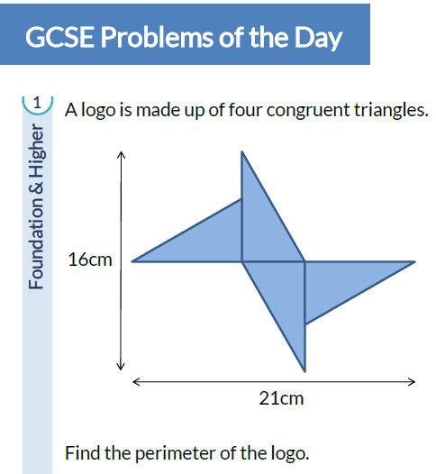
Starter
Note: Congruent – Equal size and angles.
Perimeter – The total length around the edge of the shape.

Slide 5
Starter
Note: Congruent – Equal size and angles.
Perimeter – The total length around the edge of the shape.
5cm
8.5cm
8.5cm
The height of each triangle = 8cm
The base of each triangle = 3cm
Difference between height and base = 5cm
Using Pythagoras, the slope of each triangle = 8.5cm
Add them all up
= 60cm
8cm
8cm
8.5cm
8.5cm
5cm

Slide 6
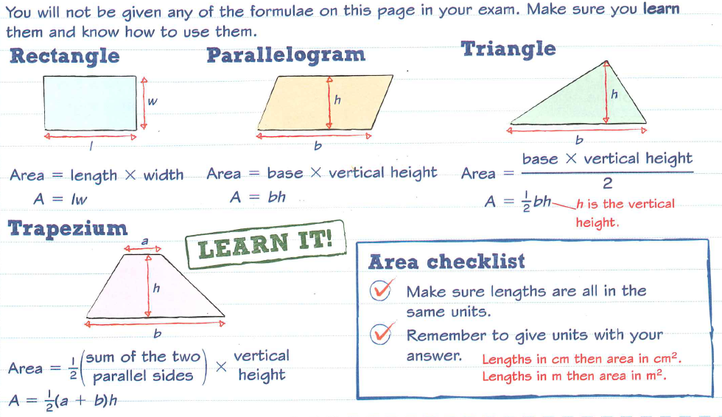

Slide 7
Rectangles
The perimeter of a rectangle with length l and width w can be written as:
l
Perimeter = 2l + 2w
Perimeter = 2(l + w)
or
w
The area of a rectangle is given as:
Area = lw

Slide 8
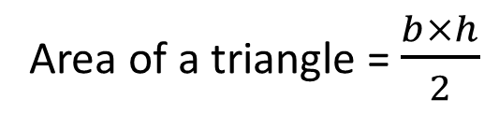
The area of a triangle
h
b
The area of a triangle with base b and perpendicular height h is given by:
Area of a triangle = $\frac{b×h}{2}$

Slide 9
The area of a parallelogram
The area of any parallelogram can be found using the formula:
Area of a parallelogram = base × perpendicular height
perpendicular height
base
Or using letter symbols,
A = bh
Notes:
Ask pupils to learn this formula.

Slide 10
The area of a parallelogram
What is the area of this parallelogram?
We can ignore this length
4.9 cm
4.5 cm
Area of a parallelogram = bh
7 cm
= 7 × 4.5
= 31.5 cm²
Notes:
Tell pupils that to work out the area of the parallelogram they must start by writing the formula.
They can then substitute the correct values into the formula provided that they are in the same units.
Point out that the length of the diagonal can be ignored.
Stress that it is important to always write down the correct units at the end of the calculation.

Slide 11

The area of a trapezium
The area of any trapezium can be found using the formula:
Area of a trapezium = $\frac{1}{2}$(sum of parallel sides) × height
a
Or using letter symbols,
perpendicular height
$$A=\frac{(a+b)}{2}×h$$
b
Notes:
Explain that finding half the sum of the parallel sides is like finding the average length of these two sides.
Ask pupils to learn this formula.

Slide 12
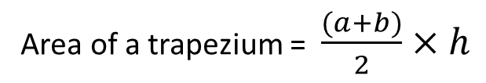

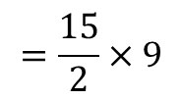
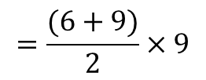
The area of a trapezium
What is the area of this trapezium?
6 m
Area of a trapezium = $\frac{(a+b)}{2}×h$
9 m
$$=\frac{(6+9)}{2}×9$$
$$=\frac{15}{2}×9$$
14 m
$$=90{cm}^{2}$$
Notes:
Tell pupils that to work out the area of the trapezium they must start by writing the formula.
They can then substitute the correct values into the formula provided that they are in the same units.
Stress that it is important to always write down the correct units at the end of the calculation.

Slide 13

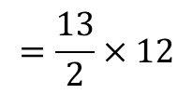
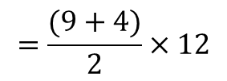
The area of a trapezium
What is the area of this trapezium?
Area of a trapezium = $\frac{(a+b)}{2}×h$
9 m
$$=\frac{(9+4)}{2}×12$$
4 m
$$=\frac{13}{2}×12$$
12 m
$$=78{cm}^{2}$$
Notes:
This example shows a right trapezium.

Slide 14
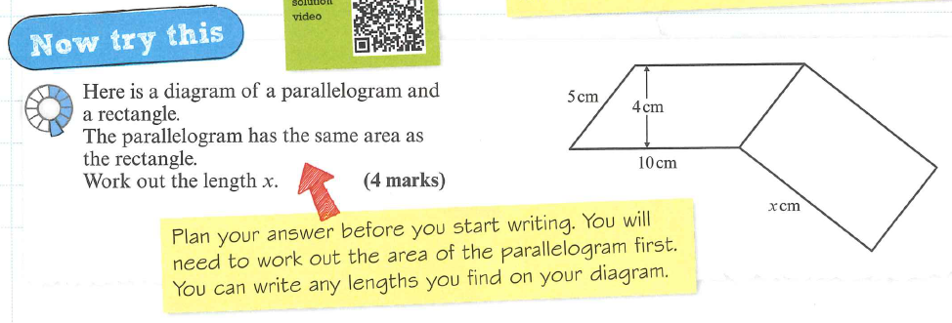

Slide 15
5cm
Area of parallelogram = 10 x 4 = 40cm²
The height of the rectangle = 5cm (same as the slope of the parallelogram)
Area of rectangle = base x height
40 = 5x
So x = 8cm

Slide 16
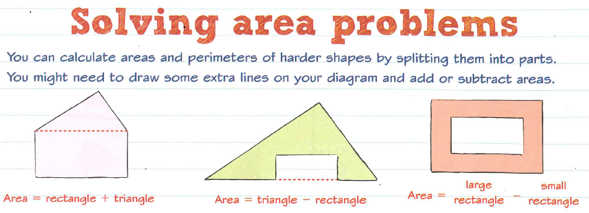

Slide 17
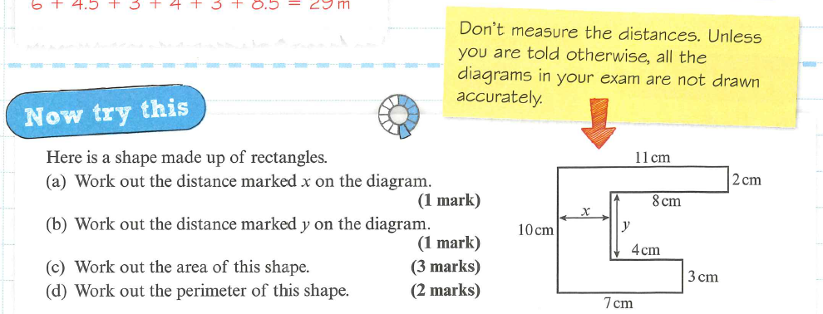

Slide 18
X = 7 – 4 = 3cm
Y = 10 – 2 – 3 = 5cm
Area = 22 + 21 + 15 = 58cm²

Slide 19
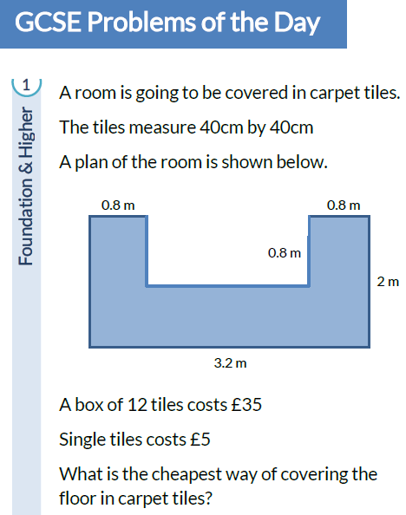
To End
Hints: - Get consistent units.
- Try and buy as many boxes of 12 as you can.

Slide 20
To End
Hints: - Get consistent units.
- Try and buy as many boxes of 12 as you can.
2 tiles
2 tiles
4 tiles
5 tiles
Each tile is 0.4m
32 tiles at £5 each box of 12 costs £35
2 boxes of 12 (24 tiles) = £70
8 single tiles = £40
Total = £110
5 tiles
3 tiles
8 tiles

Slide 21

Todays Objectives – Have you met them?
Objectives
To be able to find the Area & Perimeter of Rectangles, Triangles, Parallelograms and Trapeziums.
To be able to find the Area & Perimeter of Compound Shapes.

Slide 22
Suggested Videos
For this lesson
Ordering Numbers: https://www.youtube.com/watch?v=gOmj58JdxL8
Ordering fractions decimals percentages – Corbettmaths
Percentages:
For next lesson
Adding & Subtracting Fractions:
https://www.youtube.com/watch?v=5juto2ze8Lg
Math Antics - Adding and Subtracting Fractions
Working with decimals:
https://www.youtube.com/watch?v=kwh4SD1ToFc
Math Antics - Decimal Arithmetic
BIDMAS:
https://www.youtube.com/watch?v=6K77Igo39vk
GCSE Maths - BIDMAS - Aslam Tutoring

