Slide 1
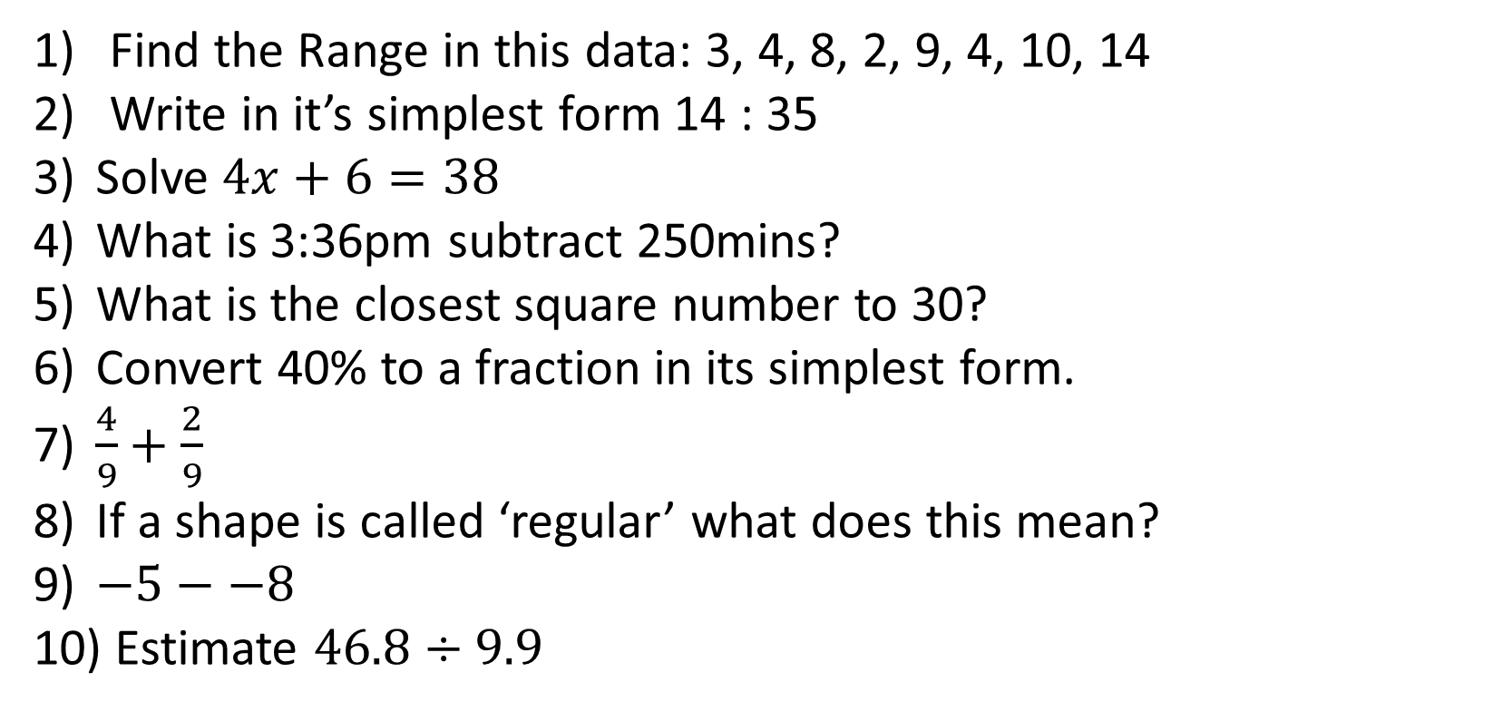
1-10 Quiz.
Find the Range in this data: 3, 4, 8, 2, 9, 4, 10, 14
Write in it’s simplest form 14 : 35
Solve $4x+6=38$
What is 3:36pm subtract 250mins?
What is the closest square number to 30?
Convert 40% to a fraction in its simplest form.
$\frac{4}{9}+\frac{2}{9}$
If a shape is called ‘regular’ what does this mean?
$−5−−8$
Estimate $46.8÷9.9$
Notes:
This could also be a YouTube clip, matching exercise, Anything that will engage the learners from the start of the lesson.
TUTOR TO TAKE THE REGISTER DURING THIS TIME. THERE IS NO NEED TO CALL OUT NAMES.

Slide 2
1-10 Quiz.
Find the Range in this data: 3, 4, 8, 2, 9, 4, 10, 14
Write in it’s simplest form 14 : 35
Solve $4x+6=38$
What is 3:36pm subtract 250mins?
What is the closest square number to 30?
Convert 40% to a fraction in its simplest form.
$\frac{4}{9}+\frac{2}{9}$
If a shape is called ‘regular’ what does this mean?
$−5−−8$
Estimate $46.8÷9.9$
12
2:5
X = 8
11:26 am
25
2/5
6/9 or 2/3
All the sides are the same length
3
5
Notes:
This could also be a YouTube clip, matching exercise, Anything that will engage the learners from the start of the lesson.
TUTOR TO TAKE THE REGISTER DURING THIS TIME. THERE IS NO NEED TO CALL OUT NAMES.

Slide 3
Title: Expanding Double Brackets
Objectives
To be able to expand simple double brackets.
To be able to expand complex double brackets.

Slide 4
Look at the different ways 2x² can be made, can you think of similar ways to make the other expressions?
3xy
4x²
2x²
2x³

Slide 5

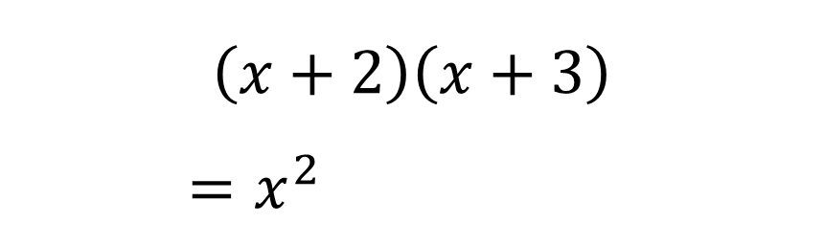
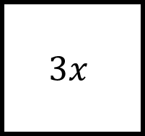



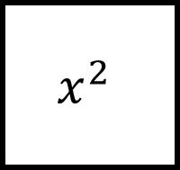

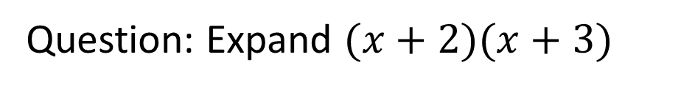




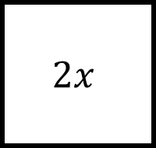


The FOIL method can be very helpful for helping us to remember how we can expand double brackets.
Question: Expand $(x+2)(x+3)$
$$\left(x+2\right)\left(x+3\right)$$
$=x^{2}$
$$x$$
$$+$$
$$3$$
$$x^{2}$$
$$3x$$
$$+ 3x$$
$$+ 2x$$
$$+ 6$$
$$x$$
Then tidy up!
$$=x^{2}+5x+6$$
$$+$$
$$2x$$
$$6$$
F – Multiply the First two terms together.
$$2$$
O – Multiply the Outside two terms together.
I – Multiply the Inside two terms together.
L – Multiply the Last two terms together.

Slide 6

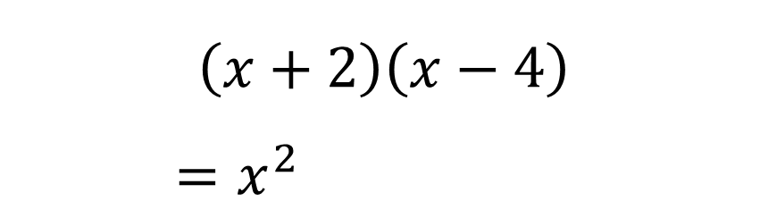
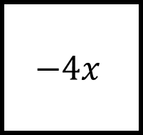


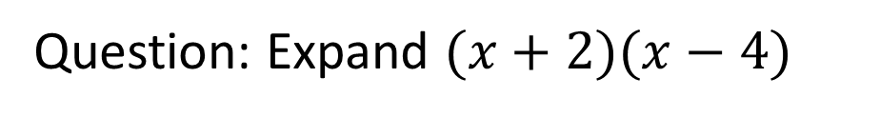
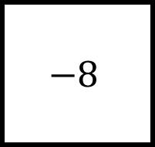


The FOIL method can be very helpful for helping us to remember how we can expand double brackets.
Question: Expand $(x+2)(x−4)$
$$\left(x+2\right)\left(x−4\right)$$
$=x^{2}$
$$x$$
$$−$$
$$4$$
$$x^{2}$$
$$−4x$$
$$− 4x$$
$$+ 2x$$
$$− 8$$
$$x$$
Then tidy up!
$$=x^{2}−2x−8$$
$$+$$
$$2x$$
$$−8$$
F – Multiply the First two terms together.
$$2$$
O – Multiply the Outside two terms together.
I – Multiply the Inside two terms together.
L – Multiply the Last two terms together.

Slide 7
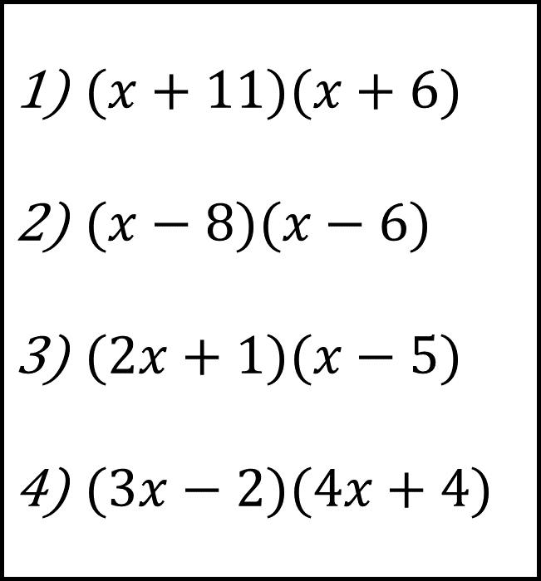
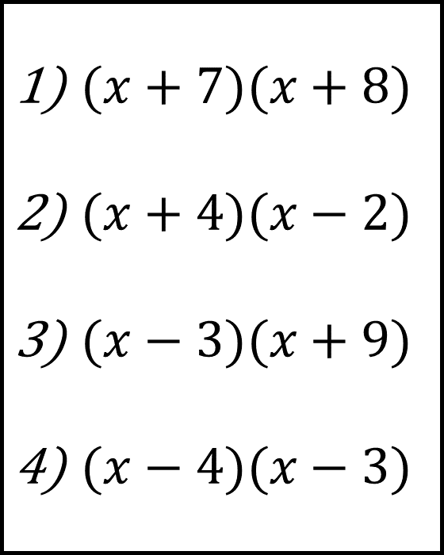
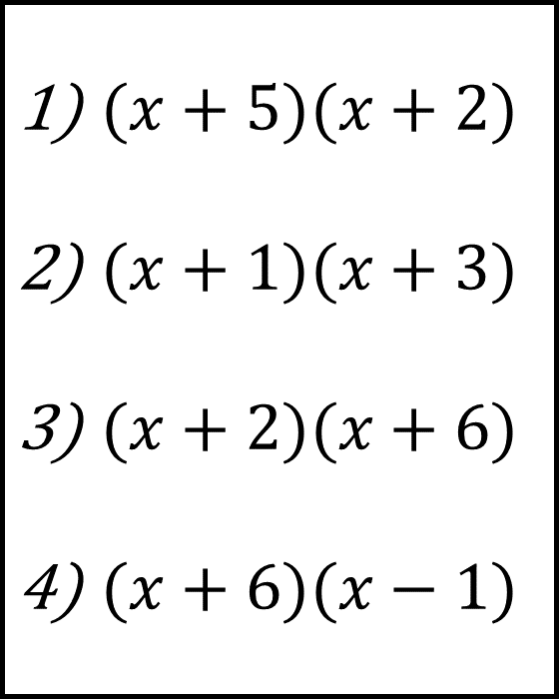
Bronze
Silver
Gold
$(x+5)(x+2)$
$(x+1)(x+3)$
$(x+2)(x+6)$
$(x+6)(x−1)$
$(x+7)(x+8)$
$(x+4)(x−2)$
$(x−3)(x+9)$
$(x−4)(x−3)$
$(x+11)(x+6)$
$(x−8)(x−6)$
$(2x+1)(x−5)$
$(3x−2)(4x+4)$

Slide 8
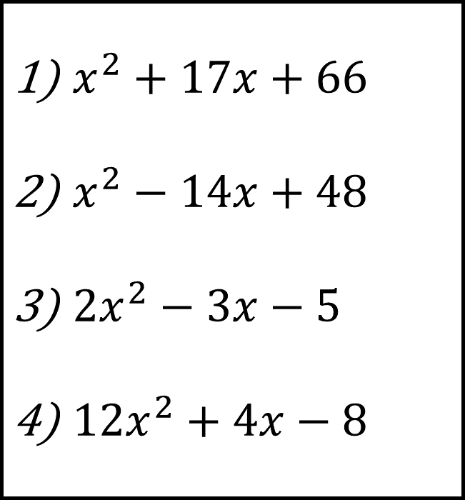
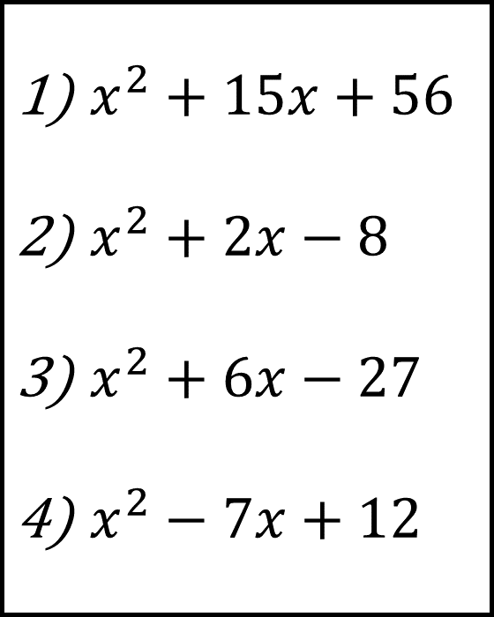
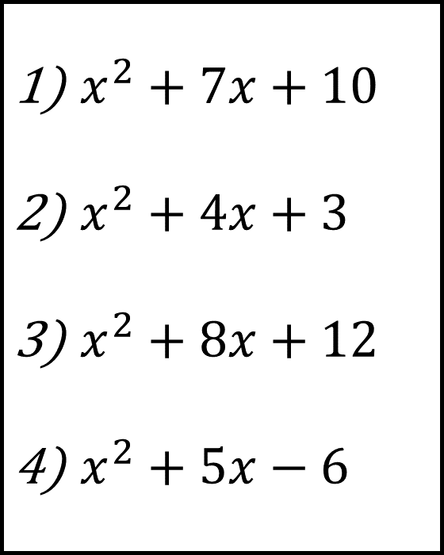
Bronze
Silver
Gold
$x^{2}+7x+10$
$x^{2}+4x+3$
$x^{2}+8x+12$
$x^{2}+5x−6$
$x^{2}+15x+56$
$x^{2}+2x−8$
$x^{2}+6x−27$
$x^{2}−7x+12$
$x^{2}+17x+66$
$x^{2}−14x+48$
${2x}^{2}−3x−5$
${12x}^{2}+4x−8$

Slide 9

Todays Objectives – Have you met them?
Objectives
To be able to expand simple double brackets.
To be able to expand complex double brackets.

Slide 10
Suggested Videos
For this lesson
Ordering Numbers: https://www.youtube.com/watch?v=gOmj58JdxL8
Ordering fractions decimals percentages – Corbettmaths
Percentages:
For next lesson
Adding & Subtracting Fractions:
https://www.youtube.com/watch?v=5juto2ze8Lg
Math Antics - Adding and Subtracting Fractions
Working with decimals:
https://www.youtube.com/watch?v=kwh4SD1ToFc
Math Antics - Decimal Arithmetic
BIDMAS:
https://www.youtube.com/watch?v=6K77Igo39vk
GCSE Maths - BIDMAS - Aslam Tutoring

