Slide 1
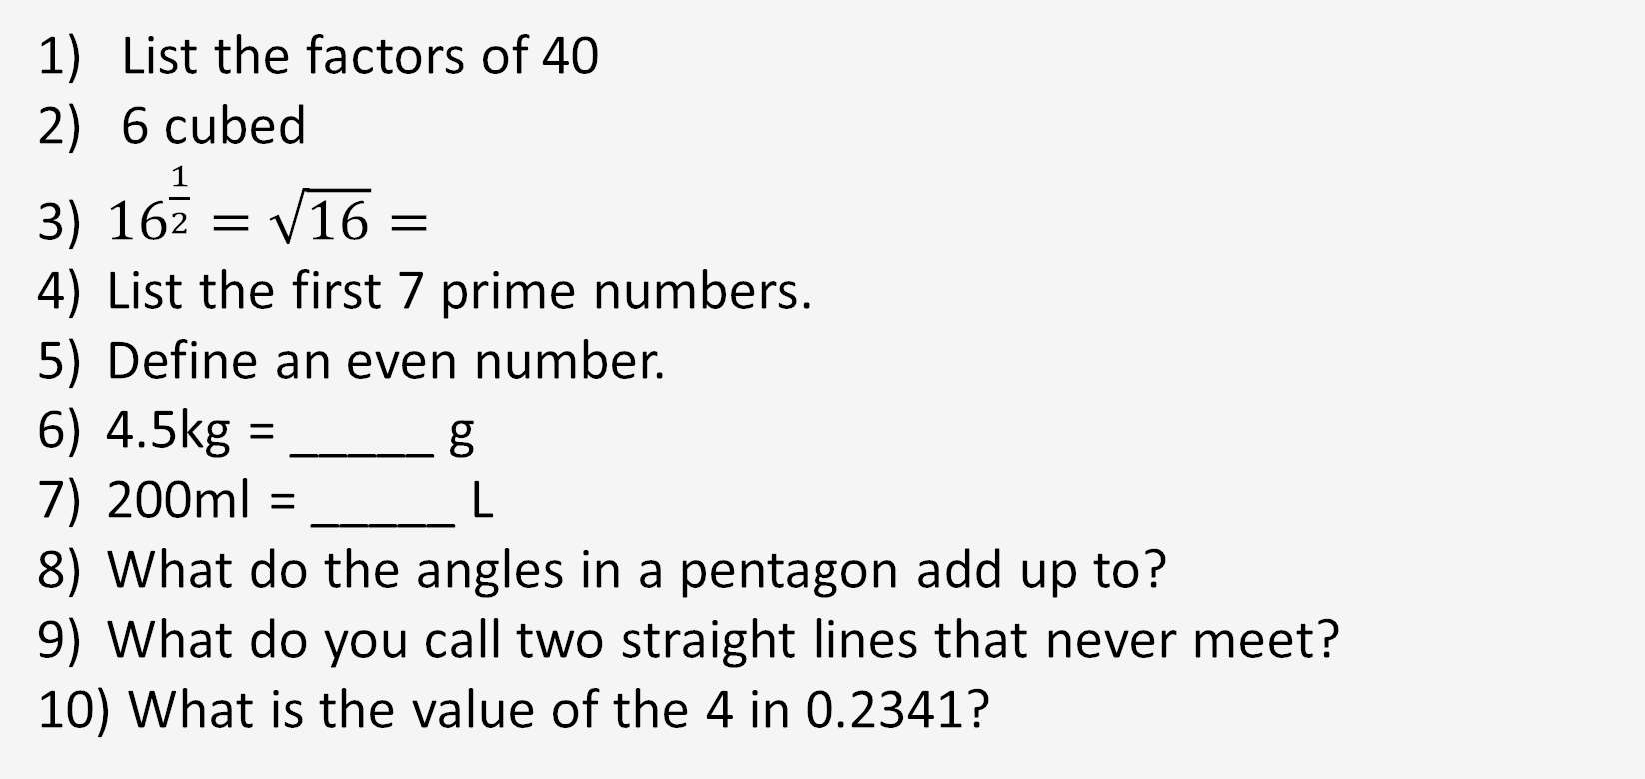
1-10 Quiz.
Notes:
This could also be a YouTube clip, matching exercise, Anything that will engage the learners from the start of the lesson.
TUTOR TO TAKE THE REGISTER DURING THIS TIME. THERE IS NO NEED TO CALL OUT NAMES.

Slide 2
1-10 Quiz.
1, 2, 4, 5, 8, 10, 20, 40
216
4
2, 3, 5, 7, 11, 13, 17
Will divide by 2
4500g
0.2 litres
540
Parallel
4/1000
Notes:
This could also be a YouTube clip, matching exercise, Anything that will engage the learners from the start of the lesson.
TUTOR TO TAKE THE REGISTER DURING THIS TIME. THERE IS NO NEED TO CALL OUT NAMES.

Slide 3
Title: Solving Equations
Objectives
To be able to Solve one & two-step Equations.
To be able to Solve multi-step Equations.
To be able to Solve Equations with unknowns on both sides.

Slide 4
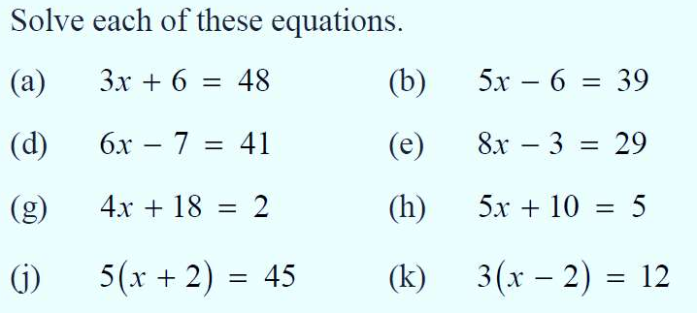
Knowledge Check – Try as many as you can.
1)
2)
3)
4)
5)
6)
7)
8)

Slide 5
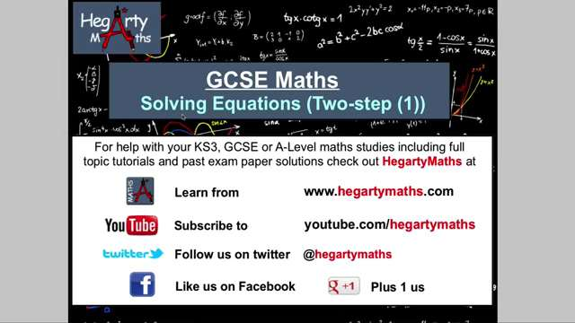

Slide 6
Unknown on both sides:
Look for the smallest x
2x + 1 = x + 5
Subtract x from each side
x + 1 = 5
Subtract 1 from each side
x = 4
Check your answer. Does the equation balance?
2x4 + 1 = 4 + 5 P

Slide 7
Unknown on both sides:
Look for the smallest x
5x - 2 = 2x + 4
Subtract 2x from each side
3x - 2 = 4
Add 2 to each side
3x = 6
Divide each side by 3
x = 2
Check your answer. Does the equation balance?
5x2 - 2 = 2x2 + 4 P

Slide 8
Try these: Solve each equation
2x + 2 = x + 9
x + 5 = 3x + 1
6x – 8 = 4x
x - 11 = 5x + 1
Top Tips:
Find the smallest ‘x’ and remove that first.
Then remove the spare number on the other side of the equation.
Remember opposites, if something is plus you must minus it to remove it. If it is minus, you must plus it.

Slide 9
Try these: Solve each equation
2x + 2 = x + 9
x + 5 = 3x + 1
6x – 8 = 4x
x - 11 = 5x + 1
x = 7
x = 2
x = 4
x = -3

Slide 10
Write each equation and solve it to find x.
2x – 1 = x + 3
3x + 4 = x + 10
5x – 6 = 2x
4x + 1 = x - 8
2x + 3 = x + 10
4x – 1 = 3x + 7
x = 4
x = 3
x = 2
x = -3
x = 7
x = 8
Extension:
2x - 6 = - 3x + 9
x = 3

Slide 11

Solving equations with brackets on both sides:
2 (3x – 1 ) = 3 (x + 2)
Multiply out the brackets
6x - 2 = 3x + 6
Subtract 3x from each side
3x -2 = + 6
Add 2 to each side
3x = 8

Slide 12
Write each equation and solve it to find x.
2 (x + 3) = x + 7
5 (2x - 1) = 3x + 9
2 (5x + 2 ) = 5x - 1
3 (x – 1) = 2 (x + 1)
x = 1
x = 2
x = -1
x = 5

Slide 13
Exam Topics:
In no particular order
BIDMAS | Negative Numbers
Converting Fractions, Decimals & Percentages | Substitution
Place Value & Rounding | Area & Perimeter
Simplifying Algebra | Ratios
Factorising | Frequency Polygons
Adding fractions | Best Buy
Volume | The Mean
Factors | Speed
Weight | Pythagoras
Forming and solving equations | Tree Diagrams

Slide 14
Exam Topics:
In no particular order
BIDMAS | Negative Numbers
Converting Fractions, Decimals & Percentages | Substitution
Place Value & Rounding | Area & Perimeter
Simplifying Algebra | Ratios
Factorising | Frequency Polygons
Adding fractions | Best Buy
Volume | The Mean
Factors | Speed
Weight | Pythagoras
Forming and solving equations | Tree Diagrams

Slide 15

Todays Objectives – Have you met them?
Objectives
To be able to Solve one & two-step Equations.
To be able to Solve multi-step Equations.
To be able to Solve Equations with unknowns on both sides.

Slide 16
Suggested Videos
For this lesson
Solving two-step Equations:
Solving Equations with unknowns on both sides:
For next lesson
REVISION for Progress Test 1
Key Topics we have covered so far and will be in the test:
Converting Fractions, Decimals & Percentages
Place Value & Rounding
Simplifying Algebra
Adding Fractions
Factors
Negative Numbers

