Slide 1
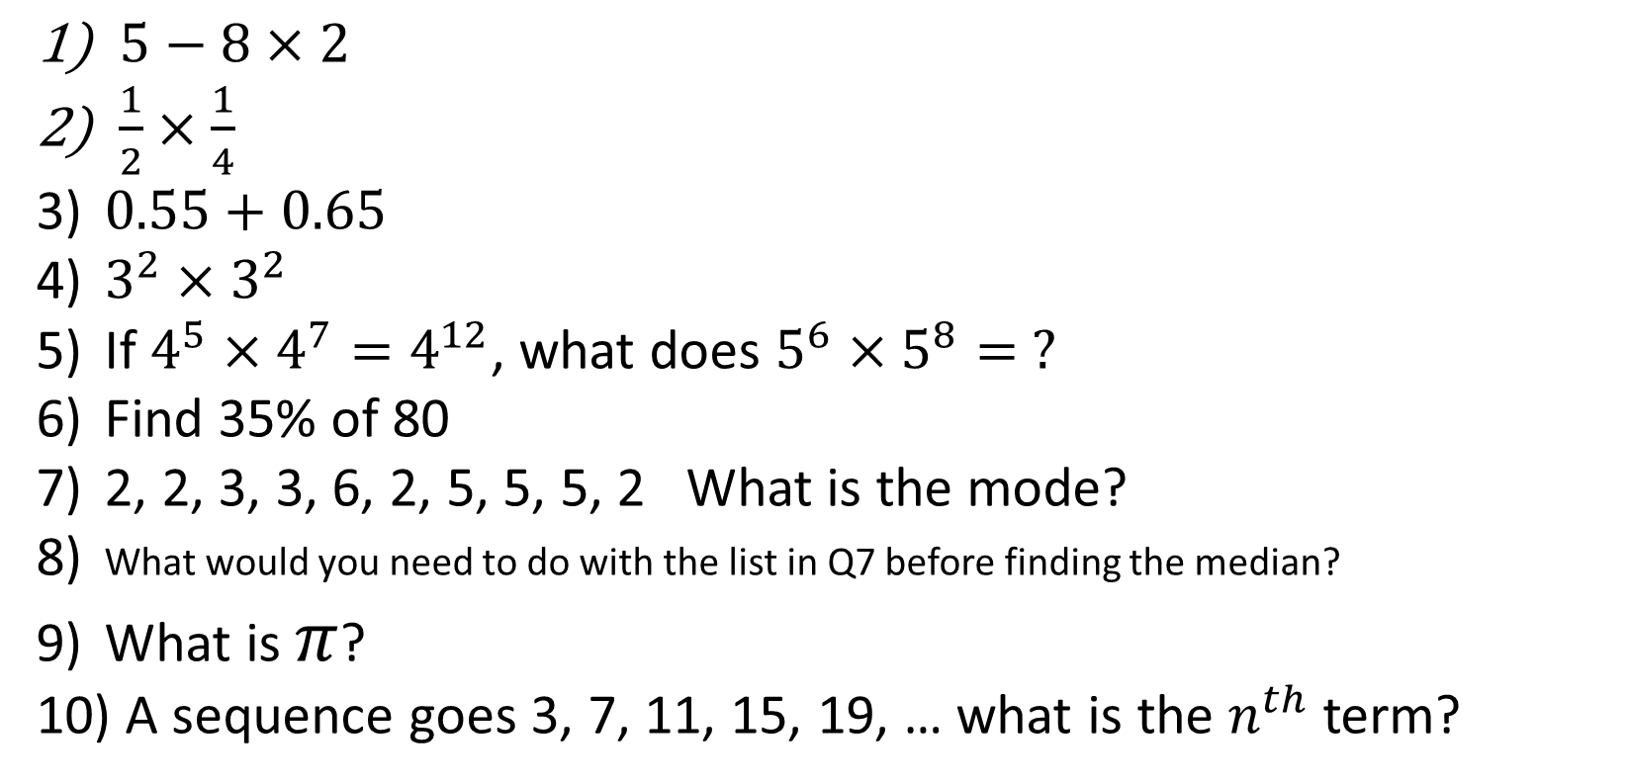
Desk Work, 1-10 Quiz. Answer these questions in your book
$5−8×2$
$\frac{1}{2}×\frac{1}{4}$
$0.55+0.65$
$3^{2}×3^{2}$
If $4^{5}×4^{7}=4^{12}$, what does $5^{6}×5^{8}= ?$
Find 35% of 80
2, 2, 3, 3, 6, 2, 5, 5, 5, 2 What is the mode?
What would you need to do with the list in Q7 before finding the median?
What is $π$?
A sequence goes 3, 7, 11, 15, 19, … what is the $n^{th}$ term?
Notes:
This could also be a YouTube clip, matching exercise, Anything that will engage the learners from the start of the lesson.
TUTOR TO TAKE THE REGISTER DURING THIS TIME. THERE IS NO NEED TO CALL OUT NAMES.

Slide 2
Desk Work, 1-10 Quiz. Answer these questions in your book
-11
1/8
1.2
3⁴
5¹⁴
28
2
Order them
3.14159
4n-1
$5−8×2$
$\frac{1}{2}×\frac{1}{4}$
$0.55+0.65$
$3^{2}×3^{2}$
If $4^{5}×4^{7}=4^{12}$, what does $5^{6}×5^{8}= ?$
Find 35% of 80
2, 2, 3, 3, 6, 2, 5, 5, 5, 2 What is the mode?
What would you need to do with the list in Q7 before finding the median?
What is $π$?
A sequence goes 3, 7, 11, 15, 19, … what is the $n^{th}$ term?
Notes:
This could also be a YouTube clip, matching exercise, Anything that will engage the learners from the start of the lesson.
TUTOR TO TAKE THE REGISTER DURING THIS TIME. THERE IS NO NEED TO CALL OUT NAMES.

Slide 3
Title: Tree Diagrams & Two Way Tables, Lesson 1
Objectives
To be able to draw tree diagrams and work out probabilities from tree diagrams.
To be able to complete Two Way Tables and find probabilities from Two Way Tables.

Slide 4
You have a pack of fifteen playing cards.
Six of the cards are red and the rest are black.
Write down the decimal probability of choosing a red card at random from the pack.
P(red card) =
6
=
0.4
15
You decide to pick a card at random from the pack, replace it and then pick another.
If you pick two red cards, you will stay in and do your homework. If you don’t, you will go out to a party.

Slide 5
All of the possible outcomes can be shown using a probability tree diagram:
1st card
2nd card
Probabilities
red
P(R, R) = 0.4 × 0.4 = 0.16
0.4
red
0.6
0.4
black
P(R, B) = 0.4 × 0.6 = 0.24
0.6
red
P(B, R) = 0.6 × 0.4 = 0.24
0.4
black
0.6
black
P(B, B) = 0.6 × 0.6 = 0.36
Notes:
Tell pupils that we can check that the calculated probabilities given by the tree diagram are correct by adding them all together. They should add up to 1.

Slide 6
1) What do the probabilities add up to?
Probabilities
0.16 + 0.24 + 0.24 + 0.36 =
1
P(R, R) = 0.4 × 0.4 = 0.16
2) What are the chances of going to the party?
P(R, B) = 0.4 × 0.6 = 0.24
P(R, R) = 0.4 × 0.4 = 0.16
P(B, R) = 0.6 × 0.4 = 0.24
3) What are the chances of your doing your homework?
P(B, B) = 0.6 × 0.6 = 0.36
P(not R, R) =
1 – 0.16 = 0.84
Notes:
Ask pupils to tell another way to work out the probability of doing your homework and not going to the party (add together the other three probabilities). Doing the alternative calculation can be used to check the answer.

Slide 7
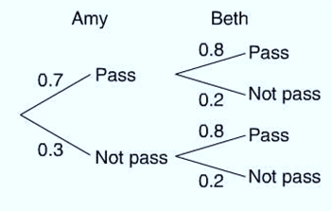
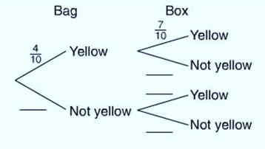
Amy and Beth are going to take a driving test tomorrow, the probability Amy will pass the test is 0.7. The probability that Beth will pass the test is 0.8. Use the probability tree shown to work out the probability that:
a Both women will pass the test.
b Only Amy will pass the test.
c Neither woman will pass the test.
2) A bag contains 10 coloured counters, 4 of which are yellow. A box also contains 10 coloured counters, 7 of which are yellow. One counter is chosen at random from the bag and one counter is chosen at random from the box.
a Copy and complete the tree diagram.
b Find the probability that:
i Both counters will be yellow.
ii The counter from the bag will be yellow and the counter from the box will not be yellow.
iii At least one counter will be yellow.

Slide 8
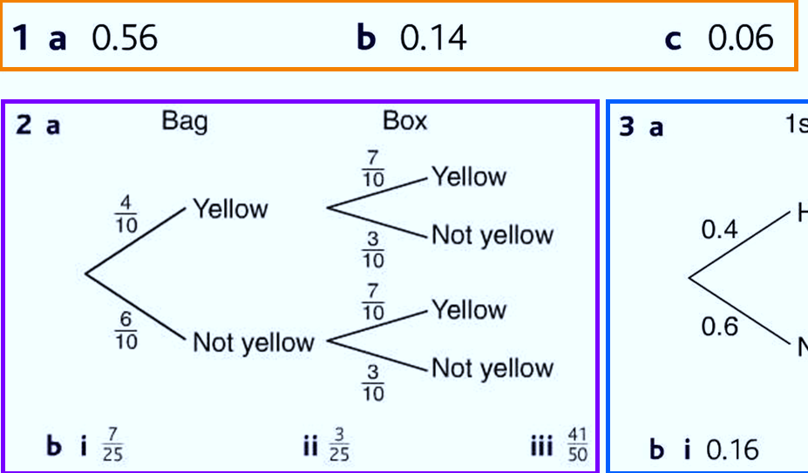

Slide 9
The light bulb in your room has blown. You are in a rush.
There are twenty socks in a drawer. Fourteen of them are blue and the rest are green.
What is the probability of randomly picking a blue sock out of the drawer?
P(blue sock) =
14
=
7
20
10
You pick out two socks, one after the other, in the hope of getting a matching pair.
Notes:
Ask pupils if they think that it is more likely that they choose an odd pair or a matching pair, or if both are equally likely.

Slide 10
All of the possible outcomes can be shown using a probability tree diagram:
1st sock
2nd sock
Probabilities
Blue
P(B, B) =
14
×
13
=
182
=
91
13
20
19
380
190
Blue
19
6
14
19
Green
P(B, G) =
14
×
6
=
84
=
21
20
20
19
380
95
6
20
Blue
P(G, B) =
6
×
14
=
84
=
21
14
20
19
380
95
Green
19
5
19
Green
P(G, G) =
6
×
5
=
30
=
3
20
19
380
38

Slide 11
1) What do the probabilities add up to?
Probabilities
P(B, B) =
91
91
+
21
+
21
+
3
=
182 + 84 + 84 + 30
=
1
190
190
95
95
38
380
2) What is the probability of getting two socks the same colour?
P(B, G) =
21
95
P(B, B) + P(G, G) =
91
+
3
=
106
=
53
P(G, B) =
21
190
38
190
95
95
3) What is the probability of getting two socks that don’t match?
P(G, G) =
3
38
P(B, G) + P(G, B) =
21
+
21
=
42
95
95
95
Notes:
Ask pupils to give you another method of working out the probability of getting two socks that don’t match (1 – 53/95). Doing the alternative calculation can be used to check the answer.

Slide 12
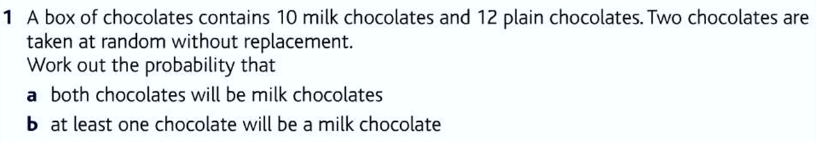
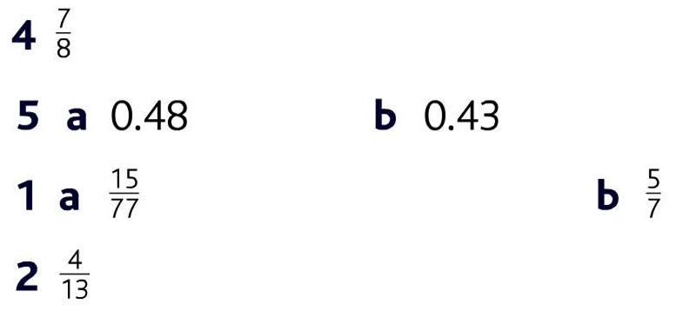
Draw a tree diagram!
Draw a tree diagram!

Slide 13
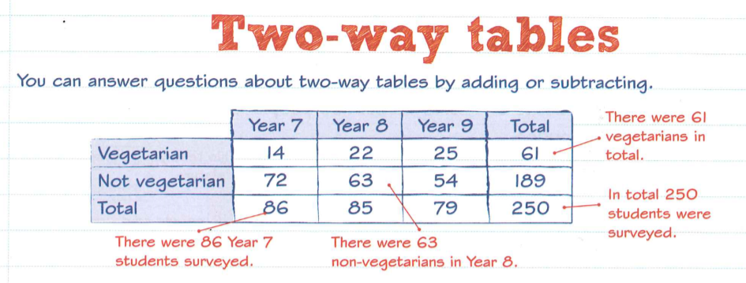
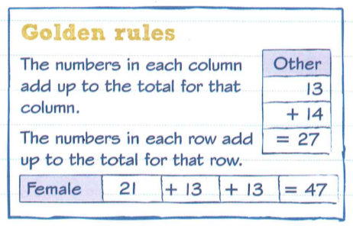

Slide 14
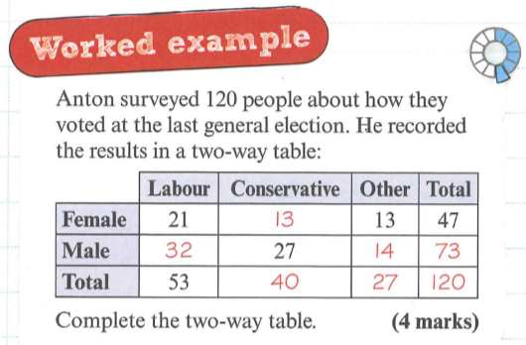
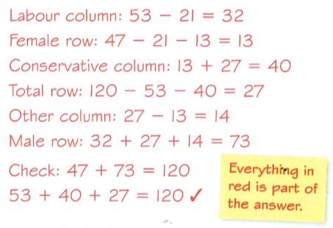

Slide 15
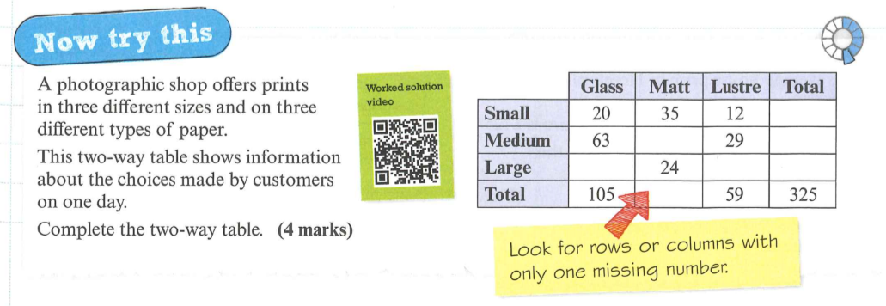
Extension:
What is the probability that a customer picked at random on the same day wanted a Medium Size on Matt Paper Photograph Print.
What is the probability that a customer picked who picked a Large size also picked the Lustre finish?

Slide 16

Todays Objectives – Have you met them?
Objectives
To be able to draw tree diagrams and work out probabilities from tree diagrams.
To be able to complete Two Way Tables and find probabilities from Two Way Tables.

Slide 17
Suggested Videos
For this lesson
Ordering Numbers: https://www.youtube.com/watch?v=gOmj58JdxL8
Ordering fractions decimals percentages – Corbettmaths
Percentages:
For next lesson
Adding & Subtracting Fractions:
https://www.youtube.com/watch?v=5juto2ze8Lg
Math Antics - Adding and Subtracting Fractions
Working with decimals:
https://www.youtube.com/watch?v=kwh4SD1ToFc
Math Antics - Decimal Arithmetic
BIDMAS:
https://www.youtube.com/watch?v=6K77Igo39vk
GCSE Maths - BIDMAS - Aslam Tutoring

