Slide 1
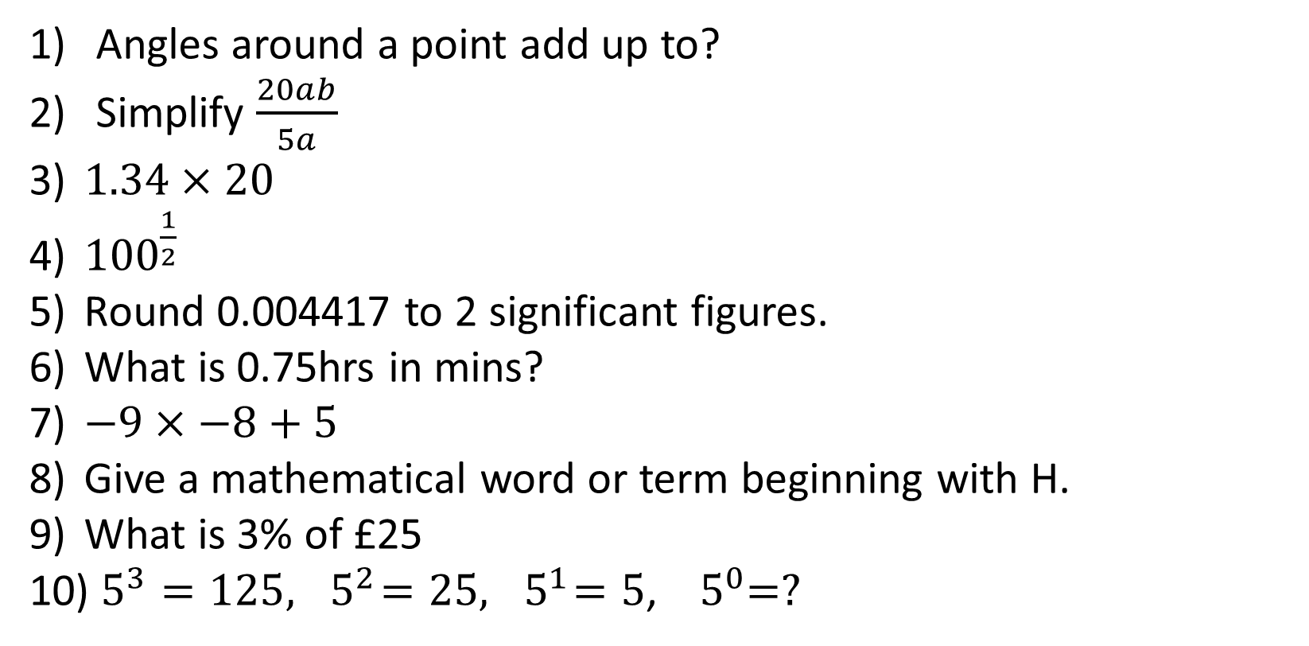
1-10 Quiz.
Angles around a point add up to?
Simplify $\frac{20ab}{5a}$
$1.34×20$
${100}^{\frac{1}{2}}$
Round 0.004417 to 2 significant figures.
What is 0.75hrs in mins?
$−9×−8+5$
Give a mathematical word or term beginning with H.
What is 3% of £25
$5^{3}=125,{ 5}^{2}=25,{ 5}^{1}=5$, ${ 5}^{0}=?$
Notes:
This could also be a YouTube clip, matching exercise, Anything that will engage the learners from the start of the lesson.
TUTOR TO TAKE THE REGISTER DURING THIS TIME. THERE IS NO NEED TO CALL OUT NAMES.

Slide 2
1-10 Quiz.
Angles around a point add up to?
Simplify $\frac{20ab}{5a}$
$1.34×20$
${100}^{\frac{1}{2}}$
Round 0.004417 to 2 significant figures.
What is 0.75hrs in mins?
$−9×−8+5$
Give a mathematical word or term beginning with H.
What is 3% of £25
$5^{3}=125,{ 5}^{2}=25,{ 5}^{1}=5$, ${ 5}^{0}=?$
360
4b
26.8
10
0.0044
45 mins
77
Eg Hypotenuse
75p
1
Notes:
This could also be a YouTube clip, matching exercise, Anything that will engage the learners from the start of the lesson.
TUTOR TO TAKE THE REGISTER DURING THIS TIME. THERE IS NO NEED TO CALL OUT NAMES.

Slide 3
Title: Stem & Leaf Diagrams and Frequency Polygons
Objectives
To be able to draw and analyse Stem & Leaf Diagrams.
To be able to draw and analyse Frequency Polygons.

Slide 4
Stem & Leaf Diagrams

Slide 5
Stem and Leaf Diagrams
How to draw one:
Put the first digits of each piece of data in numerical order down the left hand side.
Go through each piece of data in turn and put the remaining digits in the correct row.
Re-draw the diagram, putting the pieces of data in numerical order.
Add a key.

Slide 6
Here are the marks gained by 30 students in an examination:
63 58 61 52 59 65 69 75 70 54 57 63 76 81 64
68 59 40 65 74 80 44 47 53 70 81 68 49 57 61
Write the tens figures in the left hand column of a diagram.
These are the ‘STEMS’
4
5
6
7
8

Slide 7
Here are the marks gained by 30 students in an examination:
63 58 61 52 59 65 69 75 70 54 57 63 76 81 64
68 59 40 65 74 80 44 47 53 70 81 68 49 57 61
Go through the marks in turn and put in the units figures of each mark in the proper row.
These are the ‘LEAVES’
4
5
6
7
8
8
3
1

Slide 8
Here are the marks gained by 30 students in an examination:
63 58 61 52 59 65 69 75 70 54 57 63 76 81 64
68 59 40 65 74 80 44 47 53 70 81 68 49 57 61
When all the marks are entered the diagram will look like this:
4
5
6
7
8
0 4 7 9
8 2 9 4 7 9 3 7
3 1 5 9 3 4 8 5 8 1
5 0 6 4 0
1 0 1

Slide 9
Here are the marks gained by 30 students in an examination:
63 58 61 52 59 65 69 75 70 54 57 63 76 81 64
68 59 40 65 74 80 44 47 53 70 81 68 49 57 61
Rewrite the diagram so that the digits in each row are in numerical order:
4
5
6
7
8
0 4 7 9
2 3 4 7 7 8 9 9
1 1 3 3 4 5 5 8 8 9
0 0 4 5 6
0 1 1

Slide 10
Here are the marks gained by 30 students in an examination:
63 58 61 52 59 65 69 75 70 54 57 63 76 81 64
68 59 40 65 74 80 44 47 53 70 81 68 49 57 61
Add a key:
4
5
6
7
8
0 4 7 9
5|2 = 52
2 3 4 7 7 8 9 9
1 1 3 3 4 5 5 8 8 9
0 0 4 5 6
0 1 1

Slide 11
4
5
6
7
8
0 4 7 9
5|2 = 52
2 3 4 7 7 8 9 9
1 1 3 3 4 5 5 8 8 9
0 0 4 5 6
0 1 1
a) Calculate the median.
b) Calculate the range.
= 63

Slide 12
4
5
6
7
8
0 4 7 9
5|2 = 52
2 3 4 7 7 8 9 9
1 1 3 3 4 5 5 8 8 9
0 0 4 5 6
0 1 1
a) Calculate the median.
b) Calculate the range.
= 63
= 81 - 40
= 41

Slide 13
Your Turn
Put these 25 ages in a Stem and Leaf Diagram:
18, 25, 32, 19, 20, 32, 56, 41, 29, 30, 31, 38, 24, 21, 19, 43, 39, 34, 27, 20, 43, 50, 23, 42, 44
Find the Median, Range & Modal Class.

Slide 14
Your Turn
1
2
3
4
5
8, 9, 9
0, 0, 1, 3, 4, 5, 7, 9
0, 1, 2, 2, 4, 8, 9
1, 2, 3, 3, 4
0, 6
Put these 25 ages in a Stem and Leaf Diagram:
18, 25, 32, 19, 20, 32, 56, 41, 29, 30, 31, 38, 24, 21, 19, 43, 39, 34, 27, 20, 43, 50, 23, 42, 44
Find the Median, Range & Modal Class.
KEY
3|1 = 31

Slide 15
Your Turn
1
2
3
4
5
8, 9, 9
0, 0, 1, 3, 4, 5, 7, 9
0, 1, 2, 2, 4, 8, 9
1, 2, 3, 3, 4
0, 6
Put these 25 ages in a Stem and Leaf Diagram:
18, 25, 32, 19, 20, 32, 56, 41, 29, 30, 31, 38, 24, 21, 19, 43, 39, 34, 27, 20, 43, 50, 23, 42, 44
Find the Median, Range & Modal Class.
KEY
3|1 = 31
31
38
20-29

Slide 16
Frequency Polygons

Slide 17
Frequency Polygons can be a useful way to quickly get a picture of the shape of the data. It’s similar to a Bar Chart, but quicker to draw!
In a frequency polygon you plot the midpoints of each interval and join them together.
What are the midpoints of each class interval for the race times data?
Times in seconds | Midpoint | Frequency
75 ≤ t < 80 |  | 0
80 ≤ t < 85 |  | 1
85 ≤ t < 90 |  | 5
90 ≤ t < 95 |  | 28
95 ≤ t < 100 |  | 18
100 ≤ t < 105 |  | 8
77.5
To find the midpoint of two numbers, add them together and divide by 2.
82.5
87.5
92.5
97.5
92.5
Notes:
Pupils may recall the midpoint of grouped data from previous work on estimating the mean from grouped data.

Slide 18
Imagine a Bar Chart had already been drawn. If we plot the midpoints at the top of each bar and join them together the following graph is produced:
30
25
20
Frequency
15
10
5
0
75
80
85
90
95
100
105
110
Times in seconds
Notes:
This graph is an illustration of how to produce a frequency polygon from a histogram/frequency diagram.
Point out that the empty class intervals at each end have been included.

Slide 19
Removing the bars leaves a frequency polygon.
30
25
20
Frequency
15
10
5
0
75
80
85
90
95
100
105
110
Times in seconds
Notes:
Discuss with pupils the different information available on the two types of graphs. Often frequency polygon graphs are used to compare two sets of data as the shape of the graph can be more easily analyzed than bars.
Note that frequency polygons can be left open at either end, or joined to the horizontal axis like this one.

Slide 20
Frequency Polygons
Weight | Frequency
0 < w ≤ 20 | 8
20 < w ≤ 40 | 13
40 < w ≤ 60 | 20
60< w ≤ 80 | 38
80< w ≤ 100 | 4
100 < w ≤ 120 | 7
40
35
30
25
20
15
10
Can you identify the seven errors in this frequency polygon?
Extension: What should it look like?
0
20
40
60
80
100
120

Slide 21
Frequency Polygons
Frequency Polygon to show the weight of…
Weight | Frequency
0 < w ≤ 20 | 8
20 < w ≤ 40 | 13
40 < w ≤ 60 | 20
60< w ≤ 80 | 38
80< w ≤ 100 | 4
100 < w ≤ 120 | 7
40
35
30
Frequency
25
20
15
10
5
0
40
60
80
120
20
100
Weight

Slide 22
Your Turn
House price (£000) | Burnley | Norwich | London
0 < p ≤ 100 | 39 | 21 | 2
100 < p ≤ 200 | 45 | 25 | 7
200 < p ≤ 300 | 10 | 38 | 20
300< p ≤ 400 | 5 | 6 | 33
400 < p ≤ 500 | 1 | 6 | 27
500 < p ≤ 1000 | 0 | 4 | 11
The price of 100 houses in different parts of the country are shown in the table.
Draw three frequency polygons on one graph to illustrate the data.
Compare your data with three sentences.

Slide 23

Todays Objectives – Have you met them?
Objectives
To be able to draw and analyse Stem & Leaf Diagrams.
To be able to draw and analyse Frequency Polygons.

Slide 24
Suggested Videos
For this lesson
Ordering Numbers: https://www.youtube.com/watch?v=gOmj58JdxL8
Ordering fractions decimals percentages – Corbettmaths
Percentages:
For next lesson
Adding & Subtracting Fractions:
https://www.youtube.com/watch?v=5juto2ze8Lg
Math Antics - Adding and Subtracting Fractions
Working with decimals:
https://www.youtube.com/watch?v=kwh4SD1ToFc
Math Antics - Decimal Arithmetic
BIDMAS:
https://www.youtube.com/watch?v=6K77Igo39vk
GCSE Maths - BIDMAS - Aslam Tutoring

