Slide 1
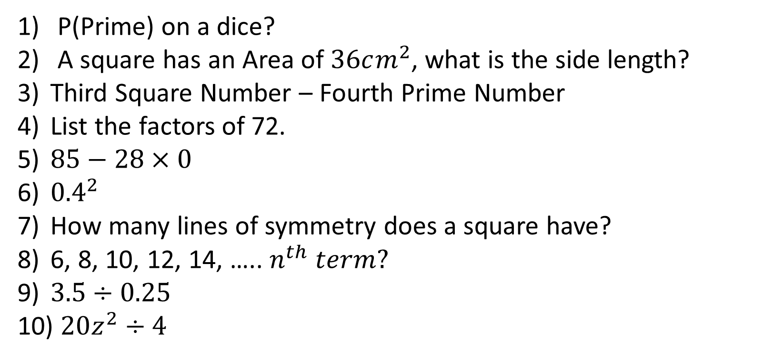
1-10 Quiz.
P(Prime) on a dice?
A square has an Area of $36cm^{2}$, what is the side length?
Third Square Number – Fourth Prime Number
List the factors of 72.
$85−28×0$
${0.4}^{2}$
How many lines of symmetry does a square have?
6, 8, 10, 12, 14, ….. $n^{th} term?$
$3.5÷0.25$
$20z^{2}÷4$
Notes:
This could also be a YouTube clip, matching exercise, Anything that will engage the learners from the start of the lesson.
TUTOR TO TAKE THE REGISTER DURING THIS TIME. THERE IS NO NEED TO CALL OUT NAMES.

Slide 2
1-10 Quiz.
P(Prime) on a dice?
A square has an Area of $36cm^{2}$, what is the side length?
Third Square Number – Fourth Prime Number
List the factors of 72.
$85−28×0$
${0.4}^{2}$
How many lines of symmetry does a square have?
6, 8, 10, 12, 14, ….. $n^{th} term?$
$3.5÷0.25$
$20z^{2}÷4$
3/6 or ½
6cm
9 and 7
1,72,2,36,3,24,4,18,3,12,8,9
85
0.16
4
2n + 4
14
4z²
Notes:
This could also be a YouTube clip, matching exercise, Anything that will engage the learners from the start of the lesson.
TUTOR TO TAKE THE REGISTER DURING THIS TIME. THERE IS NO NEED TO CALL OUT NAMES.

Slide 3
Title: Pythagoras
Objectives
To be able to find unknown lengths using Pythagoras’ Theorem.
To be able to problem solve using Pythagoras.

Slide 4
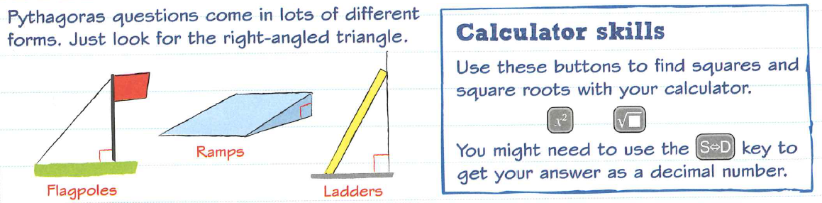

Slide 5
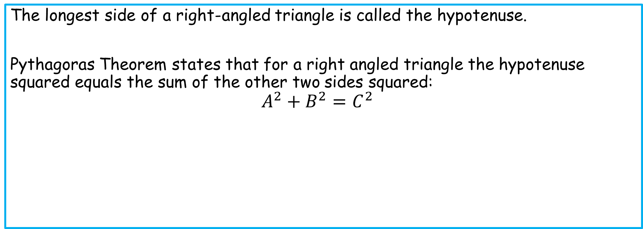
Notes
The longest side of a right-angled triangle is called the hypotenuse.
Pythagoras Theorem states that for a right angled triangle the hypotenuse squared equals the sum of the other two sides squared:
$${A^{2}+B^{2}=C}^{2}$$
C is usually the letter
used for the
hypotenuse.
A
C
A and B can be either way round.
B

Slide 6
Notes
Sketch out these triangles and label each side A, B or C. Where C is the hypotenuse.
2
5
4
1
6
3

Slide 7
Notes
A
Sketch out these triangles and label each side A, B or C. Where C is the hypotenuse.
B
2
5
4
1
B
A
A
C
C
C
B
A
C
6
A
3
C
B
A
B
B
A and B can be
the other way round.
C

Slide 8

Example 1
Find the missing length.
Eg1 $A^{2}+B^{2}=C^{2}$
$${ 6}^{2}+8^{2}=C^{2}$$
$36+64=C^{2}$
$100=C^{2}$
$C=\sqrt{100}$
$C=10cm$
?
6cm
8cm

Slide 9

Example 2
What’s different about this question?
Eg1 $A^{2}+B^{2}=C^{2}$
$A^{2 }+ 8^{2}={12}^{2}$
$A^{2}+64=144$
$A^{2}=144−64$
$$A^{2}=80$$
$A=\sqrt{80}$
$A=8.9cm (1dp)$
12cm
?
8cm

Slide 10
Standard Questions
?
?
15cm
9cm
1.5cm
?
12cm
3.2cm
12cm

Slide 11
Standard Questions
C
C
15cm
9cm
1.5cm
C
12cm
3.2cm
12cm
c² = 1.5² + 3.2²
c² = 2.25 + 10.24
c² = 12.49
C = √12.49
C = 3.5
c² = 15² - 12²
c² = 225 - 144
c² = 81
C = √81
C = 9
c² = 12² + 9²
c² = 144 + 81
c² = 225
C = √225
C = 15

Slide 12
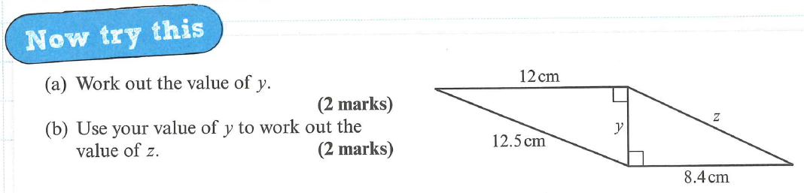

Slide 13
a)
y² = 12.5² - 12²
y² = 156.25 - 144
y² = 12.25
y = √12.25
y = 3.5 cm
b)
z² = 8.4² + 3.5²
z² = 70.56 + 12.25
z² = 82.81
z = √82.81
z = 9.1 cm

Slide 14
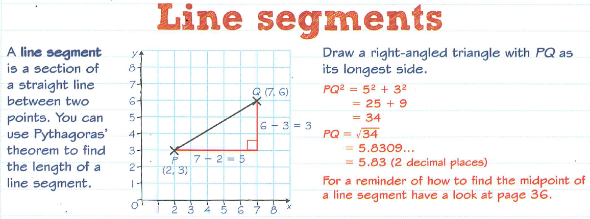

Slide 15
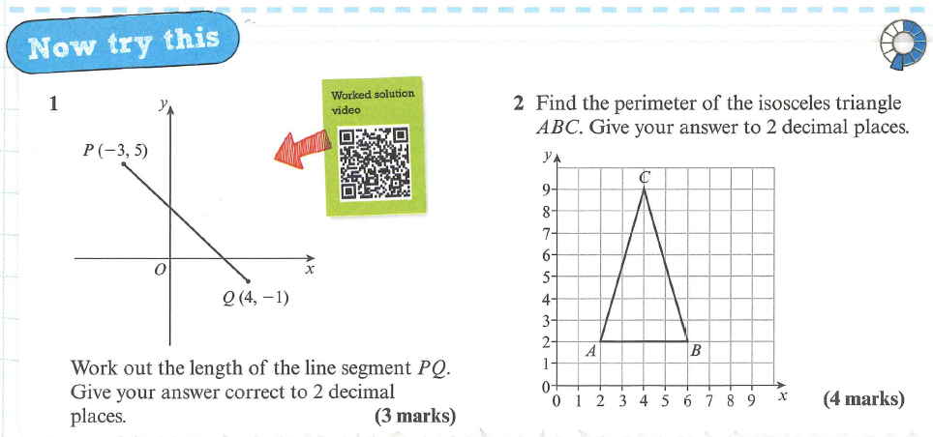

Slide 16
7
4
PQ² = 7² + 6²
PQ² = 85
PQ = 9.2
AC = BC AC² = 7² + 4²
AC² = 65
AC = 8.06
Perimeter = 8.06 + 8.06 + 4 = 20.12

Slide 17
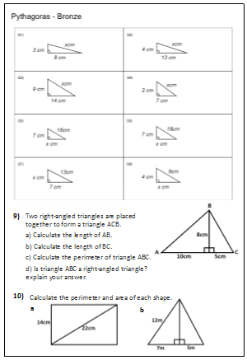

Slide 18
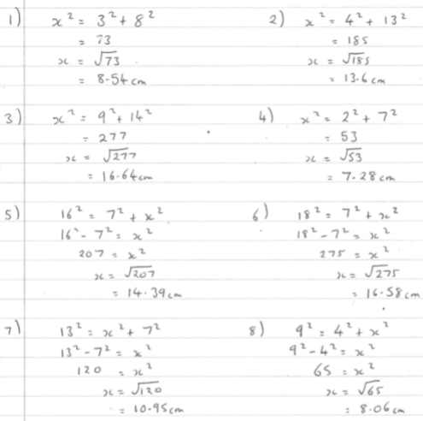
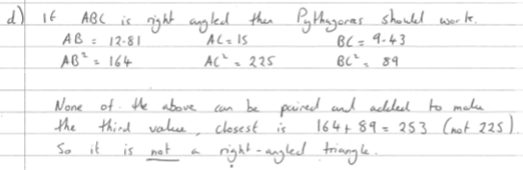
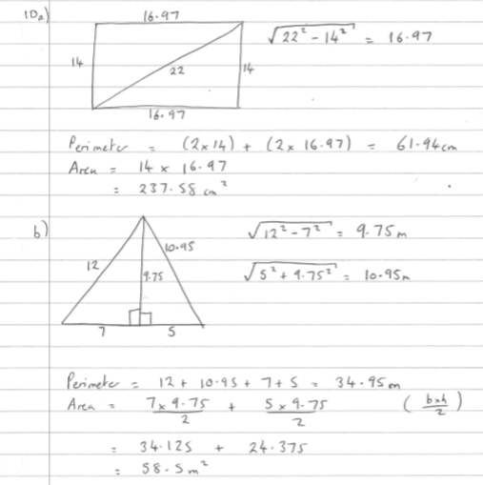
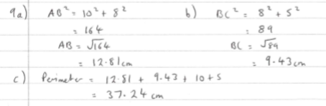

Slide 19

Todays Objectives – Have you met them?
Objectives
To be able to find unknown lengths using Pythagoras’ Theorem.
To be able to problem solve using Pythagoras.

Slide 20
Suggested Videos
For this lesson
Ordering Numbers: https://www.youtube.com/watch?v=gOmj58JdxL8
Ordering fractions decimals percentages – Corbettmaths
Percentages:
For next lesson
Adding & Subtracting Fractions:
https://www.youtube.com/watch?v=5juto2ze8Lg
Math Antics - Adding and Subtracting Fractions
Working with decimals:
https://www.youtube.com/watch?v=kwh4SD1ToFc
Math Antics - Decimal Arithmetic
BIDMAS:
https://www.youtube.com/watch?v=6K77Igo39vk
GCSE Maths - BIDMAS - Aslam Tutoring

