Slide 1
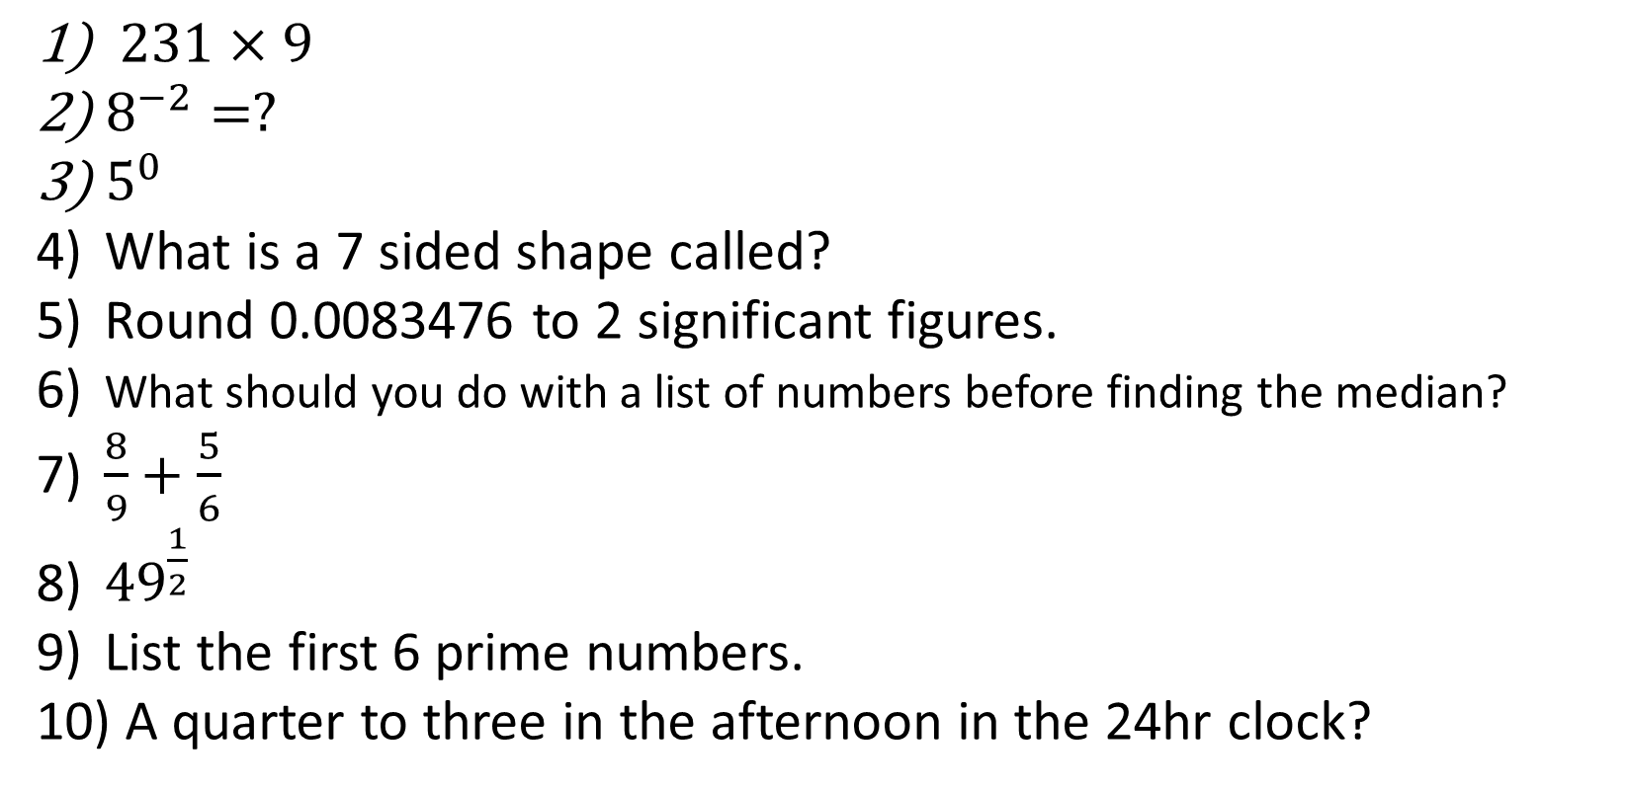
1-10 Quiz.
$231×9$
$8^{−2}=?$
$5^{0}$
What is a 7 sided shape called?
Round 0.0083476 to 2 significant figures.
What should you do with a list of numbers before finding the median?
$\frac{8}{9}+\frac{5}{6}$
${49}^{\frac{1}{2}}$
List the first 6 prime numbers.
A quarter to three in the afternoon in the 24hr clock?
Notes:
This could also be a YouTube clip, matching exercise, Anything that will engage the learners from the start of the lesson.
TUTOR TO TAKE THE REGISTER DURING THIS TIME. THERE IS NO NEED TO CALL OUT NAMES.

Slide 2
1-10 Quiz.
$231×9$
$8^{−2}=?$
$5^{0}$
What is a 7 sided shape called?
Round 0.0083476 to 2 significant figures.
What should you do with a list of numbers before finding the median?
$\frac{8}{9}+\frac{5}{6}$
${49}^{\frac{1}{2}}$
List the first 6 prime numbers.
A quarter to three in the afternoon in the 24hr clock?
2079
1/64
1
Heptagon
0.0083
Order them
31/18 or 1 13/18
7
2,3,5,7,11,13
14.45
Notes:
This could also be a YouTube clip, matching exercise, Anything that will engage the learners from the start of the lesson.
TUTOR TO TAKE THE REGISTER DURING THIS TIME. THERE IS NO NEED TO CALL OUT NAMES.

Slide 3
Title: Standard Form
Objectives
To be able to write large and small numbers in standard form
To be able to perform basic calculations with standard form.

Slide 4
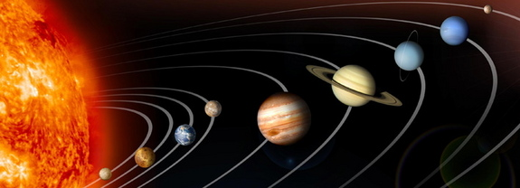
Distance from the Sun in km:
Mercury
5.81 x 10⁷
58100000
Venus
1.085 x 10⁸
108500000
150000000
Earth
1.5 x 10⁸
228000000
Mars
2.28 x 10⁸
Jupiter
7.8 x 10⁸
780000000
Saturn
1430000000
1.43 x 10⁹
2.9 x 10⁹
Uranus
2900000000
Neptune
4.5 x 10⁹
4500000000

Slide 5
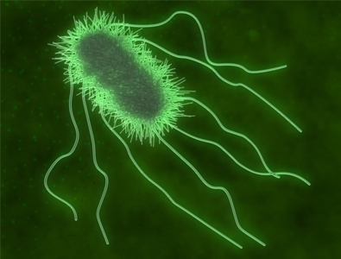
An E-coli bacterium is approximately 0.00000025 metres wide.
2.5 × 10⁻⁷
An E-coli bacterium is approximately 0.000001 metres long.
1.0 × 10⁻⁶

Slide 6
Standard Form
10
x
A power of 10
A number between 1 and 10
(but not including 10)

Slide 7
Standard Form
20000000000000000000000000
It is much easier to write the number in standard form
This number is HUGE!!
25
2
10
x
A power of 10
A number between 1 and 10
(but not including 10)

Slide 8
Standard Form
0.000000000000006
It is much easier to write the number in standard form
This number is Tiny!!
-15
6
10
x
A power of 10
A number between 1 and 10
(but not including 10)

Slide 9
Let’s try some together...
900000
78000000
0.0000005
0.00000123
9 x 10⁵
7.8 x 10⁷
5 x 10⁻⁷
1.23 x 10⁻⁶

Slide 10
YOUR TURN!
7000
86000
340000000
0.00000012
0.056
0.0000478
7 x 10³
8.6 x 10⁴
3.4 x 10⁸
1.2 x 10⁻⁷
5.6 x 10⁻²
4.78 x 10⁻⁵

Slide 11
Multiply two numbers
4 x 10¹⁸ x 3 x 10⁴
Numbers
Powers of 10
4 x 3
x 10¹⁸ x 10⁴
= 12
ADD powers
x 10²²
NOT Std Form!
= 1.2 x 10¹
x 10²²
= 1.2 x 10²³

Slide 12
Let’s try some together...
(2x 10²) x (4 x 10⁵)
(8 x 10⁸) x (2 x 10⁻⁵)
(25 x 10⁸) ÷ (5 x 10²)
8 x 10⁷
16 x 10³ = 1.6 x 10⁴
5 x 10⁶

Slide 13
Try these....
(3 x 10⁴) x (2 x 10⁵)
(4 x 10³) x (3 x 10⁵)
(7 x 10⁴) x (2 x 10⁻³)
(8 x 10⁶) ÷ (2 x 10²)
(20 x 10⁴) ÷ (4 x 10⁸)
6 x 10⁹
1.2 x 10⁹
1.4 x 10²
4 x 10⁴
5 x 10⁻⁴

Slide 14
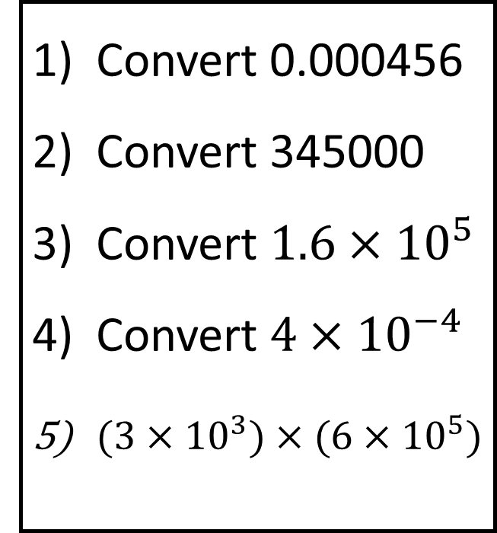
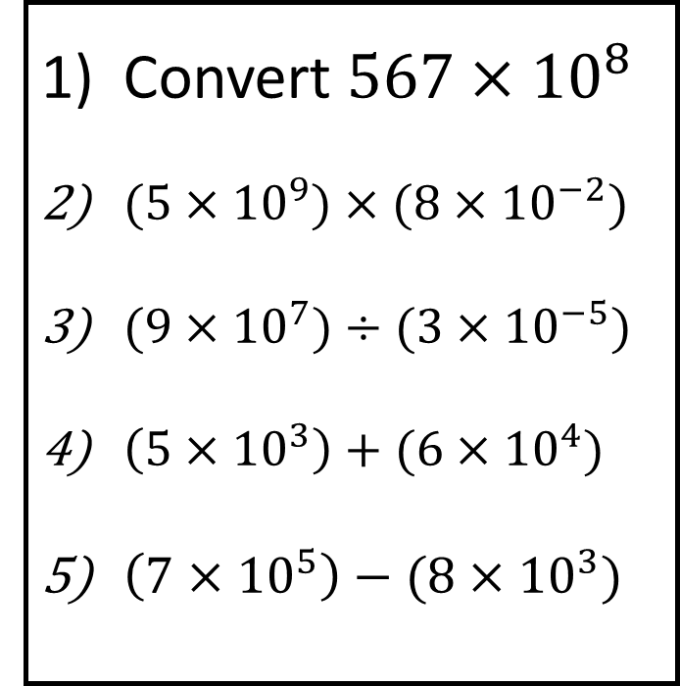
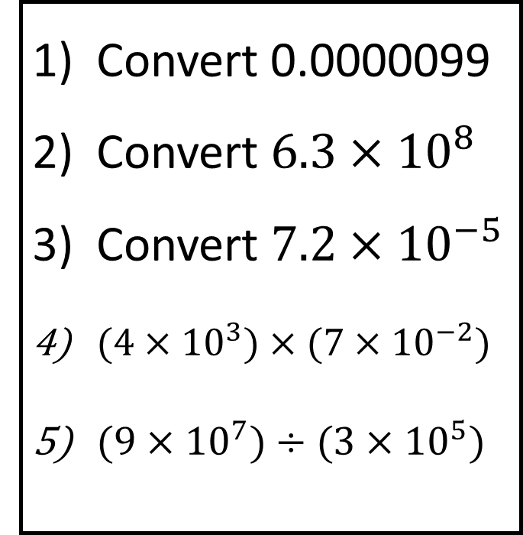
Bronze
Silver
Gold
Convert 0.000456
Convert 345000
Convert $1.6×{10}^{5}$
Convert $4×{10}^{−4}$
$(3×{10}^{3})×(6×{10}^{5})$
Convert 0.0000099
Convert $6.3×{10}^{8}$
Convert $7.2×{10}^{−5}$
$(4×{10}^{3})×(7×{10}^{−2})$
$(9×{10}^{7})÷(3×{10}^{5})$
Convert $567×{10}^{8}$
$(5×{10}^{9})×(8×{10}^{−2})$
$(9×{10}^{7})÷(3×{10}^{−5})$
$\left(5×{10}^{3}\right)+(6×{10}^{4})$
$\left(7×{10}^{5}\right)−(8×{10}^{3})$
Questions

Slide 15
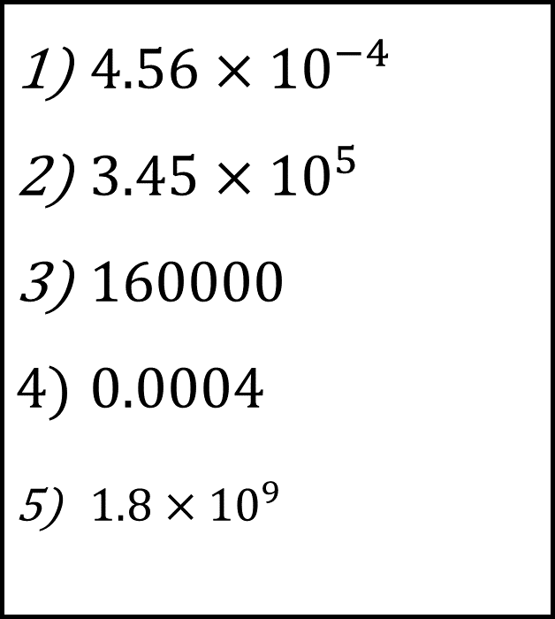
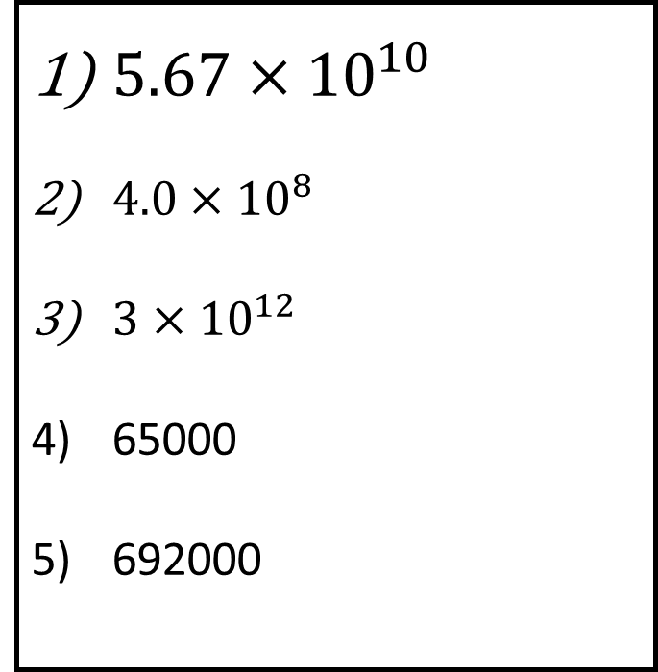
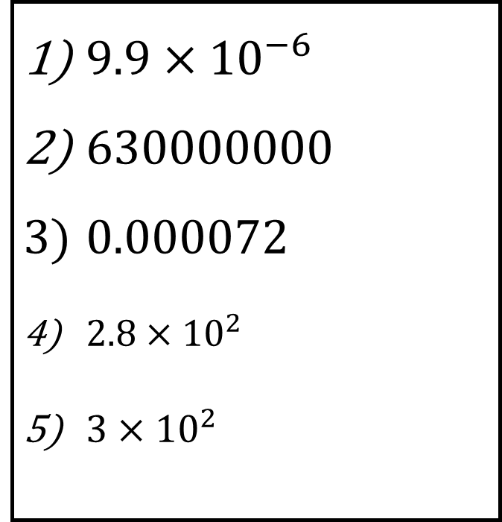
Bronze
Silver
Gold
$4.56×{10}^{−4}$
$3.45×{10}^{5}$
$160000$
$0.0004$
$1.8×{10}^{9}$
$9.9×{10}^{−6}$
$630000000$
$0.000072$
$2.8×{10}^{2}$
$3×{10}^{2}$
$5.67×{10}^{10}$
$4.0×{10}^{8}$
$3×{10}^{12}$
65000
692000
Answers

Slide 16
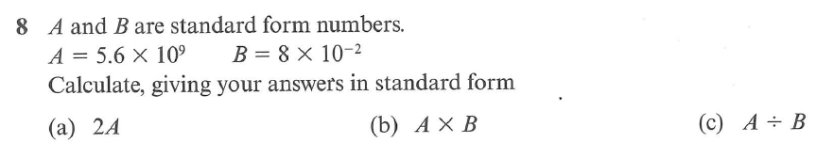
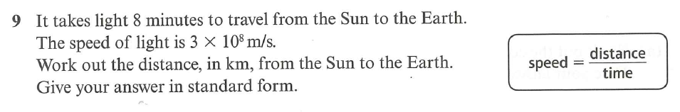
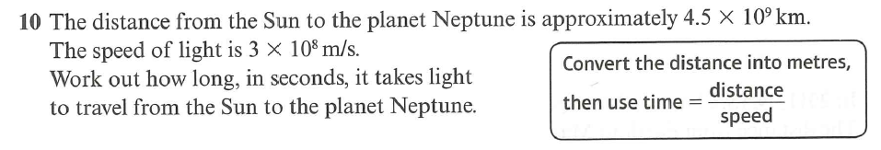
Exam Style Questions
1)
(6 marks)
1.12 x 10¹⁰
4.48 x 10⁸
7 x 10¹⁰
2)
(3 marks)
1.44 x 10⁸
3)
15000 seconds
(3 marks)

Slide 17

Todays Objectives – Have you met them?
Objectives
To be able to write large and small numbers in standard form.
To be able to perform basic calculations with standard form.

Slide 18
Suggested Videos
For this lesson
Ordering Numbers: https://www.youtube.com/watch?v=gOmj58JdxL8
Ordering fractions decimals percentages – Corbettmaths
Percentages:
For next lesson
Adding & Subtracting Fractions:
https://www.youtube.com/watch?v=5juto2ze8Lg
Math Antics - Adding and Subtracting Fractions
Working with decimals:
https://www.youtube.com/watch?v=kwh4SD1ToFc
Math Antics - Decimal Arithmetic
BIDMAS:
https://www.youtube.com/watch?v=6K77Igo39vk
GCSE Maths - BIDMAS - Aslam Tutoring

