Slide 1
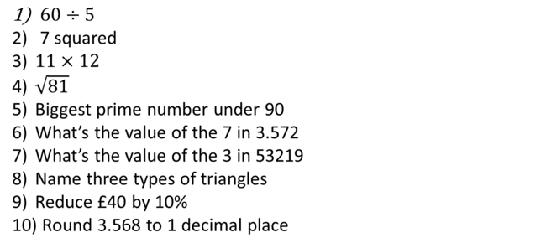
1-10 Quiz. Answer these questions.
$60÷5$
7 squared
$11×12$
$\sqrt{81}$
Biggest prime number under 90
What’s the value of the 7 in 3.572
What’s the value of the 3 in 53219
Name three types of triangles
Reduce £40 by 10%
Round 3.568 to 1 decimal place

Slide 2
1-10 Quiz. Answer these questions.
$60÷5$
7 squared
$11×12$
$\sqrt{81}$
Biggest prime number under 90
What’s the value of the 7 in 3.572
What’s the value of the 3 in 53219
Name three types of triangles
Reduce £40 by 10%
Round 3.568 to 1 decimal place
12
49
132
9
89
7/100
3000
Equilateral, isosceles, scalene
£36
3.6

Slide 3
Title: Basics of Number, Lesson 1
Objectives
To be able to add and subtract decimals.
To be able to multiply & divide decimals
To be able to round numbers using decimal places and significant figures.

Slide 4
Addition and Subtraction
Knowledge Check
Try these
632+329
234-168
961
66

Slide 5
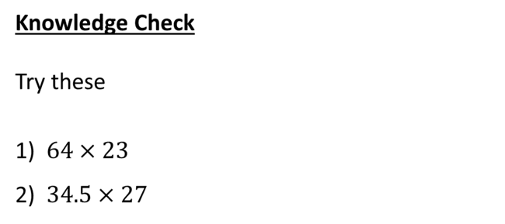
Multiplication
Knowledge Check
Try these
$64×23$
$34.5×27$
1472
931.5

Slide 6
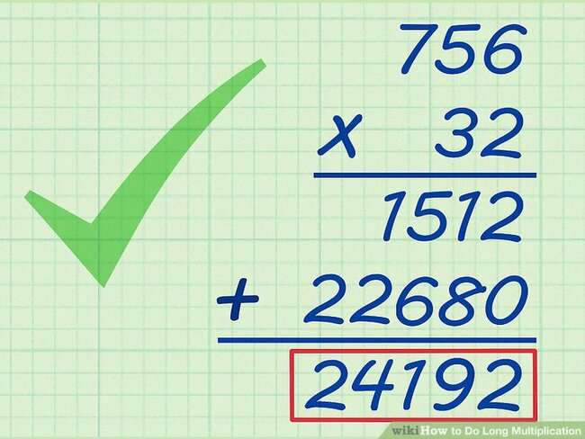
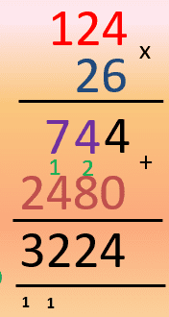
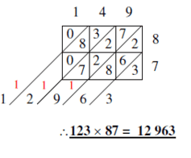
Long Multiplication
Many methods have been created, use what you are comfortable with. If you do not have a method you are comfortable with, watch the following video closely and consider using the ‘grid method’.

Slide 7
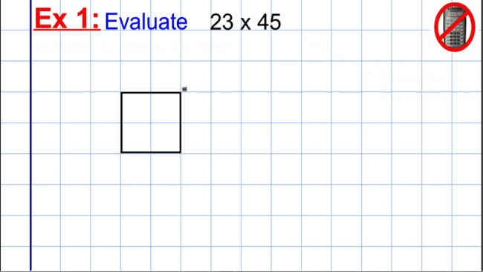
Long Multiplication

Slide 8
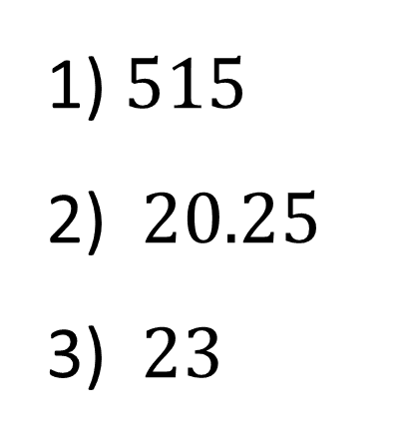

Division
Knowledge Check
Try these
$2575÷5$
$162÷8$
$345÷15$
$515$
$20.25$
$23$

Slide 9
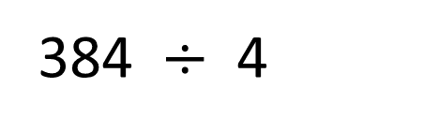

Short (Bus Stop) Division Method
How do I answer....
$38.2÷0.4$ ?
Multiply by 10 to get rid of decimals
384 $÷$ 4
96

Slide 10
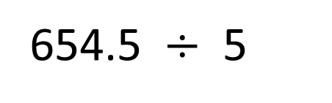

Short (Bus Stop) Division Method
How do I answer....
$65.45÷0.5$ ?
Multiply by 10 to get rid of decimal in the divisor
654.5 $÷$ 5
130.9

Slide 11
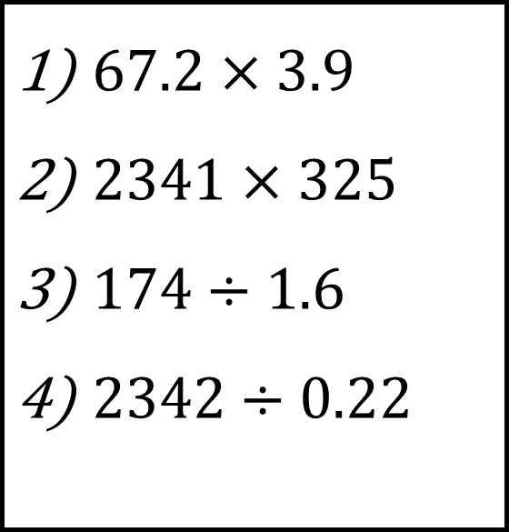
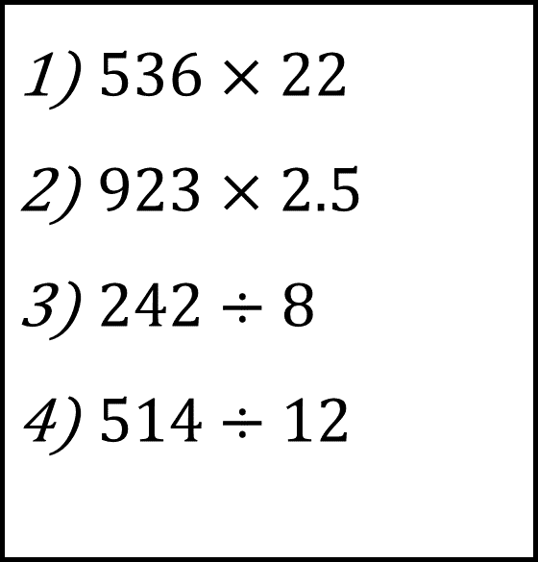
Test your skills
Silver
Gold
$536×22$
$923×2.5$
$242÷8$
$514÷12$
$67.2×3.9$
$2341×325$
$174÷1.6$
$2342÷0.22$

Slide 12
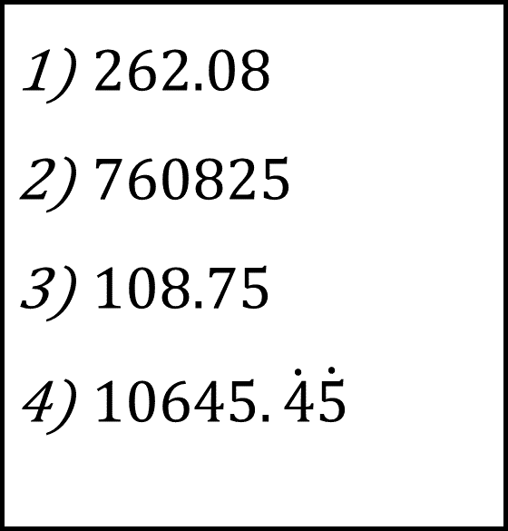
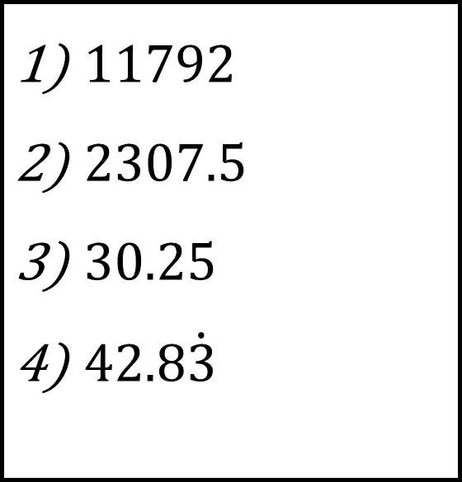
Test your skills
Silver
Gold
$11792$
$2307.5$
$30.25$
$42.8\dot{3}$
$262.08$
$760825$
$108.75$
$10645.\dot{4}\dot{5}$

Slide 13
Rounding with decimal places, whole numbers, nearest 10 etc.
Round this number to ………………………………
437.5783
Notes:
Cover decimal places and whole numbers, nearest 10 etc.

Slide 14
Rounding with Significant Figures
Round this number to ………………………………
437.5783
Notes:
Cover rounding significant figures

Slide 15
Rounding with Significant Figures
Round this number to ………………………………
2369742
Notes:
Cover rounding significant figures

Slide 16
Rounding with Significant Figures
Round this number to ………………………………
0.003946
Notes:
Cover rounding significant figures

Slide 17
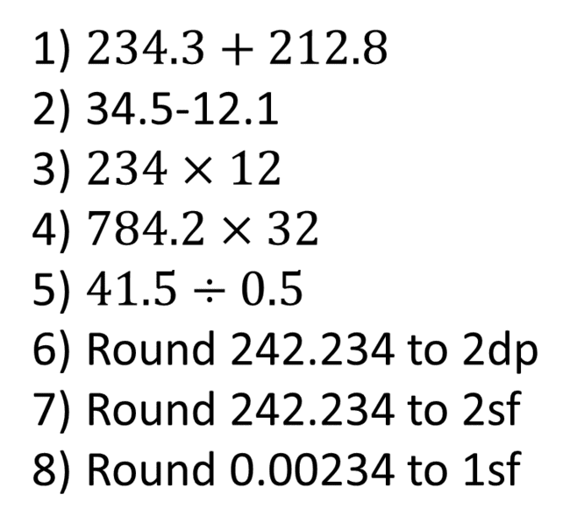
Todays Objectives – Have you met them?
Objectives
$234.3+212.8$
$\text{34.5−12.1}$
$234×12$
$784.2×32$
$41.5÷0.5$
Round 242.234 to 2dp
Round 242.234 to 2sf
Round 0.00234 to 1sf
To be able to add and subtract decimals.
To be able to multiply & divide decimals
To be able to round numbers using decimal places and significant figures.

Slide 18
Suggested Videos
For this lesson
Long Multiplication:
https://www.youtube.com/watch?v=t_bnlB2KRL4
SLEP Long Multiplication
Short Division:
https://www.youtube.com/watch?v=SLze82Zcc4Y
Speed Guide to Short Division
Rounding Numbers
https://www.youtube.com/watch?v=te89vNO5fhk
GCSE Number - Decimal Places and Significant Figures - Video Tutorial 5 of 40
For next lesson
Negative Numbers
https://www.youtube.com/watch?v=QipvCwPWYqc
GCSE Maths - Negative Numbers (Adding Subtracting Multiplying Dividing) Foundation
Simple Powers
https://www.youtube.com/watch?v=ZJDb7E6aCrA
Math Antics - Intro To Exponents (aka Indices)
Type of Numbers including Prime Numbers
https://www.youtube.com/watch?v=B3h1B1MRV7g
GCSE Number -- Types of Number - Video Tutorial 1 of 40
Factors and Multiples
https://www.youtube.com/watch?v=wsvf1RGo8mg
Factors and Multiples | Number | Maths | FuseSchool

