Slide 1
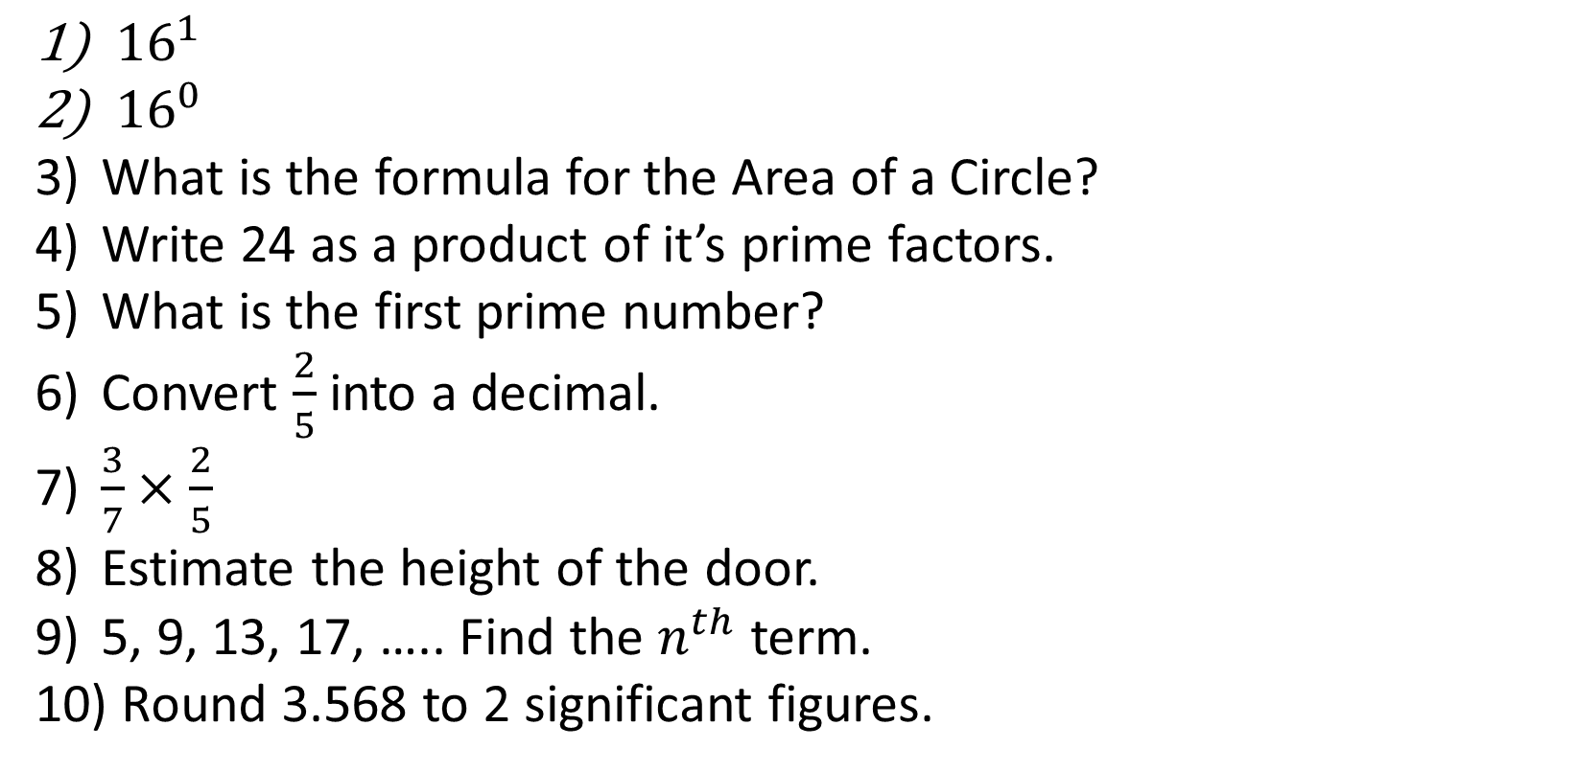
1-10 Quiz.
${16}^{1}$
${16}^{0}$
What is the formula for the Area of a Circle?
Write 24 as a product of it’s prime factors.
What is the first prime number?
Convert $\frac{2}{5}$ into a decimal.
$\frac{3}{7}×\frac{2}{5}$
Estimate the height of the door.
5, 9, 13, 17, ….. Find the $n^{th}$ term.
Round 3.568 to 2 significant figures.
Notes:
This could also be a YouTube clip, matching exercise, Anything that will engage the learners from the start of the lesson.
TUTOR TO TAKE THE REGISTER DURING THIS TIME. THERE IS NO NEED TO CALL OUT NAMES.

Slide 2
1-10 Quiz.
${16}^{1}$
${16}^{0}$
What is the formula for the Area of a Circle?
Write 24 as a product of it’s prime factors.
What is the first prime number?
Convert $\frac{2}{5}$ into a decimal.
$\frac{3}{7}×\frac{2}{5}$
Estimate the height of the door.
5, 9, 13, 17, ….. Find the $n^{th}$ term.
Round 3.568 to 2 significant figures.
16
1
Area = ∏ x radius²
2 x 2 x 2 x 3
2
0.4
6/35
@ 1.7m
4n + 1
3.6
Notes:
This could also be a YouTube clip, matching exercise, Anything that will engage the learners from the start of the lesson.
TUTOR TO TAKE THE REGISTER DURING THIS TIME. THERE IS NO NEED TO CALL OUT NAMES.

Slide 3
Title: Revision Topics 1
Objectives
Recap Multiply/Divide/Add/Subtract Fractions.
Simple Probability.
Algebra Basics
Solving Simple Equations

Slide 4



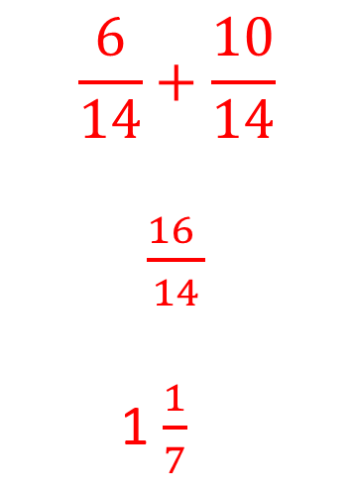


Quick Examples
$$\frac{2}{5}+\frac{1}{5}$$
$$\frac{3}{7}+\frac{10}{14}$$
$$\frac{4}{9}−\frac{1}{6}$$
$$\frac{3}{5}$$
$$\frac{6}{14}+\frac{10}{14}$$
$\frac{16 }{14}$
1 $\frac{1}{7}$
$$\frac{8}{18}−\frac{3}{18}$$
$\frac{5 }{18}$

Slide 5
Bronze
Silver
Gold
$\frac{5}{7}+\frac{4}{7}$
$\frac{2}{3}+\frac{1}{3}$
$\frac{2}{5}−\frac{1}{5}$
$\frac{1}{3}+\frac{1}{5}$
$\frac{1}{3}+\frac{1}{2}$
$\frac{2}{7}+\frac{1}{4}$
$\frac{4}{5}−\frac{3}{4}$
$\frac{1}{2}−\frac{2}{5}$
$\frac{3}{4}−\frac{2}{3}$
$\frac{5}{7}−\frac{2}{5}$
$\frac{7}{5}+\frac{4}{6}$
$2\frac{1}{3}+2\frac{1}{5}$

Slide 6
Bronze
Silver
Gold
$\frac{9}{7}=1\frac{2}{7}$
$\frac{3}{3}=1$
$\frac{1}{5}$
$\frac{8}{15}$
$\frac{5}{6}$
$\frac{15}{28}$
$\frac{1}{20}$
$\frac{1}{10}$
$\frac{1}{12}$
$\frac{11}{35}$
$\frac{31}{15}=2\frac{1}{15}$
$4\frac{8}{15}$

Slide 7




Quick Examples
$$\frac{2}{5}×\frac{1}{5}$$
$$\frac{3}{7}÷\frac{10}{14}$$
$$\frac{3 ×14}{7 ×10}$$
$$\frac{42}{70}$$
$$\frac{3}{5}$$
$$\frac{2 ×1}{5 ×5}$$
$$\frac{2}{25}$$

Slide 8
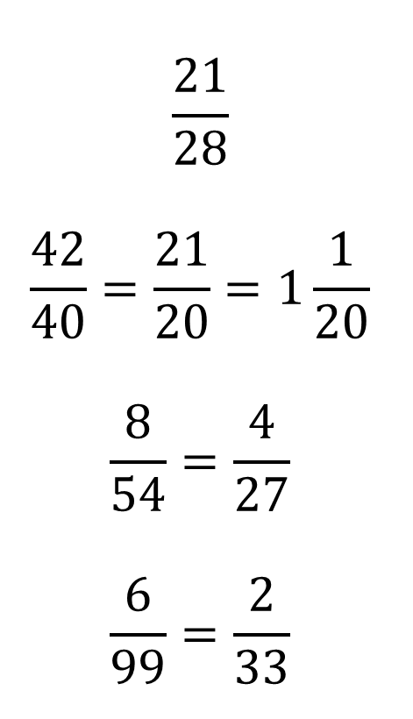
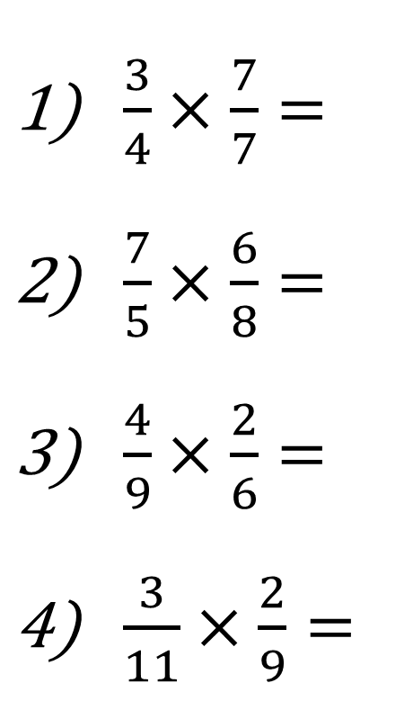


$\frac{3}{4}×\frac{7}{7}=$
$\frac{7}{5}×\frac{6}{8}=$
$\frac{4}{9}×\frac{2}{6}=$
$\frac{3}{11}×\frac{2}{9}=$
$$\frac{21}{28}$$
$$\frac{42}{40}=\frac{21}{20}=1\frac{1}{20}$$
$$\frac{8}{54}=\frac{4}{27}$$
$$\frac{6}{99}=\frac{2}{33}$$
$$\frac{3}{8}×\frac{2}{3}=\frac{6}{24}=\frac{1}{4}$$
$$\frac{7}{5}×\frac{10}{4}=\frac{70}{20}=\frac{7}{2}=3\frac{1}{2}$$
$$\frac{4}{9}×\frac{6}{12}=\frac{24}{108}=\frac{2}{9}$$
$$\frac{18}{30}×\frac{42}{30}=\frac{3}{5}×\frac{7}{5}=\frac{21}{25}$$
$\frac{3}{8}÷\frac{3}{2}=$
$\frac{7}{5}÷\frac{4}{10}=$
$\frac{4}{9}÷\frac{12}{6}=$
$\frac{18}{30}÷\frac{30}{42}=$

Slide 9
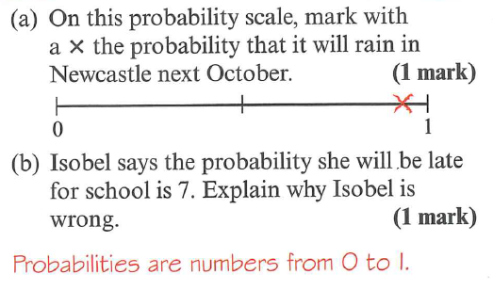
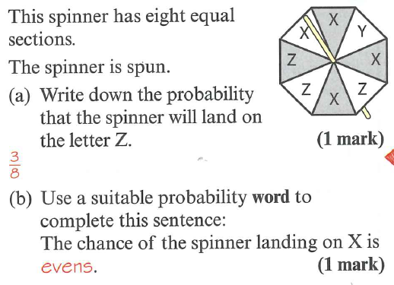
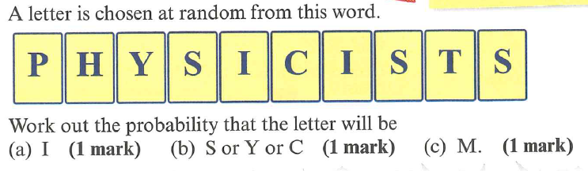
2/10
4/10
0

Slide 10
3(n + 1) = 3n + ?
3

Slide 11
5(n + 2) = ?n + 10
5

Slide 12
10(n + 7) = 10n + ?
70

Slide 13
3(n + 6) = 3n + ?
18

Slide 14
6(-7 + n) = ? + 6n
-42

Slide 15
5(2n + 11) = ?n + 55
10

Slide 16
?(n + 2) = 6n + 12
6

Slide 17
?(4n + 1) = 8n + 2
2

Slide 18
-2(12 + n) = ? – 2n
-24

Slide 19
2(2n + ½) = ?n + 1
4

Slide 20
5n(n + 3) = 5n² + ?n
15

Slide 21
10(n + ½) = 10n + ?
5

Slide 22
7(n - 3) = ?n - 21
7

Slide 23
?(2n + 4) = 18n + 36
9

Slide 24
8(n + 3) = 8n + ?
24

Slide 25
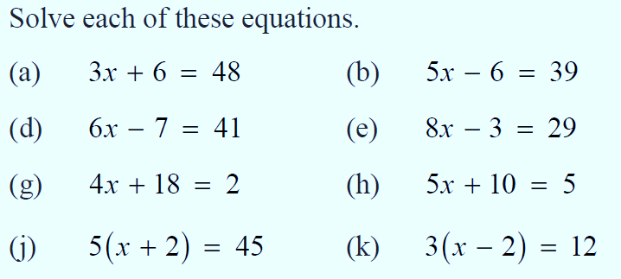
1)
2)
3)
4)
5)
6)
7)
8)
2 (x + 3) = x + 7
5 (2x - 1) = 3x + 9

Slide 26
1)
14
8
-4
7
2)
9
4
-1
6
3)
4)
5)
6)
7)
8)
2 (x + 3) = x + 7
5 (2x - 1) = 3x + 9
X = 1
X = 2

Slide 27

Todays Objectives – Have you met them?
Objectives
Recap Multiply/Divide/Add/Subtract Fractions.
Simple Probability.
Algebra Basics
Solving Simple Equations

Slide 28
Suggested Videos
For this lesson
Ordering Numbers: https://www.youtube.com/watch?v=gOmj58JdxL8
Ordering fractions decimals percentages – Corbettmaths
Percentages:
For next lesson
Adding & Subtracting Fractions:
https://www.youtube.com/watch?v=5juto2ze8Lg
Math Antics - Adding and Subtracting Fractions
Working with decimals:
https://www.youtube.com/watch?v=kwh4SD1ToFc
Math Antics - Decimal Arithmetic
BIDMAS:
https://www.youtube.com/watch?v=6K77Igo39vk
GCSE Maths - BIDMAS - Aslam Tutoring

