Slide 1
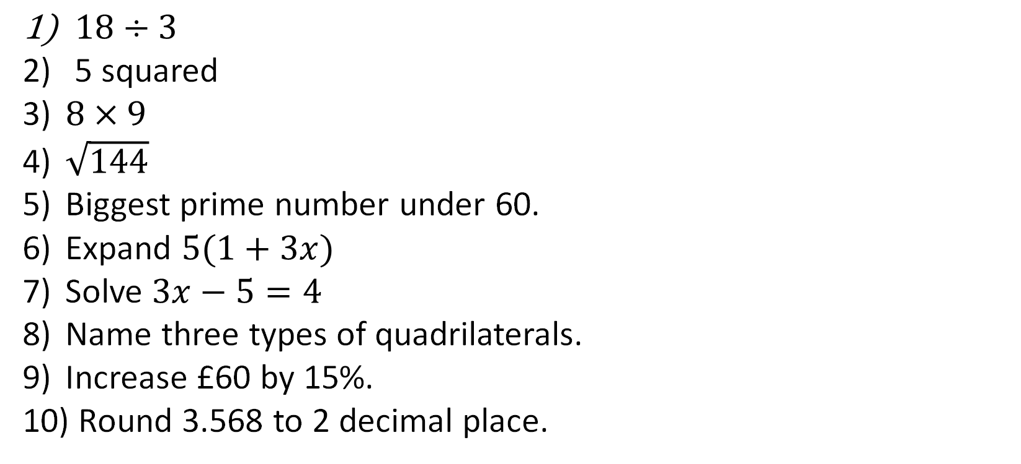
1-10 Quiz.
$18÷3$
5 squared
$8×9$
$\sqrt{144}$
Biggest prime number under 60.
Expand $5(1+3x)$
Solve $3x−5=4$
Name three types of quadrilaterals.
Increase £60 by 15%.
Round 3.568 to 2 decimal place.
Notes:
This could also be a YouTube clip, matching exercise, Anything that will engage the learners from the start of the lesson.
TUTOR TO TAKE THE REGISTER DURING THIS TIME. THERE IS NO NEED TO CALL OUT NAMES.

Slide 2
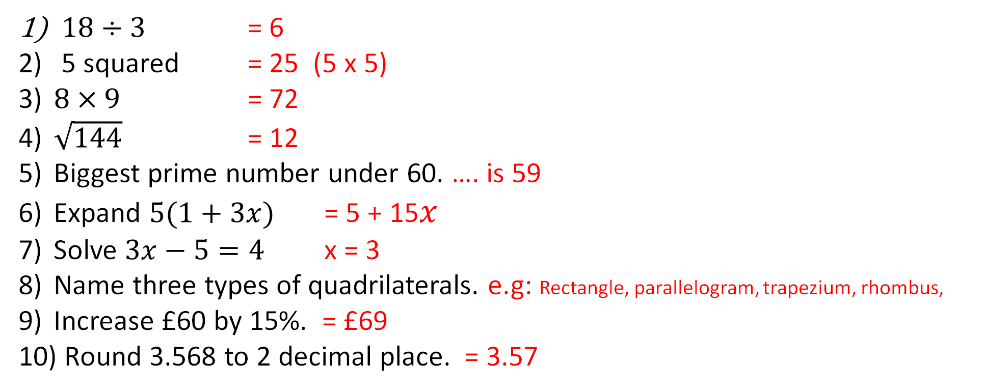
Answers
$18÷3$ = 6
5 squared = 25 (5 x 5)
$8×9$ = 72
$\sqrt{144}$ = 12
Biggest prime number under 60. …. is 59
Expand $5(1+3x)$ = 5 + 15$x$
Solve $3x−5=4$ x = 3
Name three types of quadrilaterals. e.g: Rectangle, parallelogram, trapezium, rhombus,
Increase £60 by 15%. = £69
Round 3.568 to 2 decimal place. = 3.57
Notes:
This could also be a YouTube clip, matching exercise, Anything that will engage the learners from the start of the lesson.
TUTOR TO TAKE THE REGISTER DURING THIS TIME. THERE IS NO NEED TO CALL OUT NAMES.

Slide 3
Date:
27/11/2019
Title: Basics of Number, Lesson 2
Objectives
To be able to:
calculate with negative numbers.
identify prime numbers.
find factors and multiples.
evaluate simple powers.

Slide 4
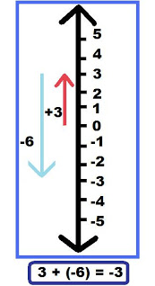
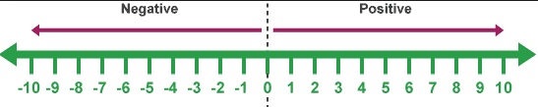
Number Line

Slide 5
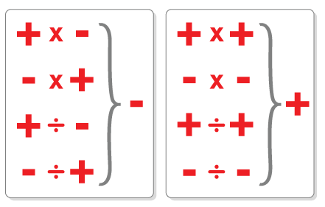
Multiplication/Division Rules

Slide 6
Bronze
Silver
Gold
Do as many as you can:
Q1) 8 - ⁻2
Q2) 5 + ⁻2
Q3) ⁻10 - ⁻9
Q4) 6 - ⁻9
Q5) 7 + ⁻10
Q1) 9 x ⁻10
Q2) ⁻18
⁻2
Q3) 7 x ⁻4
Q4) ⁻4 x 9
Q5) ⁻90
⁻9
Q1) 2 x (⁻3 – 2)
Q2) 3 x (⁻8 – 5)
Q3) ( ⁻4)²
Q4) ( ⁻5)²
Q5) ⁻2 + 6 x ⁻3

Slide 7
Silver
Mark your work:
Bronze
Gold
Q1) 9 x ⁻10 = ⁻90
Q2) ⁻18 = 9
⁻2
Q3) 7 x ⁻4 = ⁻28
Q4) ⁻4 x 9 = ⁻36
Q5) ⁻90 = 10
⁻9
Q1) 8 - ⁻2 = 10
Q2) 5 + ⁻2 = 3
Q3) ⁻10 - ⁻9 = ⁻1
Q4) 6 - ⁻9 = 15
Q5) 7 + ⁻10 = ⁻3
Q1) 2 x (⁻3 – 2) = ⁻10
Q2) 3 x (⁻8 – 5) = ⁻39
Q3) ( ⁻4)² = 16
Q4) ( ⁻5)² = 25
Q5) ⁻2 + 6 x ⁻3 = ⁻20

Slide 8
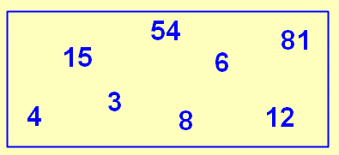
Factors, multiples and prime numbers
Discussion
From the numbers in the rectangle,
Notes:
Use your own examples to explain the following:
Factors
Multiples
Prime numbers
Write down a multiple of 5.
Write down a factor of 27.
Write down a prime number.

Slide 9
Finding Factors
Here are the factors of 60: 1,2,3,4,6,10,15,20,30,60
Here are the factors of 75: 1,3,5,15,25,75
Factors are numbers that go into another number exactly

Slide 10
Find the Factors
For the following:
24 and 64
32 and 80

Slide 11
Prime Numbers
Prime numbers are numbers that can only be divided by itself and 1.
Examples: 2, 3, 5, 7 ………………………

Slide 12
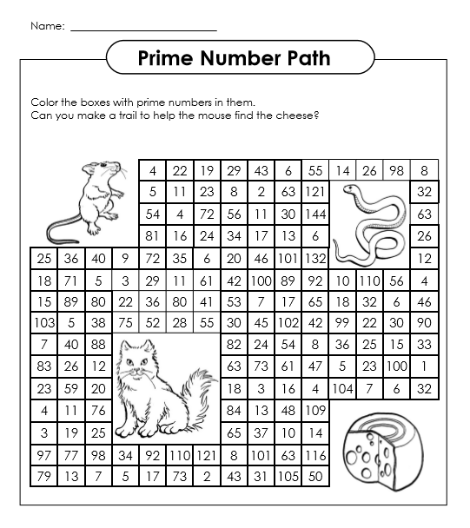
Examples: 2, 3, 5, 7 ………………………
Activity
Shade a path using only Prime Numbers that starts from a square next to the mouse and ends at the cheese.
Is it possible without using diagonals?

Slide 13
Simple Powers
How to recognise powers:
2² 2³
2 x 2 (4)
2 x 2 x 2 (8)

Slide 14

Simple Powers
Rewrite to a power :
1) 3 x 3 x 3 x 3 2) 4 x 4 x 4 3) 6 x 6
Write down the value of:
1) $3^{4}$ 2) $4^{3}$ 3) $6^{2}$

Slide 15
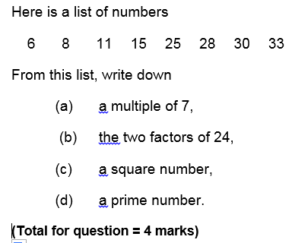
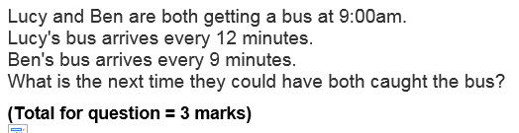
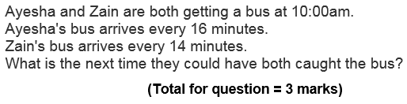
Exam style of questions

Slide 16
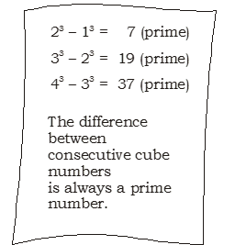
Challenge (Work in pairs)
Zoe has this page in her book
Give a counter example to show that Zoe is wrong.
Justify your answer.

Slide 17

Todays Objectives – Have you met them?
Objectives
To be able to calculate with negative numbers.
To be able to use identify prime numbers.
To be able to use find factors and multiples.
To be able to evaluate simple powers.

Slide 18
Suggested Videos
For this lesson
Negative Numbers
https://www.youtube.com/watch?v=QipvCwPWYqc
GCSE Maths - Negative Numbers (Adding Subtracting Multiplying Dividing) Foundation
Simple Powers
https://www.youtube.com/watch?v=ZJDb7E6aCrA
Math Antics - Intro To Exponents (aka Indices)
Type of Numbers including Prime Numbers
https://www.youtube.com/watch?v=B3h1B1MRV7g
GCSE Number -- Types of Number - Video Tutorial 1 of 40
Factors and Multiples
https://www.youtube.com/watch?v=wsvf1RGo8mg
Factors and Multiples | Number | Maths | FuseSchool
For next lesson
Adding and Subtracting Fractions
https://www.youtube.com/watch?v=DYcqDfgpveM
Adding & subtracting fractions
Multiplying and Dividing Fractions
https://www.youtube.com/watch?v=B7MtFQW7i_I
How to Multiply and Divide Fractions in Algebra For Dummies
Converting Mixed Numbers to Improper Fractions
https://www.youtube.com/watch?v=TrutPJf9GmQ
Change a Mixed Number to an Improper Fraction
Converting Improper Fractions to Mixed Numbers
https://www.youtube.com/watch?v=GpumUOiGS6Q
Change an Improper Fraction into a Mixed Number

